Slide 1
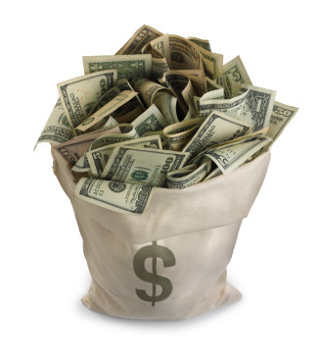
Let’s draise!!!
FUN
A Conversation on Fundraising
Jessica Mendiola, GRA

Slide 2
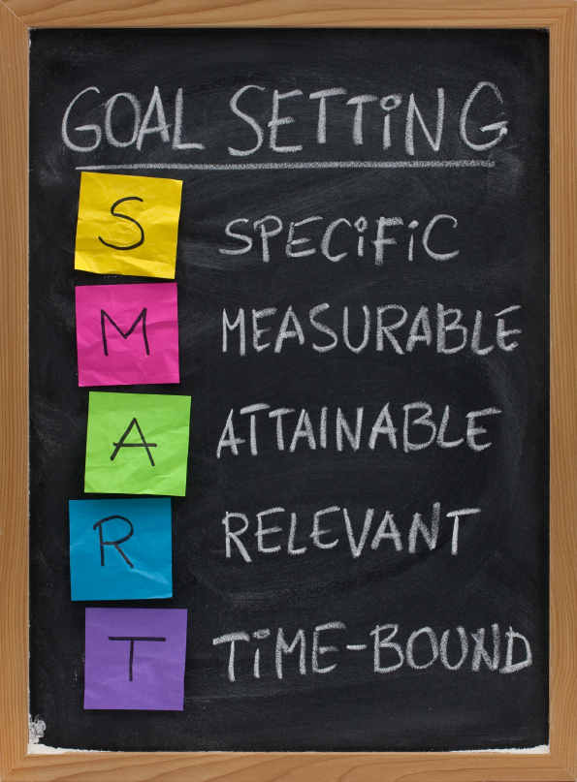
Let’s consider our…
Motivation?
Goal?
Action Plan?
Resources?
Requirements? Limitations?
Texas State does not allow raffles because they are considered gambling.

Slide 3
Our Organization’s…
Strengths
Weaknesses
Opportunities
Threats

Slide 4
Forms Required

Slide 5
Sources of Funding
Individual Donors
Benefits
Concert
Breakfast
Dinner
Sales
Direct Solicitation
Goods/Donations
Money

Slide 6
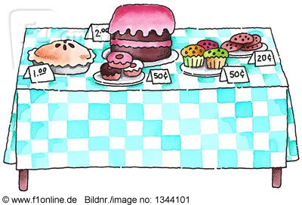
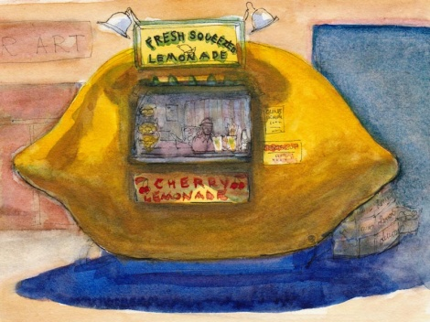
Let’s Get in a Kitchen!
Baked Goods
Food
Cookies
Cupcakes
Flan
Cake
Enchiladas
Tamales
Food Plates
Mexican
Pasta
BBQ
“Lemonade Stands”
Water
Sodas
Etc.
***Ask businesses for DONATIONS!!!
*** Organizations must now take a class in Food Safety in order to sell food.

Slide 7
Restaurants
Participants of Profit Sharing

Slide 8
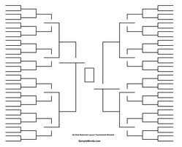
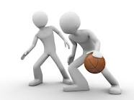
Athletic Tournaments
Soccer
Kickball
Basketball
Tennis
Softball
Football
Etc.
Sales at Events
T-shirts
Other Sales

Slide 9
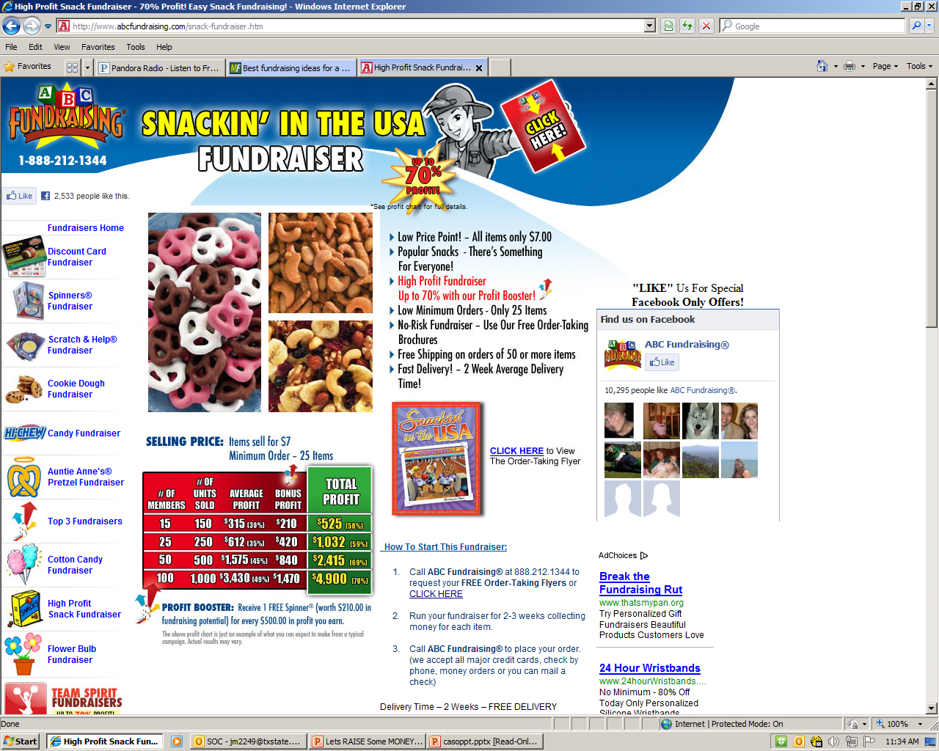
Abcfundraising.com

Slide 10
Ideas
Car wash – donation or go by car rate
Pie a Professor/favorite member- Similar to a penny wars, the professor with the most money spends an hour or so on the receiving end of whipped cream pies.
Care packages- Mail order forms to parents and deliver kits to students during finals/holidays
Cram-o-grams – wish your friends well on their exams

Slide 11
Ideas
Key chains - with either school colors, Greek colors and/or with the name or the nickname of your organization
Holiday gift wrapping and gift bag crafting
Candy bar kits
Fashion Show
Haunted House
Picture booth
Greeting cards-student organization will create it and deliver/mail it.

Slide 12
Ideas
Make your own tie-dye - Get t-shirt sponsors and make your own shirt.
Balloon pop or carnival games
Song-A-Grams/Valentine’s Day Serenades – For example, 4-5 members of your organization will go surprise someone’s sweetie with a love song.
Hold a musical performance/skit competition between student groups/residence halls/etc.
Ads in programs/agendas

Slide 13
How does your organization fundraise?

Slide 14
Questions?

