Slide 1
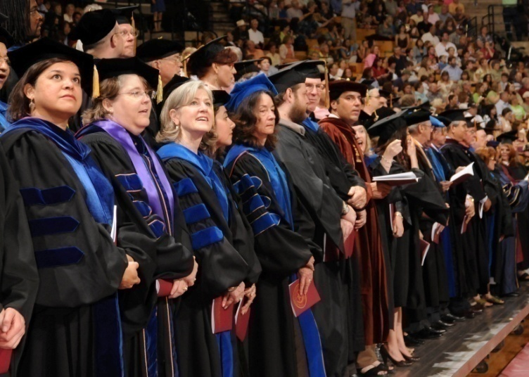
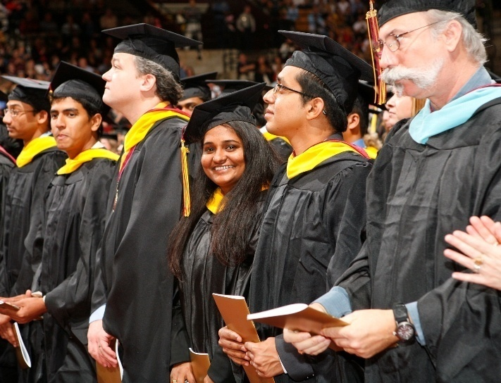
Commencement Team: Engaging the Campus Community

Slide 2
Texas State University
Four-year Emerging Research University
38,694 students
Grants baccalaureate, masters, specialist and doctoral degrees
8,653 graduates in AY17

Slide 3
Commencement at Texas State
Texas State holds 17 annual commencement ceremonies in December (6), May (8) and August (3).
Ceremonies are divided by college and in some cases by department.
Held in Strahan Coliseum, the campus basketball arena.
Depending on the semester, each ceremony will host 600-800 graduates and as many as 8,000 guests.
Gathering information from these graduates about their plans for commencement is critical for event planning.

Slide 4
Where we’ve been… and where we’re going
Spring 2010
Spring 2018
5 combined ceremonies over two days
Est. 3,300 candidates
Est. 33,000 guests
8 combined ceremonies over three days
Est. 4,900 candidates
Est. 49,000 guests

Slide 5
Where we’ve been… and where we’re going
Spring 2000
Spring 2010
4 Provost Office Staff
20 Faculty Marshals and Ushers
8 Academic Advising Staff
2 UPD Officers
8 Provost Office Staff
40 Faculty Marshals
120 Staff Ushers
45 Academic Advising Staff
40 UPD Officers
Disability Services
Materials Management
Auxiliary Services
Athletics
Risk Management
Bookstore
Alumni Affairs
Registrar
Student Affairs

Slide 6
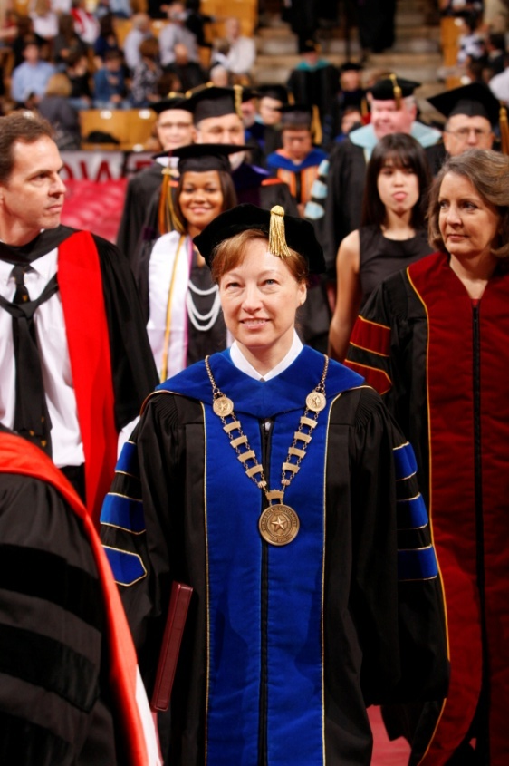
Why a Commencement Team?
Solve event conflicts
Implement “Presidential Event”
Maximize faculty and staff resources
Evaluate commencement ceremonies
Manage issues

Slide 7
Team Membership
Academic Advising Centers
Alumni Affairs
Athletics
Auxiliary Services
Bookstore
Disability Services
Facilities Management
Graduate College
Materials Management
Police Department
Provost Office
Recycling Services
Registrar
Radio Station
Risk Management
Student Musical Ensembles
Student Center

Slide 8
Team Mission Statement
To engage the University community in the planning, implementation, and continuous improvement of our commencement ceremonies with a goal of achieving excellent results.

Slide 9
Commencement Team Calendar
January Team Meeting Advisor Meeting | February Communication Meeting | March Safety Meeting | April Advisor Meeting
May Friday, 10 a.m. Friday, 2 p.m. Friday, 6 p.m. Saturday, 10 a.m. Saturday, 2 p.m. | June Team Meeting Transportation Meeting | July Advisor Meeting | August Friday, 10 a.m. Friday, 2 p.m. Friday, 6 p.m.
September Team Meeting Advisor Meeting | October Communication Meeting Transportation Meeting | November Safety Meeting Advisor Meeting | December Friday, 10 a.m. Friday, 2 p.m. Friday, 6 p.m. Saturday, 10 a.m.

Slide 11
Team Objective
1. Communicate Accurately and Consistently
The Team:
Discusses and clarifies University policies, procedures and practices
Compares candidate instructions
Communication Sub-group:
Curriculum Services, Academic Advisors, and University Police
Reviews content and design of commencement website
Drafts updated information for candidate instructions

Slide 12
Communication Issue
Students often forget to officially change their name with the University, therefore their desired name does not appear in the commencement program.
1. Received complaint from student
2. Added issue to team meeting agenda
3. Added a PDF version of the commencement program draft to the website for students to view
4. Updated verbiage on the Graduation Application, Commencement Website, and Candidate Instructions
Result: Students now have an extra opportunity to check their information prior to the publishing of the program.

Slide 13
Team Objective
2. Create a Safe Environment and Comply with all Codes
The Team:
Discusses safety issues and concerns such as:
Accessibility
Crowd management
Fire code requirements
Evacuation procedures
Emergency/Safety Sub-group:
Curriculum Services, Risk Management, and University Police
Drafts emergency procedures
Discusses modifications to the Coliseum

Slide 14
Safety Issue
The lack of handrails in high seating areas caused dizziness, loss of balance and falls in guests.
1. Requested incident report from UPD
2. Identified possible causes
3. Added issues to the Team meeting agenda
4. Scheduled Sub-group meeting on issue
5. Met in Strahan Coliseum with Emergency/Safety Sub-group, Office of Facilities Planning, Design and Construction and Athletic Facility Managers
6. Scheduled installation of additional handrails
7. Inspected handrails upon completion
Result: Zero accidents were reported by UPD, down
from 4 in Fall 2007.

Slide 15
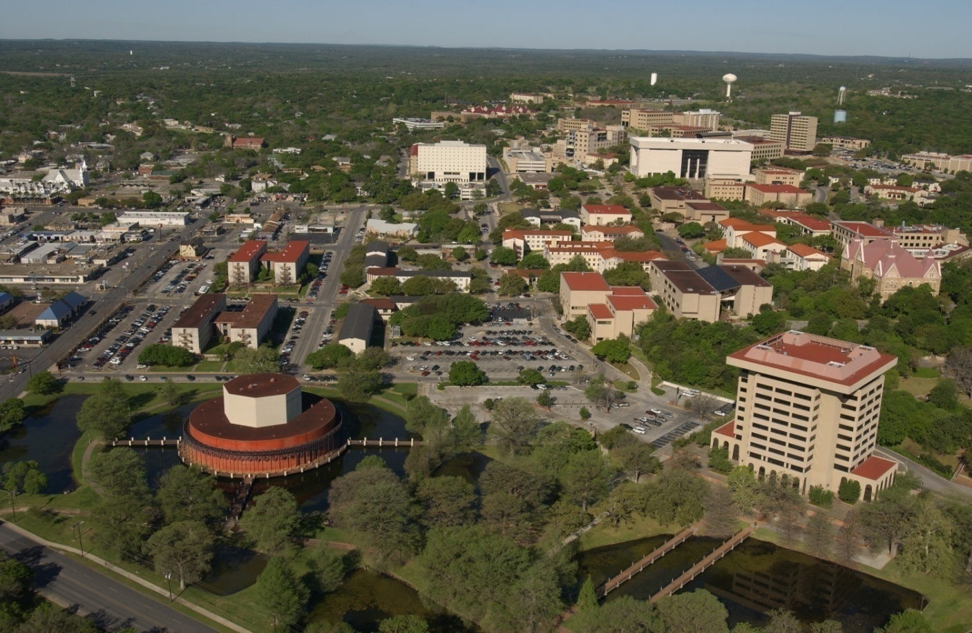
3. Understand Roles and Responsibilities
Team Objective
Meet your colleagues
Understand the pressures and concerns of others and how they relate to your own

Slide 16
Crowd Issue
Candidates and the guests that attend for them cause a strain on the city and campus.
Academic Advisors: “How am I going to line up all these candidates?”
Curriculum Services: “How are we going to fit all these candidates in the
seating area?”
University Police: “How many guests will be attending with these candidates, and will there be sufficient seating and parking?”
Risk Management: “How many of these candidates will have elderly or special needs guests, and is there sufficient seating, parking and enough parking shuttles?”

Slide 17
Action Items List
Progress | Date | Action Item | Budget Implication | Action Required
 | 9/23/08 | Consider marquee sign purchase | $10,000 | Complete. UPD purchase signs.
 | 9/23/08 | Record recessional music | unknown | _add to duties
 | 9/23/08 | Create guest and candidate homepages | n/a | _Communication Sub-group meets _update website
 | Completed
 | In Progress
 | To be Addressed

Slide 18
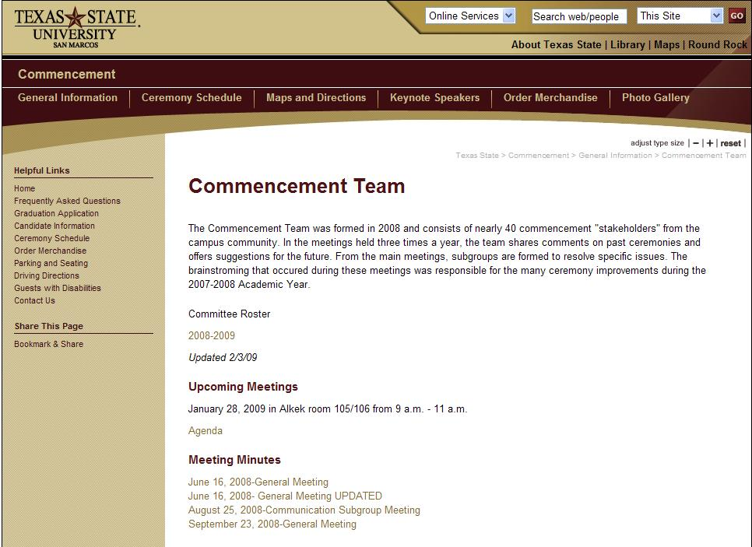
Tools to Stay Engaged
Email Updates
Action Items List
Team and Sub-group Meetings
Web Development
www.txstate.edu/commencement

Slide 20
“Teamwork is the ability to work together toward a common vision.”
Andrew Carnegie

Slide 21
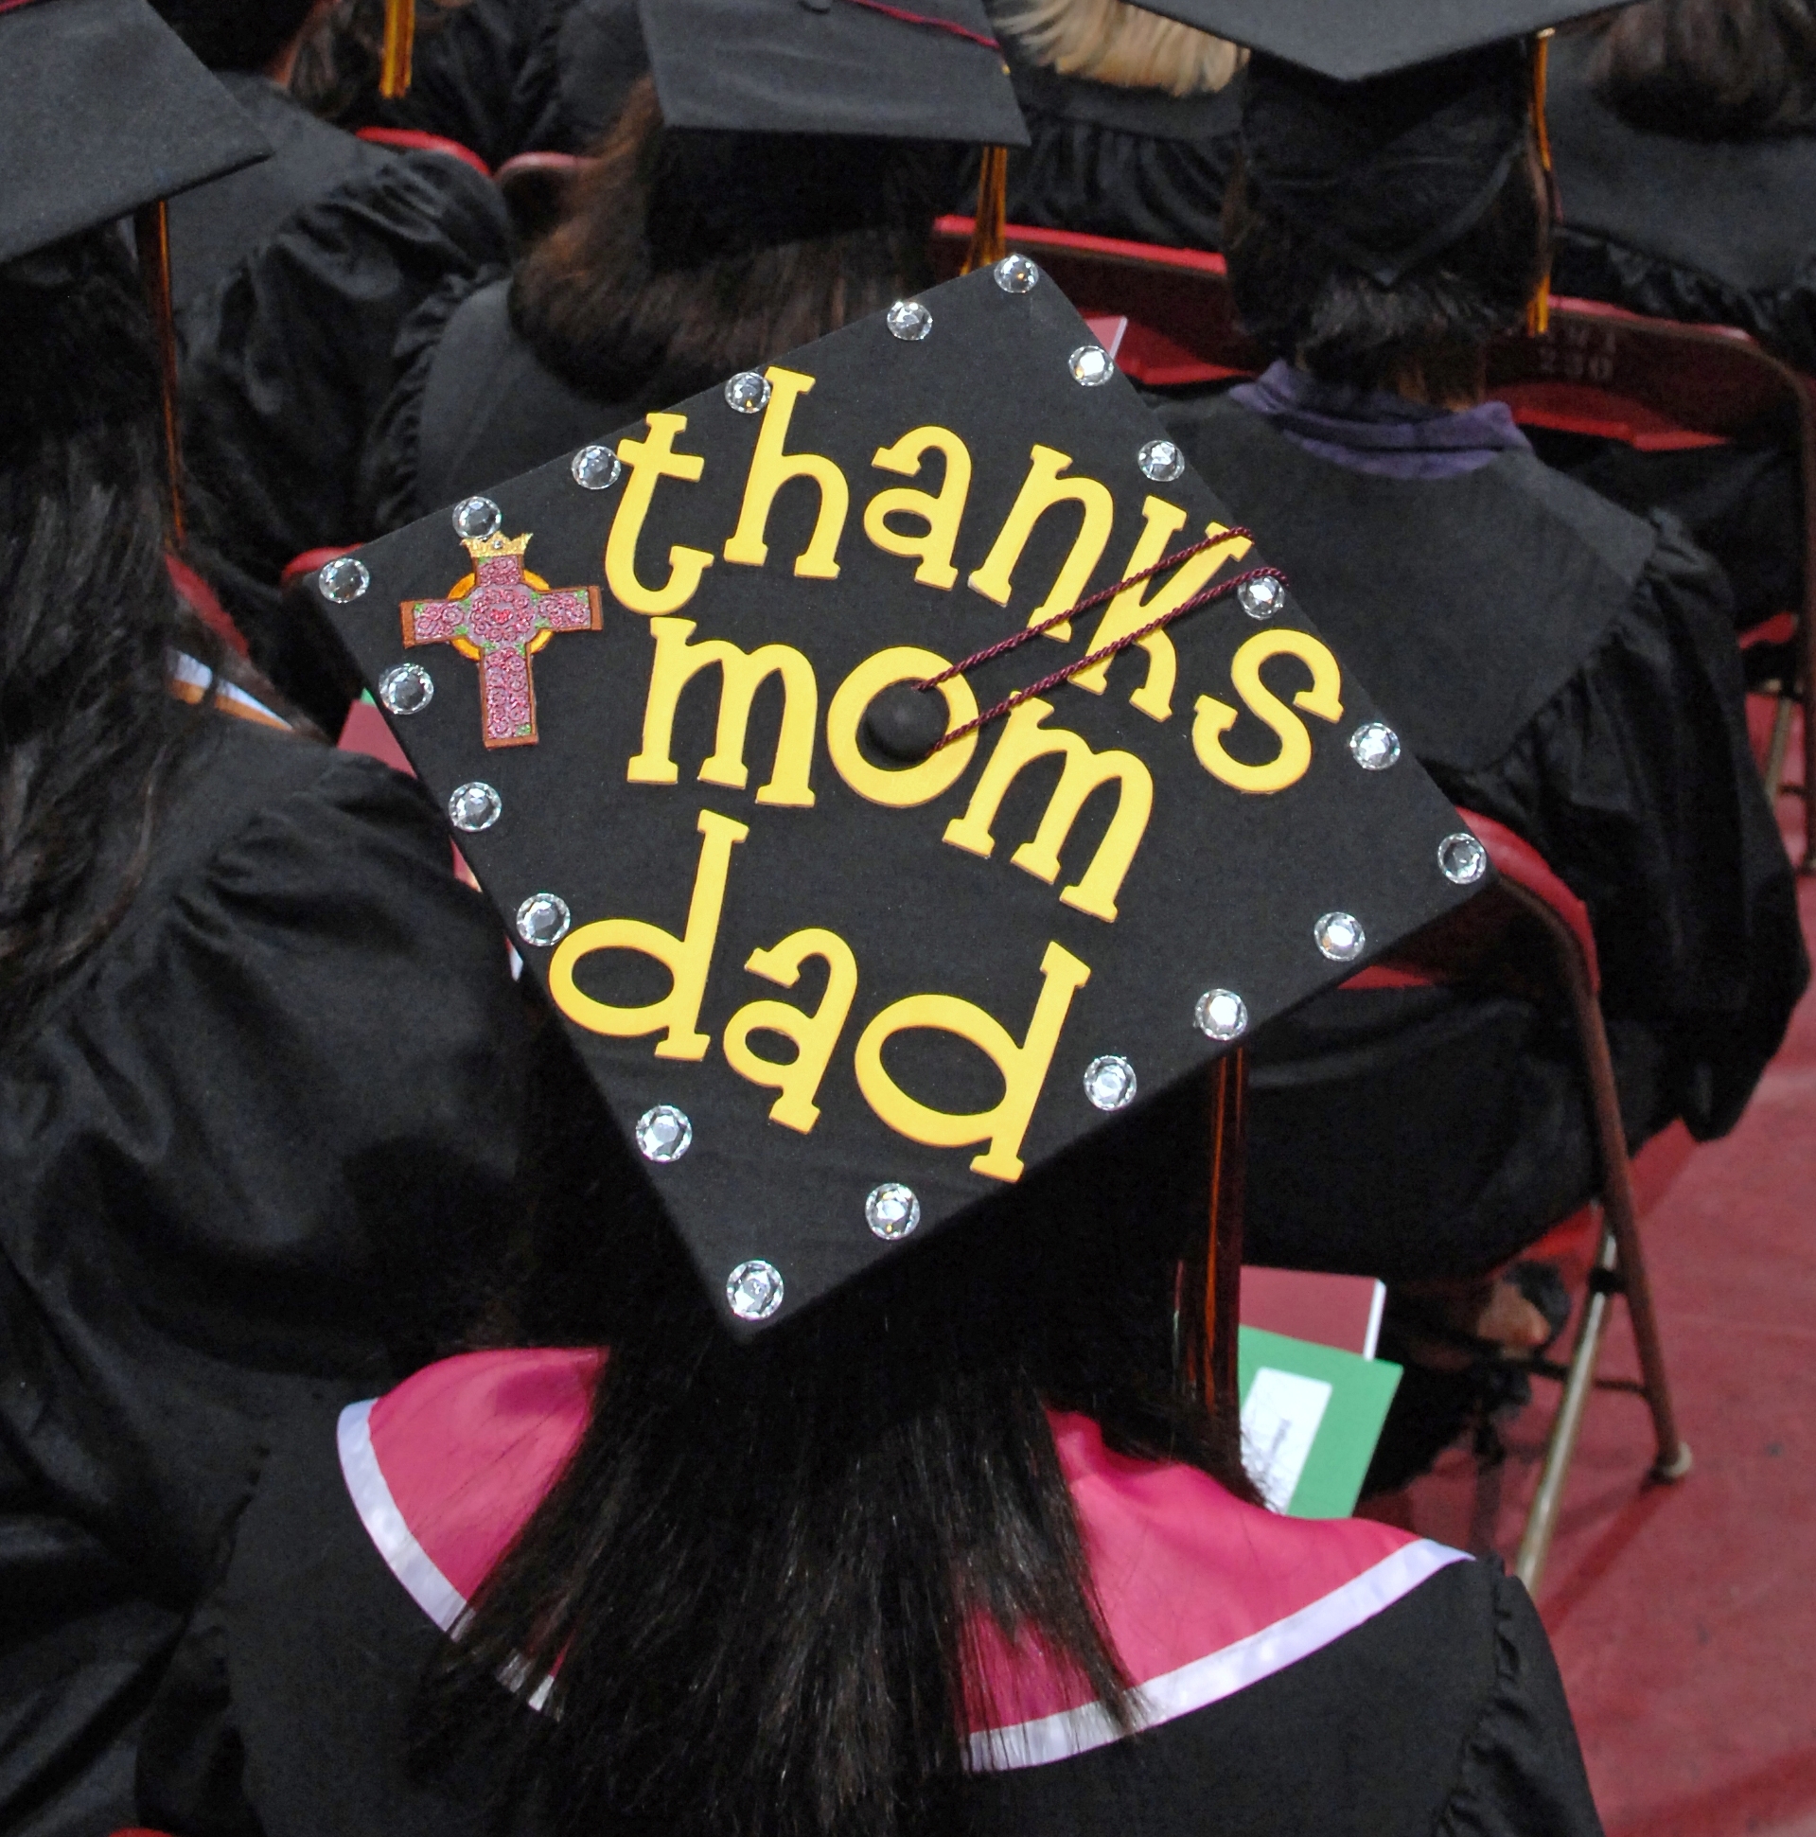

Slide 22
“Perfection is not attainable. But if we chase perfection, we can catch excellence.”
Vince Lombardi

Slide 23
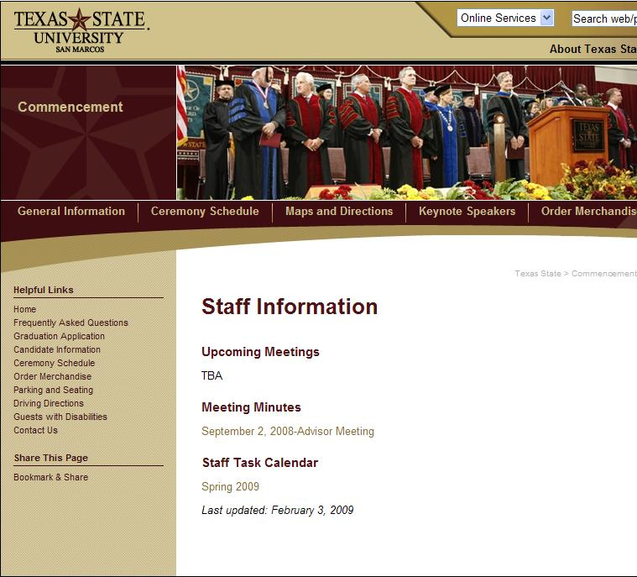
Looking to the Future…
Staff Web Pages

Slide 24
Looking to the Future…
Faculty Web Pages

Slide 25
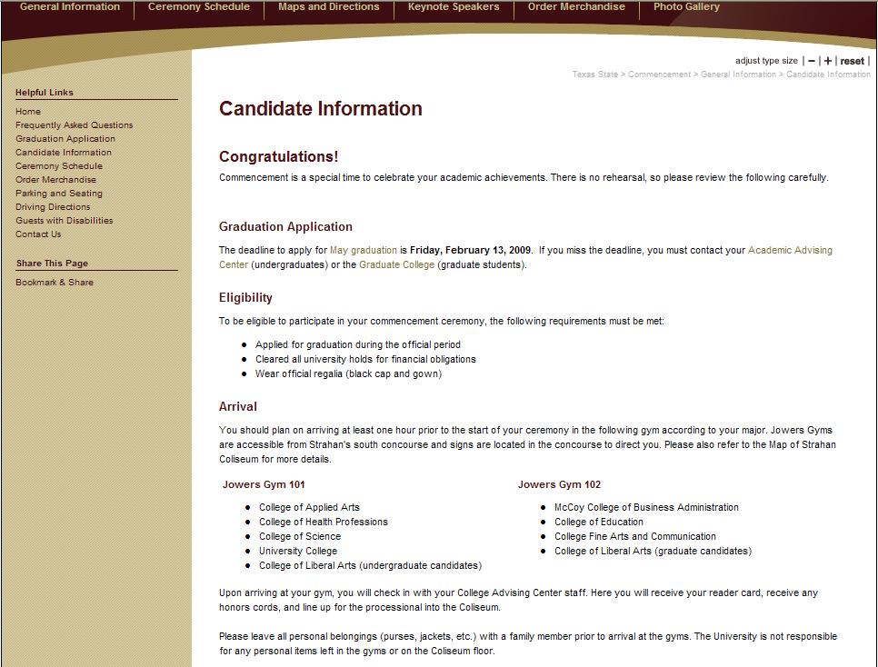
Looking to the Future…
Student Web Pages

Slide 26
Areas That Will Be Assessed
Pre-ceremony Candidate Instructions
Parking, Seating, and General Crowd Issues
Website Effectiveness

Slide 27
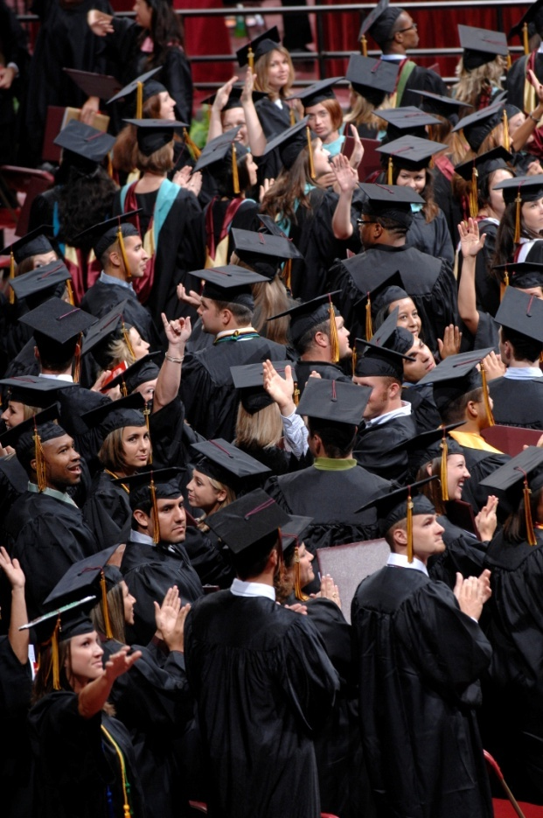
Future Team Planning
Ceremony Assessment
Annual Safety Workshop

Slide 28
“Success comes from knowing that you did your best to become the best that you are capable of becoming.”
John Wooden

Slide 29
Future Team Planning
5th Ceremony Addition
Spring 2010
Budget Issues
Volunteers

Slide 30
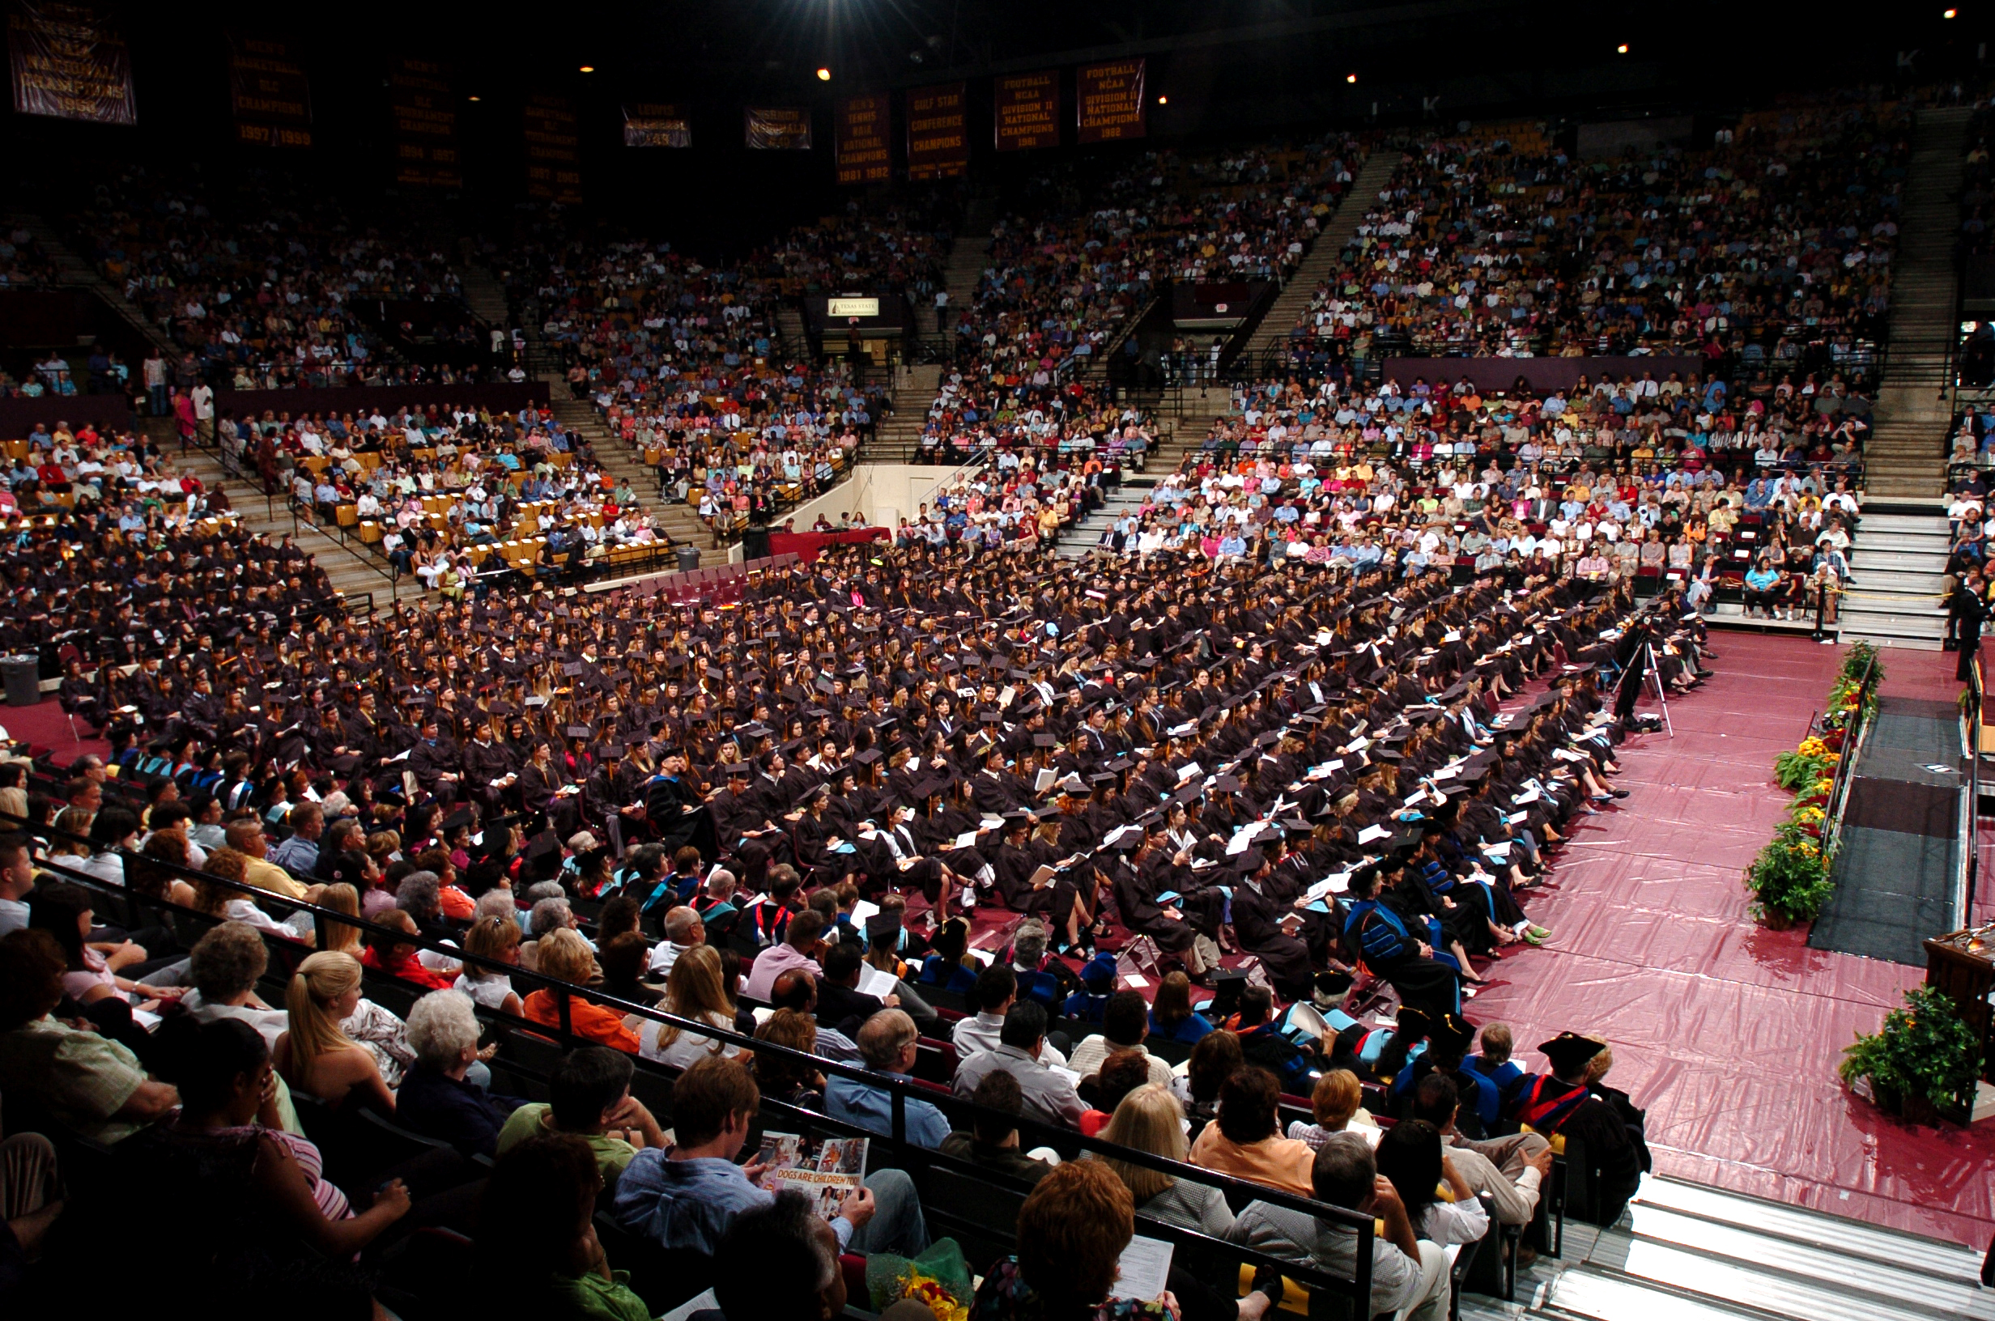

Slide 31
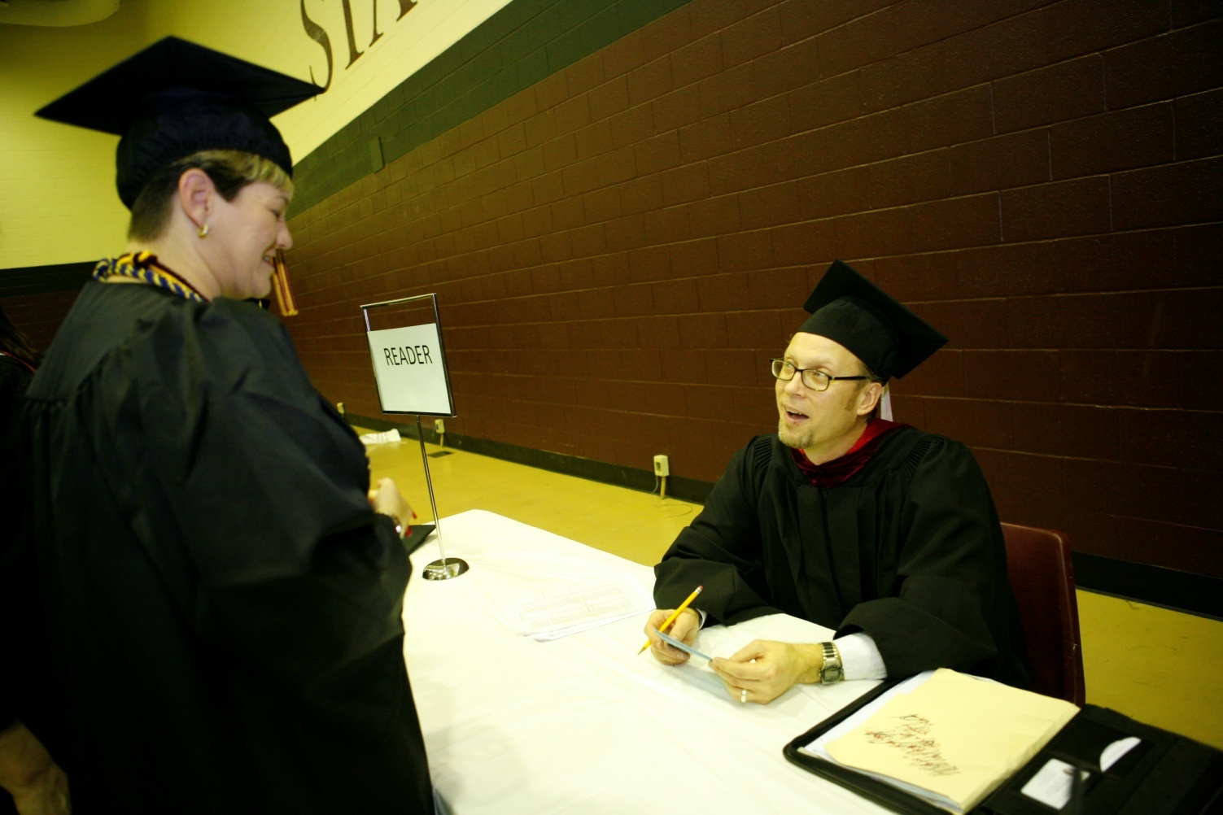
Outreach
Staff Involvement

Slide 32
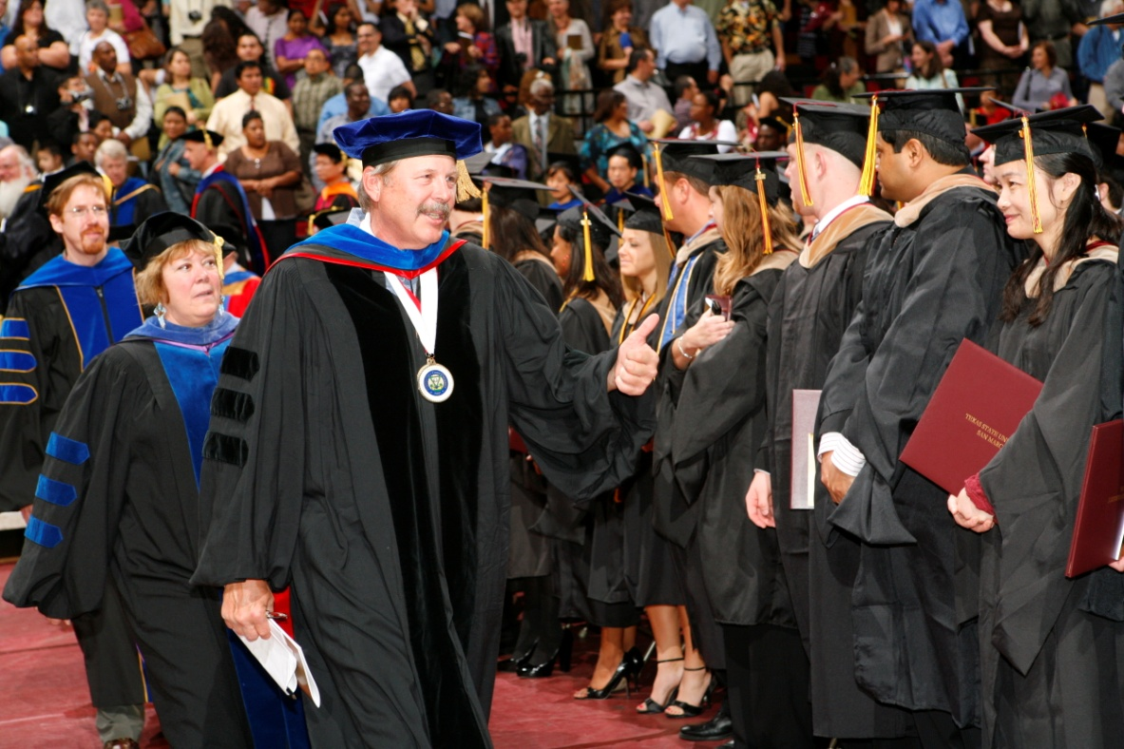
Outreach
Faculty Involvement

Slide 33
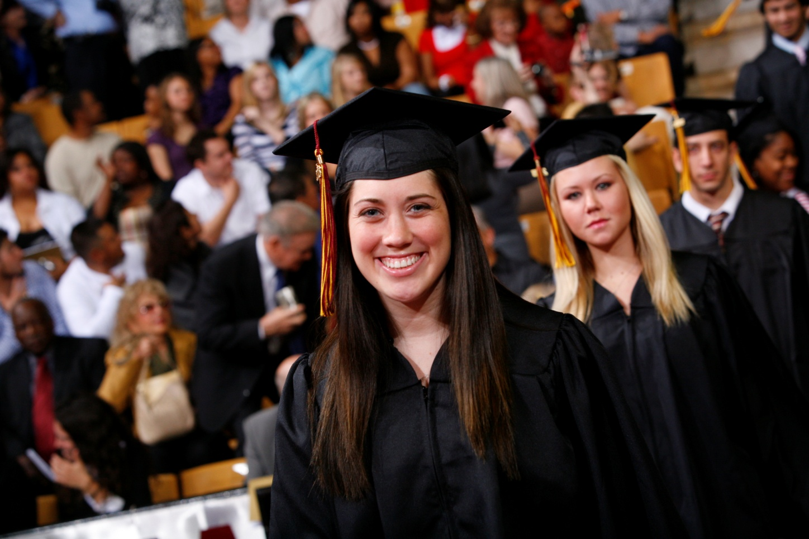
Outreach
Student Involvement

Slide 34
Team Assessment
Is our Team effective?
Have we used our resources effectively?
What issues remain unresolved?

Slide 35
Feedback from Team and Guests
“Networking, breaking down the silos that are so common in higher education - - This Team is doing that!”
Lanita Legan, Student Center
“The staff who actually work at commencement now have some input on campus!”
Sara Boysen, Academic Advisor
“The ceremony was the best I’d ever seen. I felt a strong sense of famliy.”
Email from Don Flores, BOR
“The young lady who sang was amazing!!! What a talent and what a prize for your university to have her.”
Email from parent
“The big screen that allowed us to see our graduate close up when she shook your hand was very nice. So often, all the grads look alike in their robes and you are never absolutely sure which one is yours. Seeing her face on that big screen was a nice surprise."
Email from parent

Slide 36
“It is amazing what you can accomplish when you do not care who gets the credit.”
Harry Truman

Slide 37
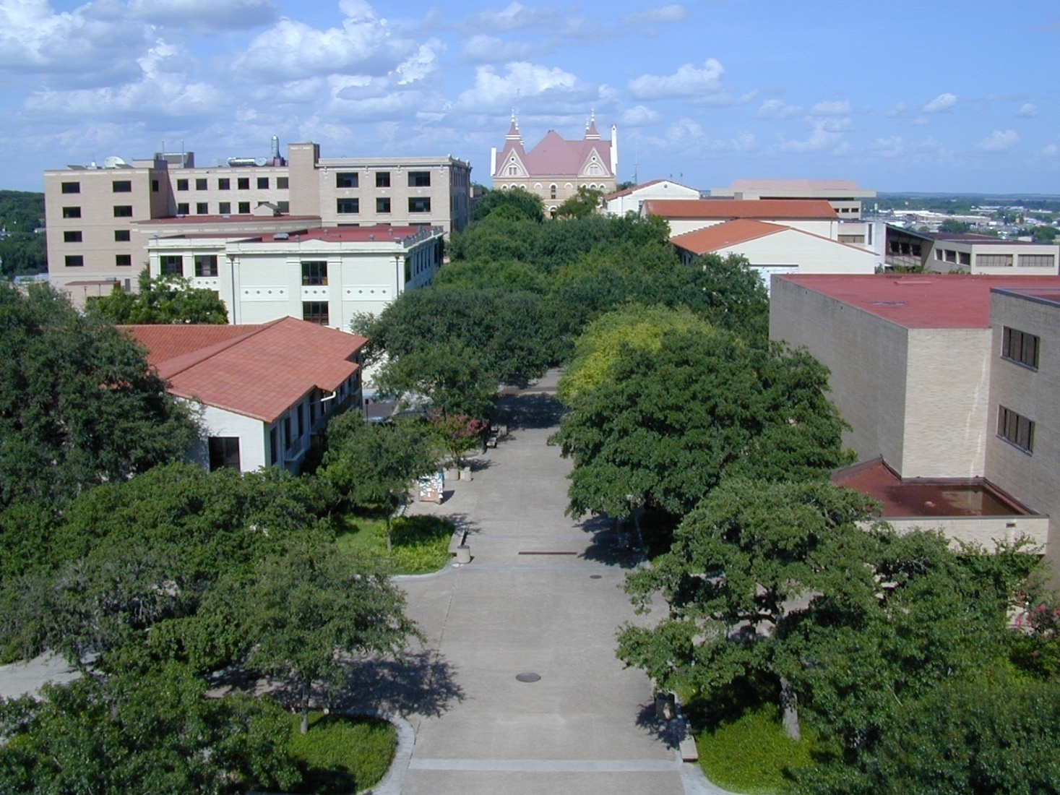
Commencement Team: Engaging The Campus Community

Slide 38
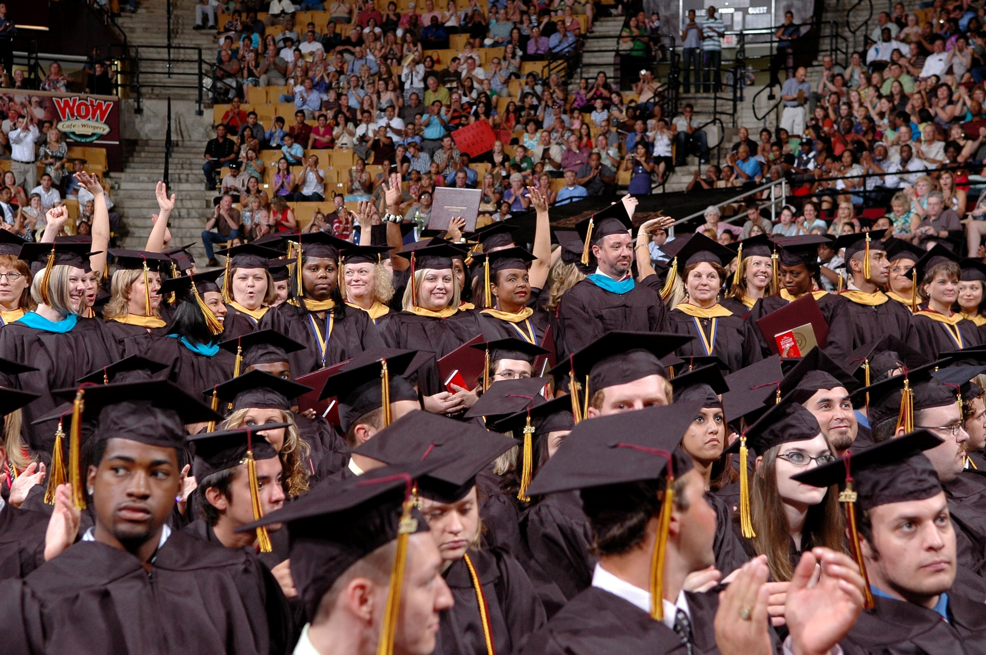

Slide 39
Questions? Suggestions?
We are ready
to hear any ideas you have for us!
Micky Autrey
ma02@txstate.edu
512-245-8122
Kristin McDaniel
km48@txstate.edu
512-245-8313
Jennifer Jahns
jj26@txstate.edu
512-245-8857
www.txstate.edu/commencement

