Slide 1
Great Streets for Small Towns
October 25, 2012

Slide 2
5 Principles of Great Streets
1. Streets are Public Places

Slide 3
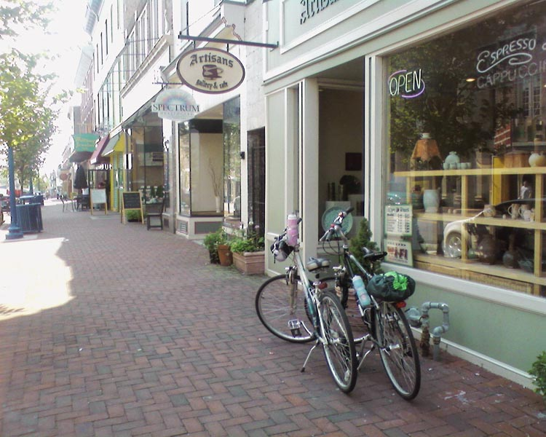
5 Principles of Great Streets
2. Great Streets are Great for Business
Trail Towns: Pottsdam, PA
www.schuylkillriver.org

Slide 4
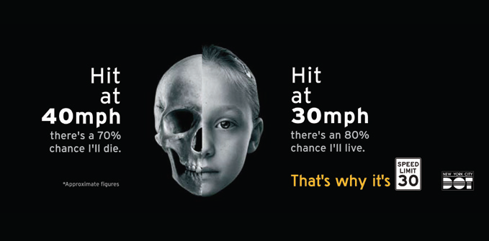
5 Principles of Great Streets
3. Design for Safety
http://nacto.org/wp-content/uploads/2012/10/NACTOUrbanStreetDesignGuide_Highrez.pdf

Slide 5
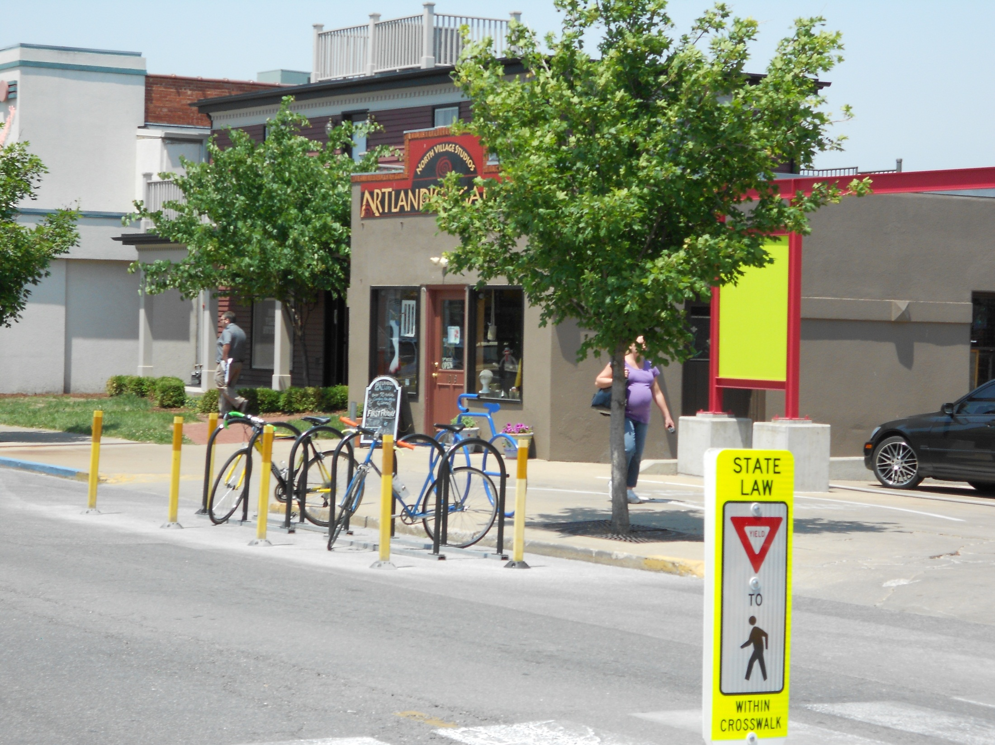
5 Principles of Great Streets
4. Streets can be changed
Columbia, MO

Slide 6
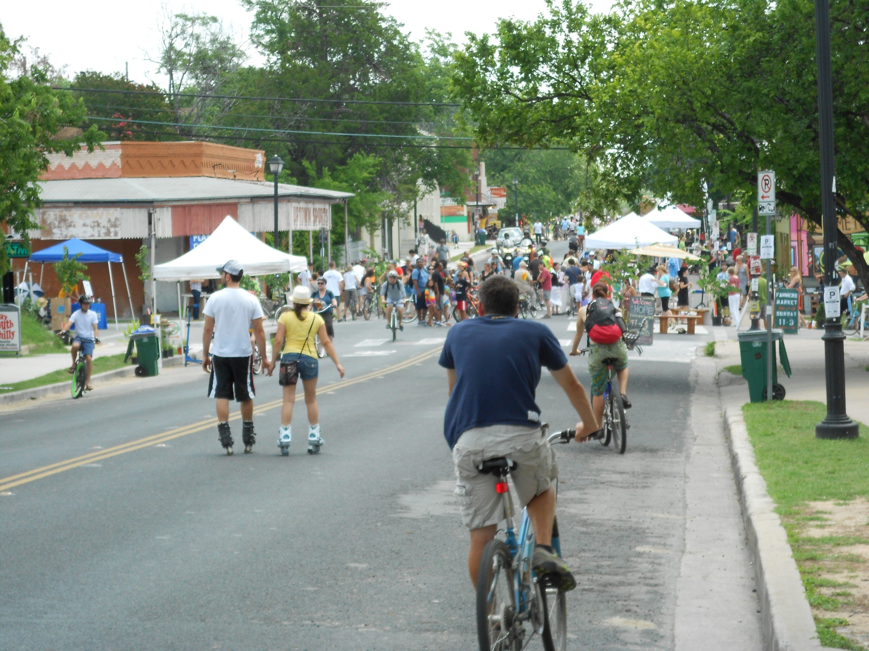
5 Principles of Great Streets
5. Act Now: Opportunities for Change be Implemented Quickly
Austin, TX

