Slide 1
PAC/Garage/SCP South Campus Traffic Flow Logistics
6/28/2011

Slide 2
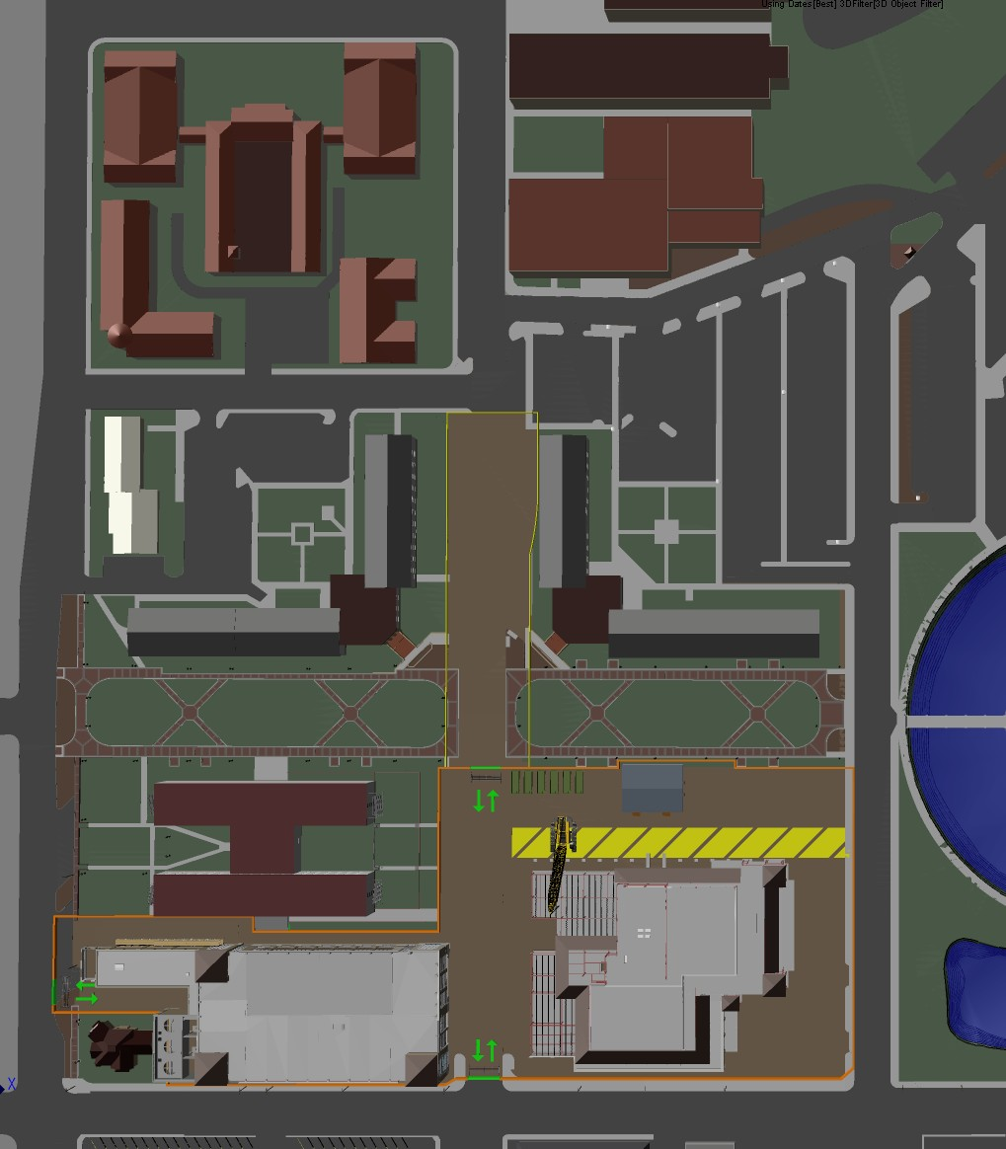
BOBCAT TRAIL
PAC/Garage/SCP
South Campus Traffic Flow Logistics
BERETTA HALL
BROGDON HALL
July 6, 2011 – May 14, 2012
COMMONS HALL
COLLEGE OF EDUCATION
Street Closures
Edward Gary Street closed from University Drive
to Woods Street
-Existing one-way traffic is preserved
LAUREL HALL
BRAZOS HALL
OLD WOODS STREET
WOODS STREET
Parking Space Closures
BAPTIST
STUDENT
CENTER
Lot 103 – Sterry Hall parking is lost
All parking along Edward Gary Street from University Drive to Wood Street
Alumni House staff and visitor parking in Lot 103
Student move-in traffic temporary access August 17 – 19, sidewalk access to handicap ramp.
EDWARD GARY DRIVE
NORTH LBJ
LANTANA HALL
BUTLER HALL
MOON STREET
CONCHO GREEN
CONCHO GREEN
HUNT
GC
STERRY HALL
GRAVEL ACCESS PATH
Building Closures
None
South rooms of Sterry Hall occupied, Hunt to provide 72HR notice in advance of disruptive work outside of regular construction work hours
PAC
SCP
SCP
PAC
University Drive
Parking Garage
University Drive
Parking Garage
UNIVERSITY DRIVE

Slide 3
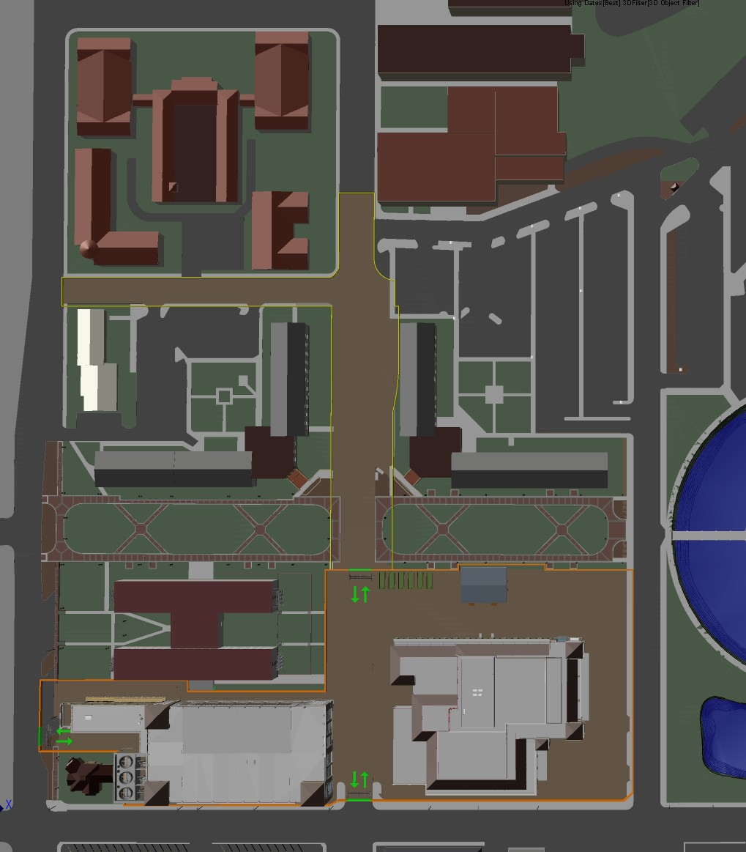
BOBCAT TRAIL
PAC/Garage/SCP
South Campus Traffic Flow Logistics
BERETTA HALL
BROGDON HALL
May 14, 2012 - August 10, 2012
COMMONS HALL
COLLEGE OF EDUCATION
Street Closures
Bobcat Trail closed to through traffic. (Coordinate with UPD to manage traffic flow)
Woods Street between Edward Gary and North LBJ closed due to utility work.
Moon Street is two way to serve JCK traffic.
LAUREL HALL
BRAZOS HALL
OLD WOODS STREET
WOODS STREET
Parking Space Closures
All parking on Moon Street is lost
Lot 103 – Sterry Hall parking is lost
All Parking along Edward Gary Street fro University Drive to Wood Street is lost.
Alumni House Staff & Visitor Parking in Lot 103 is lost
Bobcat Trail parking is modified/lost
BAPTIST
STUDENT
CENTER
EDWARD GARY DRIVE
NORTH LBJ
LANTANA HALL
BUTLER HALL
MOON STREET
CONCHO GREEN
CONCHO GREEN
Building Closures
Commons Hall Renovation Dec 2011 – Aug 2012
Brogdon Hall Renovation May 2012 – Aug 2013
HUNT
GC
STERRY HALL
GRAVEL ACCESS PATH
Utility Shutdowns
Scheduled and coordinated utility work will effect the following buildings:
Sterry Hall
Butler Hall
Lantana Hall
Brazos Hall
SCP
PAC
Laurel Hall
Commons Hall
College of Education
University Drive
Parking Garage
UNIVERSITY DRIVE

Slide 4
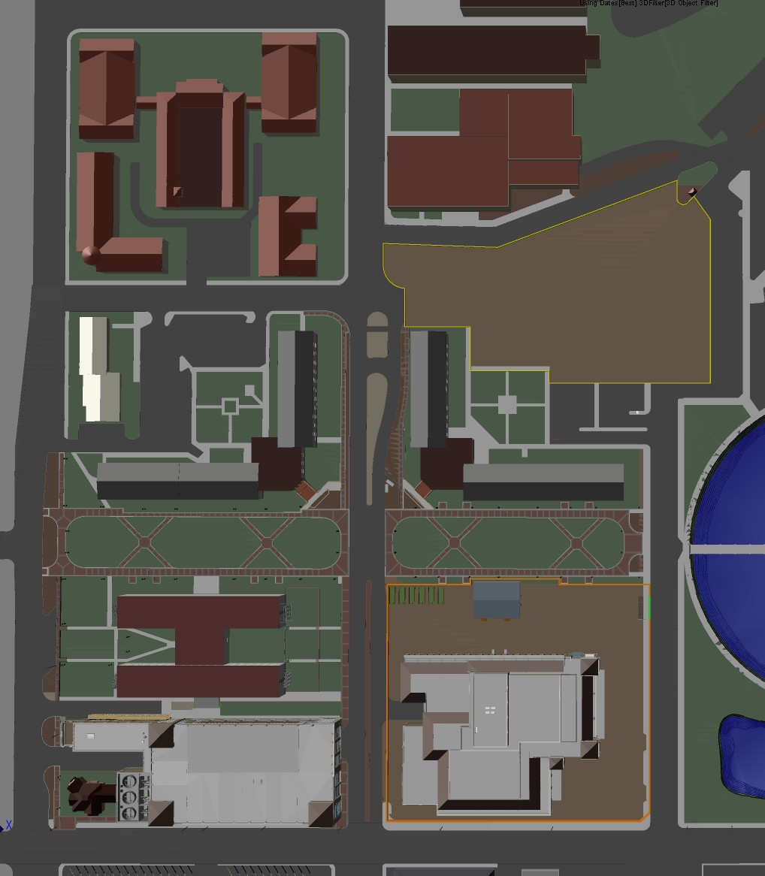
BOBCAT TRAIL
PAC/Garage/SCP
South Campus Traffic Flow Logistics
BERETTA HALL
BROGDON HALL
August 13, 2012 - January 11, 2013
COMMONS HALL
COLLEGE OF EDUCATION
Street Closures
One-way traffic on Moon Street
Two-way traffic on Old Woods Street
Two-way traffic on Woods Street
LAUREL HALL
BRAZOS HALL
OLD WOODS STREET
WOODS STREET
Parking Space Closures
BAPTIST
STUDENT
CENTER
All Parking on Old Woods Street is lost
All Parking on Woods Street is lost
All Parking at Butler Hall / Education Lot 102 is lost
One-way traffic will be routed through parking area West of JCK, parking will be lost to facilitate drive aisle.
All parking along Moon Street remains closed
Butler Hall move-in traffic – Dates to be determined.
EDWARD GARY DRIVE
NORTH LBJ
LANTANA HALL
BUTLER HALL
CONCHO GREEN
CONCHO GREEN
MOON STREET
HUNT
GC
STERRY HALL
Building Closures
None
Brogdon Hall construction renovation
May 2012 – August 2013
SCP
PAC
University Drive
Parking Garage
UNIVERSITY DRIVE

Slide 5
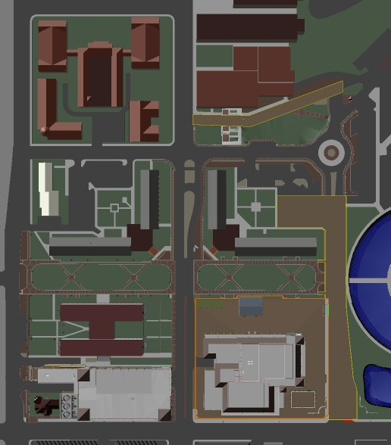
BOBCAT TRAIL
PAC/Garage/SCP
South Campus Traffic Flow Logistics
BERETTA HALL
BROGDON HALL
January 14, 2013 – September 22, 2013
COMMONS HALL
COLLEGE OF EDUCATION
Street Closures
Moon Street between University Drive & Butler Hall parking lot closed due new construction and rerouting of traffic.
Old Woods Street Between JCK & Bobcat Trail closed due to landscaping work.
New Woods Street East of Edward Gary is two-way
Old Woods Street is closed
LAUREL HALL
BRAZOS HALL
OLD WOODS STREET
WOODS STREET
NEW WOODS STREET
BAPTIST
STUDENT
CENTER
EDWARD GARY DRIVE
Building Closures
NORTH LBJ
LANTANA HALL
BUTLER HALL
None
Brogdon Hall construction renovation
May 2012 – August 2013
CONCHO GREEN
CONCHO GREEN
MOON STREET
HUNT
GC
Utility Shutdowns
STERRY HALL
Scheduled and coordinated utility work will effect the following buildings:
College of Education
SCP
PAC
University Drive
Parking Garage
UNIVERSITY DRIVE

Slide 6
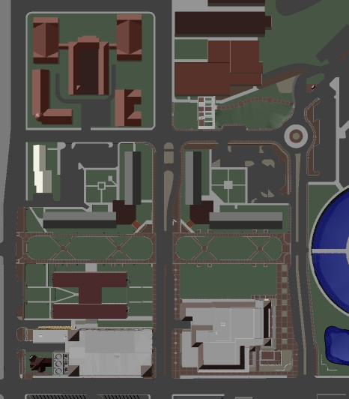
BOBCAT TRAIL
PAC/Garage/SCP
South Campus Traffic Flow Logistics
BERETTA HALL
BROGDON HALL
September 24, 2013
COMMONS HALL
COLLEGE OF EDUCATION
Street Closures
None
LAUREL HALL
BRAZOS HALL
WOODS STREET
NEW WOODS STREET
BAPTIST
STUDENT
CENTER
Building Closures
NORTH LBJ
MOON STREET
None
LANTANA HALL
BUTLER HALL
MOON STREET
CONCHO GREEN
CONCHO GREEN
EDWARD GARY DRIVE
STERRY HALL
SCP
PAC
University Drive
Parking Garage
UNIVERSITY DRIVE

Slide 7
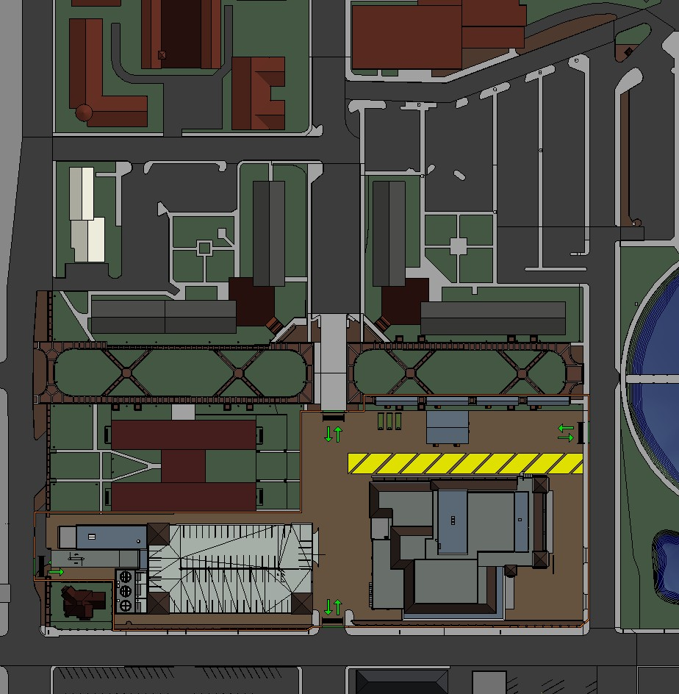
COMMONS HALL
COLLEGE OF EDUCATION
PAC/Garage/SCP
Site Logistics
OLD WOODS STREET
LAUREL HALL
BRAZOS HALL
LEGEND
WOODS STREET
SITE FENCING
University Drive
Parking Garage
BAPTIST
STUDENT
CENTER
SITE ENTRANCE / EXIT
EDWARD GARY DRIVE
CONSTRUCTION TRAFFIC
MOBILE CRANE PATH
LANTANA HALL
BUTLER HALL
T/R
TRASH / RECYCLE
NORTH LBJ
MOON STREET
CONCHO GREEN
CONCHO GREEN
E
TEMPORARY TRANSFORMERS
SUB
SUB
SUB
SUB
T
TOWER CRANE
E
T/R
HUNT
GC
STERRY HALL
SUB
SUBCONTRACTOR TRAILERS
HUNT
GC
CONSTRUCTION MANAGEMENT
TRAILERS
SCP
University Drive
Parking Garage
PAC
T
UNIVERSITY DRIVE

Slide 8
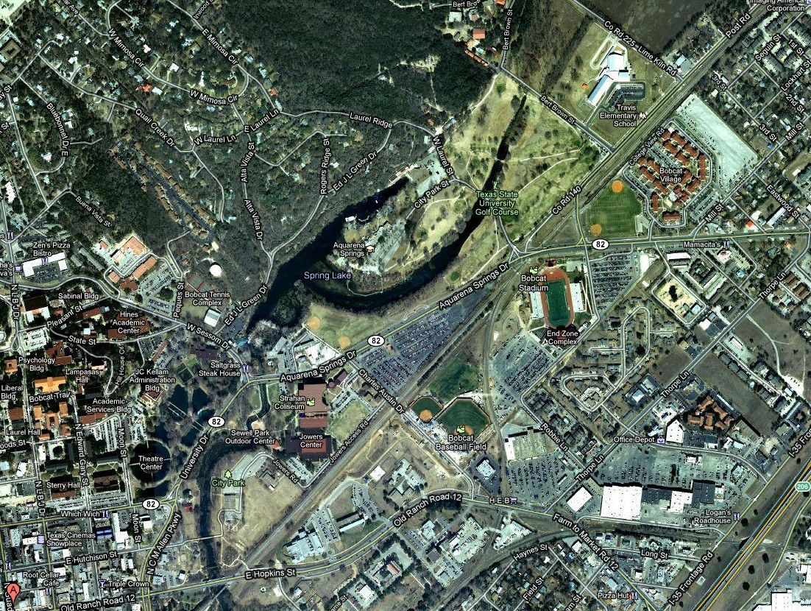
CONSTRUCTION
PARKING
JOBSITE LOCATION
Construction Parking Location
UNIVERSITY DRIVE
Bobcat Village Parking @ Corner of Aquarena Springs and Mill Street

