Slide 1
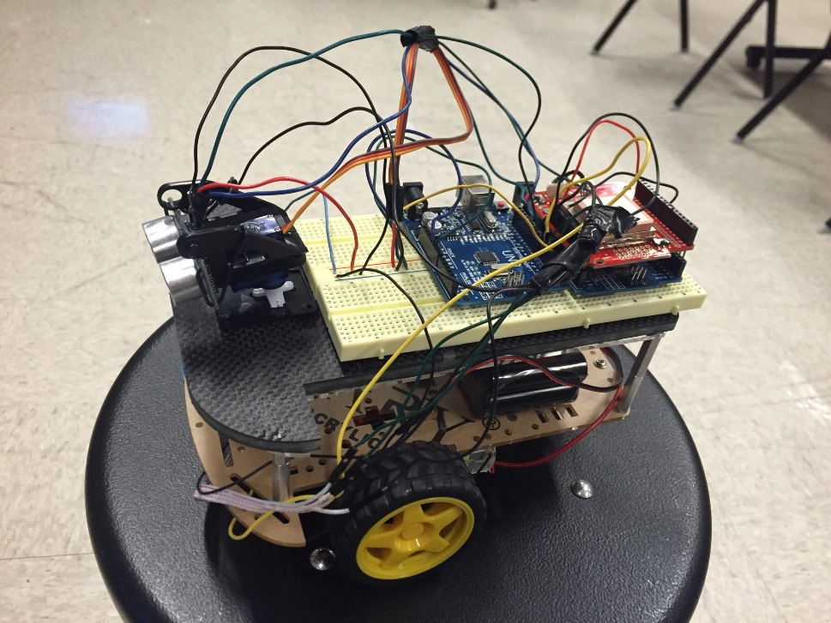
Robotic GPS Mapper
Sponsor: H. Thomas Dickey & SENSCO
Faculty advisor: Dr. Harold stern
Engineering for a better Texas
Notes:
The PM starts the presentation. “Welcome. I am Sammy Spectacular, the student project manager for the Inverting Flurbitron project, sponsored by blah-blah. Thank you for attending our Intermediate Design Review. Our major goals are to review progress and then conduct a detailed review of the Functional Specification.”

Slide 2
Agenda
Overview
Design Approach
Results
Future Work
Engineering for a better Texas
Notes:
Do NOT talk to these points at this time! Just list them! They will be covered later in greater depth. Just say what the agenda is and move on!

Slide 3
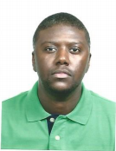
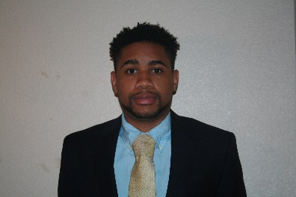
Team Members
Luis Rivero Jr. Project Manager
Braylon Yarbrough
Write code/Test
Francisco Carvalho
Hardware/Test
Duy Nguyen
Research/Test
Engineering for a better Texas
Notes:
Don’t spend time on this slide! The PM should introduce the team members and their major role per the slide – do NOT elaborate on rolls!

Slide 4
Overview of Project
Goals of project
Stretch goals of project
Have robot collect data points
Map terrain that robot travels
Autonomous moving Robot
Have robot map in real time.
Use sensors to align robot as it moves
Engineering for a better Texas
Notes:
If no stretch goals then delete the text box on the right, and expand the one on the left.

Slide 5
Motivation
The problem:
Pipe system construct within infrastructure of city
Large amounts of water lost through leaks
Why is this important?
Locate leaks quicker for faster repair
Engineering for a better Texas
Notes:
Why are you doing this project? What’s important / needed / beneficial about it?

Slide 6
Our Sponsors
Mr. Thomas Dickey & SENSCO
Dr. Harold Stern
Dr. Rich Compeau
Dr. William Stapleton
Engineering for a better Texas
Notes:
Go through this at a good pace. You could spend 30 minutes on this alone – don’t. Just give the overview.

Slide 7
Budget
Initial budget of $500
CAPITAL EXPENDITURE ESTIMATE
Task | Materials | Planned Cost | Actual Cost
Fabricate prototype | SD Card | $3 | $3
 | SD Module Slot Socket | $2.50 | $2.50
 | Robotic kit | $38(x2) | $38
 | GPS Receiver-EM-506 | $44 | $44
 | PCDuino Webcam | $27
 | GPS Shield | $17 | $17
 | Wi-Fi shield | $50
 | Proximity sensors | $25(x4)
 | DC Batteries | $12 | $12
TOTAL |  | $331.50 | $116.50
Engineering for a better Texas

Slide 8
Constraints
Wi-Fi Shield
Proximity sensor
GPS accuracy
Terrain
Engineering for a better Texas

Slide 9
Design Decisions
Autonomous moving Robot utilizing a proximity sensor
As the robot moves, GPS coordinates are collected on a external SD card
This data is used to create a map of the terrain the robot traveled
Engineering for a better Texas

Slide 10
Design approach
Mobility
_ Two motors, each moving one big wheel and balanced with a small back wheel
Proximity Sensors
_ Used as the eyes of the robot
_ Directs robot away of obstacles
GPS Plotting
_ Data is acquired during movement of the robot
_ Saved onto memory card and plotted on software program
Engineering for a better Texas

Slide 11
Block Diagram
Hardware
Engineering for a better Texas

Slide 12
Block Diagram
Software
Movement Function:
Allows Robots to move forward, left and right
Sensor Integration:
Proximity sensor performs 150 degrees sweep as robot moves autonomously
GPS Data Collection:
GPS coordinates are collected onto SD cars as robot moves
Engineering for a better Texas

Slide 13
Test results
Movement
Sensor integration
Data Collection
Engineering for a better Texas

Slide 14
Test Case #1 - Movement
Robots movement was successful in all four directions
Used RFM to simulate the PVC water pipe
Robot is autonomous
Delay of part and Overestimated task
Unable to control through Wi-Fi
Engineering for a better Texas

Slide 15
Test Case #2 – Sensor Integration
Tested in RFM building
Obstacles placed in way of robot
Sensor responded by moving about 150 degrees instead of 180
Engineering for a better Texas

Slide 16
Sensors Integration and Moving Video
Engineering for a better Texas

Slide 17
Test Case #3 – GPS
Tested in Roy F. Mitte parking lot
Using GPS receiver the longitude and latitude coordinates were stored onto a SD card successfully
GPS coordinates were compared to coordinates collected by a phone
A map of Roy F. Mitte parking lot was created successfully using GPS Visualizer and the GPS coordinates
Engineering for a better Texas

Slide 18
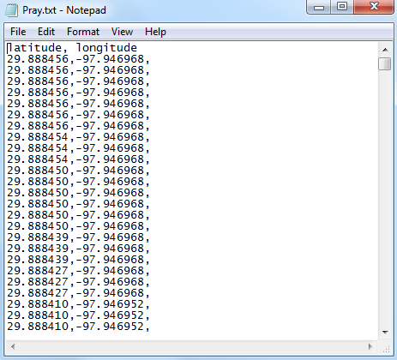
GPS Coordinates and Map
Engineering for a better Texas

Slide 19
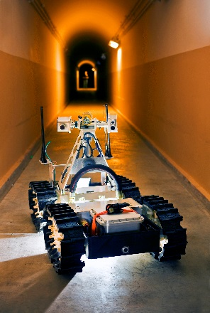
Future Work
Use clear blade to make the robot collect data in real time
Make the robot more robust by using heavy duty wheels and adding a protective layer
For communication use R.F. signals
Engineering for a better Texas

