Slide 1
Welcome BOBCATbuyers & Travel Assistants
Please Sign-In
March 30, 2016

Slide 2
AGENDA
AP Reminders
E-NPO
LBJ Student Events - Chartwells
UDC Hand Receipts
Travel Updates and Reminders
TRAVELTracks Reminders
Travel Forms Updates
International Vehicle Insurance
Travel e-NPO Process
Travel Survey
2016 Vendor Show
Questions

Slide 3
AP Reminders
Creating a PO doesn’t mean payment will occur.
Must have an invoice before payment is issued.
Don’t attach invoices to PO. There isn’t a notice generated for this and it will never be paid.
Send invoices to payables@txstate.edu.
Remember you can scan and email all documents to AP – don’t need to deliver paper. AP is paperless!!

Slide 4
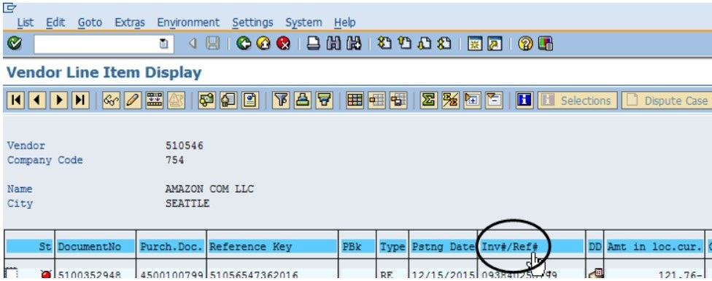
AP Reminders
Vendor Payment History – FBL1N T-Code
Reference Column Changed to Inv#/Ref#.
FBL1N - How to View Payment Activity

Slide 5
AP Reminders
Jason’s Deli Yellow Receipts
Yellow Receipt at delivery is the invoice for payment.
Approve, include PO number and SEND to AP for payment.
Attach list of attendees if 19 or fewer.
If more than 19 attendees, give a general description of who.
Include the business reason for the meal.
AP-12 Form can be used – and it lists all requirements.
Many are “Past Due” on the monthly vendor statement.
AP-12 Form

Slide 6
e-NPO
A person who is a delegate for an Account Manager can’t approve a reimbursement to themselves. Item remains in the AM worklist until AM approves.
Can include multiple receipts on a single e-NPO for employee reimbursements (except no travel allowed with other expenses).
Combine total receipts for the same employee when creating an employee reimbursement.
Can’t include multiple invoices from vendors on a single e-NPO. Need e-NPO for each invoice.
Invoice number is unique for each invoice.

Slide 7
e-NPO
If you need to pick up a check, the request must comply with policy FSS PPS 03.01.15
Specify in the NOTES when the check is needed for pickup.
Contracted Services are never paid personally and reimbursed on an e-NPO.
Creates non-compliance issues with IRS reporting requirements.
Policy Exception: FSS PPS 03.05.01

Slide 8
e-NPO
Business Purpose - what the expense is for. e.g.
Correct: Dinner with prospective candidate Dr. Joe X for Dean of Music position (and provide attendee list).
Incorrect: Reimburse Dr. Brown for dinner. (Obvious it’s a reimbursement, but this doesn’t address business purpose or attendees.)
Employee Awards when non-employment related:
Must use a “5” vendor number, not “3” number.
Award is 1099 reportable.
700001 Vendor is for Refunds & Reimbursements.
Never for Goods or Services (1099 reportable).

Slide 9
e-NPO
Whether for travel or other employee expenses:
Turn them in now!
No reason to wait – Summer and year-end will be here soon.

Slide 10
e-NPO
e-NPO Training Links
e-NPO Training – step by step instructions with index
e-NPO Checklist – guide for completion and also UPPS references on those policies that most frequently apply
Viewing Workflow Status for e-NPO’s
Monitor Report Instructions – how to use this report
How to Delete a Parked e-NPO
e-NPO Training Video – (20 Minutes)
e-NPO FAQs
e-NPO Classroom Training – Register through Profess’l Development
Monday, April 19th 9:00 – 11:00
Thursday, May 5th 1:30 – 3:30

Slide 11
LBJ Events with Chartwells
No longer need to create a PO for an event at LBJ Student Center WITH Chartwells as the caterer.
Must complete the AP-12 form and check the e-IDT box in the Funding Information Section.

Slide 12
LBJ Events with Chartwells
LBJ will pay the invoice and submit the e-IDT for the department costs for the event.
Departments no longer need to create a PO and then later request Procurement to cancel it. No funds will be encumbered, but must be available for the e-IDT. If not, LBJ will work with the Budget Office.
Departmental events not held at LBJ using Chartwells still require a PO. AP-12 form is recommended to capture all required information and approvals.
AP-12 Form

Slide 13
UDC Hand Receipts
Vendor Number is 700030 (Hand Receipt on SAP).
Vendor Name is Hand Receipt.
PO number on this is NOT your PO number.
Used when there is no valid PO number on the packing slip.
Reference for which UDC staff who handled and delivered it on campus.

Slide 14
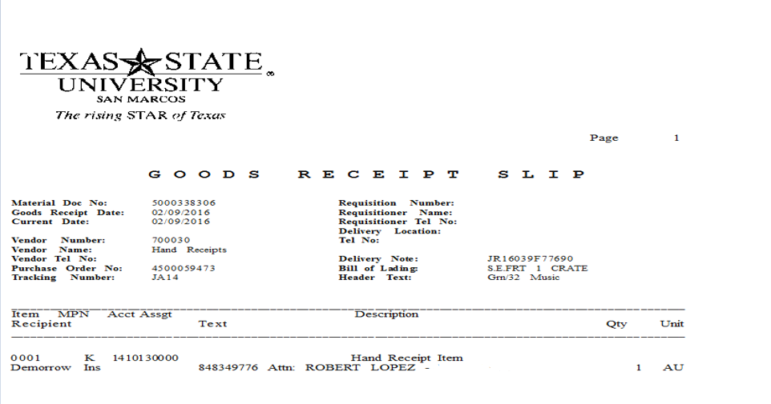
UDC Hand Receipts

Slide 15
UDC Hand Receipts
Department needs to:
Find the valid SAP PO number for the items.
Initiate a Goods Receipt for the delivered items.
From the Hand Receipt, use the date on the “Goods Receipt Date” line for the delivery date on the Goods Receipt you are creating.
Do not use the date it was delivered to your department.
Goods Receipt Notification Form

Slide 16
Travel Updates and Reminders
2016 Mileage Rate is 54 cents per mile.
Toll Road Estimator for Expense Reports:
TXTAG Toll Estimator
TXTAG Austin Toll Estimator
Tips for Taxis
Often automatically added to fare.
Reimbursable up to 20% of fare.

Slide 17
Travel Updates and Reminders
Grants General Ledger Matrix:
Grant Accounts consolidated to just one account for all travel dependent on destination.
710101 – all In-State travel expenses.
711101 – all Out-of-State travel expenses.
712101 – all Foreign travel expenses.
Note: Non-travel expense accounts did not change;
720100 – Memberships
720300 – Registrations/Employee Training
General Ledger Codes

Slide 18
Travel Updates and Reminders
Student Groups Activity Type Requirements
One or more students traveling with an employee.
Must supply a complete list of students who are traveling in the group. Attach list or include in the comments section on the Travel Request or T-10 Form (for Funds Commitment).
Update list if changes occur. AM must approve.
If airfare is required, must provide student’s driver’s license name for verification purposes.

Slide 19
Travel Updates and Reminders
Student Groups Activity Type Expense Reports
Group meal paid by the employee requires an itemized receipt since per diems are not paid.
Tip limit is 20% of the pre-tax total.
Don’t need a list of students as that was already provided.
If money is given to the students to pay for their own meals, then have a log with the trip number, date money was given, amount, student name and signature.
In TRAVELTracks, Lodging Expenses are reported in the GROUP TRAVEL expense type.
Note: Need to uncheck the Accommodation Per Diem box at the bottom of the General Data screen if all is claimed in GROUP TRAVEL.

Slide 20
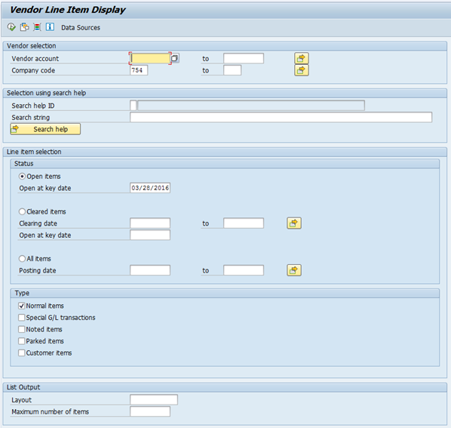
Travel Updates and Reminders
How to Find a Direct Bill Hotel – FBL1N T-Code
Click on the white box – Vendor account field

Slide 21
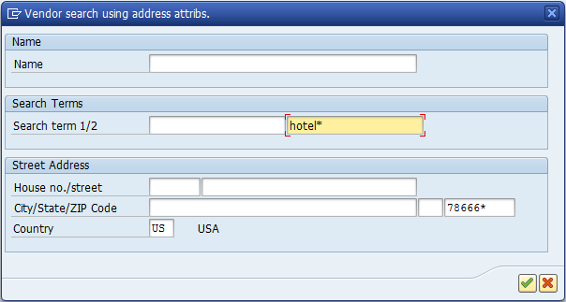
Travel Updates and Reminders
Select the Vendors by Address (TXST Active) Tab.
Enter hotel* in the Search Term field.
Enter the Zip Code in that field.
Click on the green check mark.

Slide 22
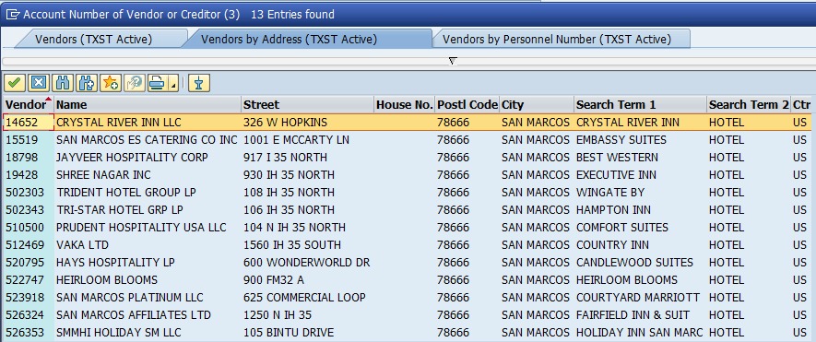
Travel Updates and Reminders
A hotel vendor list will appear for that Zip Code.
Accept Prepayment or offer Direct Bill.

Slide 23
Travel Updates and Reminders
LaQuinta Inns and Suites
No longer direct bill.
Does not accept PO.
Only accept pre-payment. Do an e-NPO.
T-3 Form for Daily Mileage Worksheet
Do not submit handwritten form.
Only use the EXCEL Form
Has built in formulas.
Formulas assist with reimbursement amount calculation and auditing.

Slide 24
Travel Updates and Reminders
Expense Report Review Before Submission
Verify documentation included for all expenses.
Check your addition (expense totals).
Don’t just guesstimate and have the Traveler “Save and Send” without doing your review.
Travel Office has to audit, then reject and reset so changes can be made. Then Traveler has to “Save and Send” again to submit.
The Travel Office has to re-audit when it’s received again.
This costs the University double!!

Slide 25
TRAVELTracks Reminders
Business meals while traveling should be included on the expense report, not paid by e-NPO.
Budget Checks on the Costing Tab and Review Tab.
Call the Budget Office if you can’t proceed so they can adjust your budget (with proper rationale).
If paying lodging on a PO or e-NPO, don’t include amount on the approval request or expense report.
NOTE: Don’t have to use a PO for lodging if under $5K. Use the e-NPO process.
If a “convention” or training room rental of more than $5K, use a PO.

Slide 26
TRAVELTracks Reminders
If your traveler is at a location where they can’t “save and send” their expense report in TT, attach an email from the traveler with the certification statement as the traveler’s approval.
This should be the exception and won’t apply to most traveler situations.
Certification Statement from the traveler:
I certify that the expenses are correct and have not been reimbursed to me by any other method. The summary of the travel expenses is as follows:
Traveler Name:
Trip Number:
Dates of Travel:
Amount of Reimbursement:
Expense report due 30 days after trip end date. Closed trip will release any unused encumbered funds back to your budget.

Slide 27
Travel Forms Updates
T-1 Airfare Equivalency Form
Must attach airfare quote.
 |  |  |  |  |  |  | Form T-1
 |  |  |  |  |  |  | Airfare Equivalency Form
 |  |  |  |  |  |  | Mileage in Lieu of Airfare - Out of State Only
Complete this form to provide the most cost-effective means comparison when opting for a different mode of travel rather than air travel. Please attach a copy of the airfare quote.
Traveler: |  |  |  |  |  |  |  |  |  |  |  | Travel Request No.
Travel Dates: |  |  |  |  | - to - |  |  |  |  |  |  | Destination:

Slide 28
Travel Forms Updates
T-10 Form (reminder)
Enter Contract Number for non-employees whose travel TX State is paying for.
Not used for prospective employees or students.
Always “easier” to include travel in the contractor’s fee amount and then only one payment is needed and they take care of travel arrangements.
Travel Forms

Slide 29
International Vehicle Insurance
Domestic liability coverage included in State contracts don’t apply.
Can accept liability insurance while abroad if AM approves the expense.
OR – Can rely on University’s Automobile Policy:
Covers liability not covered under contracts.
Includes accidents while abroad.
Policy deductible applies.

Slide 30
Travel e-NPO Process
Replaces the T-11 form for non-employees and students. (Can still use – but why would you?)
Must enter an approved Trip Number.
Can be used for “missed” expenses on the TRAVELTracks expense report.
Don’t mix travel expenses with other reimbursement expenses on the same e-NPO.
Different groups audit each Travel and Other Business reimbursements.

Slide 31
Travel e-NPO Process
Must attach the e-NPO Travel Certification Statement from the traveler (email from traveler accepted).
I certify that the expenses are correct and have not been reimbursed to me by any other method. The summary of the travel expenses is as follows:
Traveler Name:
Trip Number:
Dates of Travel:
Amount of Reimbursement:

Slide 32
TRAVEL SURVEY
Two questions (Handout) – Thank you!!
FC will only encumber Company Paid expenses.
Goal is to eliminate paper T-11 Expense Reports
Use e-NPO for other FC Trip (non-company billed) expenses.
Reimburse any travel expense for employees not included on original TRAVELTracks expense report.
TRAVELTracks Year-End Clean up.
Close trips 60 days or more past due if no company paid expenses on Travel Request. Release encumbered funds.
When traveler submits receipts for reimbursement, process as e-NPO.

Slide 33
TRAVEL SURVEY
Would you be in favor of only including company paid expenses on the Funds Commitment? All other expenses would be reimbursed e-NPO.
YES____ NO____
Would you be in favor of the Travel Office (rather than you) closing any TRAVELTracks trip without company paid expenses during the year-end process if the trip is more than 60 days past the travel end date? All other expenses would be reimbursed e-NPO.
YES____ NO____

Slide 34
AP and Travel RSS Feed
Stay informed on changes through RSS Feeds
Instructions for setting up an RSS feed for AP Office Announcements can be found on the AP Resources webpage.
How to Add RSS Feed for AP
Instructions for setting up an RSS feed for Travel Office Announcements can be found on the Travel Procedures webpage.
How to Add RSS Feed for Travel

Slide 36
Questions and Answers

Slide 37
Questions
Please provide an example of contract services.
DJ comes and plays at an event. This is considered a contract service. An employee can’t pay for the services, then seek reimbursement.
Please provide an example of non-employee vs. employee awards.
Just in Time awards recognize employees for doing a good job, therefore, they are paid through payroll using a PCR since this is related to their job.
Non-employee awards are not based on job performance (e.g. a writing composition contest that anyone can enter). In this case, the award would need to be processed by vendor number (starts with a “5”). These are IRS 1099 reportable.

Slide 38
Questions
Does a PO need to be created for alcohol when the event is held at the LBJ Student Center?
Yes. Alcohol is paid from a different funding source. Alcohol is not covered under the LBJ purchase order. Cabinet Officer approval is also required.
Please provide more information regarding catering fees.
For additional information, please contact Auxiliary Services (Mary Alice) at EXT 5-2585 or review the info at Catering Services .
Provide an example of van rental vs. airfare reimbursements.
The T-1 form is set up reimburse the lowest amount by comparing the cost of airfare (attach airfare quote), mileage to the airport, airport parking and vehicle rental and fuel at the out of state destination versus roundtrip mileage to drive a personal vehicle to the out of state destination for individual travel.
If a van will be rented under the assumption that multiple travelers will utilize this mode of transportation, a T-1 form for each traveler should be attached. Example: T-1 form for 4 travelers totals $3000 and the van rental and fuel totals $1800, it is more economical to rent a van.

Slide 39
Questions
Explain contractor travel fees.
Include travel costs in with the contract fee amount (e.g. if the fee for services is $1,000 and the travel costs are estimated at $1,000, then make the Contract amount $2,000). Contractor would make and pay their own travel. Contact Procurement at EXT 5-2521 for more guidance if needed. If travel fees are not included in the contract, then the Travel Assistant would complete the Funds Commitment, make the arrangements, process an expense report. All travel rules apply.
If an employee doesn’t want to use the direct bill to rent a car and chooses to pay for expenses and seek reimbursement instead, will the liability insurance be included in his rental?
If a traveler uses a Texas State-contracted rental company (Avis, Enterprise, or National), the insurance is included. However, if using a rental company not contracted with the university, insurance is not included. The traveler must purchase separate insurance from the rental company. An valid explanation as to why the contracted agency wasn’t used is required for reimbursement.

Slide 40
Questions
If a business meal is not included on the expense report, can an e-NPO be submitted for reimbursement?
Yes. However, if a per diem was received on the employee’s Travel expense report, the business meal will be reduced by the meal per diem for the traveler to avoid paying expenses twice. If other employees were also at the meal, the Travel Office will review their expense reports for per diem adjustments or repayment to the university.
Are airfare changes allowable?
Airfare change fees are only allowed if approved by the account manager.
A graduate student writes a paper with a professor and it was accepted. The travel will be international, but will take place after the student graduates. How will the travel application work?
Create a Funds Commitment. The former student would be listed as student since the travel relates to educational activity.

