Slide 1
Change Over Time
Lesson on Earth’s Landforms
llhammon

Slide 2
The Forces
Natural Forces from inside the Earth
Process: Tectonic Activity
Natural Forces on the surface of the Earth
Process: Weathering
Process: Erosion
Process: Ice
(and gravity)
Process: Wind (deposition)
Process: Water (deposition)

Slide 3
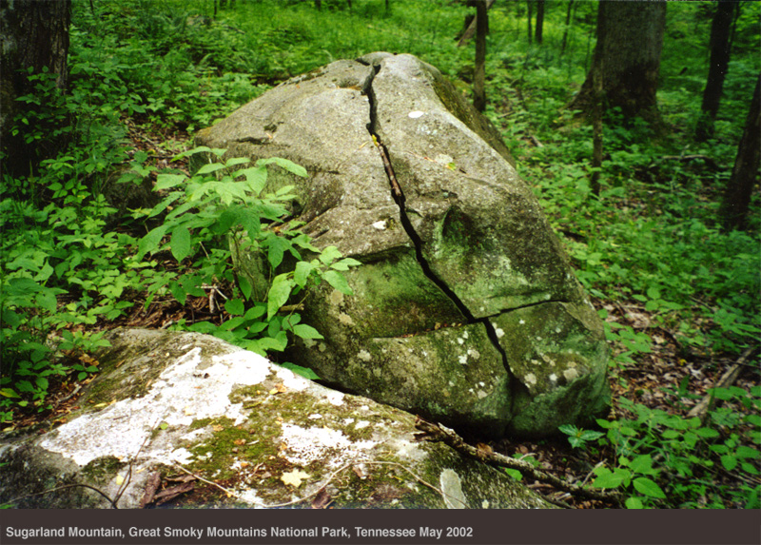
Weathering is the chemical and physical processes that change the characteristics of rocks on the Earth’s surface. It is also known as the preparation for erosion. In order for weathering to occur, the environment of a rock sample must change and the rock needs to be exposed to some form of water and the air. Human processes such as pollution, which can be a large factor in acid rain, along with the acts of other living organisms, can cause chemical weathering to occur at faster rates.

Slide 4
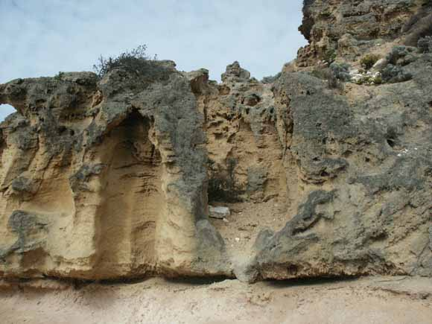
Weathering - the various mechanical and chemical processes that cause exposed rock to decompose; or the erosion or breakdown of rock into smaller fragments by natural physical agents with no chemicals involved; also called Desintigration.

Slide 5
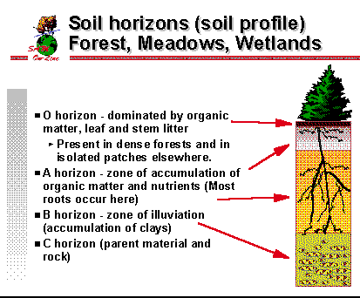
Soil Horizons
It is C horizon (parent material and rock) where the weathering can occur.
USGS

Slide 6
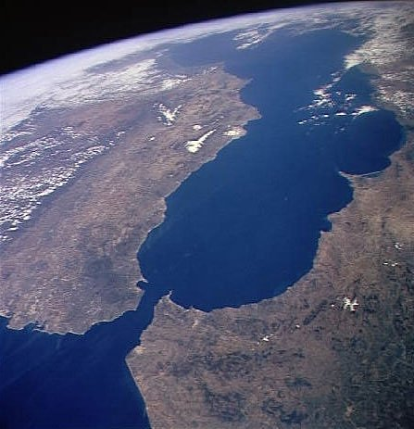
Strait – tectonic activity (not Atlas!)
Strait of Gibraltar
Between the continents of Europe and Africa
Photo - NASA

Slide 7
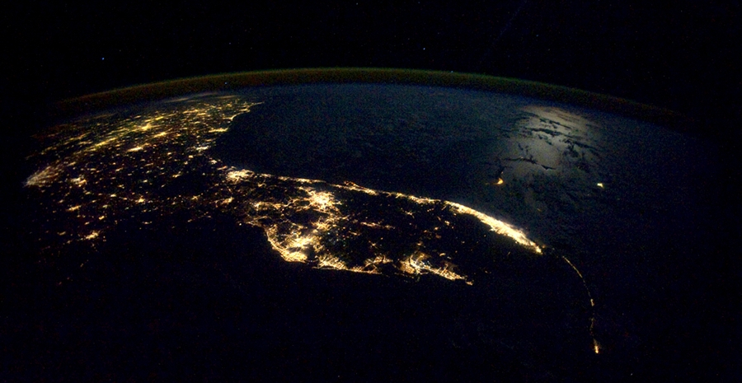
Photo - NASA
Peninsula – Florida at night - USA

Slide 8
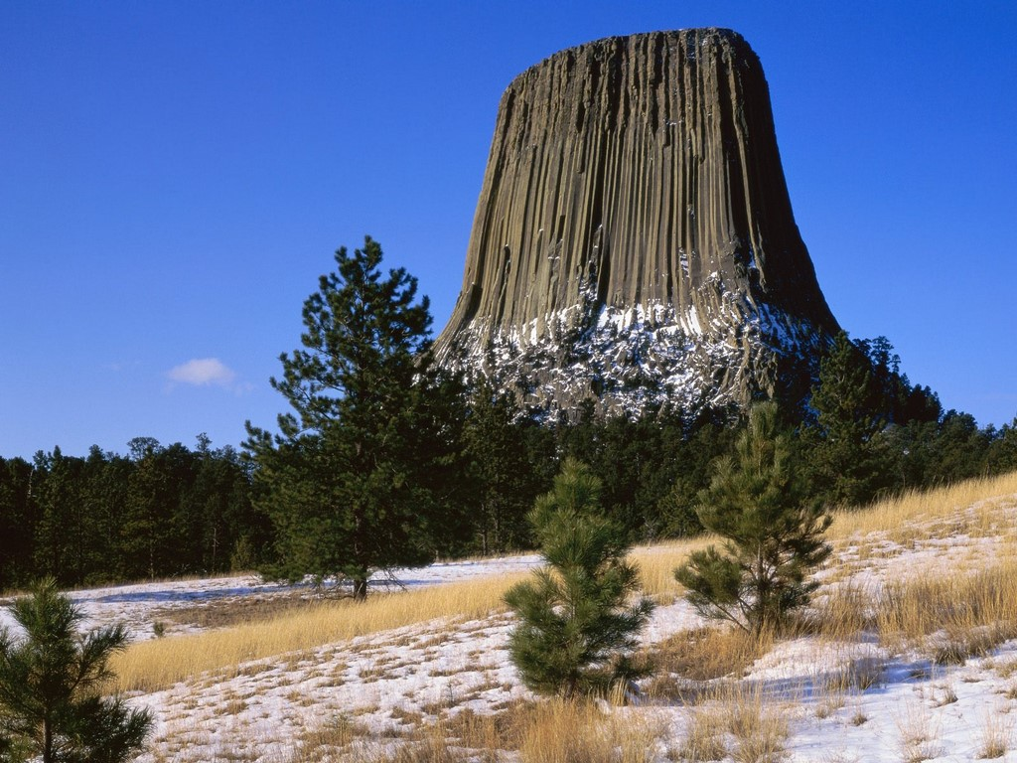
NGS
Erosion – wind – Devil’s Tower, Wyoming - USA

Slide 9
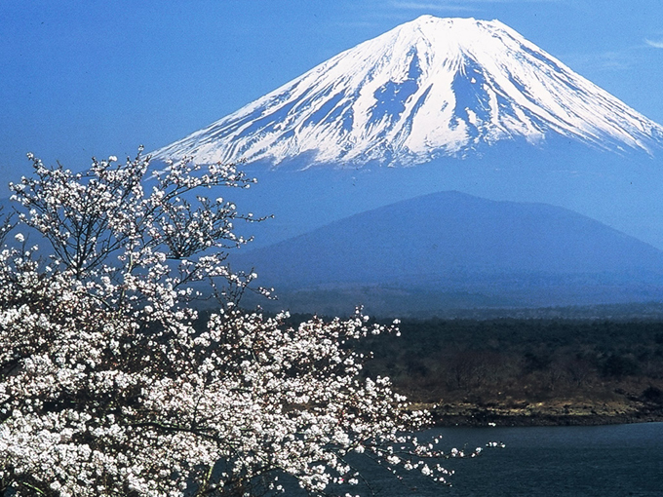
Volcanic mountain – tectonic activity – Mt. Fuji – Honshu Island Japan

Slide 10
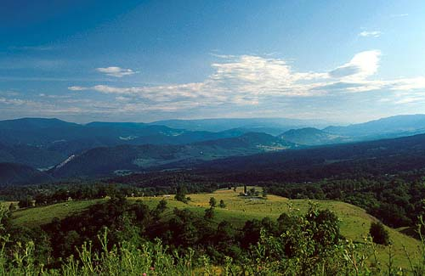
NGS
Folded mountains – tectonic activity – Appalachians – East coast United States

Slide 11
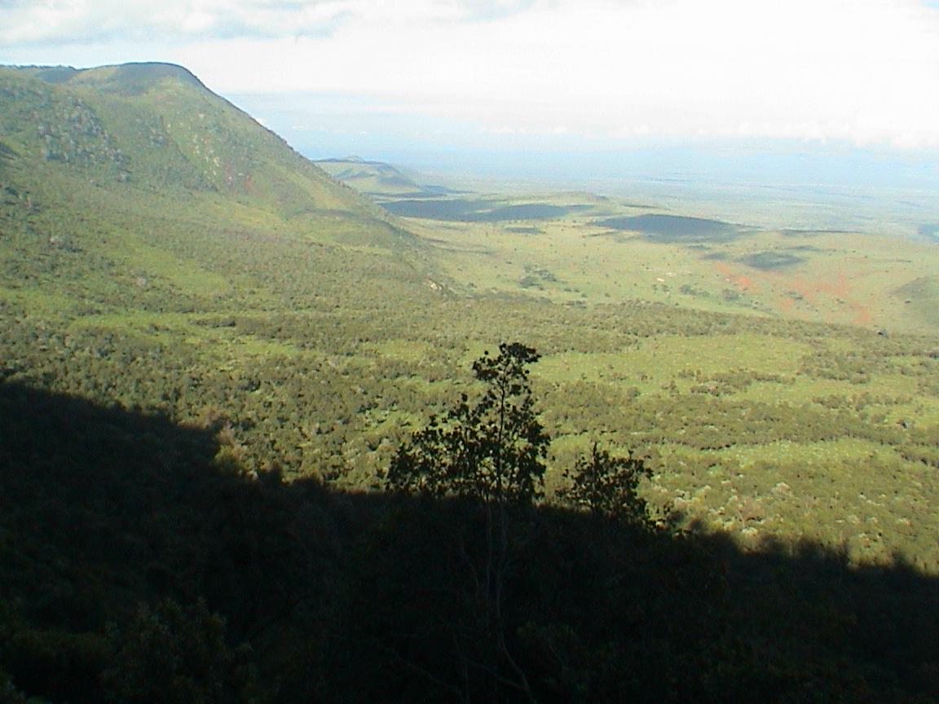
NGS
Rift – tectonic activity – Great Rift Valley – Eastern coast of African continent

Slide 12
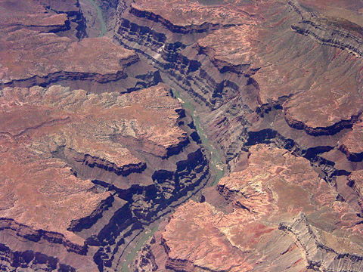
Canyon - Erosion – water – Grand Canyon - USA
NASA

Slide 13
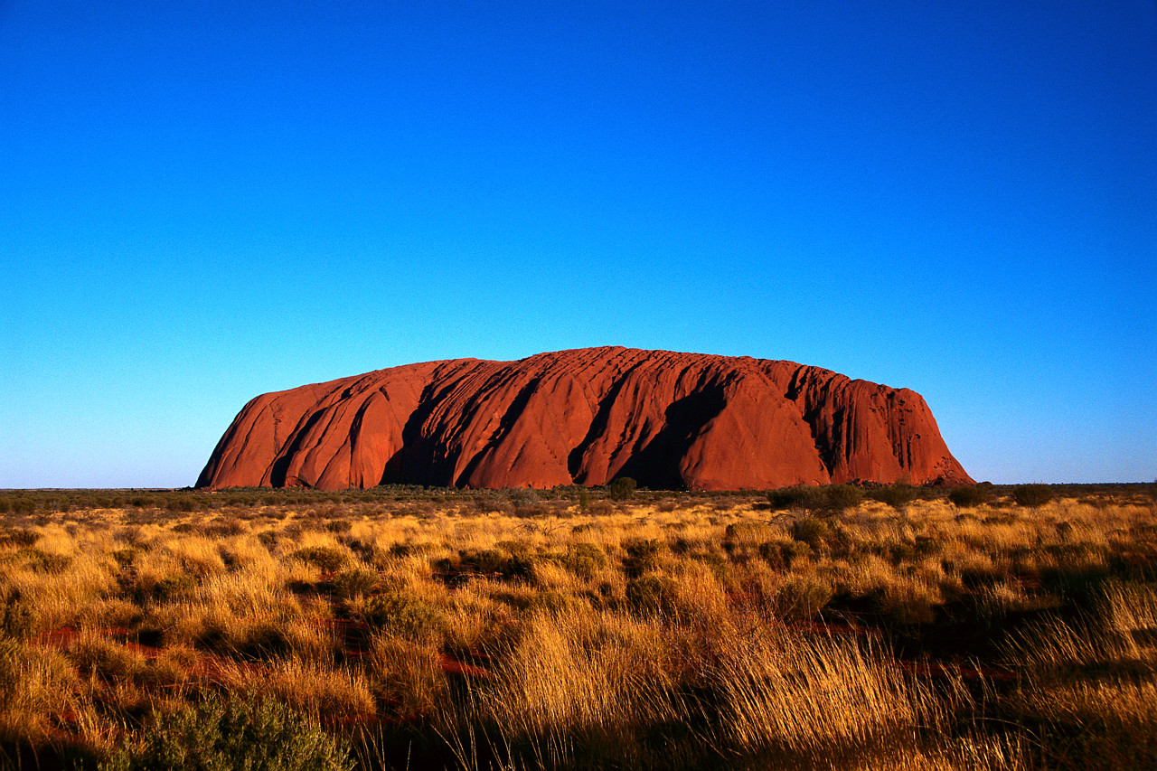
NGS
Erosion - wind – originally tectonic activity – Uluru (Ayers Rock) Outback of Australia

Slide 14
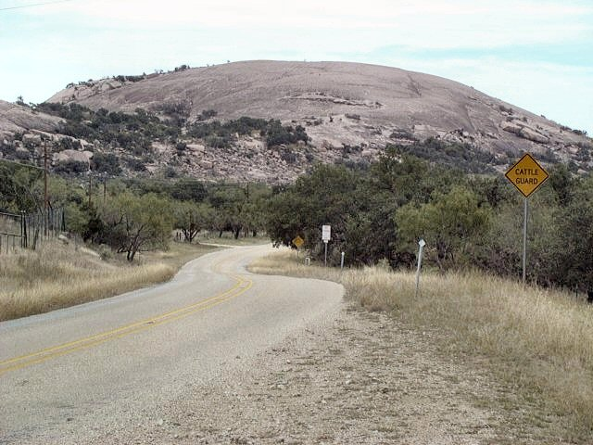
Dome Mountain (tectonic activity) – Enchanted Rock – near Fredericksburg, Texas

Slide 15
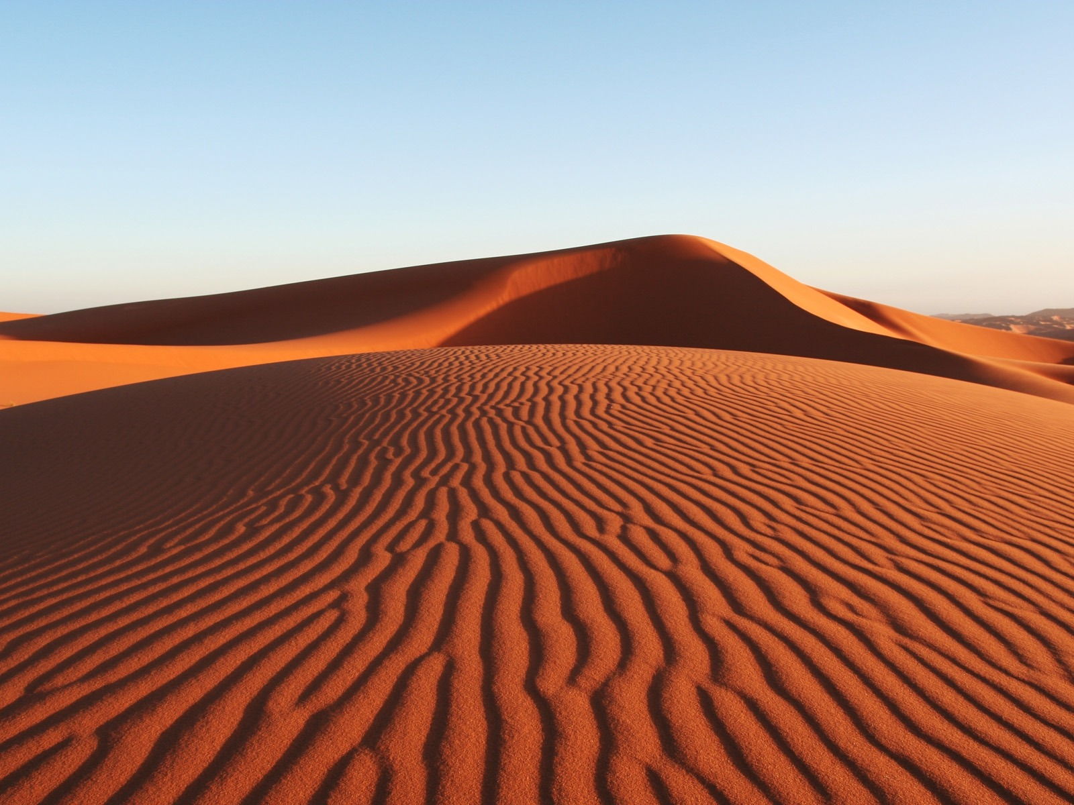
Erosion – wind – Sand Dunes – Sahara – North Africa
NGS

Slide 16
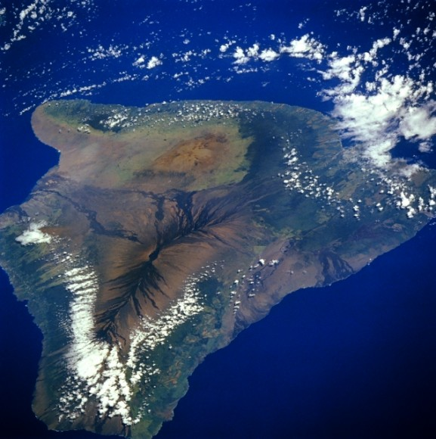
Island – Volcanic –Tectonic Activity –
Large Island of Hawaii - USA
NASA

Slide 17
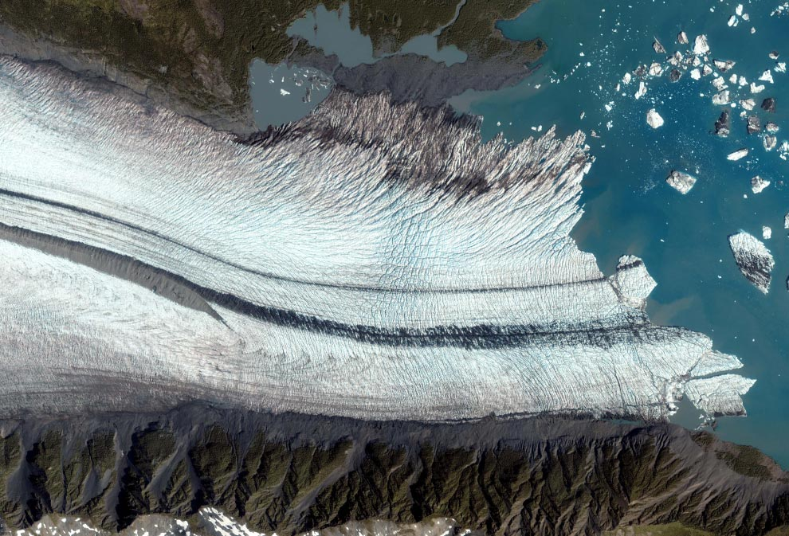
    NASA
Glacier – ice and gravity

Slide 18
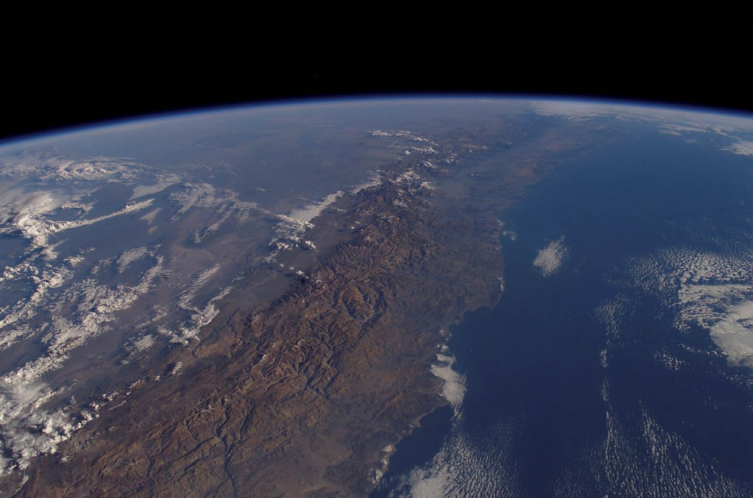
Andes
NASA
Fault-Block Mountains (tectonic activity) – Andes
South America

Slide 19
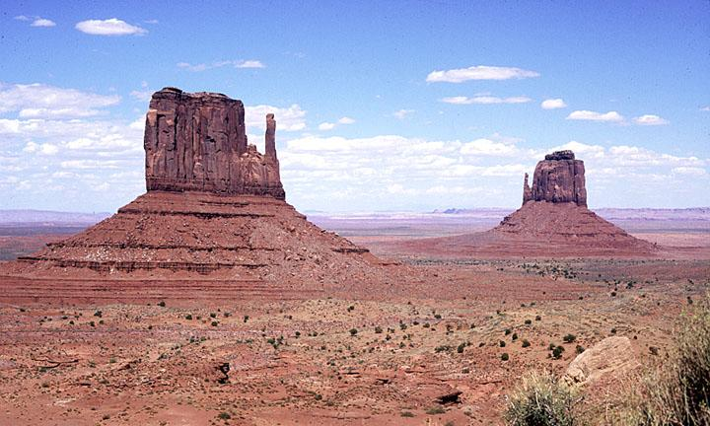
NGS
Erosion – wind - Butte (mesa)
Monument Valley – Utah, USA

Slide 20
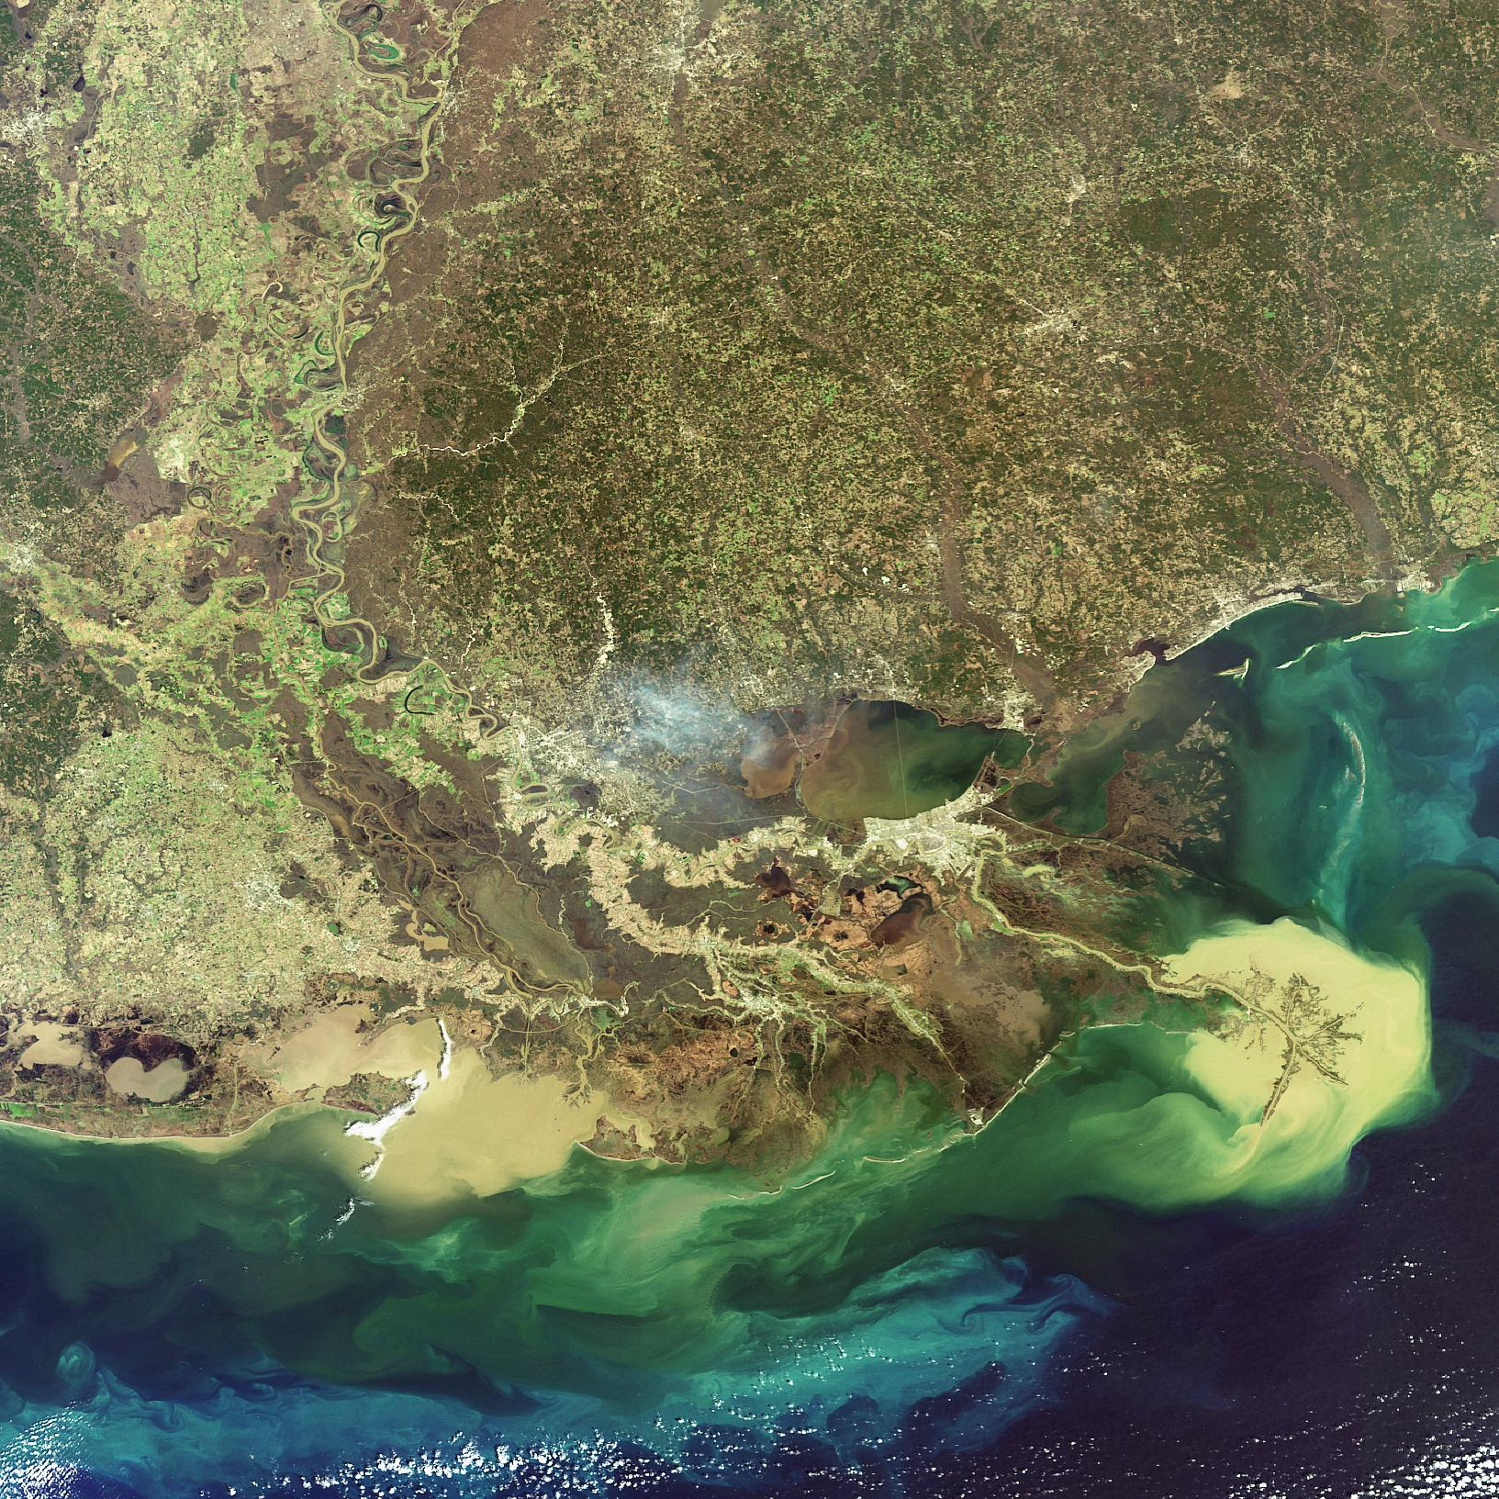
Delta - Deposition – water – Mississippi River Delta – Louisiana - USA
NASA

Slide 21
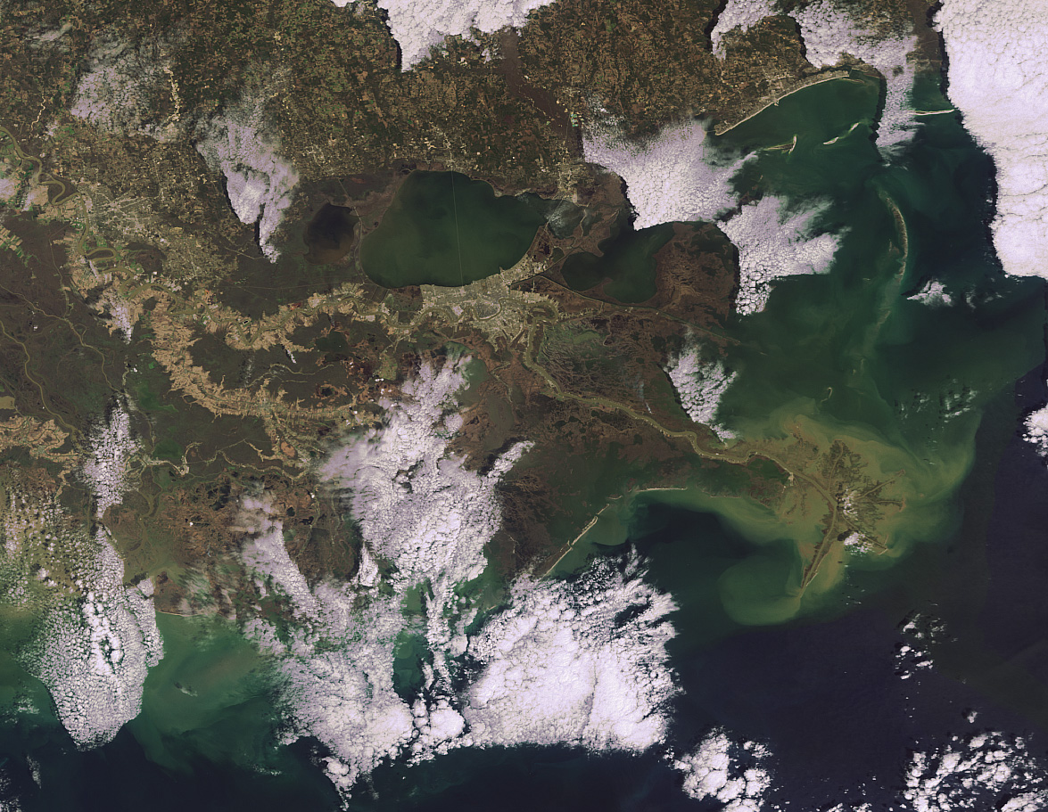
NASA

Slide 22
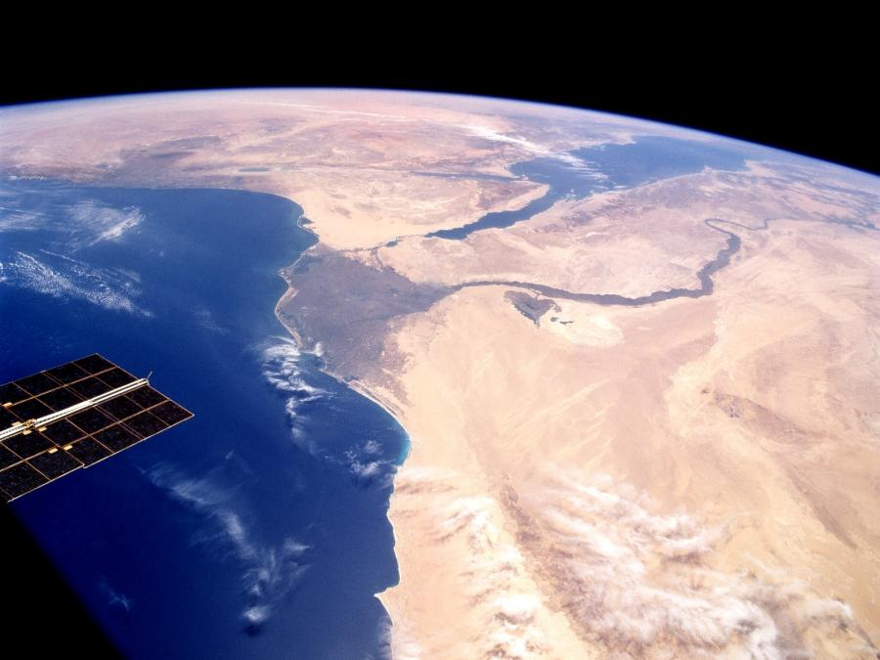
Nile River
Delta - Deposition – water – Nile River Delta – Egypt - Africa
NASA

Slide 23
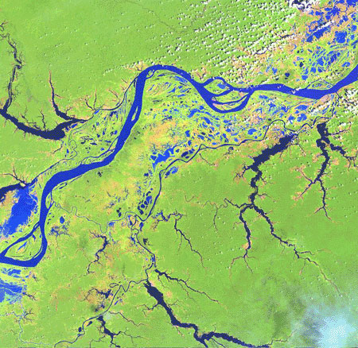
River - Water – Amazon River, Brazil – South America
NASA

Slide 24
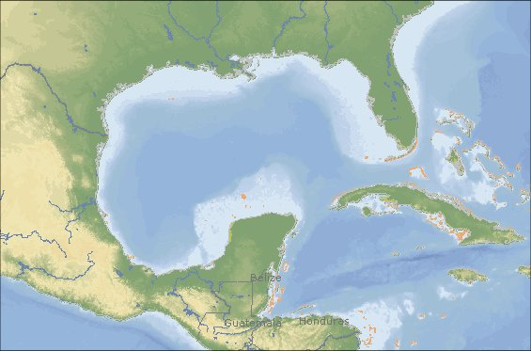
Rand McNally
Gulf – Gulf of Mexico – Western Hemisphere

Slide 25
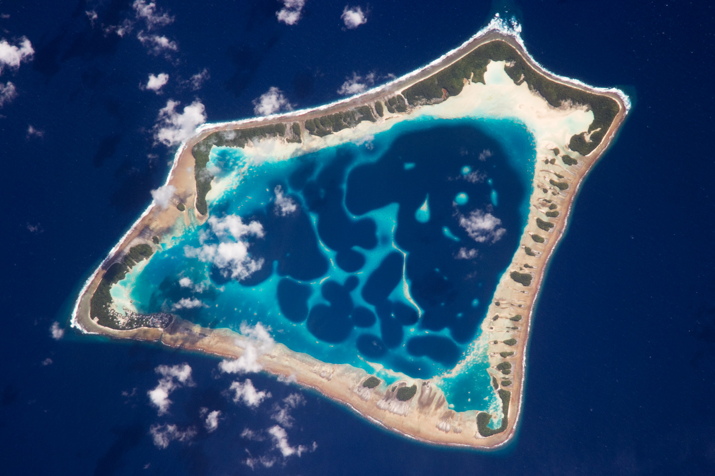
NASA
  Atoll – originally tectonic –volcanic island that sinks.
  Atafu Atoll-Tokelau Islands S. Pacific

Slide 26
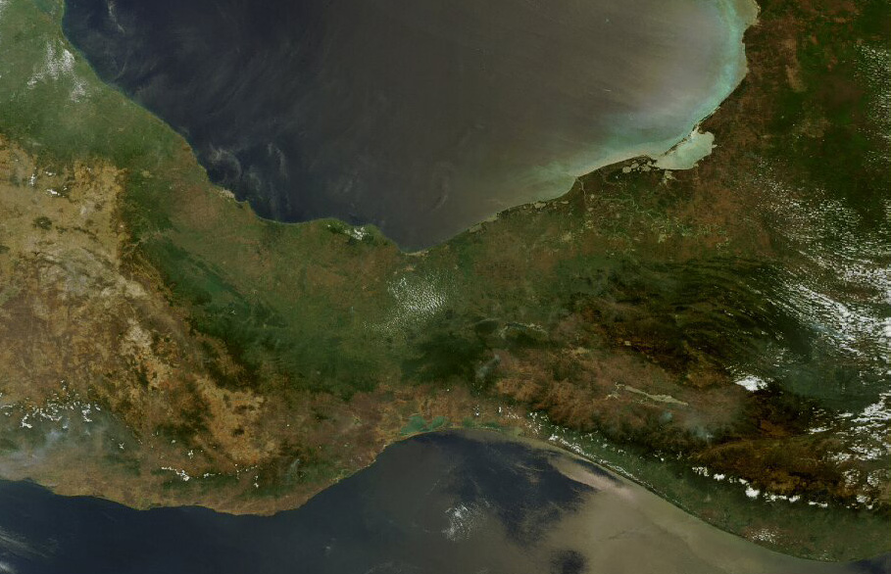
NASA
Isthmus – Gulf of Tehuantepec - Mexico

Slide 27
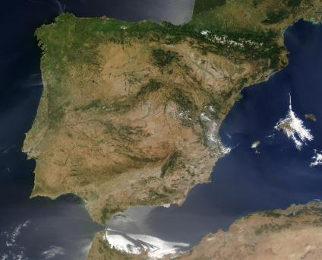
NASA
Peninsula – Iberian - Europe

Slide 28
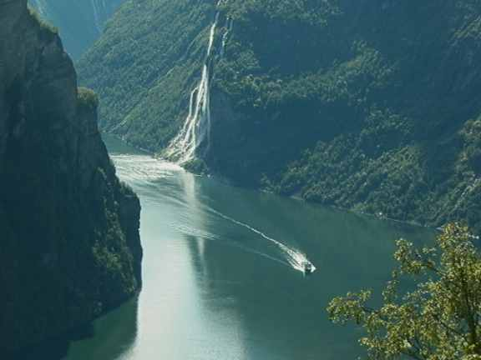
NGS
Fjord - Erosion - Glacial movement (ice)

Slide 29
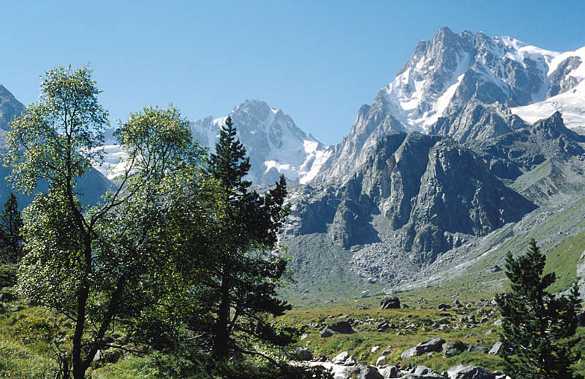
Fault-block Mountains – Tectonic Activity
Sierra Nevada - California

Slide 30
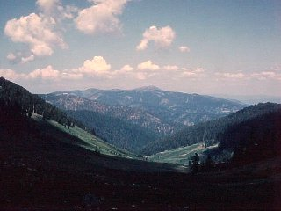
Erosion - Formed by river (water - V shaped valley )
Cirque, Oregon

Slide 31
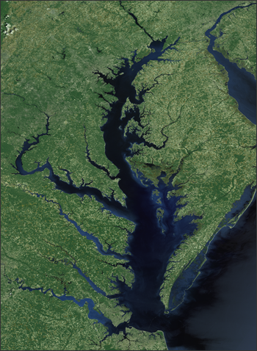
Bay
Chesapeake Bay – East coast United States
NASA

Slide 32
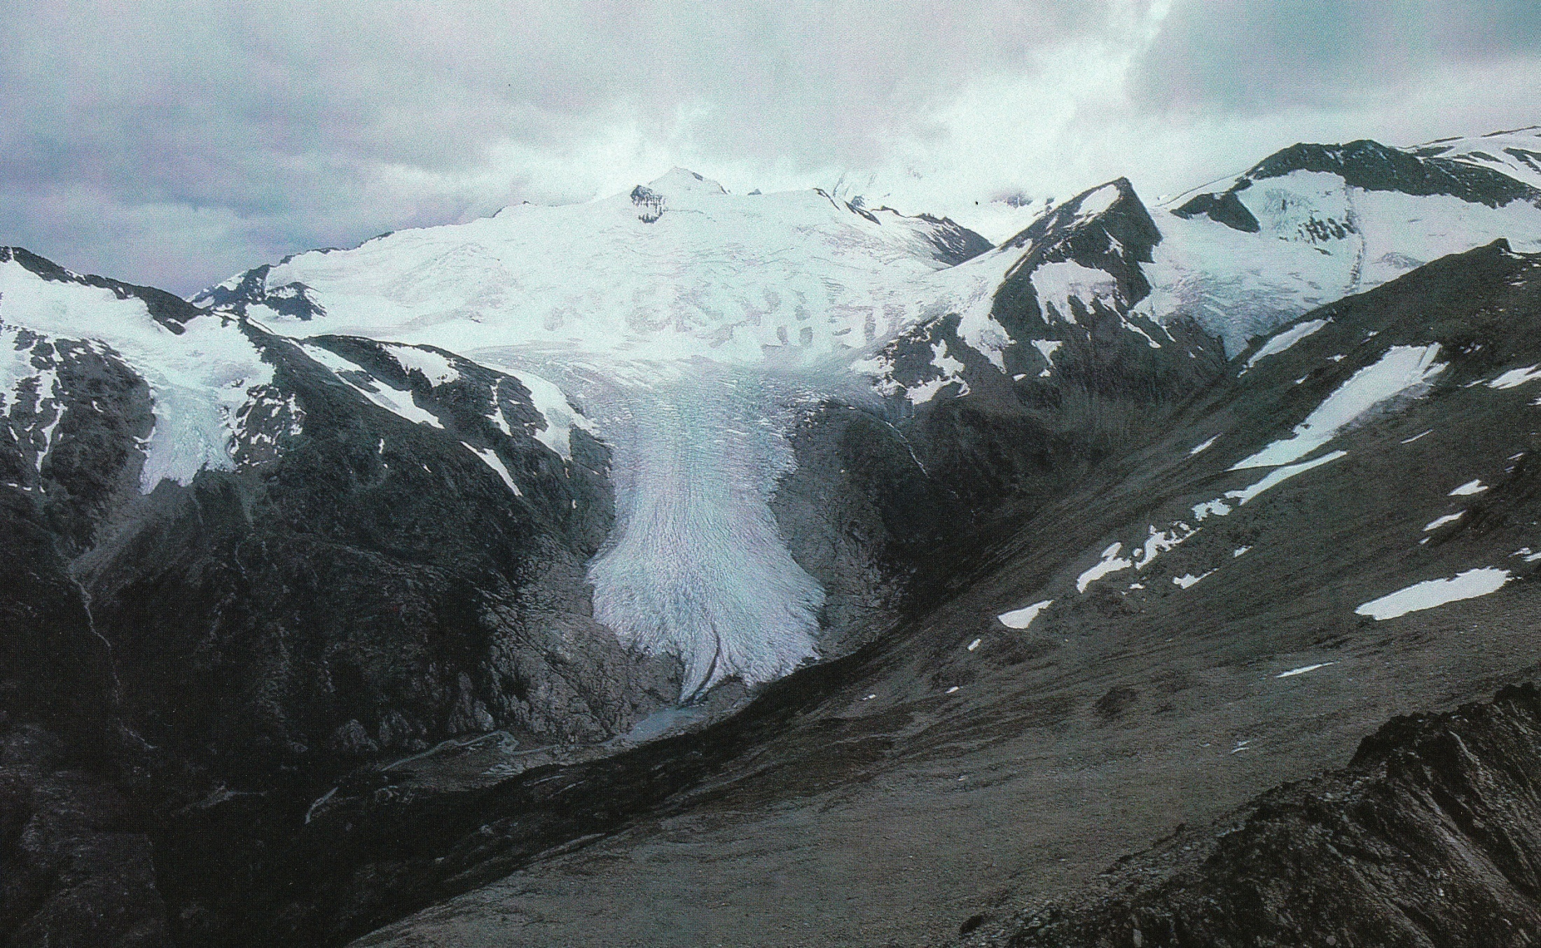
Glacier -Erosion – ice
Tierra del Fuego, Chile
NGS

Slide 33
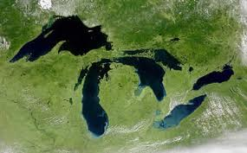
NASA
Glacial movement – Ice - Great Lakes - USA

Slide 34
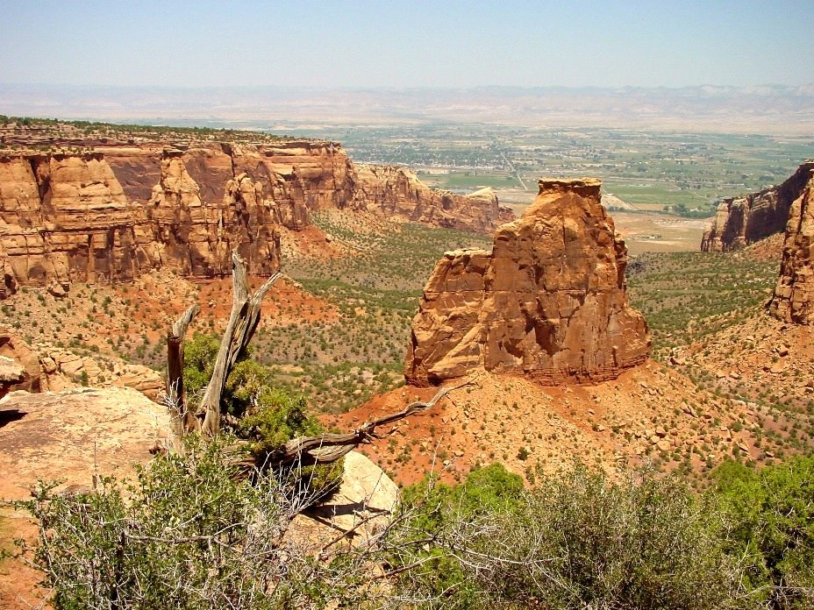
Plateau - Erosion (wind) - Colorado Plateau - USA

Slide 35
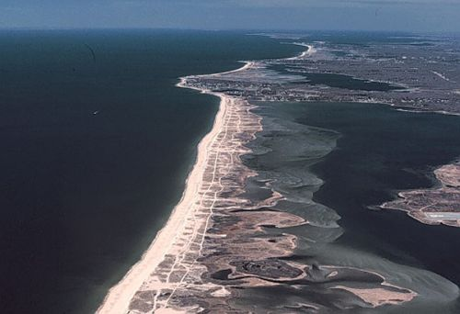
NASA
Barrier Island - Deposition – water

Slide 36
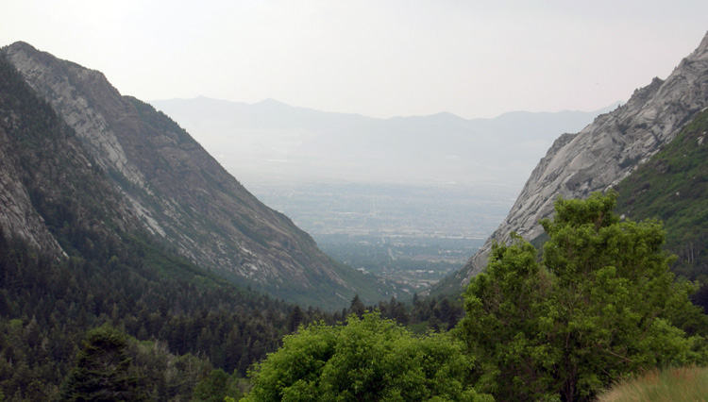
U-shaped valley carved by a glacial erosion,
Little Cottonwood Canyon, Wasatch Mountains, Utah.

