Slide 1
Part II
“We must open the doors of opportunity. But we must also equip our people to walk through those doors.”
Lyndon B. Johnson
Notes:
Title Page

Slide 2
Agenda
Breakfast
Welcome and Introductions
Texas State Information
Campus Tour
Glass-bottom Boat Ride
Equity and Access Office
Athletic Department
Lunch
Campus Resources

Slide 3
At a Glance* Fall 2016
Campus Facts
Main campus is 491 acres, plus over 4,500 off-site acres of ranch land, recreational camp, a research park, and a satellite campus in Round Rock.
Round Rock Campus has 1,821 students enrolled.
There are 1,384 full-time faculty and 2,130 full-time staff.
With enrollment of 38,808 Texas State University is the 5th largest institution of higher education in Texas.
Texas State Enrollment
Undergraduate Post-baccalaureate Masters
Doctoral
Total
34,244
563
3,515
486
38,808
*Provided by Institutional Research: http://www.txstate.edu/ir/

Slide 4
At a Glance* Fall 2016
History
1899—Southwest Texas State Normal School Founded 1903—Opened with 303 students
1923—Southwest State Teacher’s College 1959—Southwest Texas State College 1969—Southwest Texas State University 2003—Texas State University—San Marcos 2013—Present—Texas State University
Student body
35% Hispanic - 11% Black
58% Female - 42% Male
80% Full-time - 20% Part-time
17% On campus residents 96% Texas residents
3% Out-of-state
1% International
69% Financial aid recipients
*Provided by Institutional Research: http://www.txstate.edu/ir/

Slide 5
At a Glance* Fall 2016
Texas State University:
has 98 major fields of undergraduate study; 90 master’s fields; 11 doctoral fields and one professional field.
has an operating budget of over $706 million, of which 38% comes from the State and 45% comes from student tuition and fees. The remainder is made up of self-supporting activities such as room and board and the Bookstore and other sources such as interest (17%). The operating budget does not include gifts, grants and contracts due to their restricted and uncertain nature.
costs a Texas Resident approximately $22,190 annually in tuition/fees, room/board, books/supplies, transportation, personal/miscellaneous expenses based on 15 hours per semester for a student living on campus.
*Provided by Institutional Research: http://www.txstate.edu/ir/

Slide 6
Board of Regents The Texas State University System (Includes: Lamar, Sam Houston State,
Sul Ross State, and Texas State)
President Dr. Denise Trauth
Special Assistant to the President Dr. Vicki Brittain
Student Affairs Dr. Joanne Smith
Finance & Support Services Mr. Eric Algoe
University Advancement Dr. Barbara Breier
Information Technology Mr. Kenneth Pierce
Provost/ Academic Affairs Dr. Gene Bourgeois
Director of Athletics Dr. Larry Teis
University Staff Council
Faculty Senate
Student Government
President’s Cabinet

Slide 7
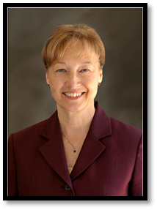
President
Dr. Denise M. Trauth President Texas State University
August 2002 -
Emerging Research University
Federal Hispanic-Serving Institution
University’s largest construction program in 116-year history

Slide 8
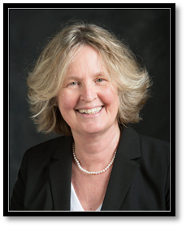
Special Assistant to the President
Dr. Vicki Brittain
Supervises the of Office of Equity and Access
Serves as a Liaison to Director of Athletics
Responsible for support for President’s interactions with:
Board of Regents of the Texas State University System
Chancellor, The Texas State University System
State governmental relations
Internal and external councils and committee

Slide 9
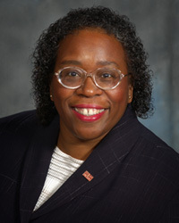
Division of Student Affairs
Dr. Joanne Smith Vice President Student Affairs
Campus Recreation | Career Services | Counseling Center
Dean of Students | Disability Services | Student Diversity and Inclusion
Housing & Res Life | LBJ Student Center | Student Health Center
Student Support Services | University Police

Slide 10
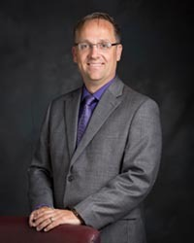
Finance and Support Services
Mr. Eric Algoe Vice President Finance and Support Services
Auxiliary Services | Budgeting, Financial Planning & Analysis | Environmental Health, Safety and Risk Management
Facilities | Financial and Support Services | Human Resources
Planning, Space Management and Real Estate | Transportation Services | Treasurer

Slide 11
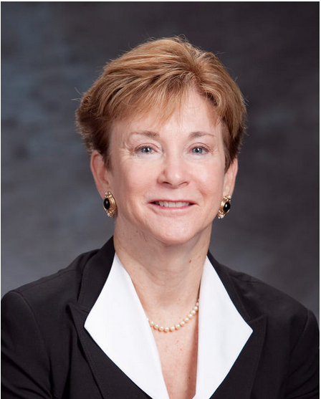
University Advancement
Dr. Barbara Breier Vice President University Advancement
Advancement Services | Endowment Services | Alumni Relations
Annual Giving | Development
Communications

Slide 12
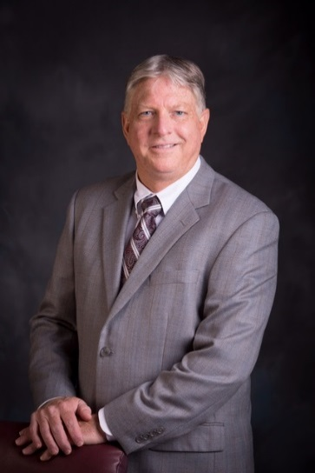
Division of Information Technology
Mr. Kenneth Pierce Vice President Information Technology
University Library | Instructional Technologies Support | Technology Resources

Slide 13
Office of the Provost and Vice President for Academic Affairs
Dr. Gene Bourgeois, Provost and Vice President Academic Affairs
Academic Affairs | Academic Services | Enrollment Management and Marketing
Institutional Effectiveness | Research and Federal Relations | Round Rock Campus

Slide 14
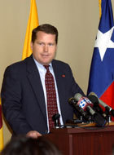
Director of Athletics
Dr. Larry Teis, Director of Athletics
Academic Services | Athletic Training | Community Service
Compliance | Corporate Sponsorships | Licensing and Branding Standards
Sports Information | Strength and Conditioning

Slide 15
Next Up:
Quick Break
Grab bottle of water
Meet bus for campus tour
Glass-bottom boat ride
Option to explore Meadows Center if preferable to boat ride

Slide 16
Texas State University
Office of Equity and Access
Notes:
16

Slide 17
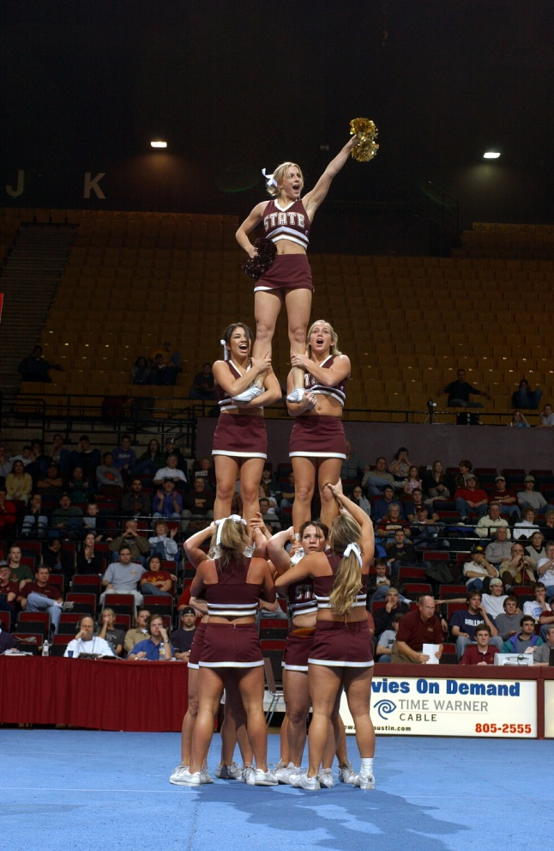
Public, student-centered: focus on students
Emerging Research University: focus on quality
Dedicated to excellence: supportive, safe learning environment
Serving the educational needs of the diverse population of Texas and the world: inclusive, diverse, equitable, fair
Notes:
5 min
Bridge between the mission seen through the diversity lens
Objective: definition of excellence/success = quality and diversity combined
NRU: marsha may have said something about NRU: national research university status requires innovation, hard work, multiple perspectives
Benefits of reaching NRU: image of Tx State is enhanced, educational journey benefits from superior research,

Slide 18
A Message from the Texas State University President, November 10, 2016:
Dear Texas State University Community:
I am aware of reports of action and expression that have occurred on campus following the recent elections in our country. While we encourage individuals in our university community to openly express their thoughts, we expect them to do so with civility and in a collegial manner that reflects Texas State’s core values. These values include:
A diversity of people and ideas, a spirit of inclusiveness, a global perspective, and a sense of community as essential conditions for campus life;
The cultivation of character and the modeling of honesty, integrity, compassion, fairness, respect, and ethical behavior, both in the classroom and beyond; and
Engaged teaching and learning based in dialogue, student involvement, and the free exchange of ideas.

Slide 19
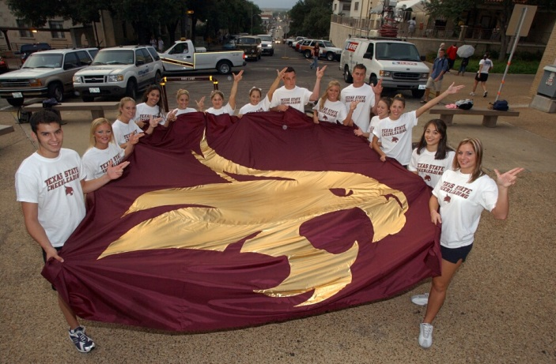
A Quality IDEA!
Quality: high degree of excellence, moving Texas State toward NRU
Inclusion: an organizational cultural trait that values and leverages diverse perspectives
Diversity: the entire range of differences between and among groups
Equity: applying the same treatment to all; fairness
Access: opportunity for entry
Notes:
10 min
Defines A quality idea:
What does quality mean to you?
Examples of inclusion/exclusion?
What are the consequences of exclusion?
How has Central Texas changed related to diversity?
How is Texas State different from where you were?
Equity means fairness….. What are the challenges to treating everyone fairly?
Access: To whom do we provide access? Have you ever heard a story about lack of access?

Slide 20
Texas State University Non-Discrimination Statement
Texas State University is committed to an inclusive education and work environment that provides equal opportunity and access to all qualified persons. Texas State, to the extent not in conflict with federal or state law, prohibits discrimination or harassment on the basis of race, color, national origin, age, sex, religion, disability, veterans’ status, sexual orientation, gender identity or expression.

Slide 21
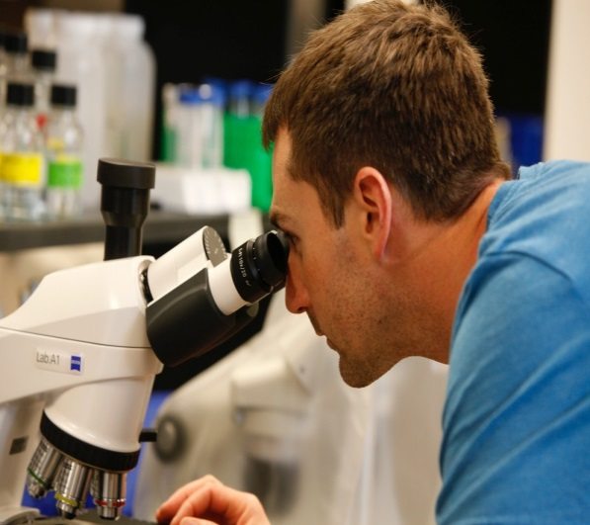
Key Laws
Title VII of the Civil Rights Act of 1964
Prohibits discrimination in employment based on race, color, national origin, sex, and religion.
Equal Pay Act of 1963
Prohibits discrimination in payment of wages or benefits on the bases of sex where men and women perform work of similar skill, effort and responsibility.
Age Discrimination in Employment Act of 1967
Prohibits discrimination in employment based on age against applicants or employees who are 40 years of age or older.
The Americans with Disabilities Act Amendments Act of 2008
Prohibits discrimination in employment based on physical or mental impairment.
Requires the employer to make reasonable workplace accommodations to qualifying individuals.

Slide 22
Key Laws
Title VI of the Civil Rights Act of 1964
Prohibits discrimination based on race, color, or national origin in programs/activities that receive federal funding.
Texas Commission on Human Rights Act
Prohibits employment discrimination based on race, color, disability, religion, sex, national origin, and age.

Slide 23
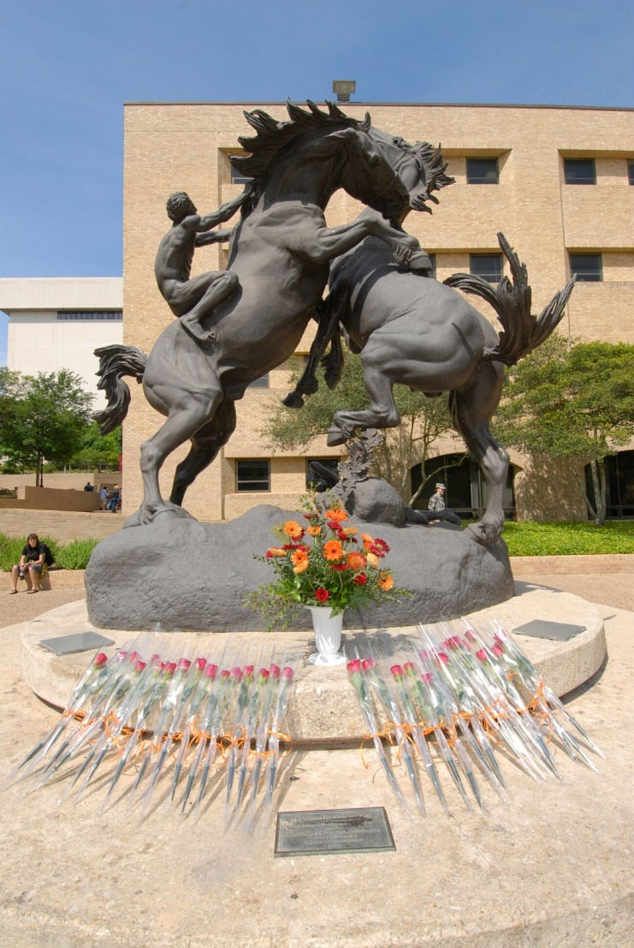
University Policies & Procedures
04.04.46-Prohibition of Discrimination or Harassment
Texas State University System Sexual Misconduct Policy
04.04.60-Workplace Accommodation
Prohibits discrimination against employees with disabilities
Outlines procedures for requesting a reasonable accommodation
04.04.39-Consensual Relationships
Requires disclosure and supervisor to act regarding improprieties or conflict of interest
Notes:
Break after this slide…….

Slide 24
Diversity Skills: Do These……….
Treat all people with respect.
Improve your diversity-related skills, know your own bias.
Get to know your colleagues
Create an environment that supports everyone’s ability to do their best work.
Base employment and educational decisions on performance and knowledge, skills and abilities.
Notes:
10 min
Best way to eliminate discrimination is to treat people with respect.
Use the checklist

Slide 25
Discrimination Prohibition
UPPS 04.04.46, Prohibition of Discrimination or Harassment
Texas State University is committed to an inclusive education and work environment that provides equal opportunity and access to all qualified persons. Texas State, in accordance with applicable federal and state laws and institutional values prohibits discrimination or harassment on the basis of race, color, national origin, age, sex, religion, disability, veterans’ status, sexual orientation, gender identity, or gender expression.
Notes:
Highlight the protected classes
Explain what protected classes: categories

Slide 26
Sexual Misconduct Policy
Relationship Violence
Sexual Assault
Sexual Harassment
Stalking
Sexual Exploitation
Sexual Intimidation
Sexual Misconduct
Notes:
Definitions:

Slide 27
Consent is an informed and freely and affirmatively communicated willingness to participate in a particular sexual activity.
Consent can be expressed either by words or by clear and unambiguous actions, as long as those words or actions create mutually understandable permission regarding the conditions of each instance of sexual activity.
It is the responsibility of the person who wants to engage in the sexual activity to ensure that s/he has the consent of the other to engage in each instance of sexual activity.

Slide 28
Factors to Consider Regarding Consent
Someone who is incapacitated cannot consent
Consent can be withdrawn at any time
Past consent does not imply future consent
Coercion, force, or threat invalidated consent
Being intoxicated or under the influence of alcohol, drugs or other substance is never an excuse for engaging in sexual misconduct.

Slide 29
Reporting Options
Counseling Center
Student Health Center
Texas State University Police Department
San Marcos Police Department
Hays-Caldwell Women’s Center
Attorney for Students
Dr. Gilda Garcia
Title IX Coordinator
Office of Equity and Access
Phone: 512.245.2539
www.txstate.edu/oea
TitleIX@txstate.edu

Slide 30
Texas State faculty and staff are “responsible employees”: technical term meaning reporting responsibilities
Texas State initiative: address sexual misconduct when it occurs, prevent its recurrence, and remedy its effects.
If you see or hear of sexual misconduct, please call the Title IX Coordinator 512.245.2539.
Submit report using the Sexual Misconduct Web line

Slide 31
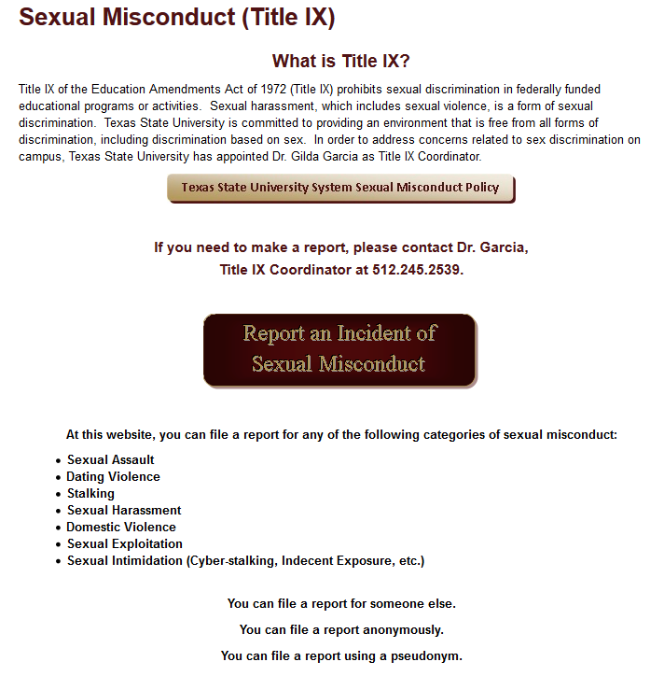
Sexual Misconduct Web line https://tim.txstate.edu/sexualmisconductwebline/

Slide 32
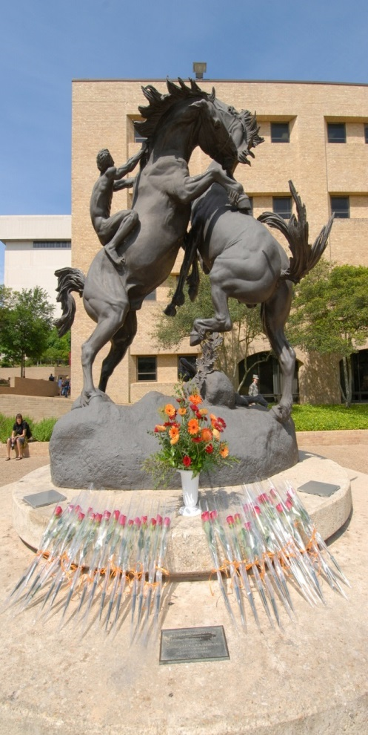
Consensual Relationship Policy
A consensual relationship is a mutually acceptable, romantic, or sexual relationship……
between a University employee with supervisory or teaching authority….
and an employee, student, or student employee who is directly supervised or taught by that employee.
Requirement: report the relationship.
Notes:
So you can see that one source of problems would be the lack of objectivity on the part of the person with the higher authority.
Another source of problems is the power or influence that the person with greater authority as over the other person.

Slide 33
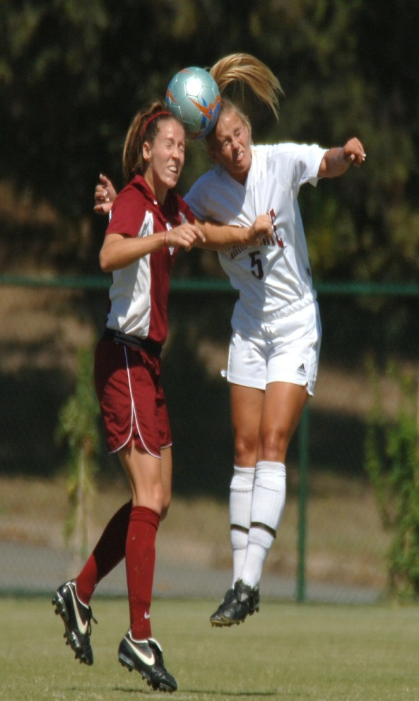
Caution……
Perception of unethical behavior
Perceptions of preferential treatment
Lower morale, bad work or academic environment
Impact on image – yours and the university
Ease of moving from a good relationship to potential sexual harassment complaint
Notes:
Gossip mill, possible violence, bringing personal problems to the work site.

Slide 34
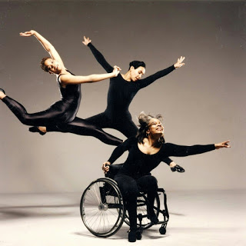
Workplace Accommodations
Texas State University provides reasonable accommodations to support equal access to learning and work success
Examples:
Acquiring or modifying equipment or devices;
Job restructuring;
Part-time or modified work schedules;
Providing readers or interpreters;
Making the workplace accessible to and usable by individuals with disabilities.

Slide 35
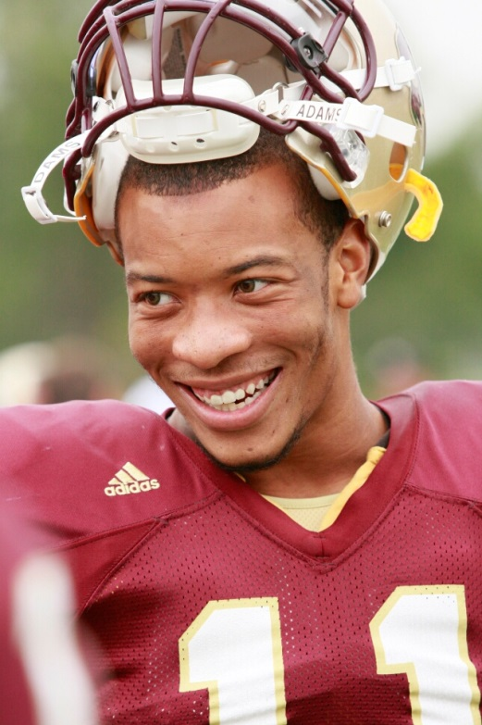
Workplace Accommodations
Dr. Sherri Benn, ADA Coordinator
Multicultural Student Affairs
Suite 5-2.1, LBJ Student Center
512.245.2278
sb17@txstate.edu
http://www.msa.txstate.edu/
Dr. Gilda Garcia
Chief Diversity Officer
Title IX Coordinator
Director, Equity and Access
JCK 840
512-245-2539
gg18@txstate.edu
Mr. John McBride
AVP, Human Resources
JCK 340
512-245-2557
jm05@txstate.edu

Slide 36
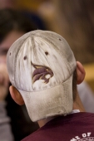
Retaliation
An employer may not fire, demote, harass or otherwise “retaliate” against an individual for filing a charge of discrimination, participating in a discrimination proceeding or otherwise opposing discrimination.

Slide 37
Contact List
Gilda Garcia
gg18@txstate.edu
Melissa Amaya
ms54@txstate.edu
Cynthia Prado
cp01@txstate.edu
Gloria Olivo-Mendoza
gm03@txstate.edu
Julie Eriksen
je36@txstate.edu
JCK 164
www.txstate.edu/oea
512.245.2539
Texas Workforce Commission Civil Rights Division (TWCCRD)
1.888.452.4778
http://www.twc.state.tx.us
Equal Employment Opportunity Commission (EEOC)
1.800.669.4000
http://www.eeoc.gov/
Notes:
37

Slide 38
Yea! We’re done!!

Slide 39
WELCOME TO BOBCAT COUNTRY
Texas State Athletics

Slide 40
OBJECTIVES
Texas State Athletics
Mission
Pride, Traditions & About Athletics
Upcoming/Recent Events
Ways to Get Involved
Benefits for University Employees
Contact Information

Slide 41
MISSION
The Department of Athletics will be nationally recognized as a leader through its commitment to excellence in education and personal development, success in athletic competition, equitable opportunities, and for serving as a stakeholder in university and community pride.
The Department of Athletics provides a competitive, diverse, equitable sports program in compliance with the applicable rules and regulations that creates opportunities for student-athletes to: Earn a degree, Develop into ethical, well-rounded, civic-minded individual and achieve individual athletic potential. The Department of Athletics also strives to achieve, with character and integrity, a winning tradition that engenders: University pride, positive community relations, institutional prestige, and quality sports entertainment The values the Department of Athletics embraces to achieve the mission include: honesty, integrity, loyalty, sportslike conduct and responsibility, as well as equity and respect for all students and staff regardless of ethnicity and/or gender.

Slide 42
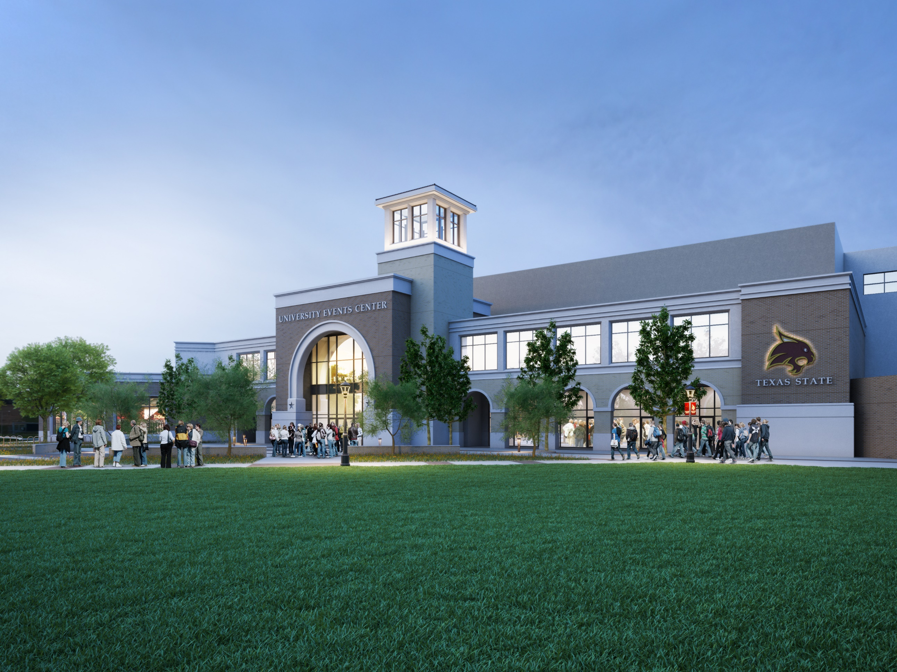

Slide 43
PRIDE & TRADITIONS
Conference: Sun Belt Conference (Football Bowl Subdivision; Division 1-A)
Sports: Texas State Athletics competes in 16 FBS (Division I) NCAA sports
Football, Women’s Volleyball, Women’s Soccer, Basketball (Men’s and Women’s), Baseball, Softball, Women’s Tennis, Golf (Men’s and Women’s), Track and Field (Men’s and Women’s Indoor and Outdoor), Cross Country (Men’s and Women’s)
Traditions:
Eat Em Up, Cats
TXST not TSU
Spirit Fridays

Slide 45
Upcoming Events
Holiday Doubleheader at Strahan Coliseum
Saturday, December 10th
Women at 2:00 PM
Men at 4:00 PM
Santa Claus
Holiday Cookies
Ugly Sweater T-Shirts

Slide 46
Upcoming Events
Next Home Basketball Games
Women’s Basketball
Dec. 19th vs. Sam Houston, 7pm
Dec. 29th vs. Coastal Carolina, 7pm
Dec. 31st vs. App State, 2pm
Men’s Basketball
Dec. 20th vs. Howard Payne, 7pm
Dec. 31st vs. App State, 4:30pm

Slide 47
WAYS TO GET INVOLVED
Basketball Season Tickets: Faculty and staff are eligible for discounts on season tickets for all Texas State sports. Basketball season gets this week!
Bobcat Club Benefits:
Payroll deduction is available for your tax deductible contribution to the Bobcat Club in support of student-athlete scholarships. Membership includes great benefits like reserved parking, prime seating and pre/halftime hospitality options.
Bobcat Kids Club: Kids 3-12 years old are invited to be a member of the Bobcat Kids Club for only $35.

Slide 49
YOUR SOURCE FOR BOBCAT ATHLETICS
Official Web Site: TxStateBobcats.com
Phone Number: 512-245-2114
Email: athletics@txstate.edu
Access to:
Bobcat Merchandise
Online Ticket Center (Shop. Buy. Print.)
News, Scores, Highlights
Bobcat Club Sign Up

Slide 50
CONTACT
Don Coryell
Associate Athletics Director – External Operations
512.245.2220
dc32@txstate.edu
Travis Comer
Associate Athletics Director – Development
512.245.2247
tcomer@txstate.edu
Matt Carson
Assistant Athletics Director – Ticket Sales & Operations
512.245.5448
mcarson@txstate.edu
Josh Whittenburg
Assistant Athletics Director – Development/Bobcat Club
512.245.2210
jwhittenburg@txstate.edu

Slide 51
Higher Education Act of 1965

Slide 52
50th Anniversary Higher Education Act

Slide 53
“The noblest search is the search for excellence.” —Lyndon B. Johnson
Class of 1930
Our Mission Texas State University is a public, student-centered, Emerging Research University dedicated to excellence in serving the educational needs of the diverse population of Texas and the world beyond.
The mission statement was approved by The Texas State University System Board of Regents on August 24, 2012, and the Texas Higher Education Coordinating Board approved the new mission statement for Texas State University at its January 24, 2013, meeting.

Slide 54
Goal 1: Promote academic quality by building and supporting a distinguished faculty.
Goal 2: Provide opportunities for a public university education and contribute to economic and cultural development.
Goal 3: Provide a premier student-centered, educational experience that fosters retention and success.
Goal 4: Enrich our learning and working environment by attracting and supporting a more diverse faculty, staff, and student body.
Goal 5: Develop and manage human, financial, physical, and technological resources effectively, efficiently, and ethically to support the university’s mission.

Slide 55
Texas State University Policies and Procedures Statements
01. Executive Management
02. Academic Administration
03. Fiscal Operations
04. General Administrative Services
05. Logistical Services
06. Community Relations/Public Service
07. Student Services
08. Facilities

Slide 56
Campus Resources

Slide 57
Semester Preview
The Preview link is sent out each semester listing opportunities
for training and development for faculty and staff.
Check with your division on required CEUs per evaluation year.
Academic Development and Assessment
targeted to academic interests:
www.ada.txstate.edu/
Instructional Technologies Support
www.its.txstate.edu/
Technology Resources
www.tr.txstate.edu/training
Professional Development www.txstate.edu/pdevelop/Services

Slide 58
Professional Development
Workshops:
During working hours at no cost to employee or department
For personal and professional development, e.g.,
5 half-days 7 Habits for Highly Effective People
2-day Teambuilding
E-mail sent 3 weeks in advance of workshop
Register on-line through the SAP Portal: https://ibis.sap.txstate.edu:50001/irj/portal
Room Use:
JCK 460
Reservations on-line: www.txstate.edu/pdevelop/Services/reservationinfo.html

Slide 59
Correspondence Courses
Do not need formal admission to Texas State
Can be taken in combination with regular courses
Requires no time away from the office
College Courses—UPPS 04.04.35, Professional Development and Educational Opportunities
Can be taken during lunch or after work hours
Eligible for Class Release Time (paid leave to attend class), cleared with supervisor first
Fees are reimbursed for courses taken with satisfactory completion
Applies to both undergraduate and graduate courses

Slide 60
Other Educational Opportunities
Staff Educational Development Program—UPPS 04.04.35, Professional Development and Educational Opportunities
Work part-time, get paid full-time in order to take several courses and finish degree; coordinated through Professional Development
Awarded from each division each semester
Can earn from 9-12 undergraduate credit hours and 6-9 graduate credit hours per long semester with tuition and fees reimbursed by Texas State after successful completion
After one year of employment
Available to non-grant, full-time staff

Slide 61
Other Educational Opportunities
Continuing Education
Courses offered for fee to on-campus as well as
off-campus individuals
Could be during the working day or on weekend
Not college-accredited courses
Professional development as well as leisure learning
Training & Development
Link on the Texas State homepage: www.txstate.edu/pdevelop/learning-and-development.html
Thirteen offices that offer training and development opportunities to faculty and staff

Slide 62
Campus Opportunities
Charitable Gifts
Texas State University Advancement and Development Foundation:
Annual voluntary fund drive
One-time gift or payroll deduction ($10 minimum)
Designate to scholarships, department programs, membership organizations or general fund (Maroon and Gold Fund)
State Employee Charitable Campaign
Annual campaign statewide

Slide 64
Texas State Acronyms
1. ADA
2. VPFSS
3. FERPA
4. HR
5. UPPS
6. TSUS
7. VPUA
8. VPIT
9. VPSA
10. LBJSC
11. ULP
12. PACE
13. ITAC
14. FMLA
15. RRC

Slide 65
1. ADA | Americans with Disabilities Act
2. VPFSS | Vice President, Finance and Support Services
3. FERPA | Family Educational Rights & Privacy Act
4. HR | Human Resources
5. UPPS | University Policy & Procedure Statement
6. TSUS | Texas State University System
7. VPUA | Vice President, University Advancement
8. VPIT | Vice President, Information Technology
9. VPSA | Vice President, Student Affairs
10. LBJSC | Lyndon Baines Johnson Student Center
11. ULP | University Longevity Program
12. PACE | Personalized Academic & Career Exploration
13. ITAC | IT Assistance Center
14. FMLA | Family & Medical Leave Act
15. RRC | Round Rock Campus

Slide 66
Reminders
Please give us your comments on the evaluation form. Leave on your table.
Please leave your name tag and place card with edits if necessary.
Verification of 9.5 hours NEW credit will be documented in the SAP Portal.
Human Resources Office (JCK 360) is available at any time to answer any hold-over questions from NEW I.
Can we assist you in distribution of your office’s information to new employees?

Slide 67
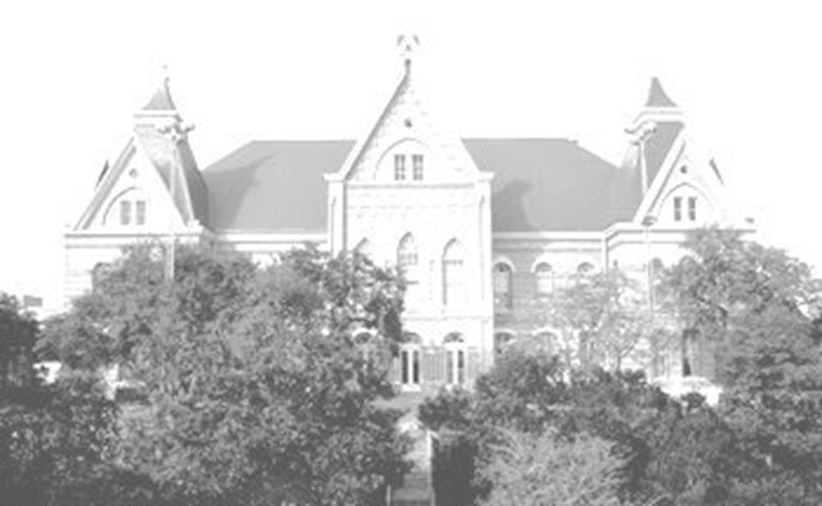
Welcome to Texas State

