Slide 1

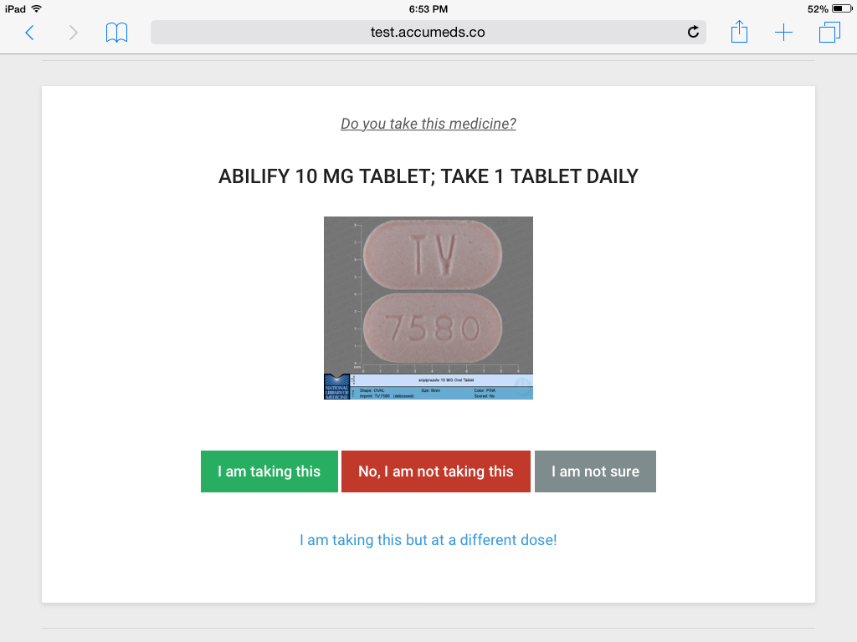
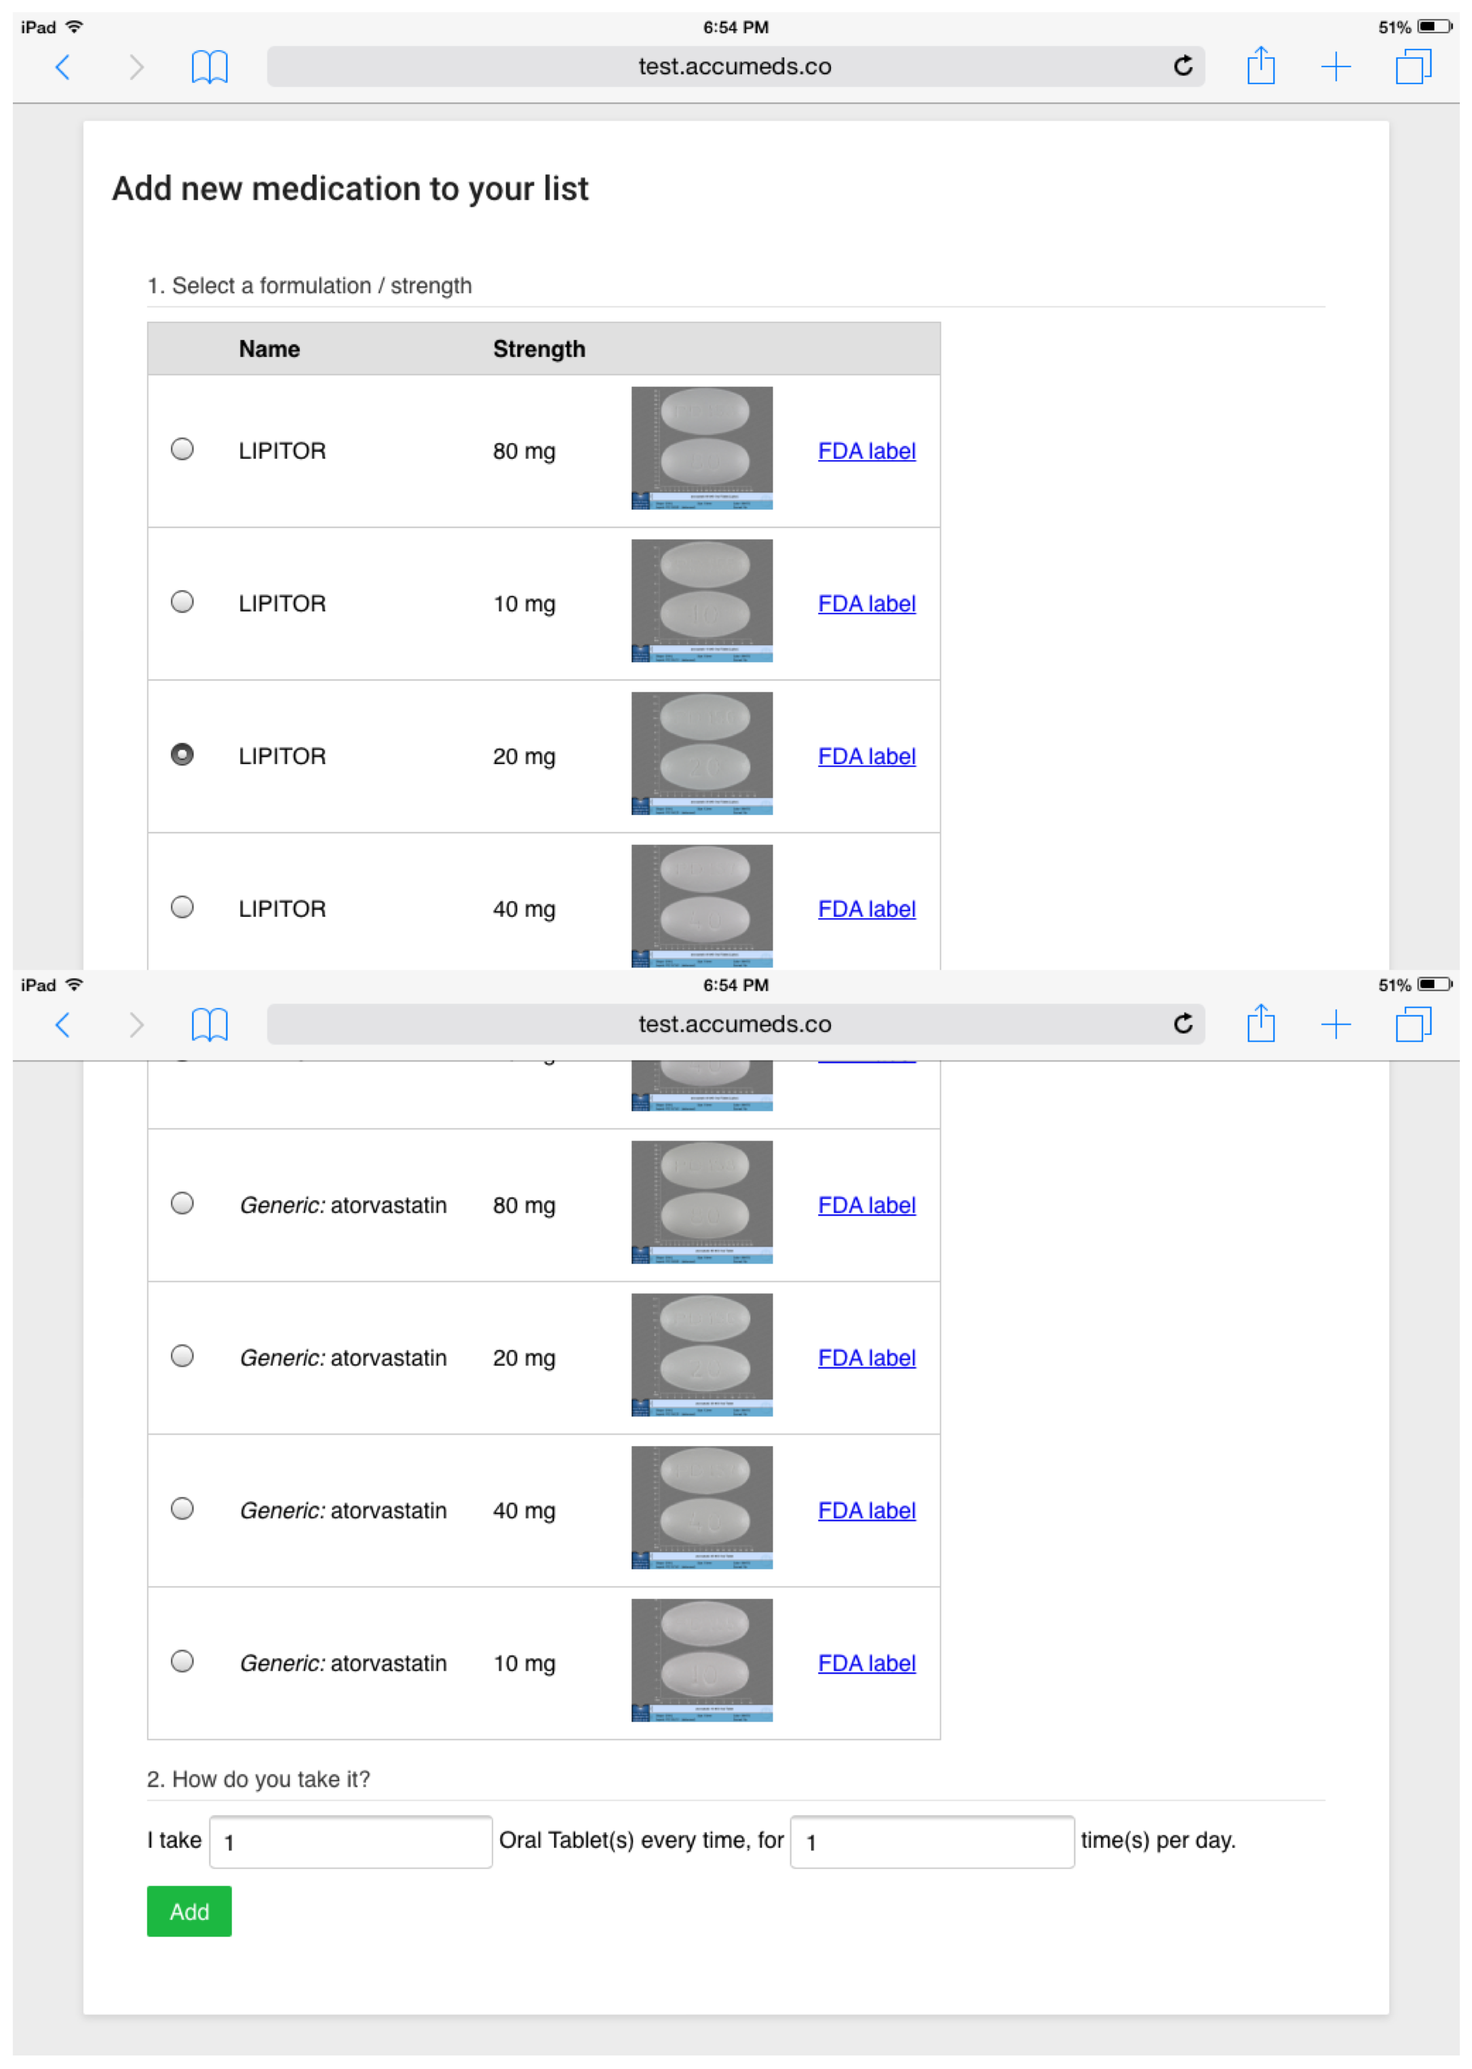
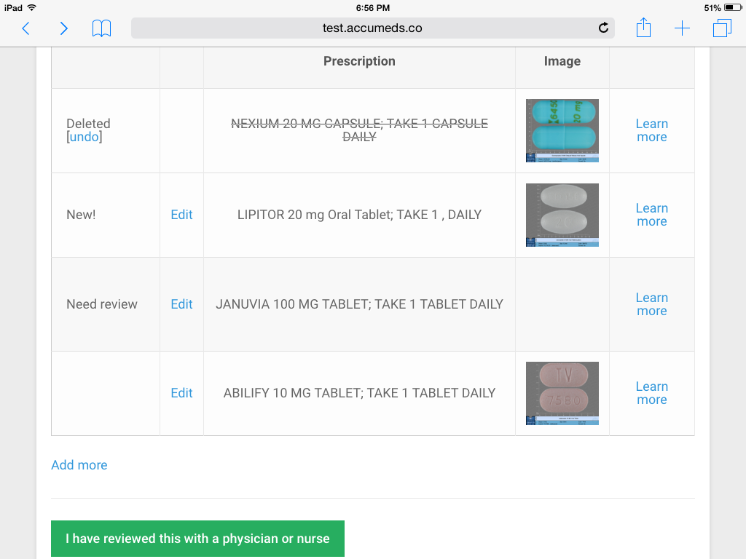
An Observational Study to Evaluate the Usability and Intent to Adopt of an Artificial
Intelligence-powered Medication Reconciliation Tool
Template for a 48”x36” poster
Presenter name, Associates and Collaborators
Department of XXXXXXXXXXXXXXXX, College of XXXXXXXXXXXXXXXXXX, University of Illinois at Urbana-Champaign
Ju Long, PhD, Michael Yuan, PhD, Robina Poonawala, MD
Department of CISQM, McCoy College of Business Administration, Texas State University
Background
Medication reconciliation is a widely practiced procedure to reduce medication errors. It is mandated by Joint Commission, and reimbursed by Medicare. Yet, in practice, medication reconciliation is often not effective due to knowledge gaps in the team. A promising approach to improve medication reconciliation is to incorporate Artificial Intelligence decision support tools into the process to engage patients and bridge the knowledge gap.
Objective
We aim to improve the accuracy and efficiency of medication reconciliation by engaging the patient, the nurse, and the physician as a team via an iPad tool. With assistance from the Artificial Intelligence agent, the patient will review her own medication list from the EMR, and annotate changes, before reviewing together with the physician and making decisions on the shared iPad screen.
Methods
We developed iPad-based software tools, with Artificial Intelligence decision support, to engage patients to “self-service” medication reconciliation, and then share the annotated reconciled list with the physician. To evaluate the software tool’s user interface and workflow, we recruited a small number of patients (10) in a primary care clinic, and observed them through the whole process during a pilot study. The patients are surveyed for the tool’s usability afterwards.
Results
All patients were able to complete the medication reconciliation process correctly. Every patient found at least one error or other issues with their EMR medication lists. All reported the tool easy to use, and 8 out of 10 patients reported that they will use the tool in the future. However, few patients interacted with the learning modules in the tool. The physician and nurses reported the tool to be easy to use, easy to integrate into existing workflow, and potentially time saving.
Conclusions
We have developed a promising tool for a new approach to medication reconciliation. It has the potential to create more accurate medication lists faster, while better informing the patients about their medications and reducing burden on clinicians.
Introduction
Medication error is a major contributor to preventable Adverse Drug Events (ADEs), which cause more than 3.5 million physician office visits, an estimated 1 million emergency department visits, and approximately 125,000 hospital admissions each year. The national cost of ADEs is estimated to be $3.5 billion dollars every year.
Medication reconciliation is an intervention designed to reduce medication errors and ADEs. It is a process of creating the most accurate list possible of all medications a patient is taking -- including drug name, dosage, frequency, and route -- and comparing that list against the existing medication list in the patient record.
Multi-disciplinary team-based medication reconciliation approaches tend to work best. For example, a study showed a reduction of medication discrepancy from 89% to 49% by involving everyone, including patient, front desk staff, nurse, and physician, in the medication reconciliation process
A promising approach is to engage patients and supplement clinical knowledge using Artificial Intelligence (AI) based electronic systems. The AI system can guide the patient to review his own medication lists and then to flag potential issues for the physician to review. For instance, the AI can understand hundreds of non-standard abbreviations in handwritten prescriptions, and can discern medications with multiple names that could confuse even expert clinicians. It is shown that computerized systems have the capability to process medication terminologies.
The technology solution could also facilitate patient education by automatically showing the medication indications, side effects, prices, and other relevant information to patients. Such information is crucial for patients to make informed decisions on their medications. It could also flag potential discrepancies and prompt the patient to ask the clinicians in the care team to explain.
A portable AI-powered decision support tool can not only help the patient identify and manage medications, but also enable better team work, since everyone can review the information on the screen together. Incorporating patients in the medical decision making process could result in increased patient’s commitment and understanding of treatment plans, improved adherence, and increased patient satisfaction
Method
Intervention
It takes a team approach to organize its workflow: The patient provides information on his up-to-date medication use, and flags medications that he wants to discuss. The clinicians review the list together with the patient to determine what the most accurate list is. During the shared-screen review process, the clinicians can answer patient questions about each medication, and provide an opportunity to adjust certain medications to address patient concerns such as cost and side effects.
The use of AI assistance
The intervention tool utilizes AI in three ways. First, it contains a machine learning (ML) module to recognize and parse prescription instructions written in natural language. The module is trained on over 2000 real-world prescription records from Electronic Medical Records (EMRs) and achieved an error rate of less than 2%.
Second, the tool aggregates multiple medication databases from NIH, FDA, and commercial vendors to figure out equivalent or conflicting prescriptions in its medication reconciliation algorithm.
Finally, the tool can converse with the patient to go through the medication review process. The conversation is semi-structured and rule-based.
Results
Observational Study
To evaluate the usability of the solution, we conducted an observational study in a South Austin Family Practice clinic. We followed and observed 10 patients with complex medications over a span of 2 days. We examined whether they were able to complete the core medication reconciliation tasks on the tablet device, and structured the observation using a software usability heuristic checklist.
The 10 patients have a combined 92 active medications prior to the appointment. After review they changed 26 medication records, representing 28% of the total records. 10 out of 10 patients changed at least one medication record.
Usability
On the scale from 1 to 7 (7 being the most easy-to-use), the patients rated the tool a 6.5 -- very easy to use. The user satisfaction score for the tool is 6.0 out of 7. Patients strongly agreed that the tool is a good idea (score 6.5 out of 7).
Intent for Future Adoption
The patients showed strong interests in using the tool for future medical visits. 9 out of 10 patients answered YES to the question about whether they will use the tool again in this clinic. 8 out of 10 patients answered they will use it in a different clinic. However, only 5 out of 10 patients would use the app to manage medications at home. We believe this reflects the user’s perception of limited utility for medication management at home without professional help nearby.
Figure 1. Review a medication from the patient’s list.
Conclusion
The tablet-based medication reconciliation tool in medical clinic is well accepted by patients and clinicians. The AI component facilitated the patients themselves to recognize their own medications and report discrepancies for the clinicians to review. It has potentials to improve medication accuracy and reduce medication errors in the clinic.
Figure 2. The process to add a medication to the list.
Figure 3. The reconciled medication list. This is the “shared screen” the patient and clinician can work together to make and approve medication changes.

