Slide 1
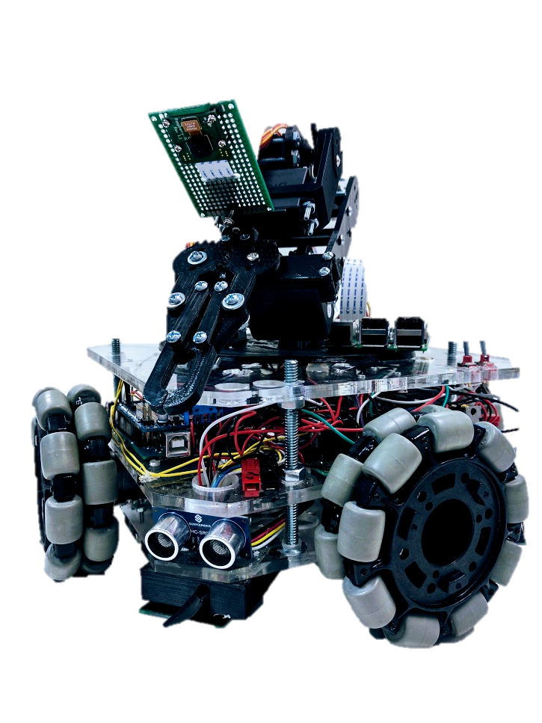
IEEE ROBOTICS
Sponsored By: Texas State IEEE Chapter
Sponsor: Dr. Larry Larson
Faculty Advisor: Dr. Bill Stapleton
Notes:
PM starts presentation. Everyone speaks. You decide who goes when.

Slide 2
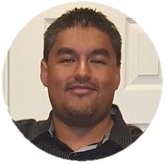
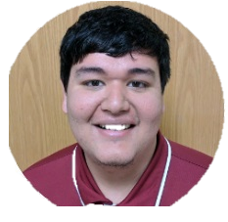
Team Members
NAME | ROLE & RESPONSIBILITIES | PHOTO
Eric Foote | PM, System Design, Physical Design, Power Distribution Infrastructure, 3D Printing, Movement
Jorge Villalobos | Feedback Display, Robotic Arm
David Vasquez | Communication Network, Movement, Sensor Algorithms, General Programming
Geovanni Hernandez | Computer Vision System, Raspberry Pi

Slide 3
Project Overview
Project designed to prepare students for the type of thinking involved in more complex robotics projects
Original plan involved creating/incorporating sensors, multi-microcontroller communication network, precision motor control, computer vision, automation algorithms, feedback display
The robot was designed to complete several tasks.
Navigate a flat surface using four wheels.
Use Robotic Arm to grasp small objects.
Camera using computer vision to get visual feedback.
Notes:
Give a brief overview of your project, like a very concise executive summary.

Slide 4
Project Motivation
There are many situations that are undesirable, too dangerous, or impossible for humans to be in. These situations include:
Environments compromised by dangerous chemical, biological, or toxic substances
Environments that might contain explosive materials
Environments too small for humans to navigate
Notes:
David, what are some existing samples of things that robots are used for?

Slide 5
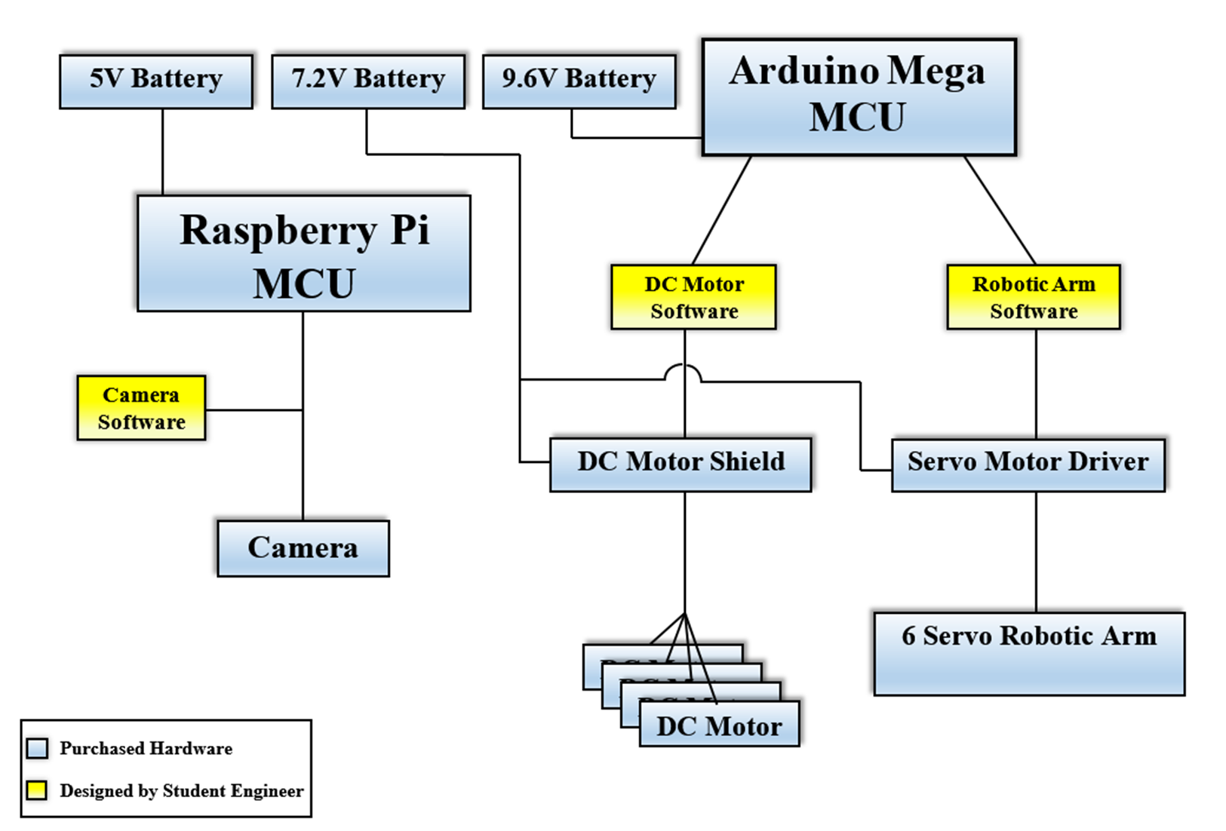
Top-Level System Diagram
Notes:
EVERYONE

Slide 6
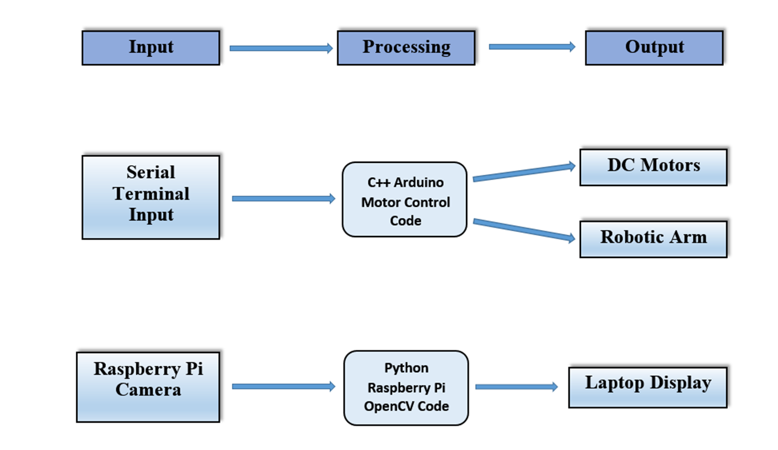
Design Block Diagram
Notes:
Eric

Slide 7
Results
Functionality | Result
Serial Input Movement Control | Successful.
Wireless Wi-Fi Movement Control | Due to time constraints, unsuccessful.
Robotic Arm Control | Successful.
Camera Vision | Successful.
Sensor Implementation | Unsuccessful
Automation | Unsuccessful
Feedback Display | Unsuccessful
Notes:
David

Slide 8
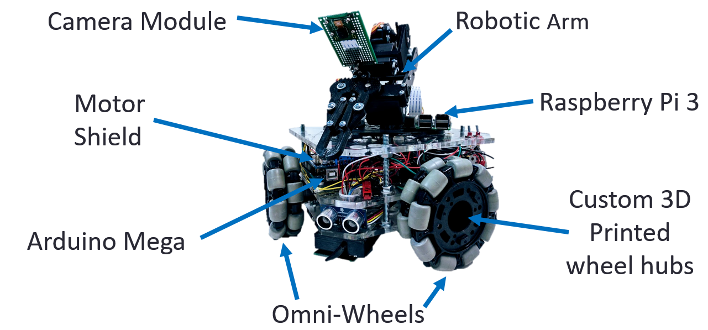
Results
Notes:
DAvid

Slide 9
Future Work
Design autonomous navigation system
Implement Wi-Fi navigation control
Implement precise Proportional Integral Derivative motor control
Implement visual feedback from computer vision system to control the robotic arm.
Incorporate sensors to detect harmful substances
Include a visual display system for potential users
Notes:
Geovanni

Slide 10
Our Sponsors
IEEE advisor Dr. Lawrence Larson
Intermediate contact with IEEE
Technical Advisor: Dr. Bill Stapleton
Provided team with technical support
Knowledgeable in robotics
Notes:
Talk briefly to how the Sponsoring company is involved – part of their business / research / outreach? Why are they interested? Say what they did/provided for you. Be brief!!
Geovanni’s Slide

