Slide 1

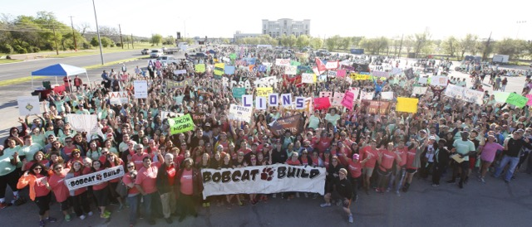
Jobsite Leader
Orientation
April 2nd, 2016 - Bobcat Stadium West Parking Lot- 9:00AM

Slide 2

Its HUGE
4,500 volunteers and 250 jobsites… it’s all possible because of you!

Slide 3
Sneak Peak
Bobcat Build purpose
Packet Paper Overview
Tool Distribution Process
Helpful Hints
Schedule
Review Handout
Questions?

Slide 4

What’s the Purpose?
Redefining perceptions of college students through social responsibility
A way to say “Thank You!” to San Marcos for hosting us
An opportunity to focus on the needs of the areas around Texas State
Building relationships between the Texas State community and the citizens of San Marcos
Started 14 years ago by a group of students

Slide 5
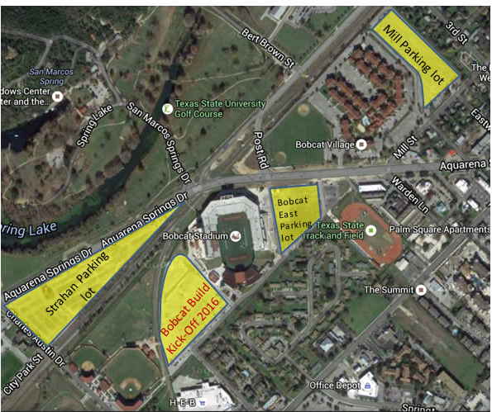
PARKING: CAR POOL AS MANY PEOPLE AS POSSIBLE -SAFLELY

Slide 6
Kick Off Location
ADD OPERATIONS PHOTO WHEN COMPLETE
HEB

Slide 7
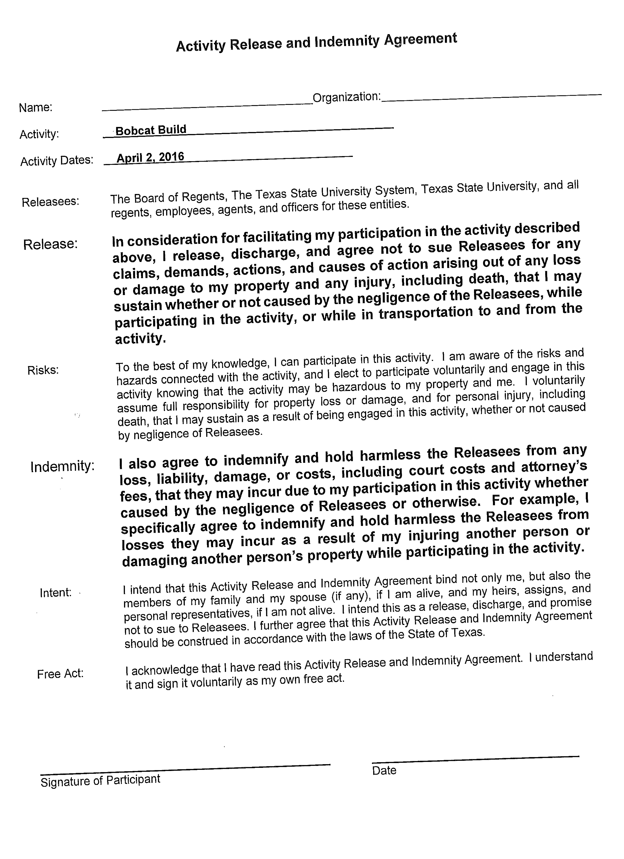
Packet Overview - Forms
Contact Info. Sheet and FAQ’s
  Bobcat Build Hotline
Participant Waiver
  EACH student you registered on your team should fill this out prior to event
  You will present your team’s waivers at check-in
  Only hard copies are accepted
Notes:
*****WE NEED A HARD COPY OF THE WAIVER. NO PHOTO OF WAIVER ALLOWED, RIGHT????****

Slide 8
Helpful Hints for NOW
CHECK YOUR EMAIL – your confirmation email with Jobsite Information will be sent this week; PRINT OR SCREEN SHOT FROM YOUR PHONE and present this at check-in
Please be in contact with everyone working on your jobsite to set up how you will meet on the day of
BE EXCITED!!!

Slide 9
Helpful Hints for NOW
Please contact your jobsite to introduce yourself and let them know you are excited to see them on April 2nd
Ask the Jobsite owner about how you should go about when parking...
  Ask if it will be an easy access or if there will be any restrictions around the site- such as a gate code or multiple houses on one property
  Consider carpooling to both kickoff and jobsite!
Please remind the rest of the people in your group! It is your responsibility to keep them accountable!
Remember: YOU are the only point of contact between your group and the jobsite leader

Slide 10
Packet Overview - FAQ
  More than 1 Jobsite Leader?
    All jobsite leaders have to check in their group and present the signed indemnity forms, student ID, and email confirmation
    The first jobsite leader to check-in will receive the Tool Card
  Parking?
    You can park your car at Strahan Parking Lot, Mill Street, or Bobcat East Parking Lot
  Tools?
    Present your tool card to the front table of the tool tent to receive your tools.
  Can I go home before 2:00?
    You cannot go home before 2pm unless the job is done AND the homeowners say its okay.
    If there are many tasks, prioritize on what you can get done in the time!

Slide 11
Check in process (April 2nd DAY OF!!!)
  Must present: EMAIL CONFIRMATION, TXST ID, & STUDENT WAIVERS
    This will be exchanged for:
    Homeowner Evaluation
    Copy of the Jobsite Evaluation Form
    Tool Card (Only 1 Jobsite Leader per jobsite will receive this)
  Look for table with your designated JOBSITE NUMBER
  ONLY Jobsite Leaders should check in
    When receiving the Tool Card, it will be given to the first Jobsite Leader to check in for that site

Slide 12
Tool Distribution Process
Only 1 Jobsite Leader per site will receive the Tool Card
Only this Jobsite Leader should go to the Tool Tent to pick up tools
This Jobsite Leader is responsible for the returning all of the tools
Tools must be back by 2:30pm
**OUR TOOLS WILL HAVE A BOBCAT BUILD STICKER AND/OR SPRAY PAINT ON THEM

Slide 13
Helpful Hints for Day-Of
Be on time (check-in begins at 8:00AM)
Make or bring a sign/banner for your organization!
  This is one way to gather the big organization groups
Wear appropriate clothes and shoes to work
  Close toed shoes
  BE SURE TO CALL THE JOBSITE OWNER FOR SPECIFICS!!!!
Know where your jobsite is (find directions before the day of)
Bring a truck for tools! (if possible)
Call your jobsite when you are on your way
Bobcat attitudes (positivity, hard-working, attentive, etc.)!
If people don’t show up – let us know immediately!!

Slide 14


Safety Tips
Absolutely NO power tools (including power lawn mowers)
Wear sunblock
If it looks or feels dangerous, don’t do it!!

Slide 15
Schedule for April 2nd
7:30 AM: Gates will be open
8:00 AM: Check-in for Jobsite Leaders begins
8:30 AM: Music, dancing, shirts, food, MEMORIES!
9:00 AM: KICK-OFF w/ Special Guests
9:15 AM: Group Photo
9:30 AM: Jobsite Leaders pick-up tools at Tool Tent
10:00 AM: By this time, all jobsite teams should have arrived at their jobsites

Slide 16

REVIEW TIME

Slide 17




Student Planning Committee
Student Organization
  Join the Planning Committee (Fall 2016)
www.bobcatbuild.txstate.edu

Slide 18
Social Media
Twitter: Follow @BobcatBuild
Facebook: “Like” Bobcat Build
Instagram: Follow @Bobcatbuild
Tag your posts to:
#BobcatBuild16 #TXST

Slide 19
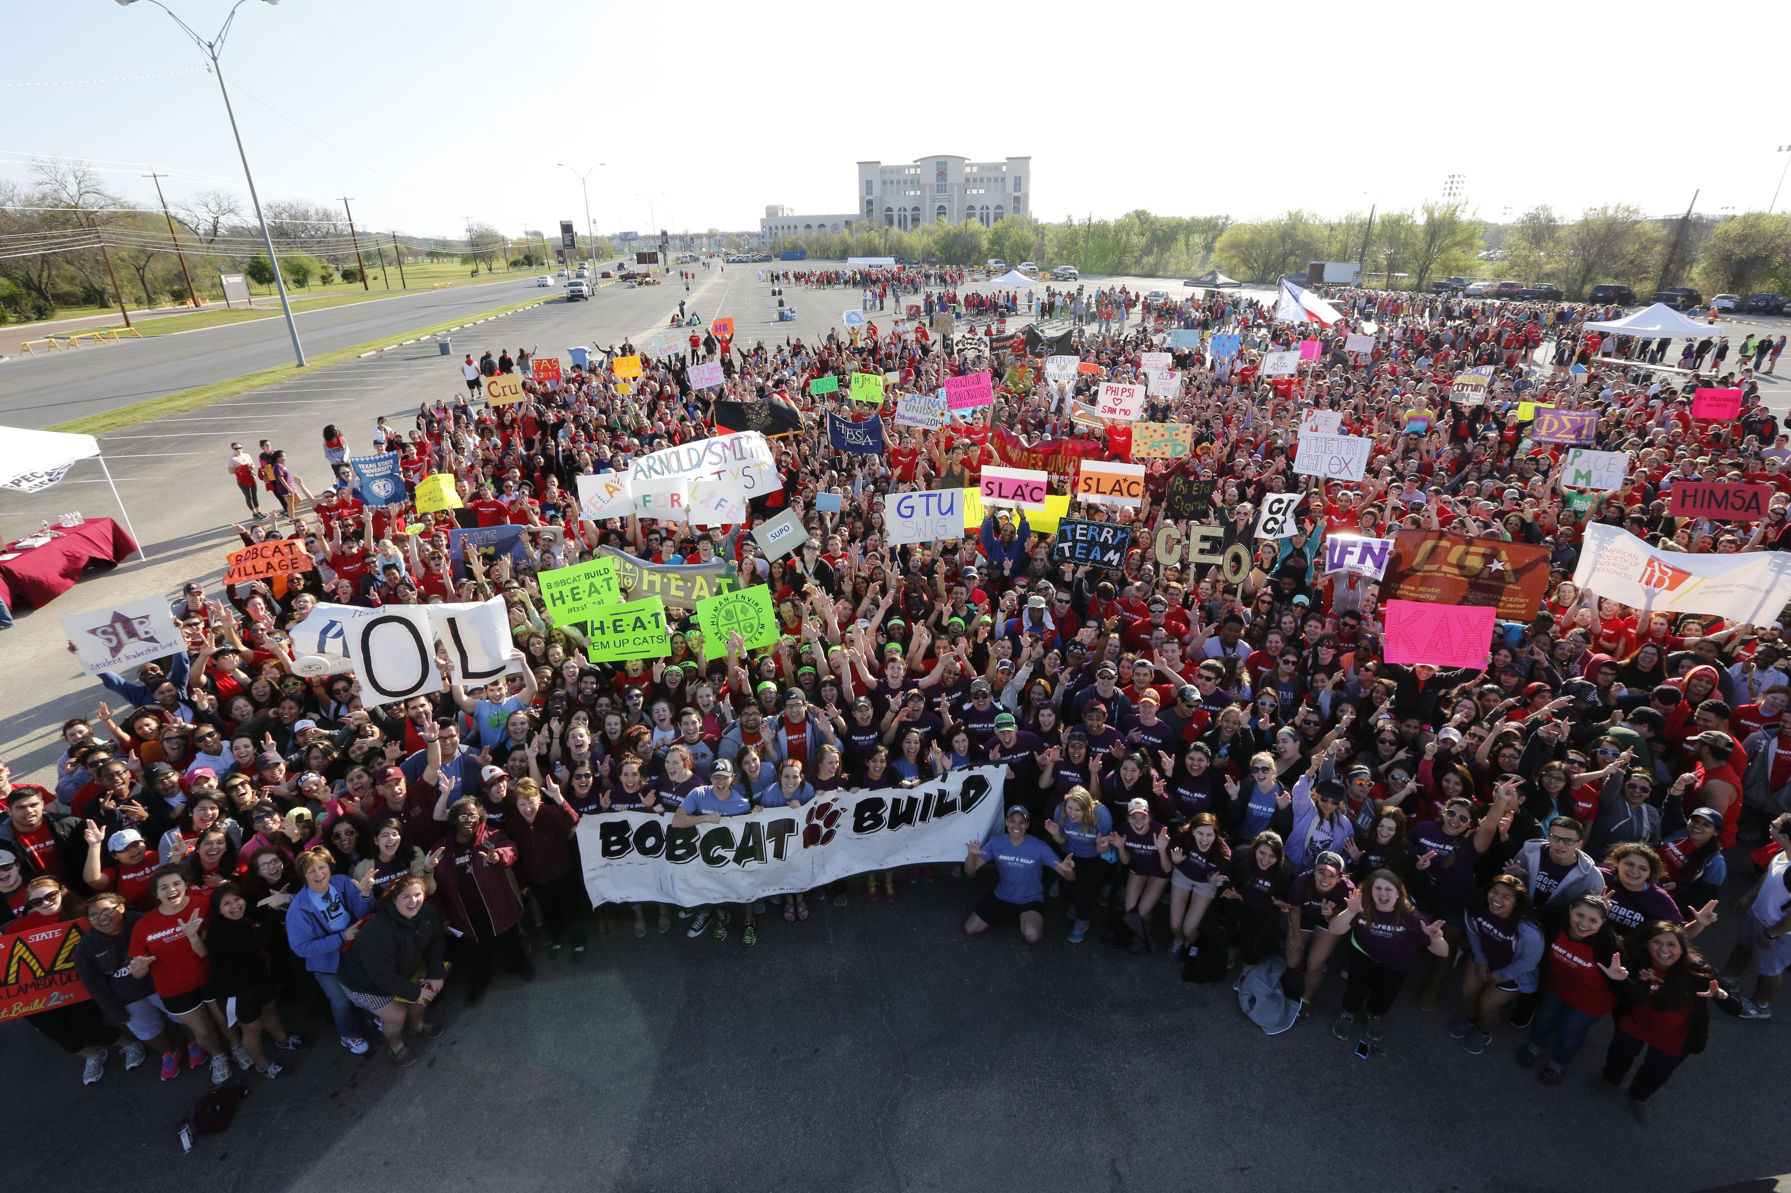
Any Questions?

