Slide 1
Pain Management: Arts-Based Therapies To Reduce Dependencies On Pain Medication
Team HOPE – Hope of Overcoming Pain Effectively
Nico Schüler (Music)
Shuying Sun (Statistics)
Ruth Taylor (Marketing, Craft Therapy)
Kaipeng Wang (Social Work)

Slide 2
Problem
100 million Americans & $600 Billion / year
15,000 deaths in 2010
12 million Americans – pain medications for non-medical purposes without prescription
5,500 people a day abuse prescription pain meds for the first time
Sales of Opioid Pain Relievers (OPR) quadrupled between 1999-2010: enough OPR prescribed per year to medicate every American adult for one month
Nonmedical use of prescription painkillers costs health insurers up to $72.5 billion annually
Notes:
100 million Americans suffer from Chronic Pain at a cost of $600 Billion per year in medical treatments and lost productivity

Slide 3
Why Arts-Based Therapy?
Anecdotal evidence exists, but very little empirical evidence
Few peer-reviewed studies use randomized controlled trials
Great need for low-cost, non-pharmaceutical therapy to a large population
Benefits of arts-based therapy
Not overly physically straining
Allows for creating art work and diversion from pain
Express their pain artistically
Release their stress and pain
Notes:
Arts also help with depression and anxiety, which usually go along with chronic pain

Slide 4
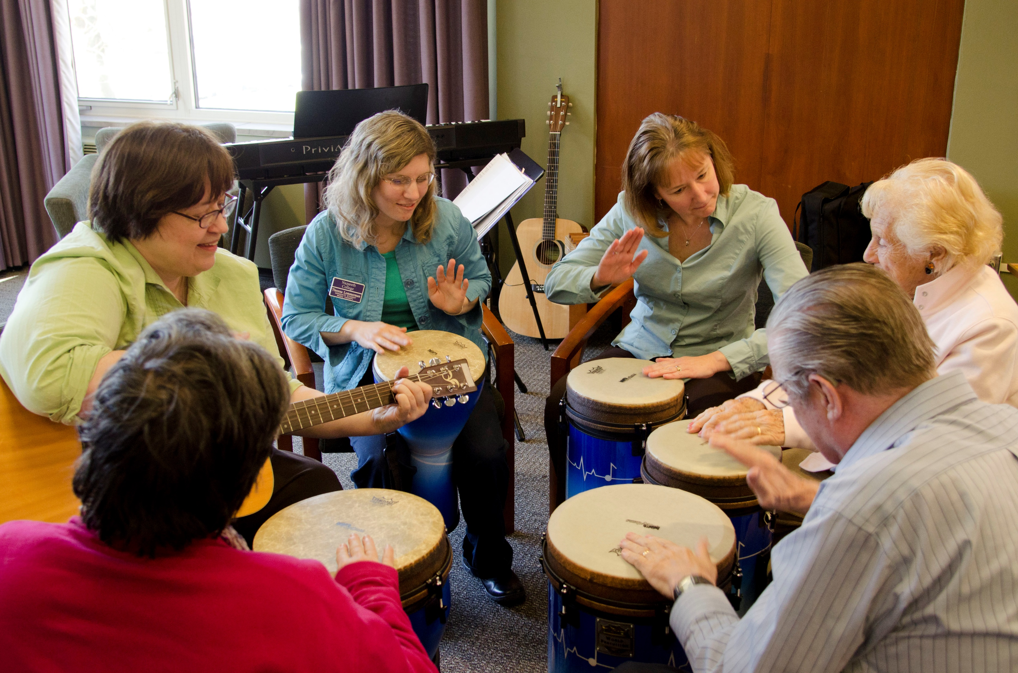
Scope of Pilot Study
Chronic Pain, regardless of pain source
Arts-based therapy to supplement existing therapy
Elements:
Music Listening
Elements Music Therapy, particularly with Orff instruments
Elements of Art Therapy, particularly drawing / painting
Music & Movement (Dalcroze-based)
Education about medication overuse and pain medication reduction

Slide 5
Goals
Develop arts-based therapy curricula that
Lower pain medication intake
Increase quality of life
Team up with Health Care Provider(s) in Central Texas
Teach participants arts-based therapy
Self-managed therapy path
Measure the effectiveness of arts-based therapy

Slide 6
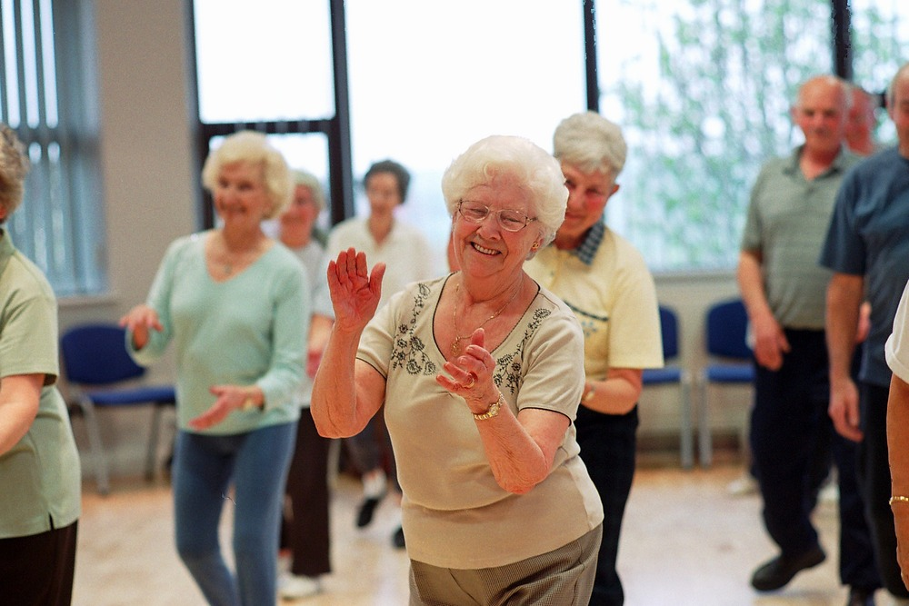
Assessment Methods
Variables to measure/assess:
(1) Anxiety
(2) Depression
(3) Type and Amount of Pain Medication Intake
(5) Perceived Pain-Level
(6) Quality of Life
When to measure: before and after treatment, at different phases / stages of treatment
Statistical analysis: Chi-square test and paired t-test

Slide 7
Timeline
Fall 2017
Seek seed funding ($10,000)
Literature study (continued)
Add team members (health professional, art, movement, . . .)
Detailed planning / design of the project
Team up with Health Care Provider
REP
Spring 2018
Curriculum development & training of therapist(s)
MIRG grant
Summer & Fall 2018
Conduct Pilot Study
Spring 2019
Data Analysis & Write-up of scholarly article
External grants

Slide 8
Grant Opportunities
Internal Grants:
REP (Fall 2017)
MIRG (Spring 2018)
External Grants:
Peer Reviewed Medical Research Program (PRMRP) - Clinical Trial Award https://pivot.cos.com/funding_opps/113216
Peer Reviewed Medical Research Program (PRMRP) - Technology/Therapeutic Development Award https://pivot.cos.com/funding_opps/113215
Future Leaders in Pain Research Grants Program https://pivot.cos.com/funding_opps/130800
Research on Chronic Overlapping Pain Conditions https://pivot.cos.com/funding_opps/152733

Slide 9
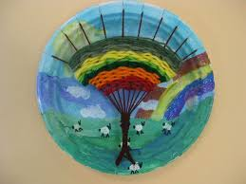
Future Streams of Research
Focus on opioid pain meds dependencies only
Develop smart phone App
Publish video tutorials
Include other nontraditional therapy methods
Focus on lowering readmission rates to health care providers

Slide 10
Select References
Nan, J. K., & Ho, R. T. (2017). Effects of clay art therapy on adults outpatients with major depressive disorder: A randomized controlled trial. Journal of Affective Disorders, 217, 237-245.
Kim, K. S., Loring, S., & Kwekkeboom, K. (2017). Use of Art-Making Intervention for Pain and Quality of Life Among Cancer Patients: A Systematic Review. Journal of Holistic Nursing, 0898010117726633.
Bailey, L. M. (1986). Music therapy in pain management. Journal of Pain and Symptom Management, 1(1), 25-28.
Gatchel, R. J., Turk, D. C., Cohen, L. L., Stack, C. M., & Maclaren, J. E. (2004). Pain Management in the 21st Century. Psyccritiques, 49.
Trauger-Querry, B., & Haghighi, K. R. (1999). Balancing the focus: art and music therapy for pain control and symptom management in hospice care. Hospice Journal.
Centers for Disease Control and Prevention (CDC. (2013). Vital signs: overdoses of prescription opioid pain relievers and other drugs among women--United States, 1999-2010. MMWR. Morbidity and mortality weekly report, 62(26), 537.

Slide 11
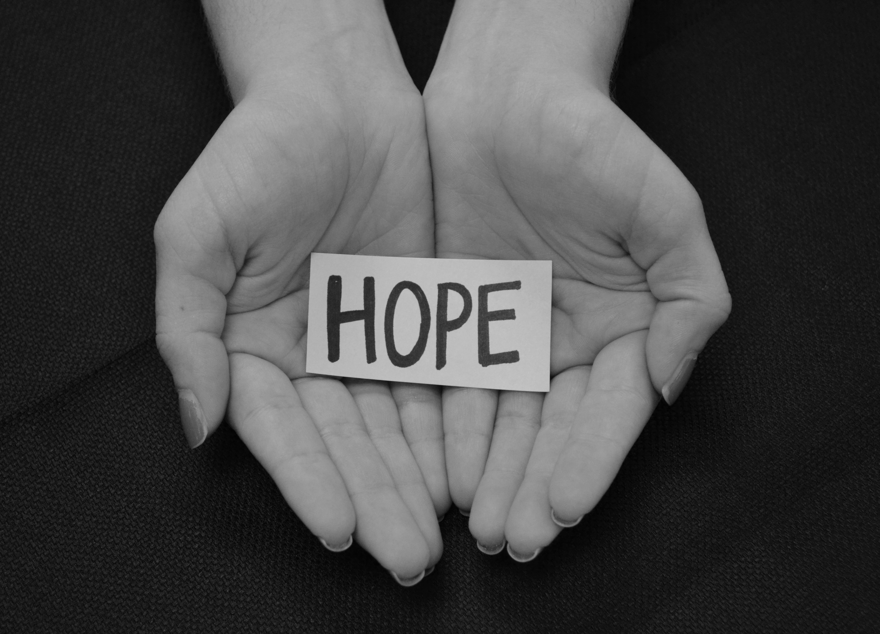
Thank you from Team HOPE!

