Slide 1
OPT Optional Practical Training
International Student and Scholar Services (ISSS)
Texas State University

Slide 2
Types of OPt
Pre-Completion
Post-Completion
STEM OPT Extension

Slide 3
Pre-Completion OPT
Temporary
Part-time while school in session
Work Authorization
Benefit
For F-1 students in a bachelor's, master's, or doctoral program to gain practical experience prior to the student’s program end date.

Slide 4
Post-Completion OPT
Temporary
Full-time
Work Authorization
Benefit
For F-1 students in a bachelor's, master's, or doctoral program to gain practical experience after completion of all course requirements for the degree (excluding thesis or equivalent)

Slide 5
Stem opt extension
24-month extension for STEM degree students
Full-time
Work Authorization
Benefit
For F-1 students in post-completion OPT with a STEM degree.

Slide 6
What is OPT? Optional Practical Training
F-1 students apply to USCIS for temporary employment authorization for 12 months.
Students in STEM designated degrees can apply for a 24-month extension known as STEM OPT.
OPT employment must directly relate to their major area of study.
Refer to the STEM list on USCIS website:
www.ice.gov/sites/default/files/documents/Document/2016/stem-list.pdf

Slide 7
Legal Advice and ISSS advising Statement of Understanding
International Student and Scholar Services (ISSS) offers best practice information on temporary employment authorization such as Optional Practical Training (OPT) and STEM OPT Extension as a courtesy to international students under a Texas State University issued Form I-20.
You may choose to compile and submit your application for temporary employment authorization on your own and inform ISSS accordingly through email.
Please note that all information provided is not considered legal advice.

Slide 8
WHY OPT?
Participating in OPT is an excellent way to demonstrate and expand the skills and knowledge you learned, in the classroom, in a place of work.
Think about the following:
Why should an employer hire you?
What skills and knowledge do you have that sets you apart?
What contributions can you offer to your future employer?
What are your goals for OPT?

Slide 9
ELIGIBILITY FOR OPT
Consecutive enrollment full-time (UG 12hrs/ GRAD 9hrs) for one full academic year.
Full-time enrollment, every fall and spring semester. If you are not enrolled full-time submit an RCL.
Lawfully maintained and currently in active F-1 status.
Ineligible if completed12 months of full-time Curricular Practical Training (CPT).
You must complete OPT within a 14-month period following the completion of study (date of graduation).

Slide 10
OPT for Thesis/dissertation students
A student who only has the thesis or equivalent remaining may either apply for pre-completion OPT or post-completion OPT while completing the thesis/dissertation.

Slide 11
OPT Application Overview
Applications Start
September
February
May
Graduation
December
May
August
Applications End
February
July
October
Fixed End Date
February
July
October
GRADUATION DATE
14-Months later
(fixed ED)
ED
(12 months from SD)
90-days before
SD
60-days after
14-Month Rule: 12 months of OPT must be completed within 14 months from the graduation date, regardless of the start date.
5-month Application Window
SD – Start Date: Must be between Graduate Date and 60 days after graduation date
ED – End Date: 12 months from SD but no later than 14 months from graduation date
APPLY EARLY due to 5-month USCIS processing time!

Slide 12
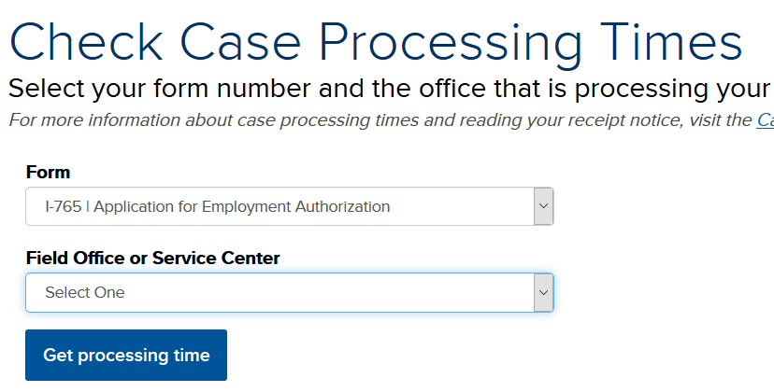
USCIS Processing Time
Check I-765 Processing Time: egov.uscis.gov/processing-times/
Up to 5 months for processing time
USCIS will not do a case inquiry until after the standard processing time

Slide 13
USCIS Application Process
Submit documents online for a DSO review.
DSO enters OPT request in your SEVIS record.
ISSS prepares your OPT application packet
(pick up or request documents to be mailed to you)
Student reviews documents and submits application to USCIS.
Receipt Notice
Pending
Approval Notice
EAD Processing
EAD Card Delivered
Receipt Notice
Approval Letter
EAD Card
Check USCIS processing time: egov.uscis.gov/processing-times

Slide 14
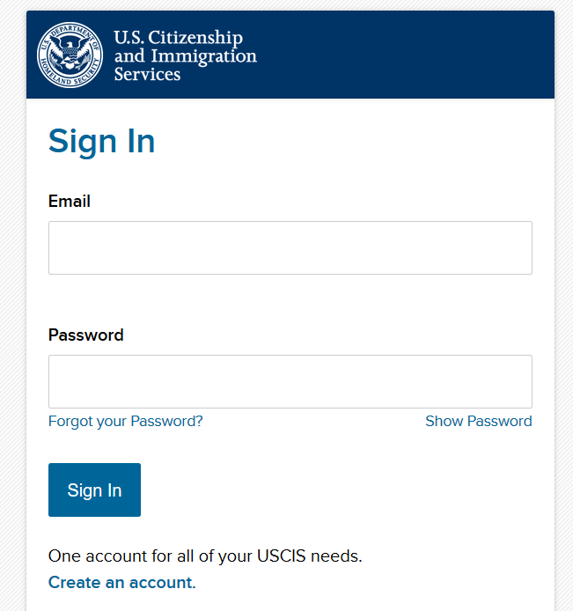
April 26 2021 – F-1 Students Seeking Optional Practical Training Can Now File Form I-765 Online
Submit their forms;
Pay their fees;
Track the status of their case;
Communicate with USCIS through a secure inbox; and
Respond to Requests for Evidence.
https://myaccount.uscis.gov/

Slide 15
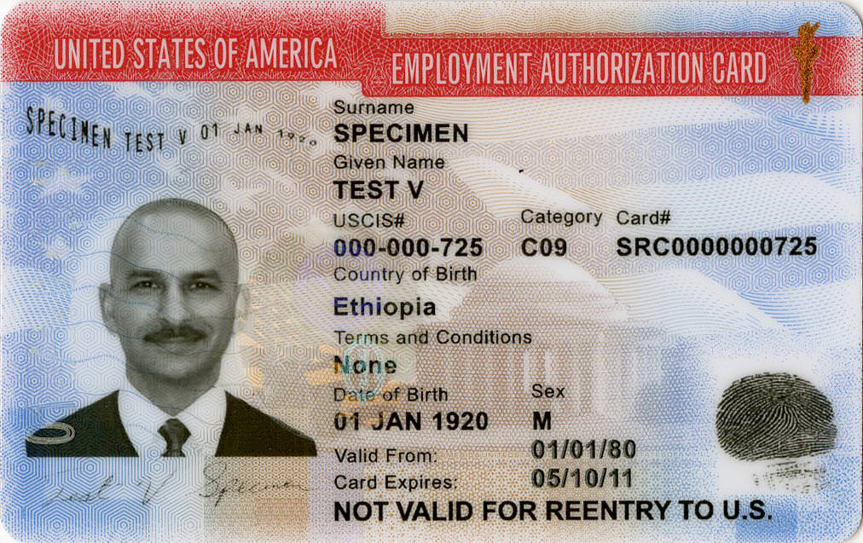
Employment Authorization Document EAD Card
Can only work between
Valid From (start date)
Card Expires (end date)
Must renew if lost
Must renew if applying for STEM OPT
Used when traveling into the US
Must have valid passport, F-1 visa, and I-20 with a travel signature

Slide 16
When & How to Apply for OPT https://www.international.txstate.edu/Work-Authorization/opt.html
Apply 90 days before but no later than 60 days after the graduation date.
Allow up to 5 months for USCIS processing. Apply early!
Submit ISSS and USCIS documents online: https://www.international.txstate.edu/Work-Authorization/opt.html
Offer of employment is not required to apply for OPT.
When choosing the Start Date consider when you expect to begin working. This date cannot be changed.
Work with Career Services for career readiness. www.careerservices.txstate.edu/

Slide 17
The OPT Application Checklist
Submit Documents Online:
OPT Statement of Responsibility signed by the student
Legal Advice and ISSS Advising Statement of Understanding signed by the student
Completion of Degree Form signed by an Advisor or Professor or Letter of Completion from the Graduate College
Completed Form G-1145 if you would like to be E-Notified from USCIS (mail-in only)
*Completed Form I-765
Valid Passport & Visa
Most Recent Entry I-94 printed (i94.cbp.dhs.gov/I94/#/recent-search)
*Check/money order for $410.00 to “U.S. Department of Homeland Security”
2 recent Passport photos (travel.state.gov/content/passports/en/news/picture-perfect-passport.html)
Any previous EAD Card or I-797 Change of Status approval (if applicable)
*Review USCIS website for most up to date filing fee and Form I-765 edition

Slide 18
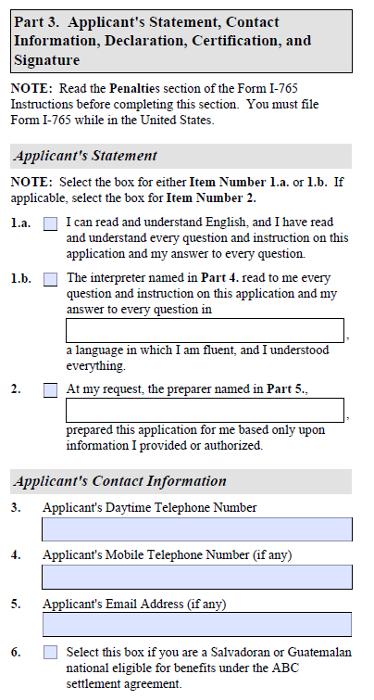
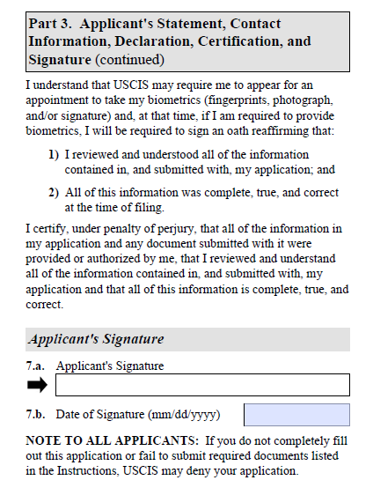
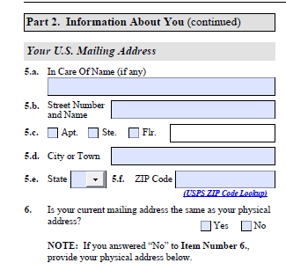
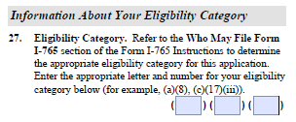
Use your personal mailing address or the ISSS address
Wet signature needed. Digital or electronic signatures will be denied.
Select 1.a.
Lower case “c”, 3, B

Slide 19
OPT Application Expectations
The student will…
Submit all OPT documents (ISSS and USCIS) ONLINE
Request an employment Start Date on the Statements of Responsibility form. You must choose a start date or OPT cannot be processed.
Submit all required documents directly to USCIS (mail-in or online)
International Student and Scholar Services (ISSS) will...
Review all ISSS and USCIS documents prior to student submitting documents to USCIS.
Review Academic Transcript to ensure students have maintained F-1 status and are eligible to apply for OPT.
Create a new OPT requested I-20 with the student’s requested Start Date.
Make documents available for pick-up or mail documents to students.

Slide 20
OPT Application Process
Student submits all OPT documents online to ISSS
DSO creates recommendation in SEVIS and prints a new OPT requested I-20
Student picks up (or requests a shipping label) for new I-20
DSO reviews students documents and makes suggestions on documents
Student submits OPT Application to USCIS directly.
Student reviews documents (DSO will make suggestions to edit any documents)

Slide 21
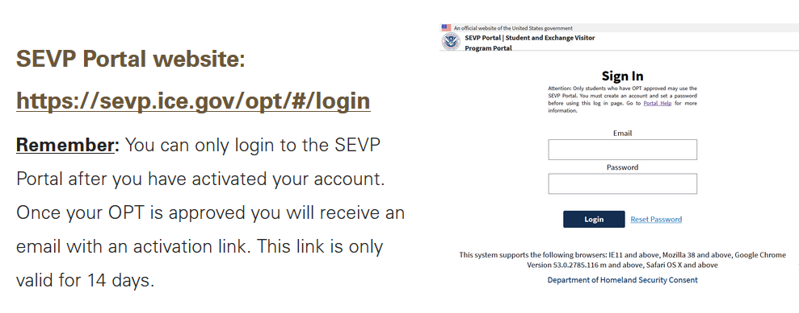
Reporting Employment and Personal Contact Information
You must report your employment and personal contact information using the SEVP Portal.
All updates must be reported within 10 days of changing.

Slide 22
Eligibility for a 24-Month Stem Extension https://www.international.txstate.edu/Work-Authorization/optstem.html
STEM students are eligible to apply for a 24-month extension of post-completion OPT if…
The degree that was the basis for the student's current period of OPT is a bachelor's, master's, or doctoral degree in one of the degree programs on the STEM Designated Degree Program List, published on the SEVP website at www.ice.gov/sevis.
The student's employer is registered in the E-Verify program, as evidenced by either a valid E-Verify company identification number or, if the employer is using a designated agent to perform the E-Verify queries, a valid E-Verify client company identification number, and the employer is a participant in good standing in the E-Verify program, as determined by USCIS.
You must apply before your current OPT expires
(as early as 90 days)

Slide 23
H-1B Cap GAP Extension
SEVIS has been modified to automatically add cap-gap extensions to records of eligible F-1 students whose H-1B petition was receipted by USCIS. Review ISSS H-1B Cap Gap website.
Manual extensions by a DSO:
H1-B Filed (received by not receipted) – June 1
Classic scenario:
Step USCIS – Electronic Registration Process | Date 03/09 – 03/25/2021
H-1B COS Filed | April 1, 20XX
Standard OPT Ends | May 31, 20XX
Cap Gap Begins | June 1, 20XX
H-1B COS Approved | August 15, 20XX
Cap Gap Ends | September 30, 20XX
H-1B Status Begins | October 1, 20XX

Slide 24
What constitutes Employment?
Paid employment (salary/hourly)
Self-employment
Must be able to prove student has the proper business licenses.
Multiple (short-term) employers
Artists, Musicians - Maintain a list of all gigs, the dates and duration
Work for hire (contractual relationship)
Maintain evidence showing duration of the contract and name/address of contracting company
Employment through an agency
Volunteering or unpaid internship
Be mindful to not violate any labor laws
read more about volunteering vs employment here: https://www.international.txstate.edu/Work-Authorization/Volunteering-Versus-Employment.html
Employment must directly relate to the student’s program of study. Review how to assess a direct relationship between the job and major.

Slide 25
Things to remember about OPT
May not begin working before the EAD Card start date.
F-1 status is dependent on employment. May not accrue an aggregate of more than 90 days of unemployment.
Must work at least 20 hours per week (no maximum hours).
Work must directly relate to the major area of study.
Report all changes in phone number, address, name, and status of employment in the SEVP Portal.
Request a new OPT I-20 every time there is a change in your employment.

Slide 26
questions about travel
Can I reenter if my request for OPT is pending?
Yes, but traveling during this time should be undertaken with caution. USCIS may send you a request for evidence while you are away, however, so you would want to make sure you have provided a correct U.S. address both to your DSO and on the application and would be able to send in requested documents. Also, if USCIS approves your OPT application, you will be expected to have your EAD in hand to re-enter the United States. Like a request for further information, USCIS can only send the EAD to your U.S. address.
Things you need for international travel: signed I-20, valid passport, valid visa, OPT EAD, and a letter from your employer
Can I reenter if I left while on OPT?
If USCIS has approved your OPT you will be expected to have your EAD in hand to re-enter the United States, in addition to your Form I-20, valid passport and visa, and a letter of employment if you have one. If you exceed the limits on unemployment while outside the United States, you will not be eligible to re-enter the United States in F-1 status.
If you have a job, you may travel and reenter to resume work at the same job or you have a written offer for another job
http://www.ice.gov/sevis/travel

Slide 27
Frequently Asked Questions
What happens if I do not graduate, can I still do OPT?
Yes. ISSS does not recommend cancelling the OPT application. However, you might have to cancel or withdraw your OPT application. Contact ISSS as soon as you are informed that you will not be graduating.
Students cannot work more than 20 hours per week while taking face-to-face classes.
Graduate students completing only thesis/dissertation requirements are permitted to work more than 20 hours.
Can I study while on OPT?
Student cannot be actively engaged in a new degree program and on OPT at the same time (online only programs are fine). If a student’s SEVIS record is transferred or a change of level I-20 is created, the OPT is immediately terminated.
Can I apply early for OPT?
Pre-completion OPT is available, but time used is deducted from post-completion OPT.
Graduate students in thesis/dissertation, or equivalent, only may apply for OPT prior to completing their program of study.
If a student does not complete the thesis/dissertation during OPT, or STEM OPT, the student should prepare to change status, change education level, request a SEVIS transfer, or depart the country prior to the end of the 60-day grace period.

Slide 28
What happens when I graduate, or Finish OPT?
After completing your studies, you have a 60-day Grace Period to do one of the following:
Apply for Optional Practical Training, OPT.
Apply for STEM (before finishing OPT)
Depart the US
Complete the SEVIS Completion Request: https://www.international.txstate.edu/current/SEVIS-Completion.html.
Apply for a change or adjustment of status
Update your immigration status with ISSS: https://www.international.txstate.edu/current/Immigration-Status-Update-Portal.html.
Request a SEVIS Transfer to begin a new degree at a different institution.
Request a Change of Level I-20 to begin a new degree at Texas State.

Slide 29
Tips and Reminders
Start saving money now!
Apply early for OPT due to USCIS processing delays.
No in-person appointments. Save time and apply online.
Use I-765 Form Instructions and ISSS Template. Sign Form I-765 – no digital signatures.
Check Passport expiration date and I-94 Classification
Be confident in your decision to pursue OPT.

Slide 30
visit the OPT website For More Information: https://www.international.txstate.edu/Work-Authorization/opt.html

