Slide 1
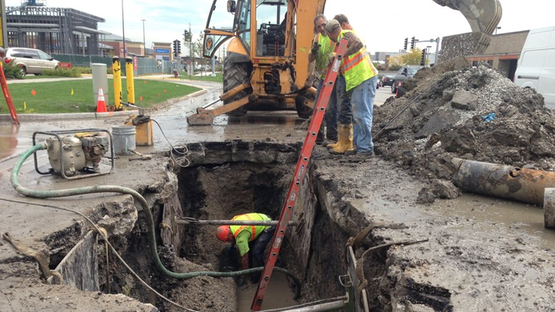
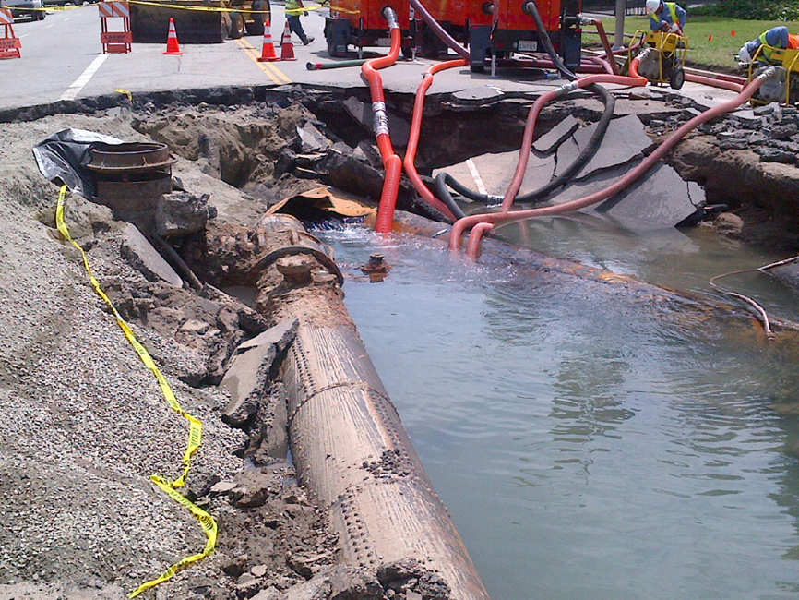
WLDS Sonic Spectrogram
Sponsor: Tom Dickey, SENSCO Solutions
Faculty Advisor: Dr. Harold P.E. Stern
# 2.7: WLDS Sonic Spectrogram
Notes:
The PM starts the presentation. “Welcome. I am Sammy Spectacular, the student project manager for the Inverting Flurbitron project, sponsored by blah-blah. Thank you for attending today. Our major goals are to review the outcomes of our Senior Design project.”

Slide 2
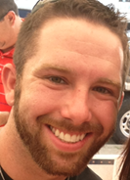
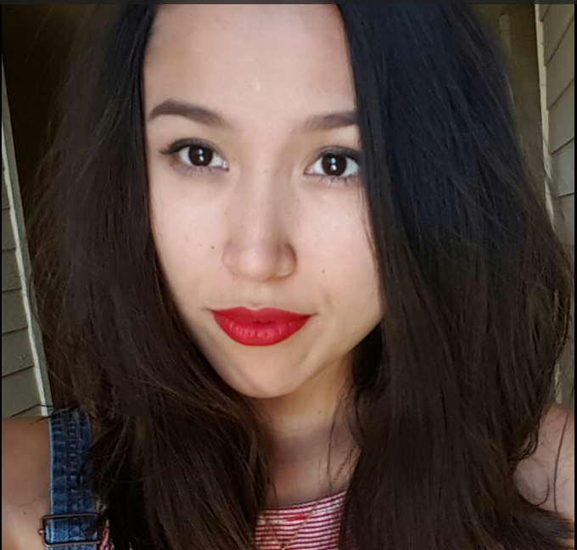
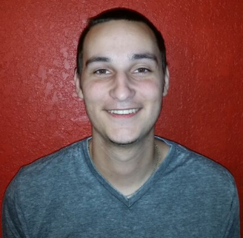
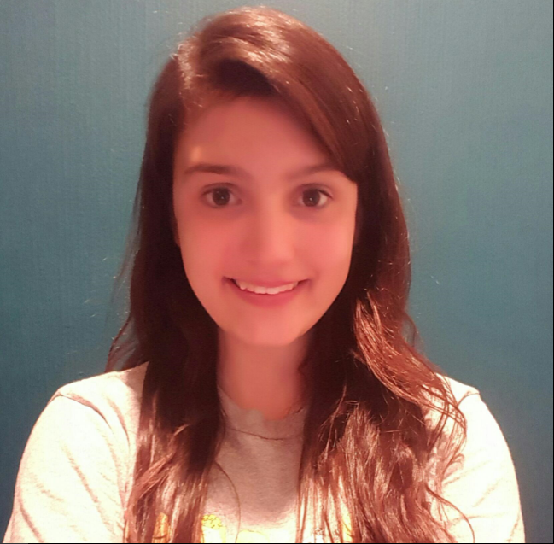
Team Members
Anthony Goodson
Project Manager and system integration
Ana Amaro
Coding and system integration
Alex Diaz
Coding and system integration
Haleigh Walker
Coding and system integration
Notes:
Don’t spend time on this slide! The PM should introduce the team members and their major role per the slide – do NOT elaborate on rolls!

Slide 3
Presentation Topics
Motivation
Overview
SENSCO Solutions
Budget
Roles & Responsibilities
Constraints approached
Design Decisions
Design Approach
Results
Recommendations and Estimates

Slide 4
Motivation
The problem:
Billions of cubic meters of water is lost every day in outdated and unsupervised water distribution networks around the world.
Existing Leak detection systems of water municipalities are very costly due to the response time to leaks.
Possible Solution:
The WLDS Sonic Spectrogram project hopes to help greatly reduce the response times by creating a visual, graphical representation of the acoustical activity within the pipes it is monitoring sending alerts to the user real time at start of the leak.
# 2.7: WLDS Sonic Spectrogram
Notes:
Why are you doing this project? What’s important / needed / beneficial about it?

Slide 5
Overview of Project
Goals of Project
Stretch Goals of Project
Capture sound data via WLDS & transmit to Bridge Unit.
Import data from bridge unit to Audacity, creating audio file with time stamp.
Import data into ClearBlade.
Export data to LabVIEW, displaying Spectrogram.
When a leak is detected, ClearMessage alerts the user of the leak.
# 2.7: WLDS Sonic Spectrogram
Notes:
If no stretch goals then delete the text box on the right, and expand the one on the left.

Slide 6
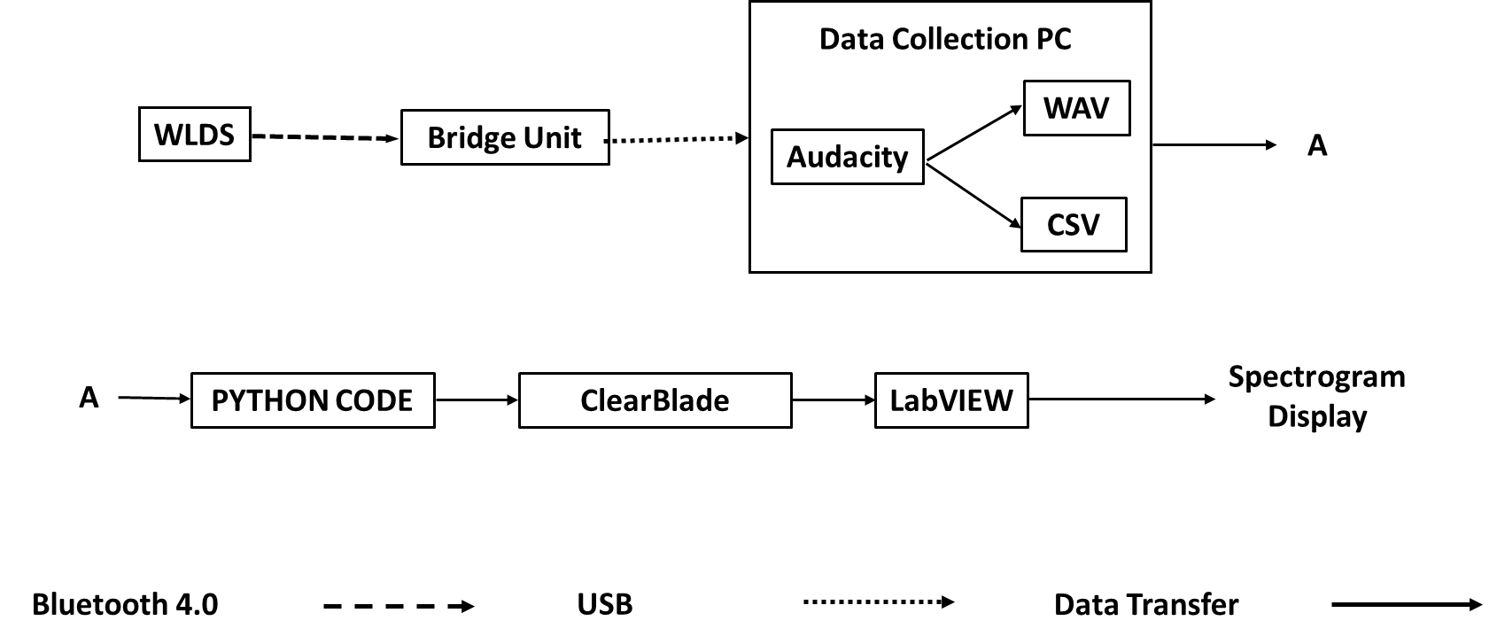
WLDS Project Block Diagram

Slide 7
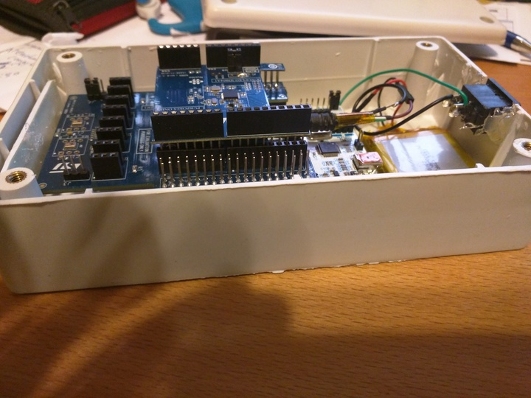
Sponsored by SENSCO Solutions
SENSCO’s Water Leak Detection Sensors Sonic Spectrogram project can be implemented into any water distribution network, instantly providing improved response times to leaks through:
Instant leak detection
Details of the leak and its location
SENSCO developed and provided the Water Leak Detection Sensors (WLDS) and the Bridge Unit.
Water Leak Detection Sensor
Notes:
Talk to how the Sponsoring company is involved – part of their business / research / outreach? Why are they interested?

Slide 8
Roles & Responsibilities
NAME | ROLE
Anthony Goodson Jr, Project Manager | Project Manager duties, Tested and verified the WLDS’ physical and transmission capabilities.
Ana Amaro | Development of system integration between Audacity, ClearBlade, and LabVIEW.
Alex Diaz | Development and testing of the user interface and python code
Haleigh Walker | Development and testing of the LabVIEW interface and user interface
# 2.7: WLDS Sonic Spectrogram
Notes:
State WHO actually did WHAT.

Slide 9
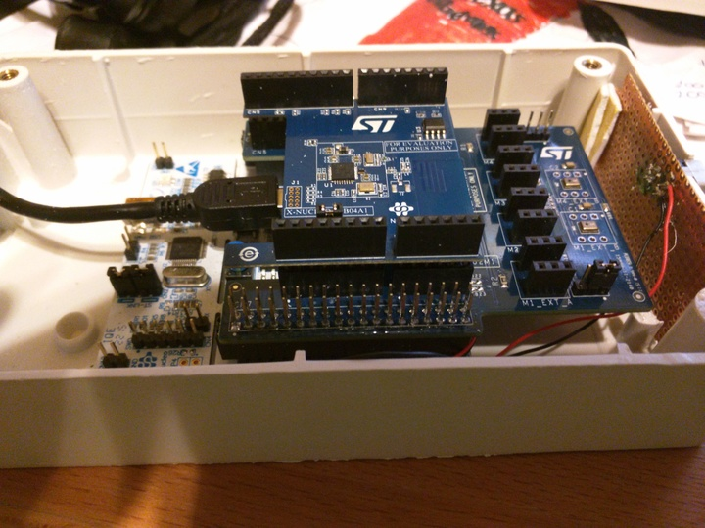
Budget
Through Texas State University and SENSCO Solutions, the team has all the funding and resources needed to deliver a desired product.
Texas State provided testing equipment and the required software needed to complete our project.
SENSCO Solutions developed and provided the team with the Water leak detection sensor and the Bridge Unit.
Bridge Unit
Notes:
Compare planned vs. actual. Be brief!

Slide 10
Constraints
The most obvious is the lack of data from an operational environment.
The team lacked the necessary qualifications and training to test all aspects of the project to industry standards.
However efforts were made to compensate and provide data to the best of our abilities.
Notes:
This is from Section 6 of the Final Report. Be brief!

Slide 11
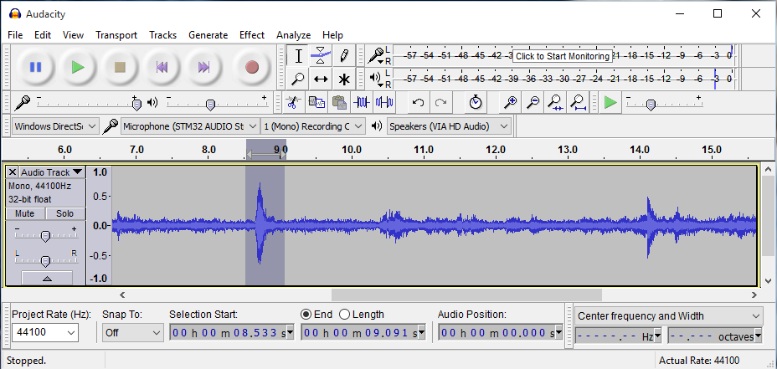
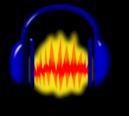
Design Decisions
Audacity
WAV files
CSV files
Notes:
Draw from Section 5.1 of Final Report.

Slide 12
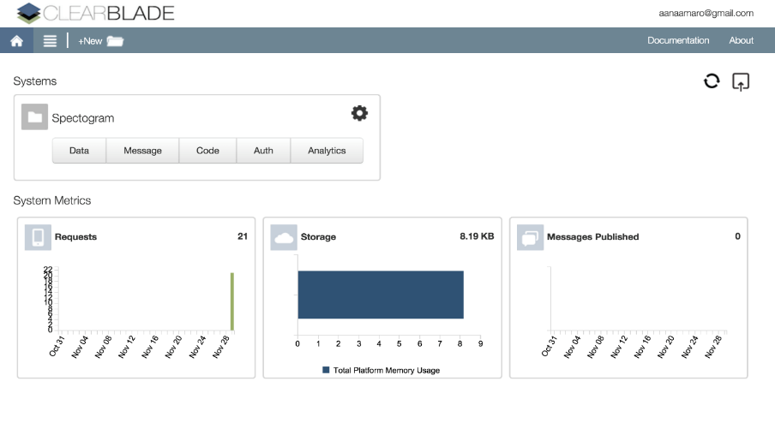
Design Decisions
clearMessage
clearUsers
clearData
Notes:
Draw from Section 5.1 of Final Report.

Slide 13
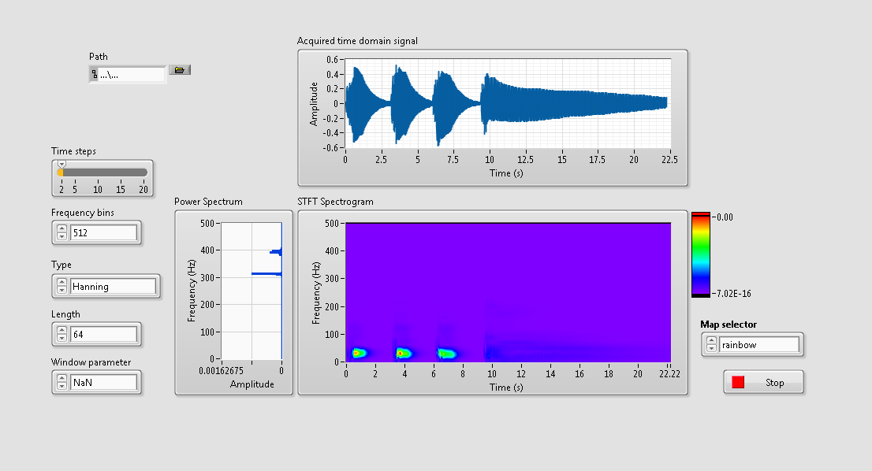
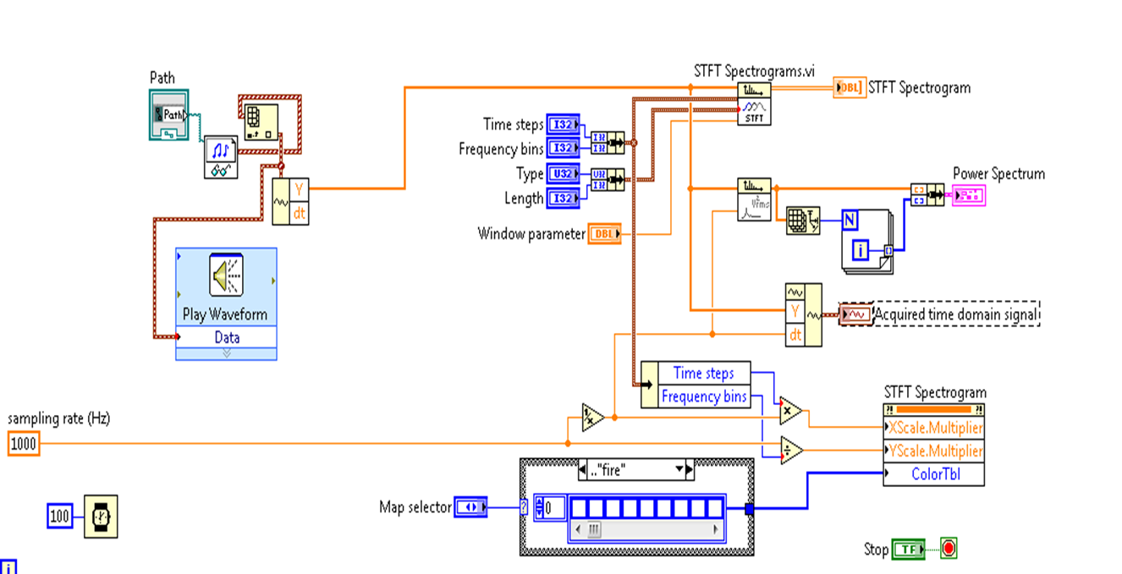
Design Decisions
LabVIEW
Real-time analytics
Notes:
Draw from Section 5.1 of Final Report.

Slide 14
Design Approach
Each team member was responsible for the integration of a specific system block:
Anthony handled communications between the team, sponsors, and mentor; as well as test the WLDS’s physical and transmission capabilities.
Ana focused on integrating ClearBlade.
Haleigh , LabVIEW lead, was responsible for the spectrogram interface integration.
Alex concentrated on integrating the automation of data collected to various system blocks.
Notes:
Draw from Section 5.2 of Final Report.

Slide 15
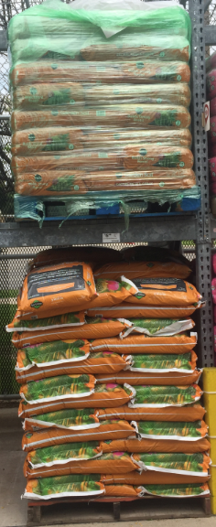
Results from Testing Phase:
BU
WLDS’ ability to capture the acoustical activity of a certain object it is attached to and transmit that data without distortion:
50 feet within line-of-sight of the bridge unit
up to 9 feet through soil and wood
BU
9 feet
4.5 feet
WLDS
WLDS
Notes:
Use results + compliance statement from the Characterization Report. Table is OK. Add a slide for margin or fail if need be. USE GRAPHICS and PICTURES! Be visual!! Add slides if need be!!

Slide 16
Results from Testing Phase:
Audacity is efficient in converting the raw audio data into a form more suitable, WAV and CSV files, for our real time analytics.
The python code effectively pushes the WAV and CSV files into ClearBlade’s database. The database is protected with a secure system that requires the correct credentials to access.
The LabVIEW interface that the team designed can effectively pull the WAV and CSV files from a designated library for spectrogram generation.
Notes:
Use results + compliance statement from the Characterization Report. Table is OK. Add a slide for margin or fail if need be. USE GRAPHICS and PICTURES! Be visual!! Add slides if need be!!

Slide 17
Recommendations & Estimates
Bluetooth transmit through a dense medium:
Transmission intensity can be improved with consideration of the environment and careful placement
Or a wire antenna could be back fed to avoid transmission through difficult mediums
ClearMessage:
The implementation of ClearMessage isn’t priority but serves to compliment the project.
Analytic server:
We have a baseline to upload into the server but we are lacking all real world scenario simulated leak audio data.
The new prototypes of the sensor will contain the analytics server on it, eliminating the need for an off hand server
Notes:
Pull from your Characterization Report what would be required to meet all specs.

Slide 18
Acknowledgments
We would like to thank Dr. Compeau for placing us on a great team and in a position to succeed.
We would like to thank Dr. Stern for his technical guidance.
We would like to thank Eric Blair for all of his help and guidance with the most frustrating parts of this project
We would like to thank Tom Dickey and Glori Ramirez for presenting this opportunity to the team as well as all the support they have constantly provided along the way.
Notes:
Create a bulletized version of Section 13 from the Final (2nd Semester) Report.

