Slide 1
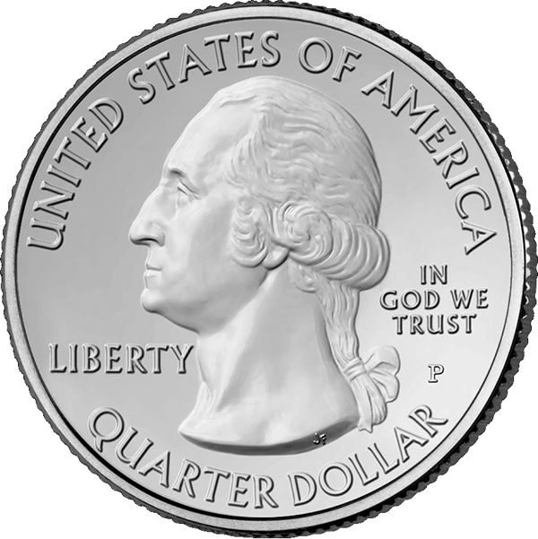
Quantifying Sample Information for Better Decisions: Stratification and Sampling Decisions in Medicare
Rasim Musal, Tahir Ekin
Department of CIS and Quantitative Methods, McCoy College of Business, Texas State University
Problem: Fraud Waste and Abuse (FWA) Estimation
In Medicare Audits which involves claims, an important decision is how to allocate sampling resources given multimodal data. Such methods should estimate the total FWA as close to the real FWA possible without being unfair to the healthcare provider.
Lets assume a claim X as either FWA (k=0) or legitimate (k=1)
Method: Incorporation of Entropy
Better solution?
• At t=0 samples to S1 to S5 via Neyman Allocation
• From t=1 to T use Entropy to Quantify Information
Evaluate after each t, find expected information from the next draw
Identify highest expected information stratum
If the dice below are loaded and represent the uncertainty behind “k” k=0 | k=1
Payment Data:
Why are these profits occurring?
Bayesian Methods:
Instead of Central Limit Theorem to approximate K, we use a probability distribution that better represents the uncertainty over K, total number of FWA
Entropy Methods:
We use entropy and employ information theoretic methods to come up with decisions involving stratum choice.
Data ➔ Strata
Y=k*X | k = 0 | 1
This is the payment data from a hospital provided by Center for Medicare Services (CMS)
Data into Strata
S1 | S2 | S3 | S4 | S5
n₁ | n₂ | n₃ | n₄ | n₅
σ₁ | σ₂ | σ₃ | σ₄ | σ₅
Conclusion:
More research is needed, however results are promising and provide a better, probabilistic interpretations to the final result associated with an audit. The iterative information theoretic methods (entropy) leads to savings for society under multiple scenarios involving FWA.
At each iteration the “coin” is thrown and the results are recorded. At each recording the expected amount of information to be gained from the next draw is updated.
Classical Solution:
Neyman Allocation uses stratum size and standard deviation to come up with Sample Resource allocation. Then, Central Limit Theorem is used to extrapolate from the lower bound of a 95% CI
Sc1 | Sc2 | Sc3 | Sc4 | Sc5 | Sc6 | Sc7
$7,557,430 | $3,620,643 | $7,455,268 | $3,722,805 | $5,589,036 | $2,794,518 | $8,383,554
At each iteration we compute the
expected information gain from the next throw based
on history.
A simple Conjugate Bayesian Model is used to
come up with probability distribution for
total number of FWA, K, in every stratum
P(K1)… P(K5)
We use Cumulative Distribution of K to come up with a
conservative estimate
The Expected Total Overpayments in Each Scenario
Note:
In all of these tests, our estimates do not put undue burden upon the providers relative to the Neyman Allocation Method.
Application: Using maximum expected information gain criteria with 45 initial Neyman Allocation followed by 10 iterations
 | s=1 | s=2 | s=3 | s=4 | s=5
t=0 | 8(0) | 10 (1) | 6 (2) | 14 (11) | 7 (7)
t=1 | 0 | 0 | 1 (1) | 0 | 0
t=2 | 0 | 0 | 1 (1) | 0 | 0
t=3 | 0 | 0 | 1 (1) | 0 | 0
t=4 | 0 | 1 (0) | 0 | 0 | 0
t=5 | 0 | 1 (0) | 0 | 0 | 0
t=6 | 0 | 1 (0) | 0 | 0 | 0
t=7 | 0 | 1 (0) | 0 | 0 | 0
t=8 | 0 | 1 (0) | 0 | 0 | 0
t=9 | 0 | 1 (0) | 0 | 0 | 0
t=10 | 0 | 1 (1) | 0 | 0 | 0
Total | 8(0) | 17(2) | 9 (5) | 14 (11) | 7(7)
At t=0 we use Neyman
Allocation.
Then, we employ Entropy Methods to come up with decisions to whether to sample from stratum s
The number in the parenthesis
is total number of FWA
 |  |  |  | S1 | S2 | S3 | S4 | S5
A1 | 45+10 |  | Sc1 | 0 | 0.25 | 0.5 | 0.75 | 1
A2 | 45+20 |  | Sc2 | 1 | 0.75 | 0.5 | 0.25 | 0
A3 | 45+30 |  | Sc3 | 0.05 | 0.25 | 0.5 | 0.75 | 0.95
A4 | 60+10 |  | Sc4 | 0.95 | 0.75 | 0.5 | 0.25 | 0.05
A5 | 60+20 |  | Sc5 | 0.5 | 0.5 | 0.5 | 0.5 | 0.5
A6 | 60+30 |  | Sc6 | 0.25 | 0.25 | 0.25 | 0.25 | 0.25
A7 | 90+10 |  | Sc7 | 0.75 | 0.75 | 0.75 | 0.75 | 0.75
A8 | 90+20
A9 | 90+30
Profits over our method relative to the use of Neyman Allocation only
Why are these savings occurring?
We illustrate our method via 9 allocation (A) alternatives and 7 probability scenarios (Sc) for k=1, each combination of A and Sc is run for 1000 times

