Slide 1
2.2 Networked Orientation Sensor (Magnetic)
Angel Quintanilla
Jay Richardson
Javier Rodriguez
Sponsor: Freescale
Advisor: Dr. Aslan
Instructor: Dr. Stephan

Slide 2
Background
Freescale
The Internet of things
Renewable Energy
Electromagnetism

Slide 3
The Project
A cross between renewable energy and the internet of things
The next step: sensors for data storage and analysis
The internet of things provides a way for consumers to monitor performance and reduce O&M costs
The Project: use the necessary knowledge and tools to design a system that will find the direction of a wind turbine. Then, upload the sampled data to the cloud

Slide 4
Project Requirements
Use Freescale’s Tower system module. Specifically the TWR-KW24D512 MCU for its wireless transmission capability
It must sample at 10Hz and run on batteries
It must be weather proof
The design must implement a magnetic approach

Slide 5
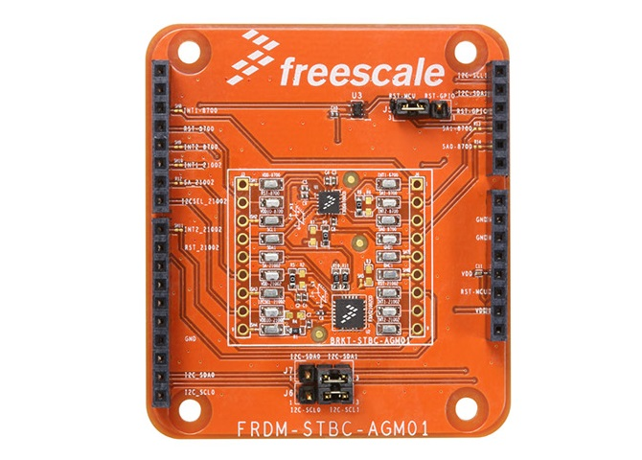
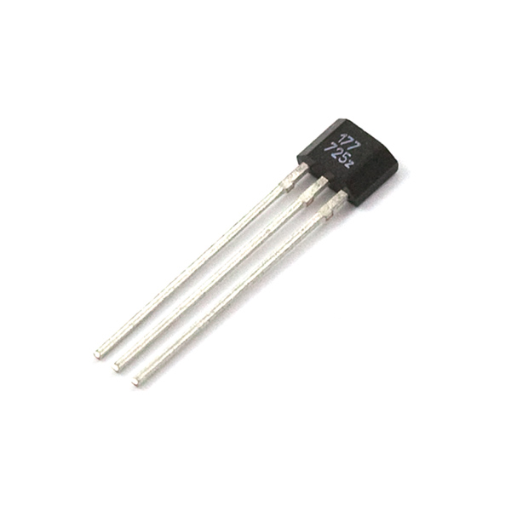
Project Process: Brainstorming
Magnetometer
Hall Sensor

Slide 6
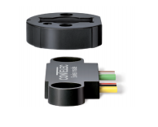
Project Process: The Sensor
permanent magnet attached to the rotating shaft is used as a position marker
The orientation of the magnetic field is captured using an integrated circuit.
The analog output represents the calculated angle
Vert-X 05E Touchless Rotary sensor

Slide 7
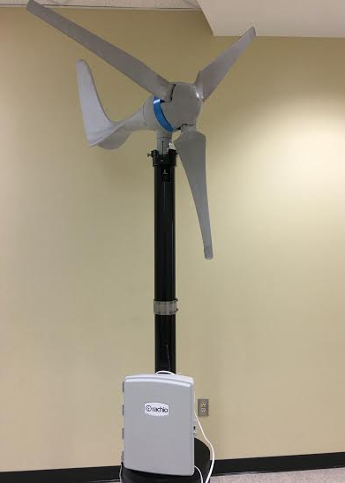
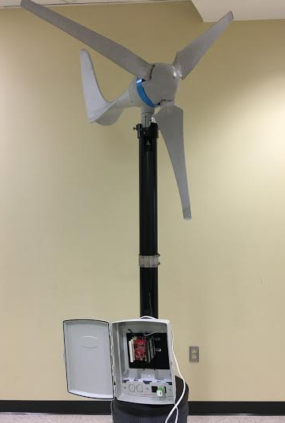
Project Process: Hardware
Weather Proof Box
Sensor mounted internally
Away from internal Magnetic field.

Slide 8
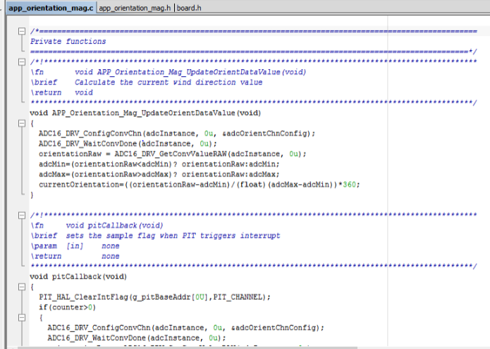
Project Process: Software
IAR Workbench
AnalogIn/DigitalOut
Thread Protocol

Slide 9
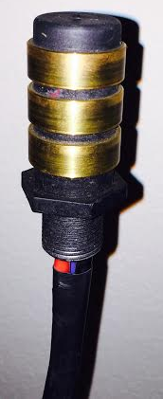
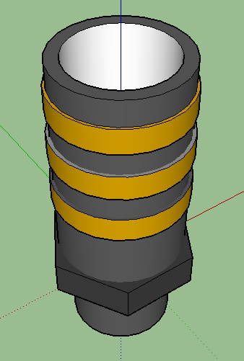
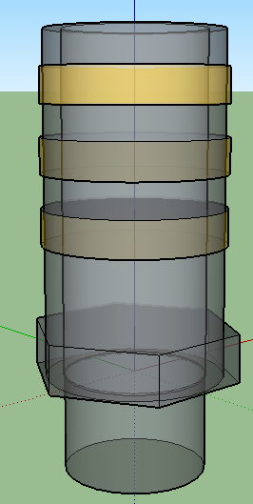
Complications: Internal Components

Slide 10
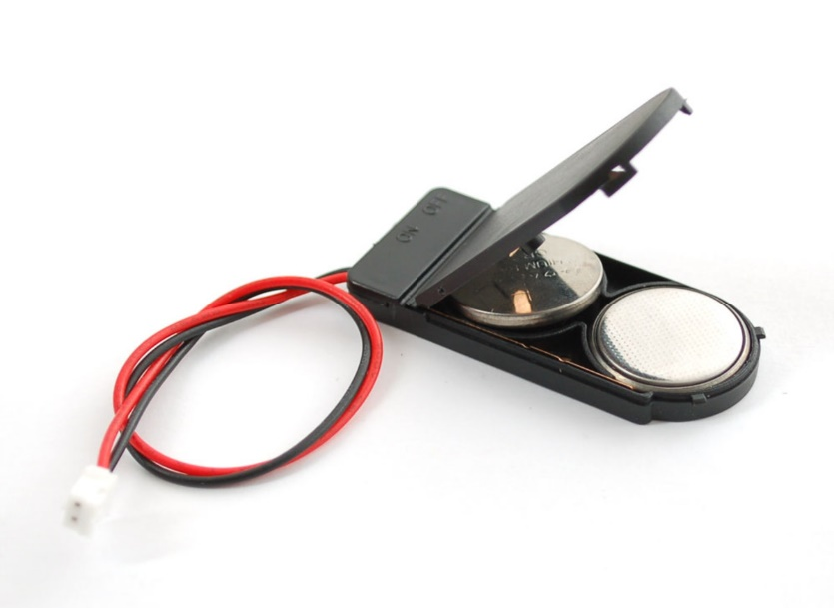
Complications: Other
Difference between sampling rate and uploading rate.
Power usage

Slide 11
Result
Degrees vs Time graph
Showing data points obtained from the wind turbine sensor.

