Slide 1
E2.2 Implementation of a Demodulator
Sponsor: Steve Hicks, FlexRadio Systems
Faculty Advisor: Dr. Harold Stern & Dr. Semih Aslan
Notes:
“Welcome. I am Jonathan Rodriguez, the student project manager for the Implementation of a Demodulator project, sponsored by FlexRadio Systems. Thank you for attending our Intermediate Design Review. Our major goals are to review our team’s progress and then conduct a detailed review of the Functional Specification.”

Slide 2
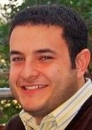
Team Members
Jonathan Rodriguez
Project Manager
&
Software Designer
Cory Cox
Software Designer
Nicolas Govea
Software Designer
Notes:
Jonathan Rodriguez: Project Manager & Software Designer
Cory Cox: Software Designer & Test Engineer
Nicolas Govea: Software Designer & Validation Engineer

Slide 3
Today’s Presentation Covers
Motivation
Project Overview
Team Roles and Responsibilities
Results
Notes:
Today’s agenda will be covering:
Motivation
Senior Design Goals
Description of the Project
In depth review of the Functional Spec

Slide 4
Roles and Responsibilities
Project Manager: Jonathan Rodriguez
Managerial Duties
Schedule team meetings
Communicate project progress with the project sponsor and the instructor
Monitor project’s milestones
Research
Software defined radios
Error handling
Constraints
Software design
Configuration between devices used
Notes:
Talk to managerial tasks FIRST then technical responsibilities.

Slide 5
Motivation
The Problem:
Analog and digital radio operators currently can not communicate with each other due to incompatibility of communication modes
The Solution:
By implementing System Fusion, the radio will automatically switch the transmit mode from either digital or analog based on the mode detected by the receiver
How?:
For this to be completed, necessary code must be written, based off of the specification documents for System Fusion, that will allow the integration of the C4FM modem into FlexRadio’s SmartSDR software
Notes:
Why are you doing this project? What’s important / needed / beneficial about it?

Slide 6
Sponsored by FlexRadio Systems
Why FlexRadio Systems?
FlexRadio currently does not have communication modes that support interoperability between analog and digital
Yeasu has developed System Fusion, with C4FM as the standard modulation technique, which solves this problem
With addition of System Fusion into their radios, FlexRadio can meet consumer demands of having many communication modes in one product
This allows FlexRadio to continue to be the industry leader in software defined radios
Notes:
Talk to how the Sponsoring company is involved – part of their business / research / outreach? Why are they interested?

Slide 7
What is System Fusion and C4FM?
System Fusion
Four different communication modes
Full Rate Voice Mode
Full Rate Data Mode
Voice / Data Mode
Analog FM Mode
Continuous 4-Level Frequency Modulation (C4FM)
The standard modulation scheme used for System Fusion

Slide 8
Project overview
Goals of Project
Stretch Goals of Project
Configure FLEX-6300 radio and SmartSDR software to run on FM mode
Integrate D-Star mode into SmartSDR software
Run D-Star on Linux, verifying packets being sent are seen on the command terminal
Bit-pack System Fusion, using the GMSK modem of D-Star
Replace that modem with the C4FM modem
Verify System Fusion is functioning on SmartSDR software
Upon successful implementation of the full rate voice mode, the remaining modes of System Fusion will also be implemented
Full rate data mode
Voice/Data mode
Analog FM mode
Notes:
If no stretch goals then delete the text box on the right, and expand the one on the left.

Slide 9
Budget
Allotted Budget: $500
Budget Amount Used: $0
FlexRadio supplied all of the radio equipment needed.
FLEX-6300 Radio
Yaesu FT1DR Handheld Radio
Texas State University supplied the power supply needed for the FLEX-6300 radio

Slide 10
Roles and Responsibilities
Team Member: Nicolas Govea
Research
Characteristics of C4FM
D-Star Frame Structure
System Fusion Frame Structure
Software design
State Machine
Bit Pattern Matcher
FICH Table Integration
Notes:
Talk to managerial tasks FIRST then technical responsibilities.

Slide 11
System Fusion State Machine

Slide 12
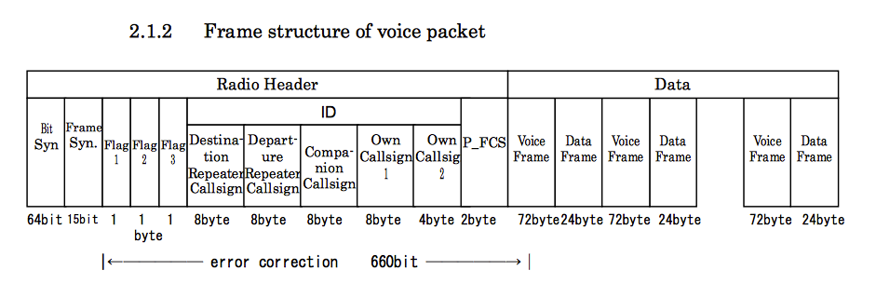
D-Star Frame Structure of Voice Packet
D-Star frame structure of voice packet
The packet below describes how bits are allocated within each frame of the packet.
Understanding this packet was a vital step in understanding how the D-Star state machine functioned.

Slide 13
System Fusion Full Rate Voice Mode Frame Structure

Slide 14
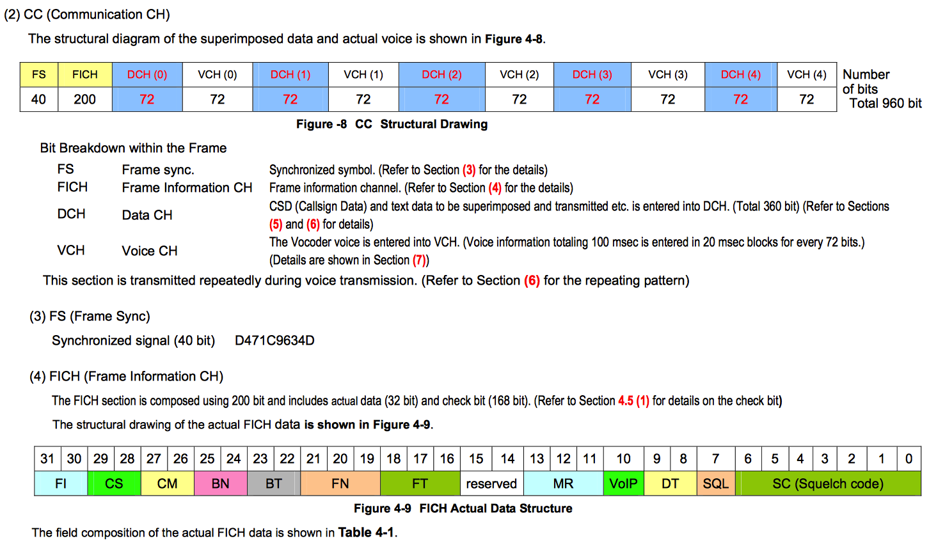
System Fusion Header Frame Structure

Slide 15
Roles and Responsibilities
Team Member: Cory Cox
Research
Interfacing
System requirements
Existing systems
Performance
Software design
State Machine
Bit-Pattern Matcher
FICH table integration
Notes:
Talk to managerial tasks FIRST then technical responsibilities.

Slide 16
Design Approach
Modulator / Demodulator
All code written in the C programming language
Eclipse IDE
GCC Compiler
GitHub repository
Applicable Courses Taken
CS 1428 – Foundations of Computer Science I
EE 3420 – Microprocessors
EE 4370 – Communication Systems
EE 4378 – Data Compression and Error Coding

Slide 17
Constraints
Budgetary
FLEX-6700
Substituted with FLEX-6300 with an added transverter to send a receive signals up to the 150+ MHz range
Design
Limited resources for System Fusion
Unable to locate open source coding for C4FM

Slide 18
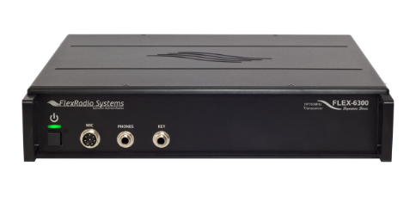
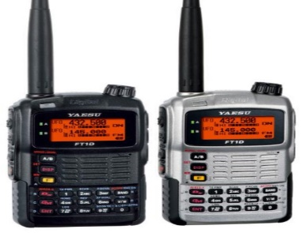
Results
Radio Communication
Communicate on FLEX-6300 with Yaesu FT1DR handheld using FM
Communicate on FLEX-6300 with Yaesu FT1DR handheld using D-Star
Software Design
Using the existing GMSK modem, we implemented the communication mode D-Star
Bit-Pack System Fusion using GMSK modem (Create a state machine)
FLEX-6300 SDR
Yaesu FT1DR
Notes:
Go through this at a good pace. You could spend 30 minutes on this alone – don’t. Just give the overview.

Slide 19
Future Work
Complete System Fusion state machine with implementation of GMSK modulation scheme
Replace the modulation scheme GMSK with C4FM.
Ensure that System Fusion and C4FM are properly operating on the FLEX-6300 radio and verify communication between radios.

Slide 20
Acknowledgements
A special thanks to the following individuals for their support and guidance throughout this project:
Sponsor - Steve Hicks, VP of Engineering at FlexRadio Systems
Sponsor – Ed Gonzalez, Software Designer at FlexRadio Systems
Faculty Mentor - Dr. Harold Stern
Faculty Mentor - Dr. Semih Aslan
Senior Design Advisor – Dr. Rich Compeau

