Slide 1
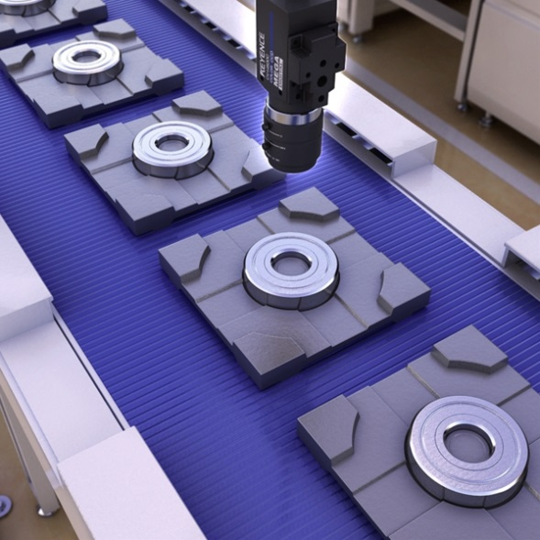
Machine Vision Burr Detection
Sponsor: Hunt and Hunt Ltd.
Faculty Advisor: Dr. Fred Chen

Slide 2
Roles & Responsibilities
NAME | ROLE
Justin Jordan, Project Manager | Software architecture, detection algorithm
David Ikemba | Filter design, image manipulation
Thuong Nguyen | Main driver, control flow, unit testing
Woodrow Bogucki | System testing, feature classifier training
Notes:
Get these from the L-C-S. Go over this VERY quickly!

Slide 3
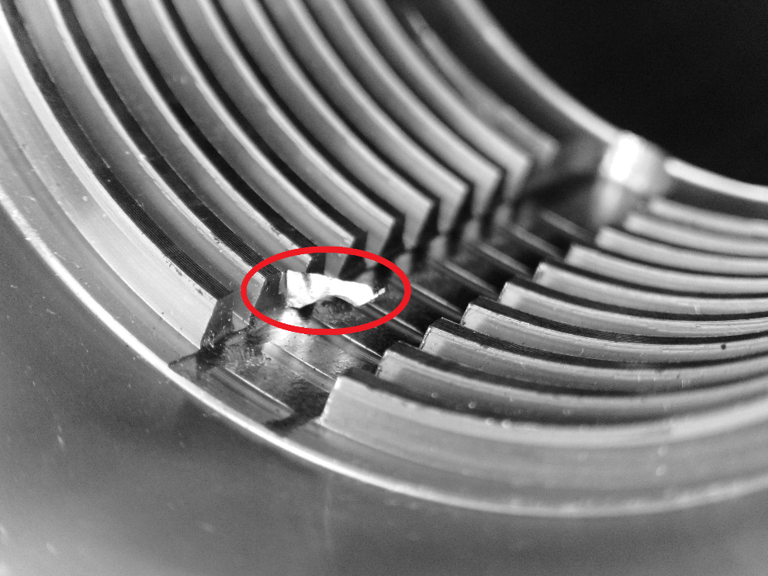
Project Overview
The Machine Vision Burr Detection System (MVBDS) is designed to detect burr in machined pipes.
Sponsor - Hunt and Hunt, Ltd.
Notes:
If no stretch goals then delete the text box on the right, and expand the one on the left. DO NOT ELABORATE ON THE GOALS, JUST STATE THEM QUICKLY AND MOVE ON!!!

Slide 4
Project Motivation
The problem:
Burrs – Unwanted defects from machining process
Automation of a manual process
Utilize robot idle time
Notes:
Why are you doing this project? What’s important / needed / beneficial about it? Why is this a good senior design project? MAKE FONT BIG

Slide 5
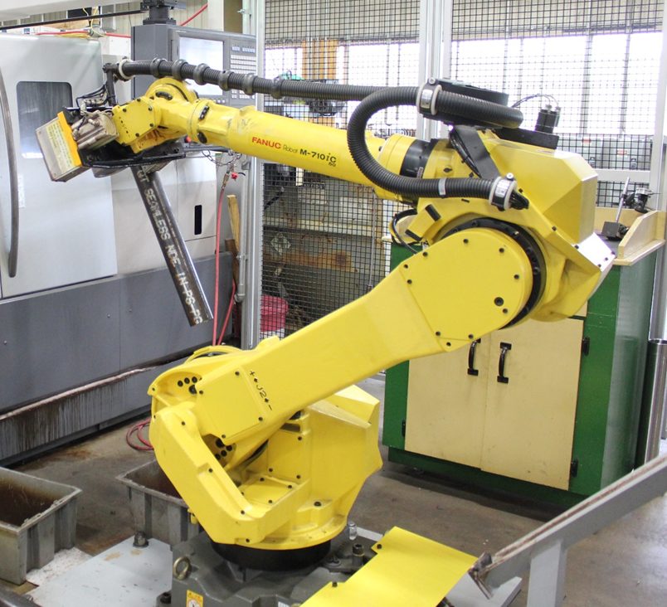
Top-Level Block Diagram
Threading of Pipe
Initial Test for Burr
Deburring
Final Test for Burr
Next Stage of Production
Notes:
Put in a readable top-level block diagram to show what your project does and how it fits in to the system.

Slide 6
Design-Level Block Diagram
System level diagram of Machine Vision Burr Detection Systems. Blocks highlighted in yellow will be designed and coded for this project.
Notes:
You may need to show this block diagram more than once to provide context. You may also need to add a block diagram of the next level of detail where relevant.

Slide 7
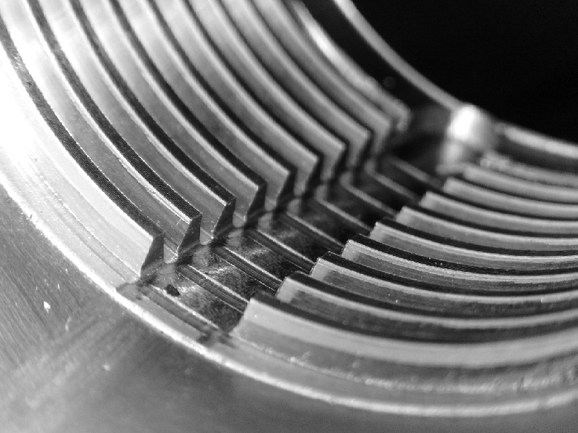
Grayscale Image
Notes:
Put in a readable top-level block diagram to show what your project does and how it fits in to the system.

Slide 8
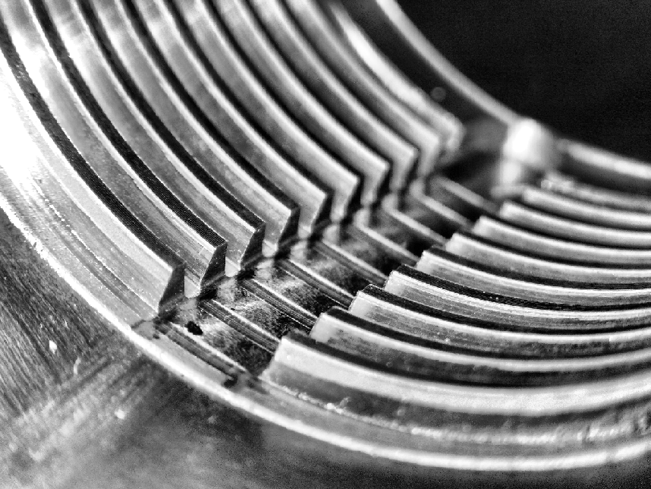
Histogram Equalized
Notes:
Put in a readable top-level block diagram to show what your project does and how it fits in to the system.

Slide 9
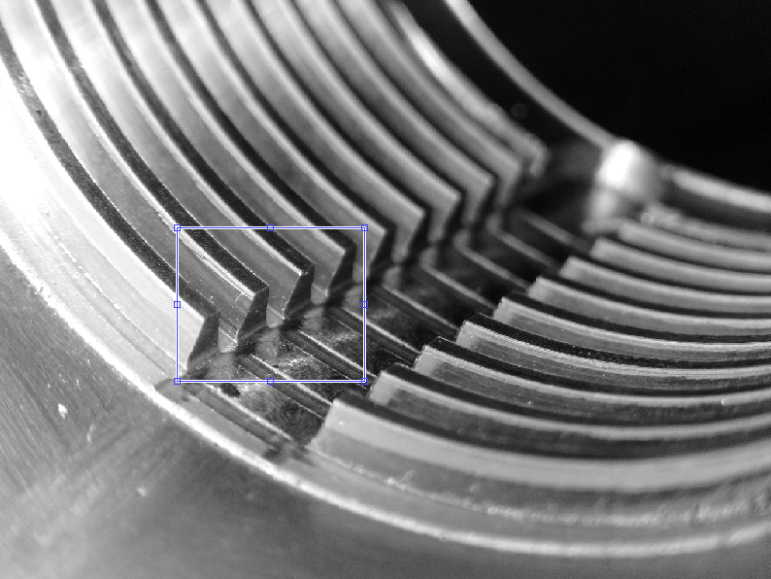
Region of Interest Defined
Notes:
Put in a readable top-level block diagram to show what your project does and how it fits in to the system.

Slide 10
Haar Cascade Detection
Used in facial recognition software (Viola-Jones algorithm)
Trained a custom detector in Matlab
400 positive samples used
Over 10,000 negative images used
Accurate and fast object detection
Notes:
Insert a tabular form of Section 4.1 from the Characterization Report.

Slide 11
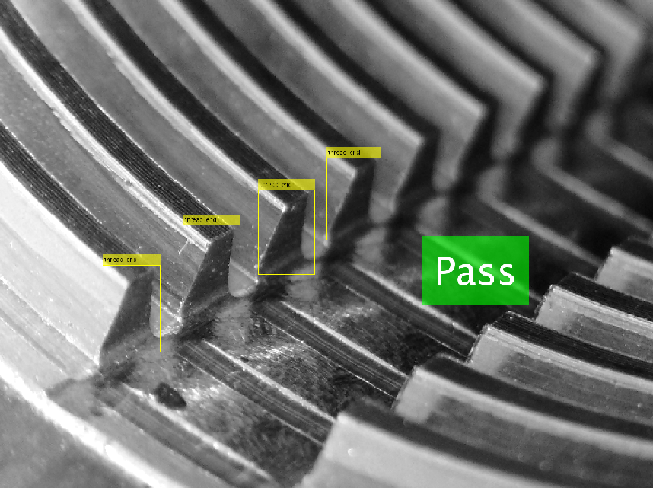
Pass/Fail Determination
Notes:
Put in a readable top-level block diagram to show what your project does and how it fits in to the system.

Slide 12
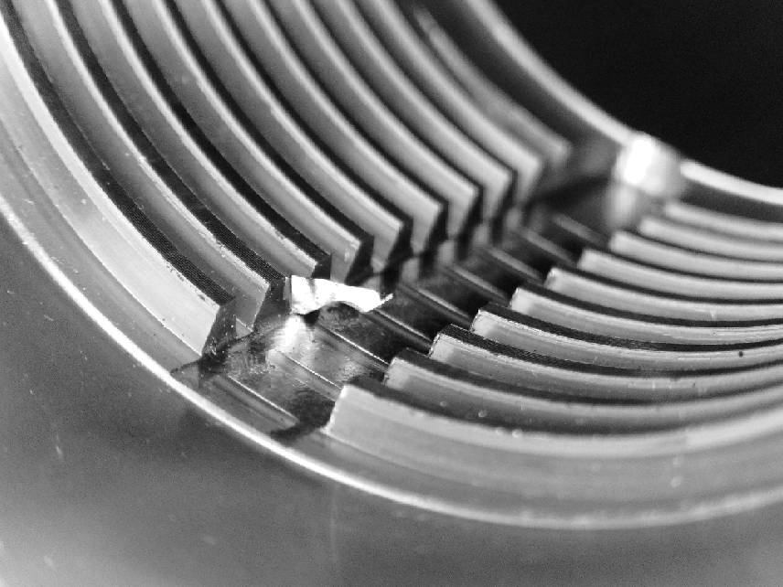
Grayscale Image
Notes:
Put in a readable top-level block diagram to show what your project does and how it fits in to the system.

Slide 13
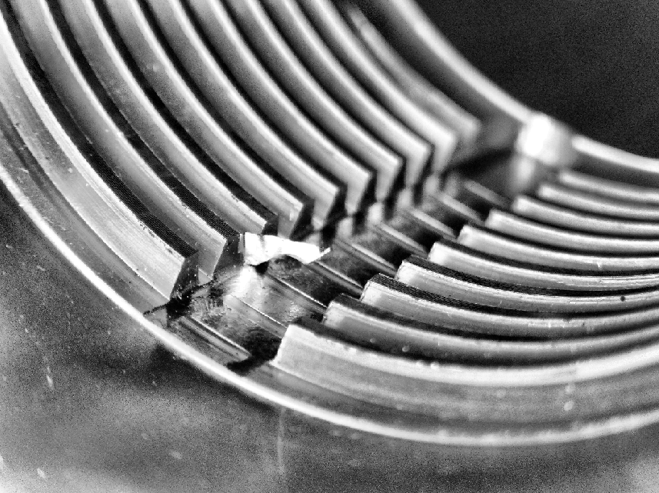
Histogram Equalized
Notes:
Put in a readable top-level block diagram to show what your project does and how it fits in to the system.

Slide 14
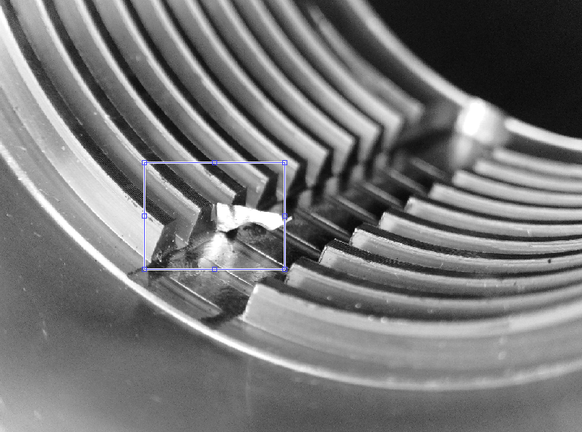
Region of Interest Defined
Notes:
Put in a readable top-level block diagram to show what your project does and how it fits in to the system.

Slide 15
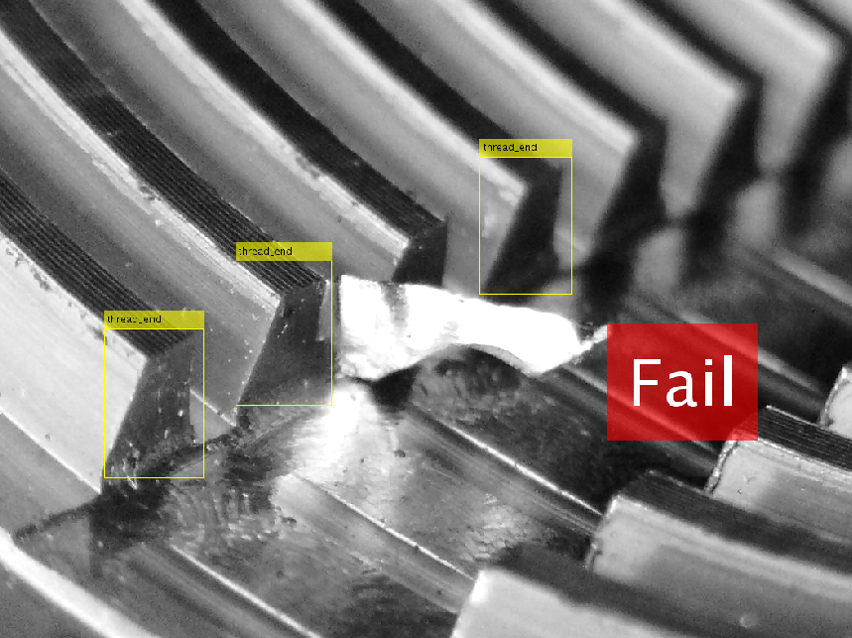
Pass/Fail Determination
Notes:
Put in a readable top-level block diagram to show what your project does and how it fits in to the system.

Slide 16
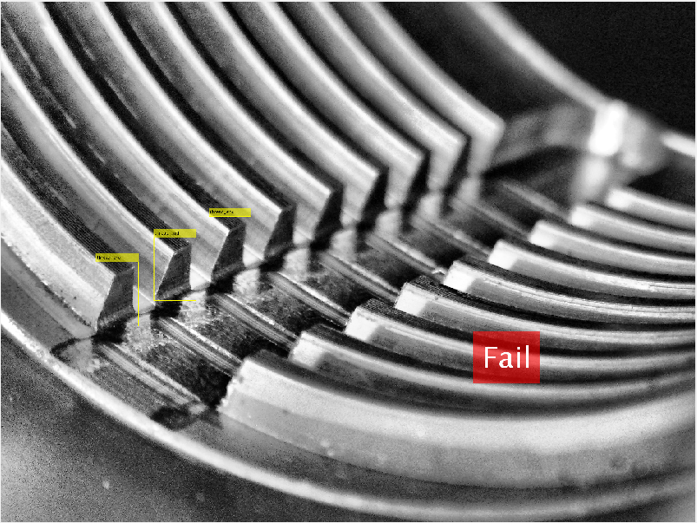
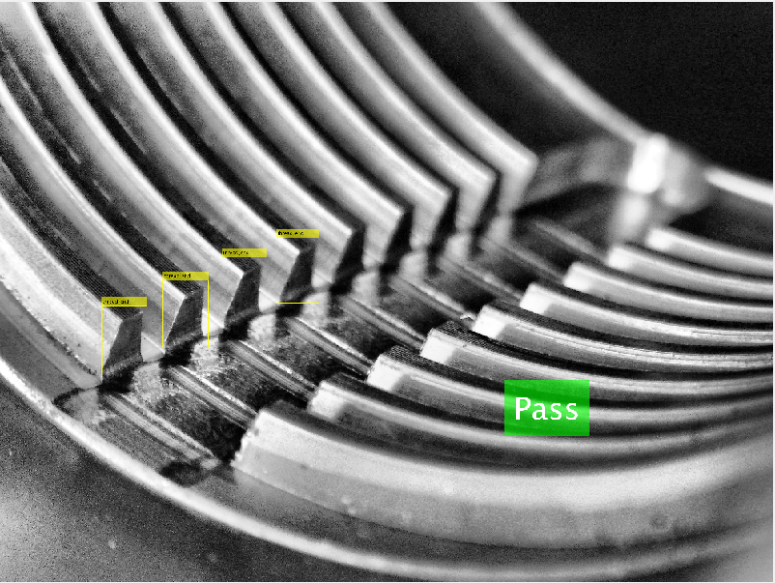
Importance of ROI
ROI was too small. False Negative.
ROI must be correctly defined for optimal results.

Slide 17
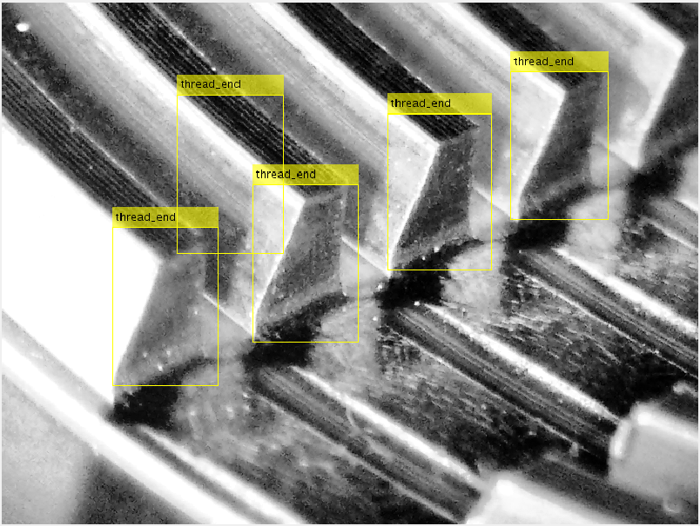
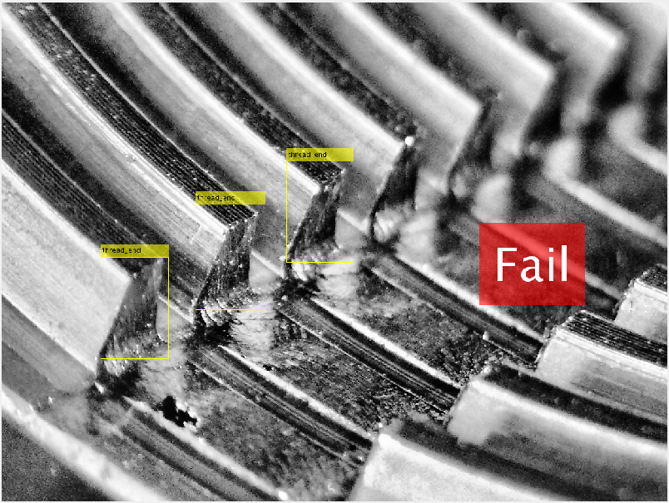
Other Errors
“Double Count” Error. ROI too large.
Missing Keyhole Error. Typically affects 1st or 4th key

Slide 18
Demonstrated Capabilities
Achieved 98.9% fail accuracy on parts with burr
Achieved 94% overall accuracy
Tendency to fail parts without burr
Average time for 4 threads of 0.056 seconds
Approximate full keyway time of 0.226 seconds
Notes:
Insert a tabular form of Section 4.1 from the Characterization Report.

Slide 19
Future Work
Develop rig for two cameras of smaller size
ROI definition hard coded
Larger sample base for training
Establish communication between MVBDS and robotic systems
Program robot to bring part to camera rig for burr detection process
Notes:
BRIEFLY give 2-4 bullets of future work. BRIEF

Slide 20
Acknowledgments
Mike Bowman & David Leal of Hunt & Hunt
Dr. Chen, our Academic Advisor
Dr. Stapleton
Dr. Compeau
Sarah Rivas, College of Engineering Administration
Notes:
Create a bulletized version of Section 13 from the Final (2nd Semester) Report.

