Slide 1



An-IP Based Tool for Scheduling Patients and Providers at Outpatient Clinics
Darbie Walker
Emma Shanks
David Montoya
Adolfo Weiman
Dr. Eduardo Perez
Dr. Lenore DePagter
IE Senior Design 2015

Slide 2

Agenda
Motivation
Background and Problem Statement
Solution Approach
Computational Study
Conclusions and Recommendations

Slide 3
Background
Setting
Focus: multi-specialty outpatient clinic
Live Oaks Health Partners is a multi-specialty group of physicians and healthcare providers.
It is also affiliated with the Central Texas Medical Center
Clinic Objectives
Achieve equitable access for patients
Serve the agreed number of patients
Use resources efficiently

Slide 4

Background
Long wait times are the major reason for patient service dissatisfaction
Patients visiting the clinic for the first time require a longer check-in period than existing patients and therefore increasing the total processing time
Service times vary depending on both doctor and type of patient
Each of the doctor’s schedules are unique and vary by day
Notes:
Patients expect short waiting times resulting from these activities; otherwise, there will be patient dissatisfaction and inadequate utilization of resources that will impact the clinic’s quality of service.
Graph axis represent new patient arrival saturation, and the corresponding waiting time for low, normal and high conditions.

Slide 5
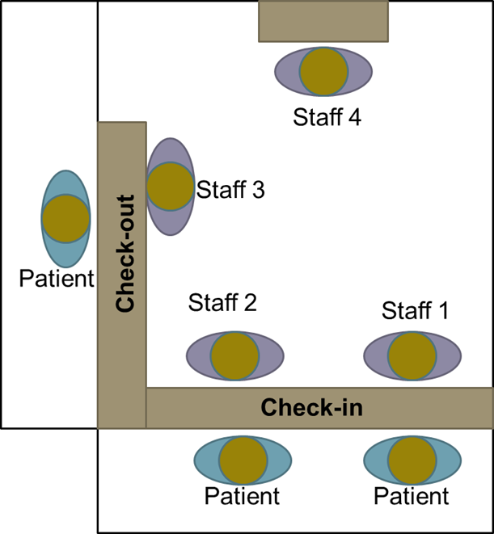
Previous Work
  In Mocarzel et al.,13 results showed that patient waiting time at the front desk increases when multiple new patients are scheduled at the same appointment time.
  We learned that waiting time can be reduced by optimizing the number of new patients scheduled at each appointment period.
Exit
Entrance
Notes:
Patients expect short waiting times resulting from these activities; otherwise, there will be patient dissatisfaction and inadequate utilization of resources that will impact the clinic’s quality of service.
Graph axis represent new patient arrival saturation, and the corresponding waiting time for low, normal and high conditions.

Slide 6
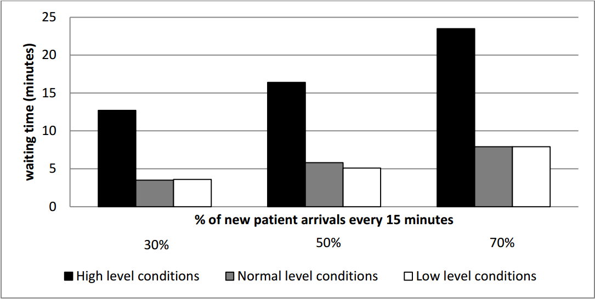
Previous Work
Figure 2: Patient waiting time for check-in under different new patient arrivals’ scenarios
This table represents the conclusions of previous work
It is broken into three patient arrival percentages
  30% new, 70% existing
  50% new, 50% existing
  70% new, 30% existing
Also shows high, normal, and low level conditions

Slide 7
Problem Statement
Research Objective:
Optimize the patient appointment schedules at the Live Oak Health Partners.
Decrease check-in and check-out waiting times
Decrease number of patients in queue
Decrease workload on staff
Increase doctor utilization
While considering patient no-shows and walk-ins
Notes:
observe clinic
New patients require more time to check-in

Slide 8
Problem Statement
Clinic Description:
The clinic has 7 physicians
  (2 orthopedic, 3 general surgeons, 1 audiologist, and 1 ENT doctor)
The typical morning weekly schedule for the physicians:
Table 1: Morning weekly Schedule for Physicians
Notes:
Although the focus of this work is on the front desk operations, it is important to understand the correlation between the availability of the doctors and the clinic front desk operations. For example, on those days where most of the physicians are available (i.e. Mondays) a higher volume of patients is expected. In contrast, on those days where few of the doctors are available (i.e. Fridays) a low volume of patients is expected. However, doctors availability do not have a direct impact of the number of calls received at the clinic every day.

Slide 9
Solution Approach
Model Abstraction
Develop an Integer Programming (IP) model to optimize patients scheduled
Primary performance measures considered were:
    The waiting time for check-in/check-out
    The availability of doctors
    The doctor’s schedule utilization.
  The choice to use optimization comes from the goal of preventing new patients from being scheduled together but still getting the most patients through the system as possible
Notes:
Discrete-event simulation has been adopted in multiple healthcare settings to study patient management services. This technique can be used to forecast the impact of system changes and to investigate the relationship between variables in the system.
The performance measures considered in this study involve both patient and management perspectives. The primary performance measures considered in this study were: the waiting time for check-in, the waiting time for answering phone calls, the number of unanswered calls, the number of patients waiting in queue for check-in, the patient waiting time for check-out, and the front desk staff utilization. These performance measures are used in our simulation model to assess the system performance under different possible operational scenarios at the clinic.

Slide 10
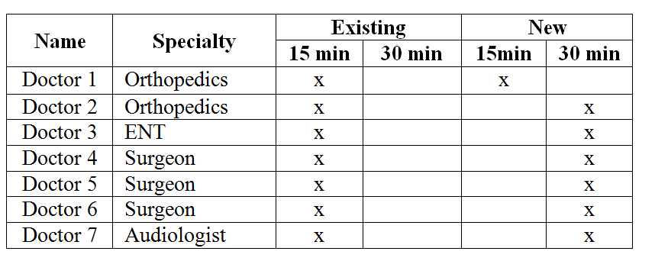
Solution Approach
Data
Data was collected at the clinic by tracking daily requested appointments.
Table 2: Appointment durations for new ad existing patients
Table 3: Appointment durations for new and existing patients

Slide 11
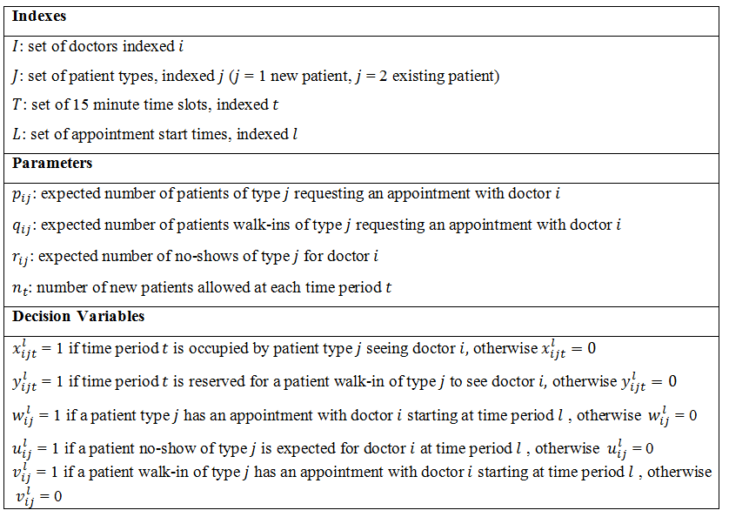
Solution Approach
Model Formulation
Table 4: Scheduling problem sets, parameters and variables
Notes:
new patients usually take more time that returning patients
The practical setting of the clinic involves four resources (i.e. staff members) and different types of entities such as: patients, phone calls, and documents to be completed. These entities are described in the context of model abstraction and are used to derive the clinic’s front desk simulation model.
Arena was used to create the discrete-event simulation model.

Slide 12
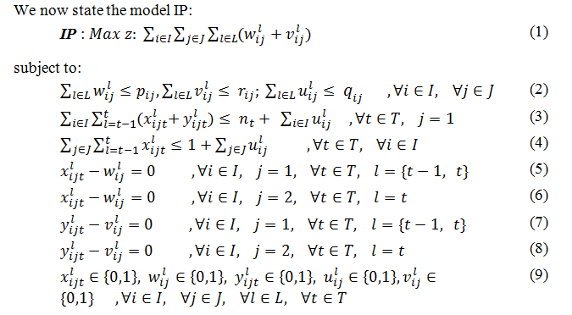
Solution Approach
Model Formulation
Figure 2: IP formulation

Slide 13
How we formulated the model
Constraint 1- ensures the maximum number of patients are scheduled for each doctor
Constraint 2- ensures that at most n_t patients per time period
Constraint 3- ensures that one patient is scheduled per doctor per time period
Constraint 4- used to reserve sequential time periods for appointment lasting more than 15 mins

Slide 14
Solution Approach
Software Review
Microsoft Excel Solver
  Since the amount of variables is so high, the Excel solver add-in alone can not produce a solution.
Open Solver
  Open solver is open source software Excel add-in that removes the max variable restriction that is default in all versions of Excel.
  In most cases it can find solutions in less than 30 seconds.
  More information can be found at: www.opensolver.org

Slide 15
Solution Approach
Verification and Validation
The model was implemented in Microsoft Excel and tested using the clinic simulation model by Mocarzel et al. (2013).
Assumptions:
  Patients arrivals follow Poisson distribution
    Based on historical data
  Patient types and doctor specialty types requested
    Based on empirical distributions

Slide 16
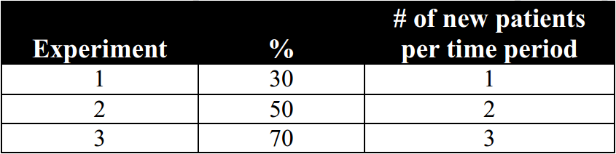
Experimental Setup
Test Cases
Three scenarios are considered:
  30% New, 70% Existing
  50% New, 50% Existing
  70% New, 30% Existing
The maximum number of patients arriving in one period must be seven therefore, n_{t} can be computed as:
Which yields:
Table 5: Number of new patients allowed to be scheduled per time period
Notes:
To limit the number of new patients per time period.

Slide 17
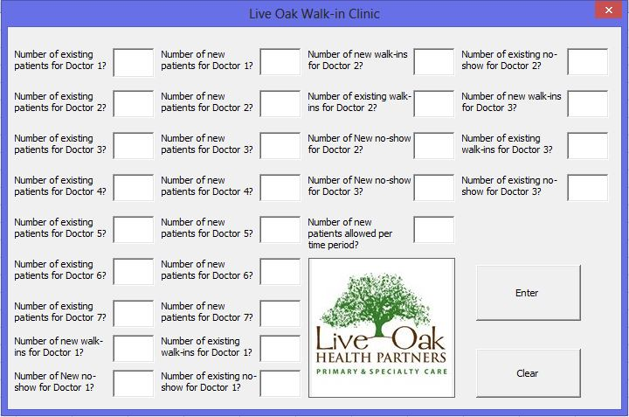
Interface Input

Slide 18
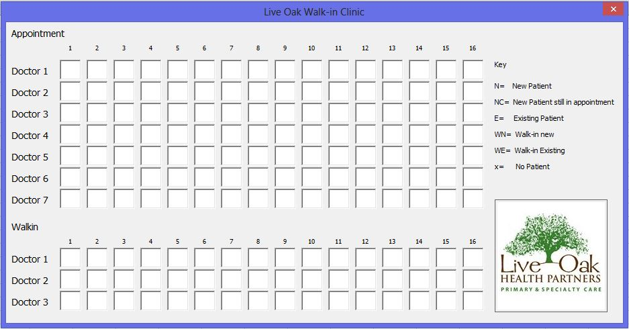
Interface Output

Slide 19

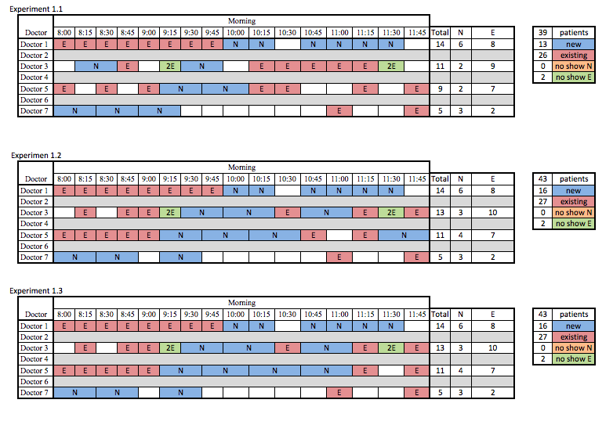
Computational Results
Figure 4: Monday schedule with only 30% new patients allowed per time period
Monday is shown because gathered data showed it to be the most requested day by patients and therefore the busiest.
39 out of 45 patients scheduled
1 existing left out, 5 new left out
Notes:
Due to space limitations, we report and discuss the results for only
one of the day of the week, Monday. Monday was selected because is one of the days with higher demand. However, only five of the seven doctors are available on Monday as reported in Table 2

Slide 20
Computational Results
Figure 5: Monday schedule with only 50% new patients allowed per time period
The IP model solution provided a schedule to accommodate as many patients as possible
43 out of 45 were scheduled
Only 2 new patients weren’t scheduled

Slide 21
Computational Results
Figure 6: Monday schedule with only 70% new patients allowed per time period
It is observed that no change in the amount of patients schedule happened when increasing the percentage of new patients arriving at each time period from 50% to 70%. Still two patients unscheduled.

Slide 22
Computational Results
Recommendations
The clinic can accommodate more patients when two new patients are allowed to be scheduled per time period.
However, to minimize waiting time at the front desk, the number of new patients arriving per time period should be limited to one.
Therefore:
There is a trade-off between the maximum number of patients that can be scheduled at the clinic versus the patient waiting time at the front desk.

Slide 23
Conclusions
An Integer Programming model was developed in order to improve patient admission and doctor schedules in a multi-specialty outpatient clinic
Create balance in the schedule of new and existing patients throughout the day.
Conduct experimental scenarios of limiting new patients and the resulting schedule optimization.
Notes:
Since it takes a longer time to check-in a new patient, having multiple new patients arriving at the same time increases the waiting times at the front desk. Also, the extra time involved in checking-in new patients would be obstacle for answering calls.
In our study, most of the patients calling the front desk needed assistance on nurse-related issues, and therefore the switchboard would direct these calls directly to the nurse’s desk.
In our simulated system study, we observed that there would be no need for an additional staff member at the front desk. In addition, the results can be used as guidelines for deciding when will be appropriate to operate with only three staff members.

Slide 24
Questions?

