Slide 1




Networked Object Motion Tracker
Sponsor: Dr. Kevin Kemp, NXP
Faculty Advisor: Dr. Bill Stapleton
End Device / Router Eligible
Thread Router
Border Router / Leader
Thread Link
E2.1: [NOMoT] Networked Object Motion Tracker

Slide 2
Topics
Overview
Design Approach
Results
Future Work
E2.1: [NOMoT] Networked Object Motion Tracker

Slide 3

Project Motivation
The problem:
  To further research Thread Network
  A need for a TWP node to track change & position over time
Why is this important?
  One important thing of the IoT is security
  As more & more chipsets are added cost increases
  Thread Network research will assure M2M/IoT is:
    Micro
    Sturdy
    Robust
    Long-life
E2.1: [NOMoT] Networked Object Motion Tracker

Slide 4

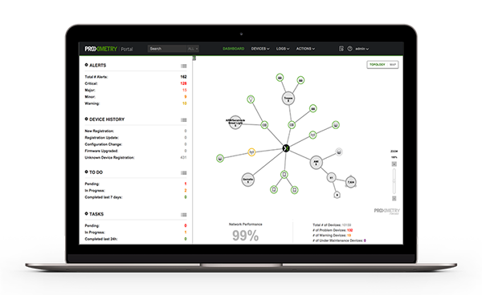
Project Overview
Design and implement a network node motion tracker
  Implement using:
    NXP sensor fusion
    Proximetry
    NXP hardware
Device is to relay data to the proximetry cloud agent
NXP Sensor Fusion Library for Kinetis MCUs
E2.1: [NOMoT] Networked Object Motion Tracker

Slide 5
Our Sponsors
Dr. Kevin Kemp, NXP
Joe Thompson, Technical Advisor, NXP
Dr. Bill Stapleton, Ingram School of Engineering, Texas State University
E2.1: [NOMoT] Networked Object Motion Tracker

Slide 6
Roles & Responsibilities
NAME | Role & Responsibilities
Joe Castellon, Project Manager | Conduct meetings, status reports
Nigel Dalke | Design engineer, liaison
Murphy Granillo | Verification & validation
Derek Kostiha | Design engineer
E2.1: [NOMoT] Networked Object Motion Tracker

Slide 7


Budget
ITEM
Portable DC Power Supply | $ 35
TWR-KW24D512 | $ 149
TWR-ELEV | $ 39
TWR-SHIELD | $ 35
FRDM-STBC-AGM01 | $ 16
TOTAL | $ 274
E2.1: [NOMoT] Networked Object Motion Tracker

Slide 8
Constraints
Complexity and limitation on information resources
Lack of specific technical skills on the team
E2.1: [NOMoT] Networked Object Motion Tracker

Slide 9
Block Diagram
E2.1: [NOMoT] Networked Object Motion Tracker

Slide 10
Design Decisions
TWR-KW4D2K512
  NXP next generation IEEE 802.15.4 smart radio platform; used for thread communication
Use of 9-axis sensors
  Use of data from sensors are “fused” to compute something more than can be determined by anyone sensor alone
  Use of pressure sensor for altitude considered, but discarded
E2.1: [NOMoT] Networked Object Motion Tracker

Slide 11
Design Approach
Sensor Fusion Libraries
  Available using Kinetis Design Studio
IAR Embedded Workbench
  Used for thread example and for project progress
Helpful classes
  Microprocessors
  Circuits I & II
  CS 1308, CS 2308
E2.1: [NOMoT] Networked Object Motion Tracker

Slide 12
Results
Software sending information to THREAD
Data is collected through 9-axis sensor board. Estimation of displacement is accomplished with this data, but this is not calculated on the device
Accuracy in these estimations are within 5%
E2.1: [NOMoT] Networked Object Motion Tracker

Slide 13
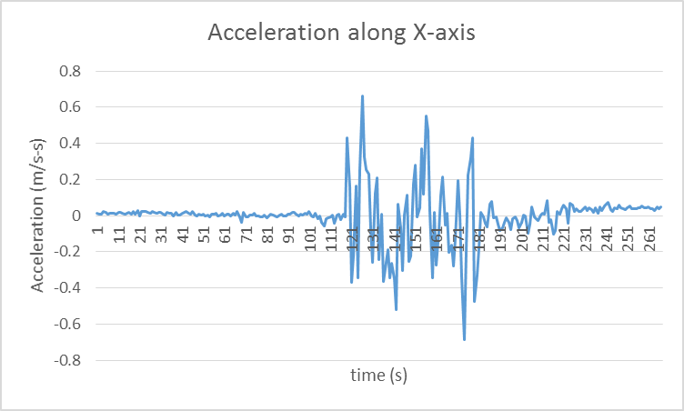
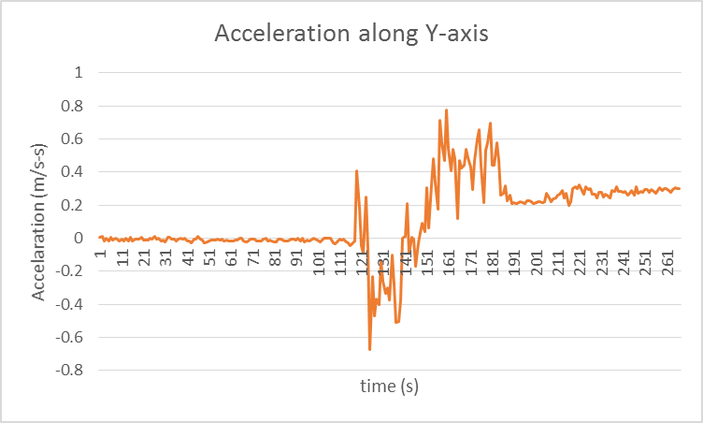
E2.1: [NOMoT] Networked Object Motion Tracker

Slide 14
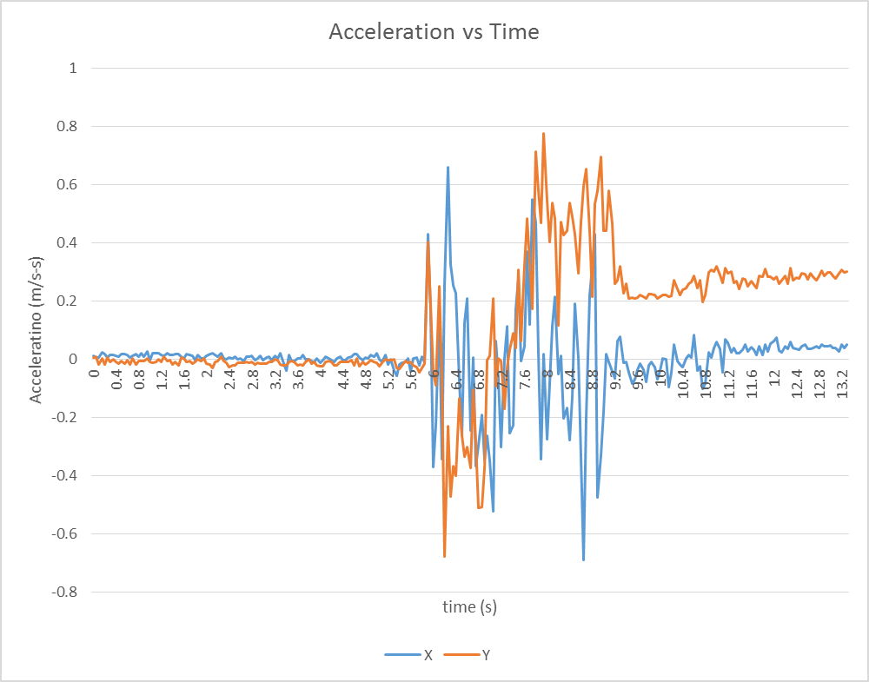
E2.1: [NOMoT] Networked Object Motion Tracker

Slide 15
Future Work
Implementation of object tracking
Durable housing unit
Code refinement
E2.1: [NOMoT] Networked Object Motion Tracker

Slide 16



Joe Castellon Project Manager
Test Bed
Nigel Dalke
Design Engineer
User Interface
Murphy Granillo
Verification & Validation
Derek Kostiha
Design Engineer
CAD/Assembly
E2.1: [NOMoT] Networked Object Motion Tracker

