Slide 1



2.1 RFID Inventory System
Cody Lovejoy Ramsey Doany Kyle Jones

Slide 2

Problem Statement
The International Space Station (ISS)
Power Consumption
Current RFID Inventory System
  Inefficient
  Wasteful

Slide 3



What is RFID?
Radio Frequency Identification
  Credit Cards
  Key Cards
  Inventory

Slide 4


RFID System
Tag
Reader
Passive
RLC Circuit
  Induction
  Frequency
  Antenna
Microchip
  Data (128 bit)
  Random Number Generators
    Handle
    Response Delay Time
Antenna
Transceiver
Computer/Software
  Modulation/Coding
  Demodulation/Decoding

Slide 5
Current Operation (TDM)
Tag Power-Up/Search Query
Load 2^{Q}-1 Bit RNG
Decrement/Search Query
Handle Number
ACK
Tag Data
ACK/Tag Power-Down

Slide 6
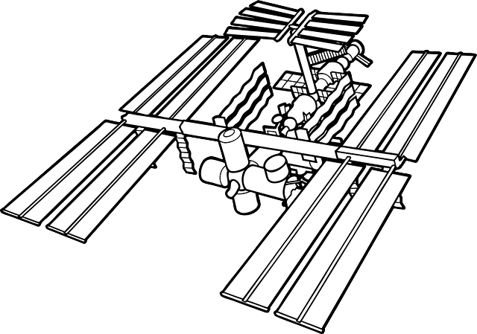
Proposal & Requirements
TDM CDMA/DSSS
Conform to Class I Gen. II Specs
75% reduction in power consumption
Read 5 tags simultaneously
  80% Accuracy (for initial
  prototype)
Alien ALR 9900+
Software simulation
Hardware Simulation (stretch goal)

Slide 7
CDMA/DSSS
Code Division Multiple Access (CDMA)
  Multiplexing
  Multiple users occupy channel simultaneously
  Orthogonal spreading codes
Direct Sequence Spread Spectrum
  Spreading signal bandwidth
  Increase transmission speed
  Bit redundancy

Slide 8
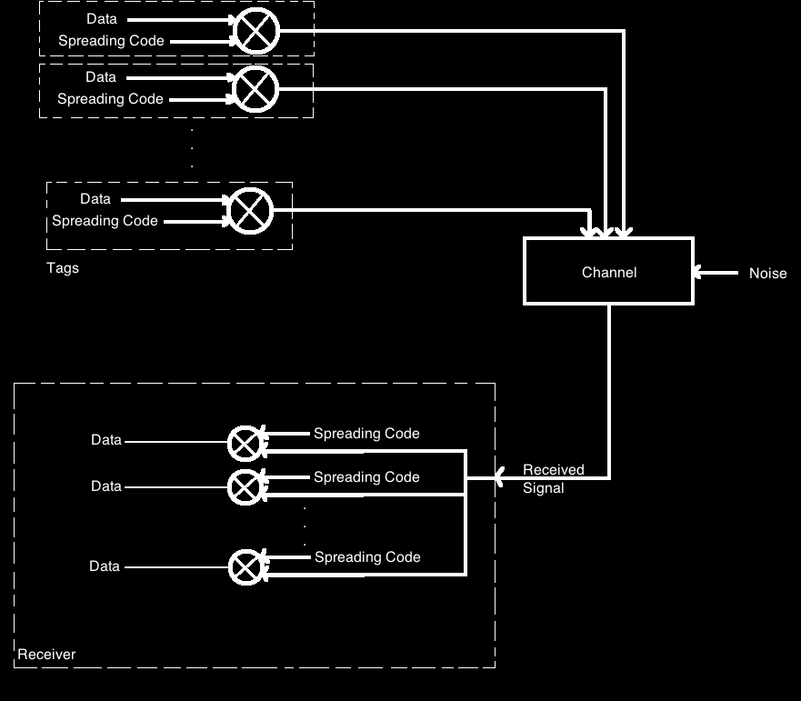

Slide 9
CDMA-Based RFID System
Tag Power-Up/Query
Tag Data
Single “beckoning” signal
All tags respond simultaneously (128 bit EPC data)
Reader receives summation of all tag transmissions
Reader demodulates/decodes signal

Slide 10


Superiority of CDMA-Based System
TDM-Based System
CDMA-Based System
“Brute force” method
At least 69 transmissions (5 tags, assuming no collisions)
Reader constantly scanning
1 transmission (any number of tags)
98.5% less power consumption

Slide 11

Budget
$600
Alien RFID hardware, testing equipment, and software provided by Texas State University
None of budget was used

Slide 12
Constraints
Technical
  Limited number of orthogonal spreading codes
Non-Technical
  Proprietary design/Industry secrets
  Manufacturability
  Economies of scale

Slide 13
System Outline
5 simulated tags
  8 bits of data
  Spreading code (Processing Gain of 16)
Transmission
  Bit streams summed (128 bits total)
  ASK modulation
Reception
  ASK demodulation
  Re-application of spreading codes

Slide 14

Tools
Alien RFID Development System
  Reader
  Tags
Oscilloscope & Spectrum Analyzer
  Characterization of RFID Signals
RF Signal Generator
  Transmission
HackRF
  Reception

Slide 15

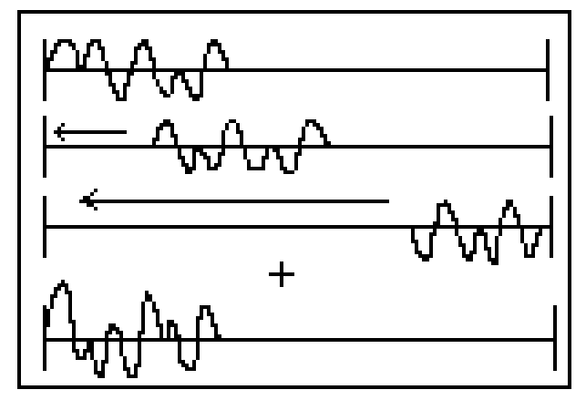
Software Design & Demo
DATA
&
AIC
SW
DEMOD
SW
MOD
DATA
FUNCTION GENERATOR

Slide 16
Hardware Design & Demo
DATA
HackRF
FUNCTION GENERATOR

Slide 17
Adaptive Interference Cancellation
Apply first despreading code to extract first signal
Decode first signal
Subtract first signal from conglomerate received signal
Apply second despreading code to extract next signal
Decode second signal
Subtract second signal from conglomerate signal
Continue until all signals are decoded
Used in Software Simulation

Slide 18
Results
Proof of CDMA RFID concept
Addition of adaptive interference cancellation
Proof of reduction in power consumption
  92%+ decrease
Feasibility

Slide 19
The Future
Greater error control capability
  Coherent PSK
  Adaptive Interference Cancellation (Hardware)
Class I Gen III tags with CDMA capability
Use in remote and/or handheld applications
Adding Locating capability

Slide 20
At Our Booth
Software Simulation
  With adaptive interference calculation
Hardware Simulation
  Transmitter
    CDMA Encoding
    Modulated waveform transmission
  Receiver
    Modulated waveform reception
    CDMA Decoding
Mathematical proof of claims

Slide 21
Questions?

