Slide 1

Inventors’ Handbook
Office of Commercialization and Industrial Relations
Texas State University

Slide 2
Texas State University recognizes that research and scholarship by its faculty, staff and students will result in inventions, discoveries and other intellectual creations with potential societal benefit and market value. These include, but are not limited to:
biological and other proprietary materials
plants
computer software
trade secrets
medical treatments
devices
pharmaceuticals
phrases
graphic designs
manuscripts
and musical, artistic, and literary works.

Slide 3
Texas State University’s IP policy seeks to protect the interests of individual inventors, researchers, creators and the university while also ensuring that the Texas State community and society benefit from fair and full dissemination of knowledge and innovation. This policy intends to foster the traditional freedoms of the Texas State faculty, staff, and students in matters of publication and invention through a fair and reasonable balance of equities and interests among creators, sponsors, and Texas State.

Slide 4
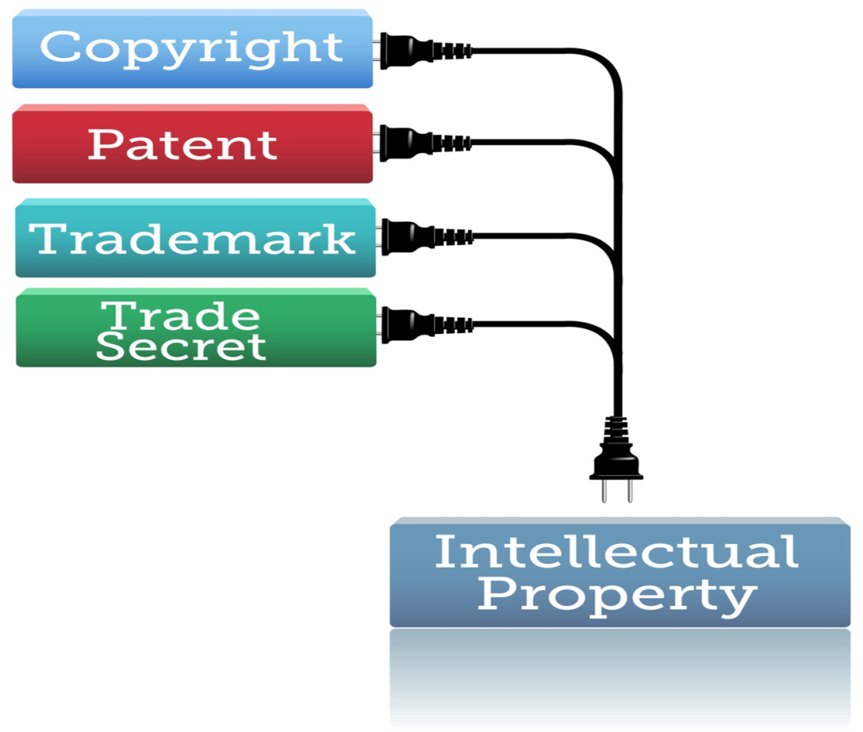
The Office of Commercialization and Industrial Relations (OCIR) is available to assist you in the process of protecting intellectual property and moving your invention towards commercialization. OCIR is located in the JCK Building, room 489.
University patent policy can be found in the TSUS Regents Rules, Section III, 12.1-18.

Slide 5
What is an invention or work ?
In general, an invention or work is fully conceived when you can reduce it to practice without any further innovation.

Slide 6

Who is an inventor?
Inventorship is defined by US patent law. An inventor is anyone who made significant contributions to the invention. Someone who merely followed the plan or direction of a manger or faculty member is not an inventor

Slide 7
What is Public Disclosure?
ANY publication, discussion, talk, presentation, conversation made concerning the work. Included in this category are:
Student posters
Presentations
Thesis or dissertations

Slide 8

Prior to ANY public disclosure:
Notify OCIR that you have a discovery by contacting:
Dr. Reddy Venumbaka at reddy@txstate.edu
512-245-2672 or
Teresa Carey at tx18@txstate.edu
512-245-2314

Slide 9

Why is this important?
Foreign patent filings require absolute novelty. Any public disclosure will automatically bar the invention from being patented outside the US.

Slide 10

Disclosing your invention and discoveries

Slide 11
Inventors/researchers should submit a disclosure form to the OCIR for all inventions and copyrightable works that you feel may solve a significant problem and/or have significant commercial value.
The disclosure to the OCIR is NOT a public disclosure.

Slide 12
If government funds were used for your research:
you are required to file a prompt disclosure so the Texas State may meet its reporting requirements to the sponsoring agency.
Similar requirements may exist for other sponsored projects.

Slide 13

Protecting the intellectual property depends on receiving a timely disclosure.

Slide 14
The Disclosure Form
The disclosure form is located on the OCIR website.
http://www.txstate.edu/ocir/For-Inventors/Invention-Disclosure.html
Download and complete the Disclosure Form from OCIR website:
The form answers some basic questions about your invention including who was involved, who provided funding for the work and if there were any publications among other things. It should also have a description of the invention that can be understood by people who are not scientists.
Submit form to Dr. Reddy Venumbaka or Teresa Carey

Slide 15
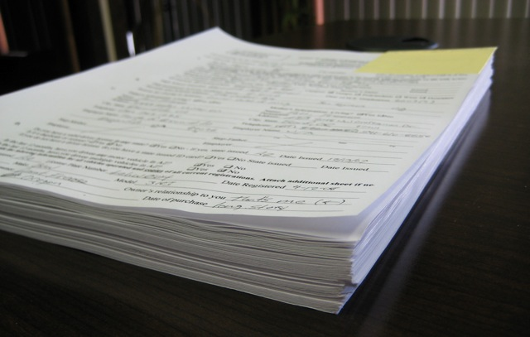
The disclosure form documents the circumstances under which your invention occurred or the details of the completion of your copyrightable work and provides the information necessary to evaluate patentability, inventor/authorship issues, commercial potential, and any obligations to research sponsors. It also begins the process that may lead to the commercialization of your discovery.

Slide 16
Keep OCIR informed of publications, talks, and interactions with companies related to your discovery
Respond to requests for information and documentation. Your cooperation with the OCIR and our IP attorney is essential to the process

Slide 17
How do I know if I should file a disclosure?
You should file whenever you think you have solved a problem or think your discovery may have some value. As an example, you may consider disclosing an invention as you prepare a proposal to take a fully conceived idea and seek funding to prove or disprove its efficacy. However, you may wish to postpone disclosing an invention that you have a general idea on solving a problem and are seeking funding to explore how to implement it. If in doubt, file a disclosure anyway. We will discuss the progress of your work and your options with you.

Slide 18
When should I file a disclosure?
File a disclosure form prior to ANY publication or ANY presentations. Student posters, presentations and thesis or dissertations are also included in this category.
You should give us at least 90 days so that we can file a patent, if necessary.

Slide 19
Can I publish my work and protect my IP?
Yes, but you must contact the OCIR prior to any publication or presentation. We can begin the process of getting your work protected upon receiving the disclosure.

Slide 20
Can I submit proposals containing my IP?
Yes. The University of Cincinnati has created a good guidance document: http://www.ipo.uc.edu/index.cfm?fuseaction=overview.how
OCIR and Office of Sponsored Projects are available to assist you.

Slide 21

Incentive to File Disclosure

Slide 22
As an incentive to help increase the entrepreneurial and commercialization efforts at Texas State, the Office of Commercialization and Industry Relations offers a stipend of $250 to up to 10 lead inventors on individual disclosures, who submit an Invention Disclosure Form during a fiscal year, and has their Invention Disclosure recommended by the Intellectual Property (IP) Committee to file a patent application.

Slide 23

The IP Committee will review all Invention Disclosures and make recommendations regarding the university's interest in filing patents. Once the action to file is taken, a PCR will be processed and stipend paid to the lead inventor.

Slide 24
What happens to my disclosure after I file?
Review & Evaluation
The OCIR in conjunction with the Intellectual Property Committee
reviews the disclosure for potential value.
OCIR may request more information and additional forms to assist with this process.
The Decision to File a Patent
The IP committee will vote on action to be taken based on the information received from the author/inventor and the evaluation of the disclosure.
If the vote is to file or move forward, the OCIR will begin working with the Texas State University System’s contracted IP attorney to file the patent. The inventor’s cooperation in this process is vital to a successful application.
The patent process can take 6 years or more to complete and cost $25,000, or more. However, we can file a provisional patent very quickly to initiate protection.

Slide 25
If the decision is not to file or move forward, the IP committee may recommend that the work be released to the inventor. Approval by the University President is required to release to the author/inventor. A decision to release means that the author/inventor may proceed on his own. However, the University may maintain an interest.
No matter which way the IP committee votes, the inventor will be kept informed of any actions related to the disclosure.

Slide 26

Who owns intellectual property?

Slide 27
Ownership depends on the situation.
Considerations include:
Use of University resources
Terms of research agreements involving the IP
Employment status of listed inventors/authors

Slide 28

When does the University own IP?
If intellectual property is created by an employee within the scope
of employment; or
If intellectual property is created on University time, with the use of
University facilities or state financial support; or
If intellectual property is commissioned by the University, System,
or a component institution pursuant to a signed contract; or
If intellectual property results from research supported by Federal
funds or third party sponsorship.

Slide 29
When does an employee own IP?
If it is unrelated to the employees job responsibilities and the employee made no more than incidental use of university or System resources
If it is an invention that has been released to the inventor in accordance with this Policy; or
If the researcher- or student-authored scholarly, educational (i.e. course
materials), artistic, musical, literary, or architectural work is in the author's field of expertise (from here on, a "scholarly work"), even though such a work may be within the scope of employment and even if university or System resources were used.
UNLESS it is a scholarly work (i) created by someone who was specifically hired or required to create it or (ii) commissioned by the System or a component institution of System, in either case, the University, not the creator, will own the intellectual property. Citation (Intellectual Property in Plain English, UT system)

Slide 30

What if I make a discovery while on Sabbatical?
Sabbatical leave is paid by the University. Depending upon the circumstances, the University will own the IP.

Slide 31

What about discoveries made while consulting?
Consulting arrangements are governed by UPPS 04.04.06, found here:
http://www.txstate.edu/effective/upps/upps-04-04-06.html

Slide 32

Faculty engaging in outside activity including consulting for companies must abide by the following guidelines:
Obtain necessary approvals from your Chair and Dean
Fill out the required form found at: http://www.hr.txstate.edu/Forms/outsideemploymentforms.html
No university resources may be used. This includes your office, computer, lab facilities, and students.

Slide 33
What intellectual property obligations do consultants have to the University?
A consulting agreement is a contract between the faculty or staff member and a company. The university is not a party to a consulting agreement. A consultant usually provides advice, not actual work on the project.
University employees have an obligation to ensure that their personal activities are compliant with university employment policies.
Faculty and staff engaging in outside employment or consulting activities must
disclose any intellectual property or inventions arising from these activities.
The University recognizes the difficulty of invention disclosure when consulting with some commercial business entities. When requested, OCIR can facilitate a confidentiality agreement or Non Disclosure Agreement with the company to cover disclosure of the new invention. University employees engaged in outside employment or consulting activities have an obligation to report any intellectual property developed in the course of their activity.

Slide 34

Sharing Material
What if I’m using someone else's’ materials?
You can use the work of others, and even materials of others, but often permission is needed from the owner/author. Physical materials from outside sources may need a material transfer agreement. Please contact the OCIR if you are using or anticipate using materials owned by someone else. More information can be found on the OCIR website: http://www.txstate.edu/ocir/For-Inventors/MTA.html

Slide 35
Can I share my materials?
Yes. Outgoing material may also require a material transfer agreement. Please contact the OCIR and we will assist you in this process.

Slide 36
Industry Sponsored Research
The Sponsored Research Agreement will often contain the terms designating IP ownership and any interest the sponsor may have in the results of the work. The University retains ownership rights to University developments under most agreements. If you have questions, please contact the OCIR.

Slide 37

Your enthusiasm and network are critical to this part of the process. Please provide contact information for any commercial partners that you know may be interested in your invention. We will make contact and proceed from there. You may be asked to participate in discussions and presentations.
Once a partner is located, a license agreement will be executed. The inventor can contribute to this process by providing contact information with anyone known to have a commercial interest in the discovery. The inventor is not included in the actual negotiation process but we will keep you informed and may ask your advice.

Slide 38
What is a license Agreement?
A license agreement is a legal document obligating the parties to the agreement to certain courses of action. The agreement will outline the rights and obligations of each party. Terms will include ownership of IP, rights in specific field(s) of use, milestones, payment, and more.
How is a licensee chosen?
The University will evaluate the potential partners based on the sound- ness of their business, the expected use of the IP, the commercialization plan for the IP, expected university return, and other factors. Public benefit and the continued right to do research in the field and publish are necessary elements to any agreement.

Slide 39
What is expected of me?
You may be asked to assist the licensee with commercialization of the invention. The relationship may require a consulting agreement or may be infrequent contacts and follow up. It will vary. Participation in startup companies will require significant time contributions depending upon your role within the company.
What do I get out of the deal?
Any financial return to the university is shared with the inventor according to university and Board of Regents policy. With success, an inventor can expect increased opportunities for one’s students, increased opportunities for partnership, consulting agreements, and continued lab funding, and let’s not forget prestige.

Slide 40

A Startup company is a new business enterprise formed to commercialize intellectual property.
Can a faculty member form a start up?
YES. Conflict of interest and commitment issues will have to be addressed. The OCIR can assist with this process.
And the IP?
If university owned IP is a part of the new company’s business plan, the OCIR with work with the company to license the needed IP to the start up. Terms will be negotiated on a case-by case basis.
NOTE: This is not automatic or guaranteed.

Slide 41

Factors considered in the licensing process
Is there a sound business plan?
Is there a sound commercialization plan for the IP?
Is licensing to a startup the best avenue for public benefit?
Is licensing to the startup the best avenue for getting the IP to market?
The startup must be the best choice available for the license to be executed.
Equity
In some cases, the University may accept equity in place of cash when licensing to a startup. The exact percentages and terms are negotiated at the time of license.

Slide 42
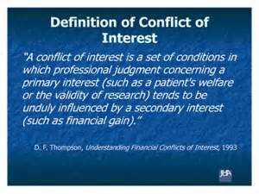
Financial
There is COI when a university employee has a financial interest in a company doing business with the university.
The University requires a financial COI disclosure under the following circumstances:
The employee or close relative of an employee owns 5% or more of a company
The employee or close relative serves on a Board or is in a management position of a company.
The employee is engaging in sponsored research with a company in which he has an interest.

Slide 43
Commitment
A conflict of commitment occurs when a university employee has an interest or employment in a company or other entity, which interferes with his commitments to the University
Other
Nepotism Reporting lines
Account management
What resources are available to help me manage COI?
The official policy and AVPR forms can be found here:
http://www.txstate.edu/research/orc/researcher-conflict-of-interest.html

Slide 44
You will need to disclose the conflict. If sponsored research or other research for a company is involved, the disclosure should be filed with the Office of the Associate Vice President for Research.
Other conflicts are disclosed to your Chair and Dean and may be filed with HR.
The disclosure will be reviewed and a determination will be made: Yes, there is a conflict or No, there is no real conflict.
If it is determined that there is no conflict, you will be notified in writing and the process is complete.
If it is determined that there is a conflict, you will receive assistance from the Office of the AVPR to write a conflict management plan.
The plan will be reviewed and recommendations for approval or revision will be made.

Slide 45

You may be asked to revise the plan. The OCIR will assist you. Upon approval, you will be notified in writing. Please note that there may be cases where conflict cannot be adequately managed. In these rare cases, the University may not be able to move forward with related pending agreements.
What do reviewers look for in a conflict management plan?
The following questions represent a few examples of the areas to be examined:
Can you separate university research from company research?
Can you provide unbiased and appropriate guidance and support to students?
Can you maintain academic integrity in research and education?
Are appropriate cost accounting standards implemented?
How will reporting take place? (OTL,Stanford University)

Slide 46
Annual financial disclosure form is due September 1
http://www.txstate.edu/research/orc/researcher-conflict-of-interest/Pre-Disclosure.html
Relevant Policies
Texas Education Code 51.912
TSUS Rules and Regulations Chapter III sections 12.16-12.18
UPPS 04.04.06 Outside Employment Activities
UPPS 01.04.02 Ethics Policy
NSF 08-1 January 2008 Chapter IV - Grantee Standards
NIH FCOI (42 CFR Part 50, Subpart F)
TXSTATE Financial Disclosure Policy: http://www.txstate.edu/ research/orc/investigator-conflict-of-interest/financial- disclosure.html

Slide 47
Revenue Sharing
If there is any revenue from an agreement, it is shared with the inventor/author according to university and system policy.
First the OTC will deduct any out of pocket expenses associated with the IP. Then 50% of the remaining funds are distributed to the inventor(s).
What about equity?
Faculty may take equity in companies and keep any revenue derived from that equity. Equity holdings must be disclosed according to university policy and state and federal law.
The university may also take equity in companies. Revenue from the university’s equity holdings are not shared with inventors.
Taxes?
The recipient of the revenue is responsible for all related taxes.

Slide 48
LAB Notebooks
Lab notebooks are the property of the University, not the individual.
Why Keep a Lab Notebook?
The lab notebook is an important tool used to document timelines and inventor contributions when a patent is filed. A patent is granted to the inventor who was first to conceive the invention. The notebook established a permanent record of events that can be used to support your claim.

Slide 49
How long do I keep my notebooks?
It can take 2-6 years to obtain a patent. Patents typically run for 20 years. Notebooks need to be available for the life of the patent. Notebooks are a great help in cases of infringement and litigation.

Slide 50
What should be recorded?
Raw data and final results of experiments
• Drawings
• Protocols and designs of experiments
• Calculations on which results are based
• Details of equipment use
• Details of research and developmental
efforts
• Ideas generated in meeting- list who
contributed to the idea
• Dates when idea was formed and when
work was started & completed
• Plans for future experiments

Slide 51
How should information be recorded?
Use archival-quality, bound notebooks with numbered
pages
• Each project should have its own notebook or set of
notebooks
• Number each notebook in multiple-notebook projects
• Make entries in permanent ink
• Use consistent nomenclature
• Enter information on the same day as the event
• Do not skip pages or leave large empty areas
• Write legibly
• Draw a line through discarded entries
• Sign and date each entry & have the entry witnessed by
someone knowledgeable about the work.

Slide 52
How should notebooks be stored?
Maintain notebooks in a central location, preferably a fireproof safe or
file cabinet.
• If there is a sprinkler system, plastic bags should be used.
• Store notebooks in a cool, dry place away from damaging light,
corrosive agents and organic fumes.

Slide 53
Electronic Records
Electronic notebooks are held to the same requirements as hard copy notebooks. Electronic notebooks should be copied to Read-only electronic storage formats with a date stamp on a regular basis. All electronic documents MUST be convertible to a human-readable format. Electronic records need to be updated as the technology changes to meet these requirements.

Slide 54
For questions about university policies regarding industry relationships, patenting and licensing, and technology transfer, please contact:
Office of Commercialization and Industrial Relations (OCIR)
Reddy Venumbaka, Director, OCIR | 512-245-2672 | reddy@txstate.edu
Teresa Carey, Contract & IP Specialist | 512-245-2314 | tc18@txstate.edu
OCIR Office | 512-245-4524 | OCIR@txstate.edu
Additional information is available on the OCIR website

