Slide 1
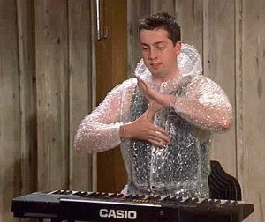
SPORTS CLUB ALLIANCE

Slide 2
Who We Is, Yo?
An oligarchy of ambassadors representing the entirety of Sports Clubs at Texas State to convene about disciplinary cases, budget hearings, policy changes, and petitioning sport clubs.

Slide 3
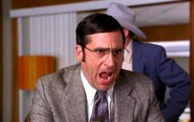
Causes of Disciplinary Hearings
Travel
Improper Club Accounting
Misconduct
Drug and Alcohol

Slide 4
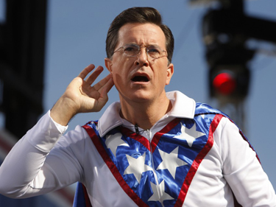
Disciplinary HEARings
Request to assemble with Sport Club Director (Cassie) and/or Graduate Assistant (Max)
Meet with Sport Club Alliance
Consequence Sentencing
Probationary period, community service, sanctions, traveling limitations, etc.

Slide 5
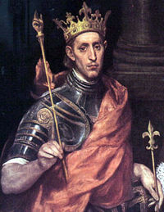
Policy Changes
Come to us!
Improve upon any system glitches
Please have well thought out concerns

Slide 6
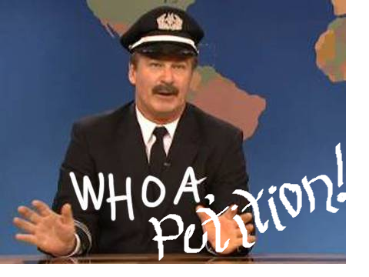
We approve or disapprove of organizations interested in becoming part of our Sport Club family based on :
Nationwide Interest
Presentation
Calendar
Commitment
BUDGET

Slide 7
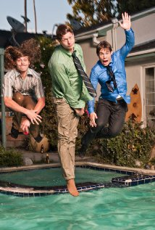
Budget Hearings, Ya’ll
Professional Developmental Experience
Bobcat Scoreboard

Slide 8
Example:
Bobcat Scoreboard

Slide 9
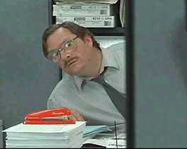
Questions?

