Slide 1
Temperature Signal Simulator
Sponsor: Emerson- Kent Burr
Advisor- Dr. Semih Aslan
Group: NPPH(2.4)
Victor Pinones, Taylor Nash, Rey Perez, and Travis Howell
Notes:
Victor

Slide 2
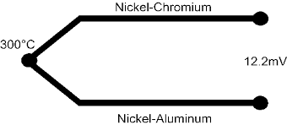
What is a Thermocouple?
Two wires made up of different metals
Seebeck effect/Thermoelectric effect
At the end that is connected, it is used as the point of measurement to measure a temperature
At the end that is not connected, it is used as the reference side, where the temperature is known
This results in a voltage being produced and using specific thermocouple polynomials the temperature can be calculated and vice-versa
Notes:
Victor: seebeck effect is when a temperature difference exist between two dissimilar electrical conductors and produces a voltage difference between the two substances

Slide 3
Why Emerson Needs A Temperature Signal Simulator
Emerson has three different test teams in Round Rock
They do different types of component testing, maxing out, and configurations
Thermocouples is a very common component they test
They want to be able to simulate thermocouple readings to test the performance of their thermocouple sensor systems
Notes:
Rey: Emerson Process Control makes data acquisition equipment that uses thermocouples. The purpose of this project is to build a system that simulates a variety of thermocouple outputs and is programmable, so that Emerson can use it to test the performance of their thermocouple sensor systems.

Slide 4
Temperature Signal Simulator
Market for Temperature Simulator
small market
results in being expensive
can only simulate one type of thermocouple
requires someone physically having to be there manually simulation various temperature readings
Notes:
The purpose of this project is to build a system that simulates a variety of thermocouple outputs and is programmable, so that Emerson can use it to test the performance of their thermocouple sensor systems

Slide 5
Project Requirements
Simulate all 8 thermocouple types
Input a current signal via CHARM
Output voltage signal to CHARM
Needs to be accurate to 士0.5°
Used to test Emerson’s products
Needs to be 24 bit resolution
Notes:
Travis: Here explain what EMERSON expects our project needs to do ;Mention 24bit resolution;SUMMARY, not a copy of your project requirements sheet (unless it is very short);Single slide only;Use bullet-style list;Give rationale for important requirements;Emerson Process Control makes data acquisition equipment that uses thermocouples. The purpose of this project is to build a system that simulates a variety of thermocouple outputs and is programmable, so that Emerson can use it to test the performance of their thermocouple sensor systems.

Slide 6
Project Description
Using Arduino, ADC/DACs, and Emerson’s CHARMs (I/O devices)
Read in CHARMS 4-20 mA input signal
Convert analog signal into digital signal
Convert into temperature reading using lookup tables and thermocouple polynomials and coefficients
Send digital signal to the optoisolators
Convert the digital signal to an analog signal
Output to another CHARM which displays temperature reading for specific thermocouple onto PC
Accurate to 士1 microvolt by using 24-bit resolution and electrical isolation
Notes:
Travis: Limit technical details;Make basic function clear;State any difficult technical problems here, how solved (or propose to solve)

Slide 7
Total Cost
Arduino $40
DACs $50
ADCs $50
Digital Isolators $60
Total $200
Rest of materials supplied by school and Emerson

Slide 8
Issues
Hardware
Component compatibility
surface mounts and PCB
Kept getting sent the wrong parts
having to send back and wait to recieve correct parts
Software
Emerson provided software to use
only works with PC’s, entire group has MACs
Notes:
Travis: Limit technical details;Make basic function clear;State any difficult technical problems here, how solved (or propose to solve)

Slide 9
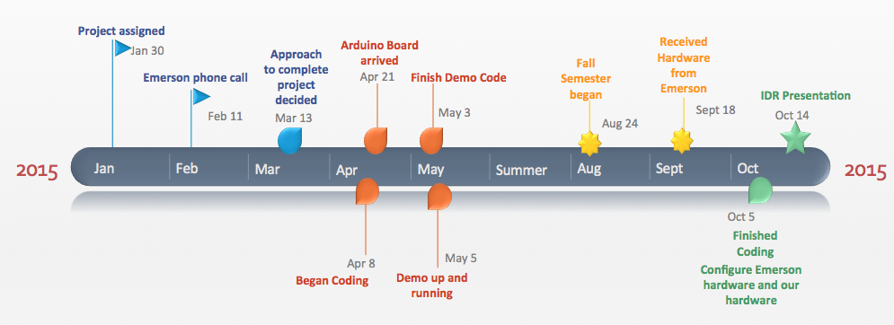
Schedule
Notes:
Taylor: Describe progress up to know
mention any schedule problems in the past and how we resolved them

Slide 10
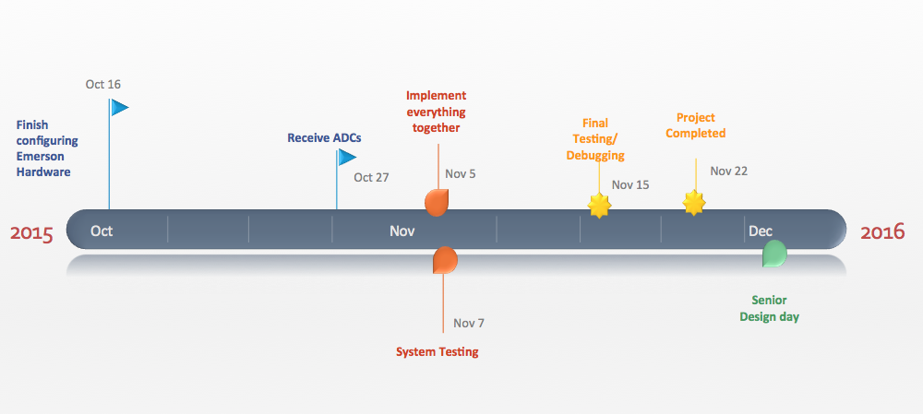
Schedule
Notes:
Taylor: Show proposed timeline from now till project completion;Describe challenges to completing on schedule

Slide 11
References
http://community.emerson.com/cfs-file/__key/communityserver-blogs-components-weblogfiles/00-00-00-02-92/3581.emerson_5F00_electric_2D00_logo.jpg
http://upload.wikimedia.org/wikipedia/en/e/ed/Thermocouple_%28work_diagram%29_LMB.png
http://www.ti.com/graphics/folders/partimages/ADS1675.jpg
http://www.vetco.net/catalog/images/VET-SP-DIP3-1.jpg
http://media.digikey.com/Renders/~~Pkg.Case%20or%20Series/DIP16_SOT38-1%20Pkg.jpg

Slide 12
Questions????

