Slide 1
The Accelerated Learning Program
The Community College of Baltimore County

Slide 2
Student Comments
.
“I’m not sure I’m really college material.”
Notes:
After discussing this slide, Peter turns it back to Sarah.

Slide 3
Student Comments
.
“ I’m really a bad writer
, but my English teacher
thinks I’m a good writer
, so this semester I
wrote really good papers, so she wouldn’t find out what a bad writer I am.”
Notes:
After discussing this slide, Peter turns it back to Sarah.

Slide 4
Co-Requisite Models
What is a Co-Requisite Model?
Developmental programs in which the developmental course is a co-requisite, not a pre-requisite, to the credit-level course.
Notes:
After discussing this slide, Peter turns it back to Sarah.

Slide 5
Co-Requisite Models
Co-Requisite Models
Writing
Center
3 hours
MyCompLab
NCBO
Compressed
Notes:
After discussing this slide, Peter turns it back to Sarah.

Slide 6
ALP
ENG 101
ENG 052
Developmental student are in ENG 101
Cohort effect
Attitude toward the developmental course changes
Allows exposures to stronger role models
Time for non-cog issues
Time for reading
Time for individual attention
Notes:
After discussing this slide, Peter turns it back to Sarah.

Slide 7
How does an ALP developmental class
differ from a traditional one?
Goal of a traditional developmental course:
.
for students to pass the developmental course and be ready for first-year composition.
Goal of an ALP developmental course:
for students to pass first-year composition course.
Notes:
After discussing this slide, Peter turns it back to Sarah.

Slide 8
traditional
stand-alone
developmental writing
high school
or
middle school
ALP
ENG 101

Slide 9
traditional developmental students:
fall 2007 –
fall 2010
took
ENG 052
Fa07-Fa10
5545
100%
passed
ENG 052
3604
65%
took
ENG 101
2661
48%
did not pass
ENG 052
1941
35%
took no
more writing
courses
943
17%
ALP students:
fall 2007 –
fall 2010
took
ENG 052
Fa07-Fa10
592
100%
passed
ENG 052
485
82%
took
ENG 101
592
100%
didn’t
pass
ENG 052
107
18%
took no
more writing
courses
0
0%
data from Cho, Kopko, & Jenkins, 2012 (CCRC)

Slide 10
traditional developmental students:
fall 2007 –
fall 2010
took
ENG 052
Fa07-Fa10
5545
100%
passed
ENG 052
3604
65%
took
ENG 101
2661
48%
passed
ENG 101
Fa07-Fa10
1829
33%
did not pass
ENG 052
1941
35%
took no
more writing
courses
943
17%
didn’t pass
ENG 101
Fa07-Fa10
832
15%
ALP students:
fall 2007 –
fall 2010
took
ENG 052
Fa07-Fa10
592
100%
passed
ENG 052
485
82%
passed
ENG 101
Fa07-Fa10
438
74%
took
ENG 101
592
100%
didn’t
pass
ENG 052
107
18%
took no
more writing
courses
0
0%
didn’t pass
ENG 101
Fa07-Fa10
154
26%
data from Cho, Kopko, & Jenkins, 2012 (CCRC)

Slide 11
traditional developmental students:
fall 2007 –
fall 2010
took
ENG 052
Fa07-Fa10
5545
100%
passed
ENG 052
3604
65%
took
ENG 101
2661
48%
passed
ENG 102
554
10%
passed
ENG 101
1829
33%
did not pass
ENG 052
1941
35%
took no
more writing
courses
943
17%
didn’t
pass
ENG 101
832
15%
F, I, or W
in
ENG102
167
3%
ALP students:
fall 2007 –
fall 2010
took
ENG 052
Fa07-Fa10
592
100%
passed
ENG 102
195
33%
passed
ENG 052
485
82%
took
ENG 101
592
100%
passed
ENG 101
438
74%
didn’t
pass
ENG 052
107
18%
took no
more writing
courses
0
0%
haven’t passed ENG102
101
17%
didn’t
pass
ENG 101
154
26%
data from Cho, Kopko, & Jenkins, 2012 (CCRC)

Slide 12
Percent Earning 12 or More Credits within 1 Year
traditional dev writing
ALP
40%
39%
38%
34%
35%
33%
30%
20%
20%
15%
16%
14%
10%
13%
N=1406
N=149
N=1328
N=288
N=1042
N=550
N=884
N=587
N=687
N=669
Fall
2009
Fall
2010
Fall
2011
Fall
2012
Fall
2013

Slide 13
Success Rates for 7 Participating Colleges
94%
comparison cohort
86%
ALP cohort
82%
75%
76%
73%
68%
50%
51%
48%
47%
38%
39%
37%
33%
35%
25%
A
5-10000
suburbs
Midwest
B
10-20000
suburbs
Midwest
C
20000+
urban
Southwest
D
<5000
small town
Midwest
E
<5000
suburbs
Southeast
F
<5000
rural
Southeast
G
5-10000
small town
Mid-Atlantic

Slide 14
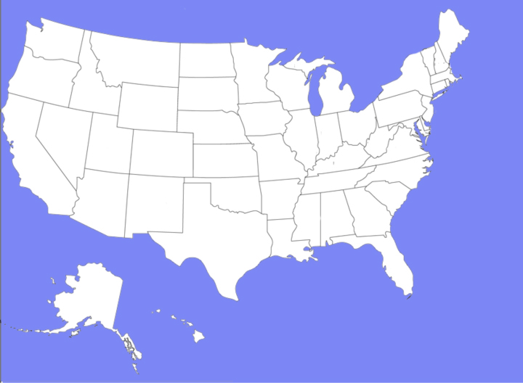
257 schools

Slide 15
Number Taking ALP or Traditional Each Fall
1406
1400
1328
traditional dev writing
ALP
1200
1142
1042
1000
966
884
800
700
687
670
669
587
590
600
550
408
400
288
200
149
34
68
Fall
2007
Fall
2008
Fall
2009
Fall
2010
Fall
2011
Fall
2012
Fall
2013
Fall
2014
Fall
2015

Slide 16
Number Taking ALP or Traditional Each Fall
1406
1400
1328
traditional dev writing
ALP
1200
1142
1042
1000
966
884
800
700
687
670
669
587
590
600
550
408
400
288
200
149
34
68
Fall
2007
Fall
2008
Fall
2009
Fall
2010
Fall
2011
Fall
2012
Fall
2013
Fall
2014
Fall
2015

Slide 17
Analyzing Pass Rates
8000
7589
7000
traditional
ALP
6000
total
5343
5000
4000
3000
2246
2000
1000
number
in cohort
2009-2013

Slide 18
Analyzing Pass Rates
8000
7589
7000
traditional
ALP
6000
total
5343
5000
30%
63%
4781
4000
3000
2993
2246
2000
1584
1409
1000
number
in cohort
2009-2013
number who
passed 101
2009-2013
number who
would have passed 101
if we had fully scaled up

Slide 19
Analyzing Pass Rates
8000
7000
traditional
ALP
6000
total
5000
4781
4000
3576
1788
3000
2993
2000
1000
number
in cohort
2009-2013
number who
passed 101
2009-2013
number who
would have passed 101
if we had fully scaled up

Slide 20
26 Boeing 737-700s
137 seats per plane

Slide 21
Obstacles to Scaling Up ALP
Faculty development
Classroom space
Credentials issues
Integrating reading and writing
Coordinating with advisors
Increasing number of 101s; eliminating freestanding developmental writing courses
Coordination with other acceleration initiatives and student success course
Inertia

Slide 22
100%
Number Taking ALP or Traditional Each Fall
1406
1400
1328
traditional dev writing
ALP
1200
1142
1042
1000
966
884
800
700
669
687
670
587
590
600
550
408
400
288
200
149
34
68
Fall
2007
Fall
2008
Fall
2009
Fall
2010
Fall
2011
Fall
2012
Fall
2013
Fall
2014
Fall
2015
Fall
2016

Slide 23
padams2@ccbcmd.edu
The Accelerated Learning Program
The Community College of Baltimore County

