Slide 1
Understanding Staff PCR Appointments in SAP

Slide 2
Course Objectives
Provide overview of organizational management role and the impact it has on PCR creation
Understanding of regulations and system requirements
Understanding of internal processes in the HR MDC to assure accurate PCR processing and appointments
Overview of different types of PCR templates and actions
Use of SAP PA20 Display

Slide 3
What is Organizational Management?
Provides a real-time view of the organizational structure
Keeps history of the organizational structure as it evolves over time
Provides ability to store the reporting structure on a position level
Provides ability to store security on a position level
Notes:
In order to carry out numerous business and human resources processes, you need an organizational plan, that is a functional structure representing the university.
This structure provides a comprehensive and dynamic model of how the University’s human resources are organized and how that organization changes over time.
Organizational Management also forms the basis for SAP Business Workflow.
The organizational plan you create forms the framework for a routing structure that SAP Business Workflow uses to assign tasks to an employee.
For example, creating, routing and approving timesheets and PCRs in the future.

Slide 4
Organizational Objects
Organizational management uses basic objects to describe the organization:
Organizational units
Jobs
Positions
Persons
Cost centers (where HR and FI link together)
By establishing relationships among these objects, a hierarchy that matches the organizational structure is created.
Notes:
An organizational plan consists of objects, much like building blocks, that when linked together form the organizational structure.
This linking occurs when relationships between the objects are created.
These are the five primary objects used to create TX State's organizational structure.

Slide 5
Positions
Each faculty, staff and student employee must be assigned to a position
GROUP POSITION TITLES FOR TASK WORKERS
Staff Task Worker
One per department
Student Task Worker
Created only for departments approved by HR to use task payments for student workers (example – Advertising sales for KTSW or The University Star)
Notes:
The third major object in Texas State’s organizational plan is the position
Positions are:
Individual employee assignments
More specific than the jobs which describe them
Are linked to other organizational objects by relationships
An individual cannot be an employee of the University without being assigned to a position.
A manager is equivalent to the department head, giving them PCR authority.
The Vice Presidents determine which managers are designated as department heads.

Slide 6
Requesting New Positions
A position must exist within SAP before any of these actions can be initiated
New Hire
Re-Hire
Change in Position
Additional Appointment
Notes:
We cannot over emphasize the critical role positions fill in SAP.
What’s the obvious prerequisite for hiring an employee? The existence of a position in your department’s SAP organizational structure.
And that same prerequisite applies to the other actions you see listed on this slide.
If funding has been approved to add a new position to a department, start the new position request process long before an employee is assigned to the position. A New Position Data Form, or NPDF, will need to be completed and submitted to Human Resources for staff, student and non-academic graduate student positions. NPDF forms are submitted to Faculty Records for faculty, academic graduate students and undergraduate instructional students.
This form is available on the Human Resources Website, at www.hr.txstate.edu.

Slide 7
Org Management Transactions
PPOSE - Organizational and Staffing Display
Used to review all positions in an organization
PPSS - Display Structure
Used to review reporting relationships (i.e., which positions report to which positions)

Slide 8
What is a Personnel Change Request (PCR) ?
STAFF PCR actions include
New hires
Rehires
Changes in pay, position and cost distribution
Additional appointments
Leave with and without pay (for leaves more than 30 days)
Return from leave
FTE changes
Separations
Special Payments (awards, stipends, etc.)
Work Schedule Change-electronic action
Change in Position – Transfer to Another Department
Notes:
If the leave is less than 30 days, pay adjustments will be made through time reporting.

Slide 9
Personnel Action Request Processing
Faculty and academic graduate student appointments are processed by Faculty Records.
Staff (hourly and salaried), hourly student workers, and non-academic graduate students’ appointments are processed by Human Resources.

Slide 10
Things to Know Before You Start
Employee appointments are open ended with no termination dates - ending dates are not set up in advance.
The funding for grant employees can have ending dates, however, a funding end date does not end an employee’s appointment or employment.
All employees, including faculty and students, must have a separation PCR prepared so that there will be a vacant position in which to hire or appoint a replacement.
If a separation PCR is not prepared for salaried employees, even those who are temporary, they will continue to be paid once they leave the university.
A separation PCR is not required if an employee is changing departments. The department that is receiving the employee will prepare the PCR.

Slide 11
Things to Know (cont.)
The effective date on a PCR should be the actual date that the action begins
Example: The first date of employment or the last day worked.
The cost distribution on a PCR must always equal 100% even if the employee’s FTE is less than 100%
Basic pay entered is the employee’s actual pay
Example: If an employee is appointed at 50%, the basic pay entered should be 50% of the full-time rate
Notes:
FTEs are not used to calculate pay rates in SAP as they were in the old system.

Slide 12
Concurrent Employment
Employees who fill multiple positions, have multiple reporting lines or multiple pay rates are concurrently employed
Concurrent employees are allowed to have multiple pay rates
Employees who are funded from different sources of funds but perform the same job duties are not concurrently employed
Each staff position that is eligible for the University Longevity Program (ULP) has its own ULP eligibility date and schedule
Notes:
Concurrent employment is needed when you have different rates of pay or different reporting lines or different job duties.

Slide 13
Processing for Less Than 12 Month Employees
Less than 12 month employees will be placed on Leave without Pay status beginning 6/1 and will be returned to Active status 9/1.
The less than 12 month status is designated as the employee subgroup and appears as “< 12 month”
No action is required by the department unless
the staff employee works during the summer,
the staff employee is a working retiree
Notes:
Working retirees and program faculty are not picked up in the mass leave and return from leave actions.
Working retirees and program faculty must have rehire or leave and return from leave actions processed for them so funds can be encumbered and unencumbered in the budget.

Slide 14
Processing for Grant Employees
Cost distribution can change from month to month but the employee remains the same (benefits or non benefits eligible, etc.).
PCRs are only created for the time period when the funding can be assigned at 100%. Most grant employees will have several Change in Cost Distribution PCRs created in one fiscal year.

Slide 15
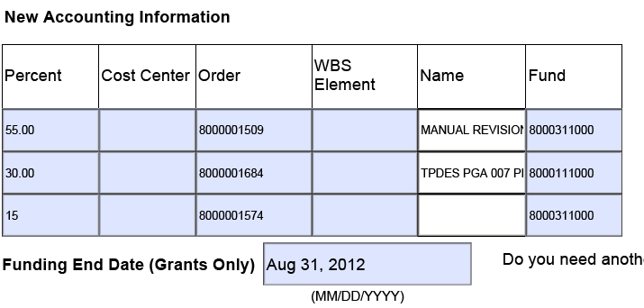
Costing effective through 8/31/2012
Notes:
Another PCR will have to be created beginning 3/1/06 up until the date when the salary can be 100% accounted for.

Slide 16
PCR Forms
PCRs initiated in the system for current employees in your department are pre-populated.
PCRs initiated to transfer an employee from another department will also include information related to the position that they are leaving.
You must use Internet Explorer as your web browser to access your employees in the SAP Portal – E-PCR tab.
Notes:
Pre-population of an employee’s current information includes position, FTE, rate of pay and other relevant information for the personnel action.

Slide 17
PCR Routing for NSNR Hourly Appointments
AA Support/Position (Dept Head Role) - Creator | Chief | Account Manager/PI | VP | OSP | Master Data Center

Slide 18
PCR Routing for Graduate Students
Faculty Records processes actions for academic appointments
Human Resources processes actions for non-academic appointments
Notes:
Academic graduate student PCRs are all approved by the Dean of the college prior to going to the Graduate College.
Non academic graduate dean PCRs are all approved by the Vice President for Student Affairs prior to going to the Graduate College.

Slide 19
PCR Routing for Staff and Faculty
Notes:
Note: Faculty Records reviews staff appointments in Academic Affairs and then forwards to HR for processing.

Slide 20
Common Problems
Hiring departments do not submit the E-PCR and attachments to the processing offices by the published PCR cut-off dates
Employee time cannot be entered until an appointment is entered
Employee paychecks are unnecessarily delayed
New employees do not get access to the system in a timely manner

Slide 21
Common Problems (cont.)
Required documents are completed incorrectly or the support documents are not being attached electronically to the PCR.
I-9s – Completed electronically through HireRight and are not attached to the PCR, but remember, Section 1 must be completed and signed by 1st day of employment; Section 2 & 3 within 3 business days from 1st day of hire.
In addition to I-9, new hire staff salaried employees are required to submit employment application, W-4, and Data Form (obtained at NEO). If male and between ages of 18-26, proof of Selective Service registration.
In addition to the electronic I-9 completion , non-student, non-regular employees are required to submit a NSNR Employment Application, NSNR Data Form and a W-4 and Selective Service, if applicable. Hiring a NSNR instructions are found at: http://www.hr.txstate.edu/hrmasterdatacenter/NSNR-Hiring-Step.html

Slide 22
Recap: Support Documents for Hiring Staff Employees
in addition to the PCR, you will need to attach….
Salaried Staff
*Completion of the E-I-9 and E-Verify
* PCR
*Support documents are obtained at NEW
Hourly Staff
* NSNR Data Form
* NSNR Employment Application
* I-9 form (HireRight)
* W-4
* Male 18-26 – Selective Service

Slide 23
Common Problems (cont.)
PCRs are submitted with incorrect position numbers.
Employees must be compensated within the University Pay Plan range established for the job title.
(to determine hourly rate, multiply monthly salary in pay plan and divide by 2080)
Salaries must be submitted based on the FTE, the system will not calculate a salary for you.
Your division has established electronic flow approval. Remember to submit the PCR in sufficient time to allow for all signature approvals prior to established cutoff dates.

Slide 24
Lessons Learned
Before an employee terminates or moves to another department, it is imperative that all work time is entered and approved.
All employees are paid either monthly or semi-monthly. When employees switch payroll areas mid month it creates processing challenges.
If you have a staff employee that needs to move from one payroll area to another - hourly to salary or salary to hourly, contact Human Resources for guidance before offering the position to the employee or establishing an official start date.
Notes:
This applies when an employee is going from an hourly to a monthly position or vice versa.

Slide 25
Change in Payroll Area
Hourly to salary
Work in position until end of month
Ensure time entry and approval by last working day in hourly appointment CATS_DA
Must attend New Employee Welcome (NEW)
Receipt of email notification from HR MDC verifying start date
Salary to hourly
Work in position until end of month
Hourly appointment starts with 1st of next month
Loss of benefits/state longevity and ULP
Correct time entry CATS_DA

Slide 26
Creating a PCR
Please refer to the Understanding Electronic PCR Process PowerPoint presentation

Slide 27
Demonstration
Notes:
These are some of the most common infotypes that a manager would check on an employee.
These infotypes are best viewed using SAP GUI.

Slide 28
Accessing PA20 in SAP GUI
Infotype 0000 Actions
Infotype 0001 Organizational Assignment
Infotype 0006 Address
Infotype 0007 Planned Working Time
Infotype 0008 Basic Pay
Infotype 0014 Recurring Payments
Infotype 0015 Additional Payments
Infotype 0027 Cost Distribution
Infotype 9001 Staff ULP
Infotype 9003 Rank and Tenure
Infotype 9004 Education
Notes:
These are some of the most common infotypes that a manager would check on an employee.
These infotypes are best viewed using SAP GUI.

Slide 29
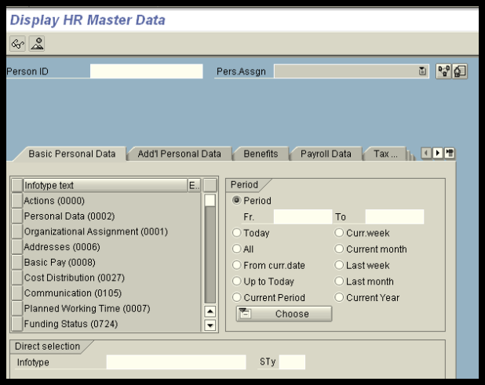
Input Person ID and Select Pers. Assgn if concurrent employee
Notes:
If an employee is concurrently employed in the same department, you can select the assignment to view by using the drop-down on the “Pers Assign” selection.

Slide 30
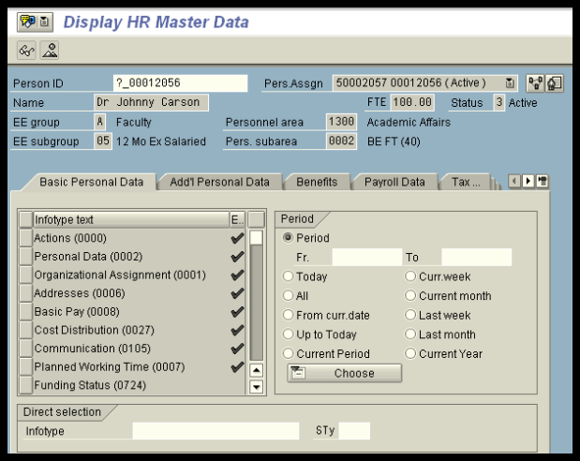
Review Employee Information
Notes:
All information is viewed with the “eyeglass or mountain” view.

Slide 31
Select Infotype or Enter Infotype number
Notes:
The infotype is selected by clicking on the box to the right of the information or can be entered by number in the field at the bottom of the screen.

Slide 32
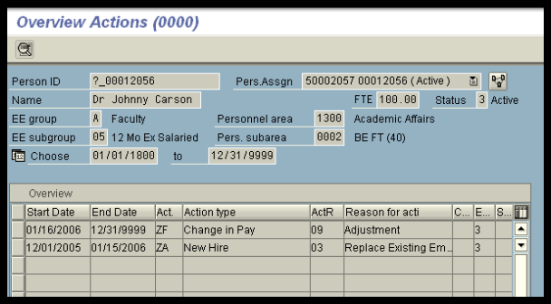
Actions (IT0000)
Notes:
The overview allows you to see all actions that have taken place on an employee. Use the mountain to view a list of all actions. The eyeglasses only allow you to see one action at a time.

Slide 33
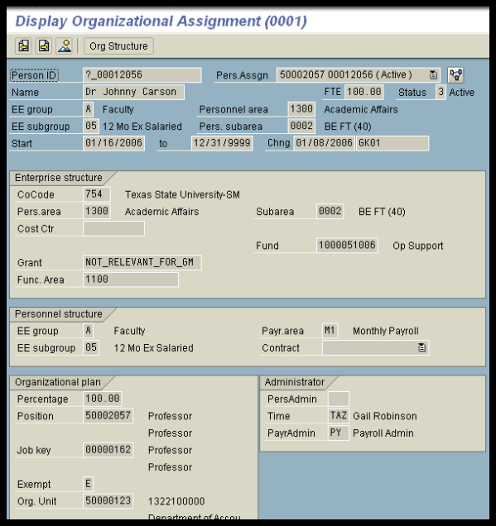
Organizational Assignment (IT0001)
Notes:
This is the one infotype where you will see the employee’s position title.

Slide 34
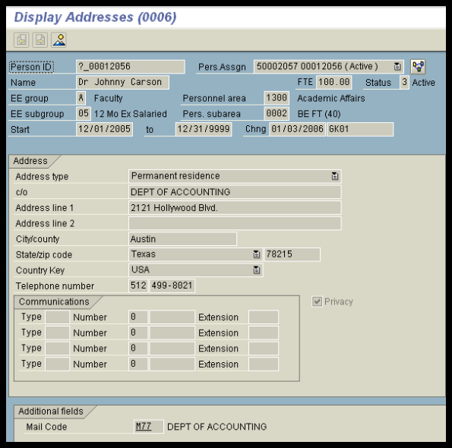
Address (IT0006)
Notes:
A permanent and temporary address can be stored on an employee and the employee can update in ESS. The employee’s personal cell or pager number can be stored in the communications section. The employee will also provide this information through ESS.
The privacy indicator is stored on this infotype which means you cannot release the employee’s address or phone number to anyone if the privacy indicator is selected.
The employee’s university mail code is also stored on this infotype. If a change needs to be made, contact HR or Faculty Records.

Slide 35
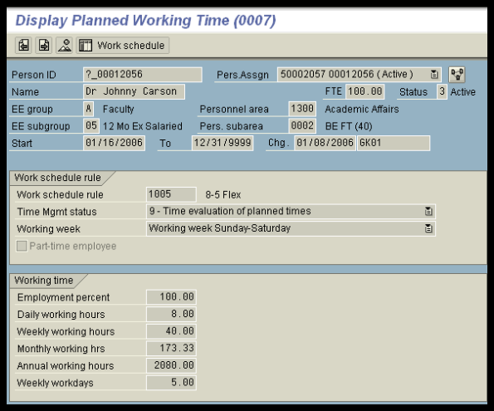
Planned Working Time (IT0007)
Notes:
This is the only infotype where the employee’s employment percent or FTE is stored. Every hourly student and task employee will have an FTE of 100% on each appointment. This is the system default and we will not change it because we do not use FTE for this group of employees.
This infotype allows you to view the work schedule for an employee. This is useful for those departments who have employees who work different work schedules such as the police department and the physical plant.

Slide 36
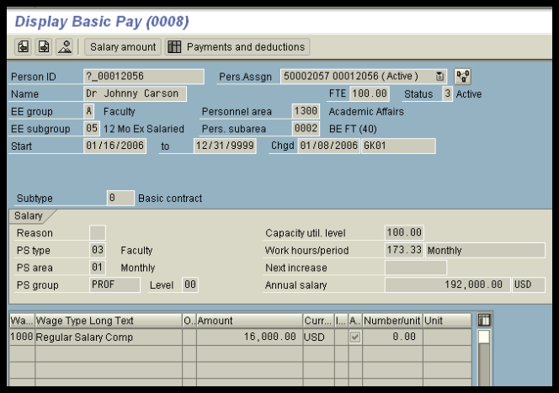
Basic Pay (IT0008)
Notes:
Note: Per course faculty will have a blank on this info type. All salary payments for per course faculty are stored in info type 14, Recurring Payments.

Slide 37
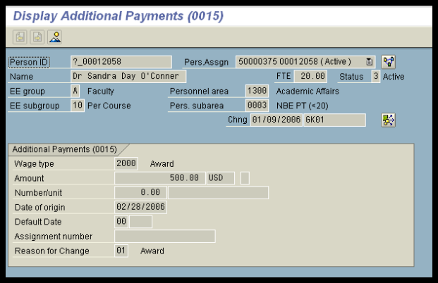
Additional Payments (IT0015)
Notes:
Additional payments are one-time payments such as awards and stipends.
A payment can to be made from an account other than the employee’s regular cost distribution account. The symbol that is circled indicates that another account has been entered for this payment. This can be done for recurring payments, such a teaching overloads as well.

Slide 38
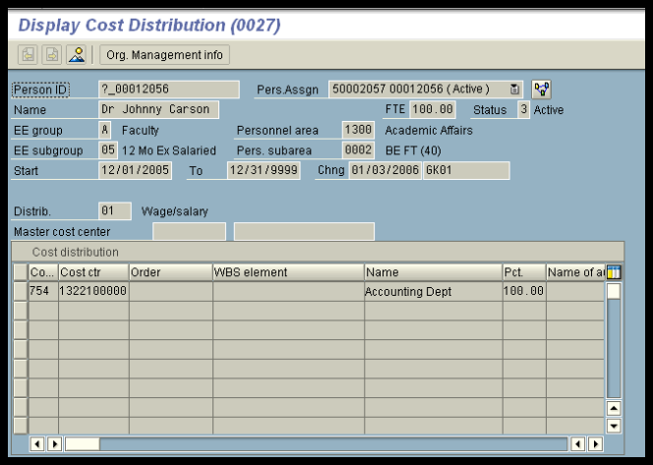
Cost Distribution (IT0027)
Notes:
An employee’s cost distribution must always equal 100%, no matter their employment FTE.

Slide 39
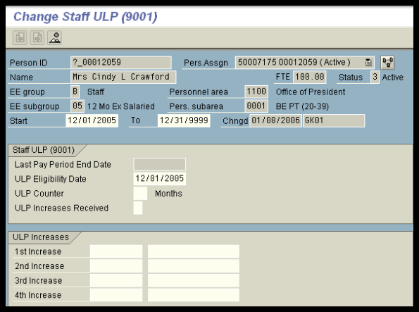
Staff ULP (IT9001)
Notes:
The infotype will show you have many ULP increases an employee has earned on an assignment.
Once payroll is run, the Last Pay Period End Date will be updated.

Slide 40
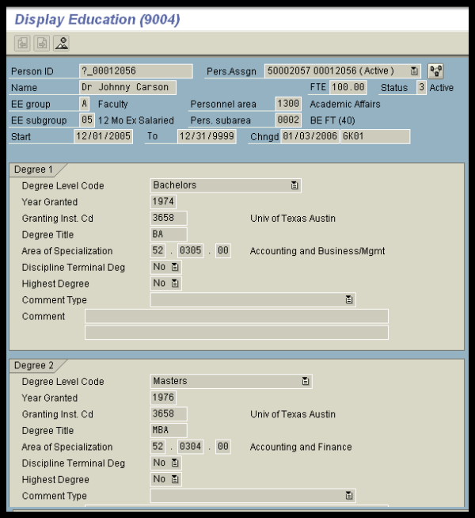
Education (IT9004)
Notes:
The Education infotype was designed to capture up to 7 degrees on an employee.
Degree 1 is always the first or lowest degree held by the employee.

Slide 41
Questions
Katie Bonner | for salaried staff and non-academic graduate students | kb1367@txstate.edu
Teresa Duggins | for NSNR staff hourly and hourly employees | td01@txstate.edu
Lisa Gonzalez | for hourly students | lisag@txstate.edu
Elizabeth Mello | Faculty Records, for faculty, academic graduate students and undergraduate instructional assistants | es15@txstate.edu

