Slide 1



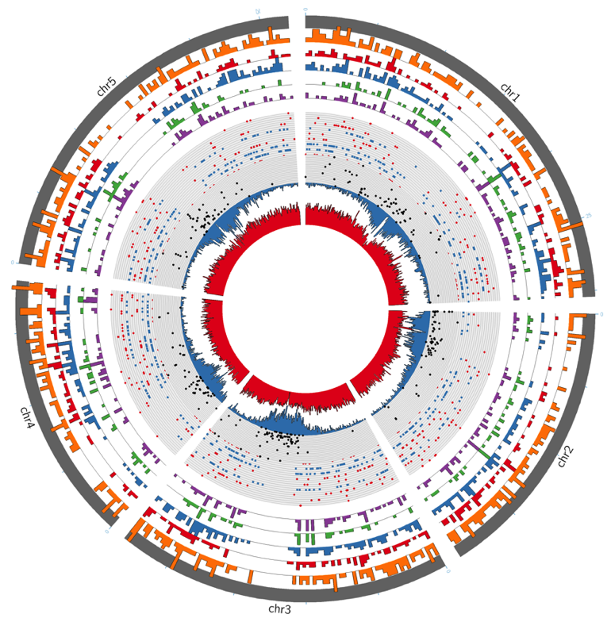
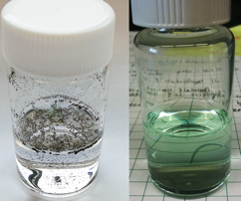
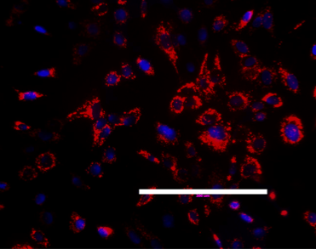
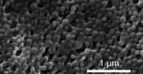



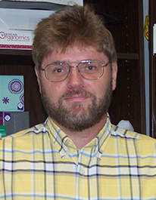



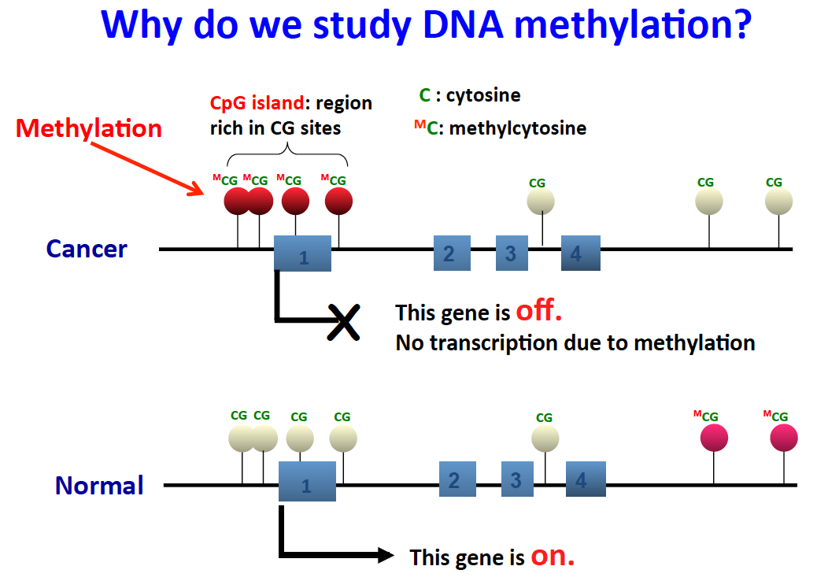
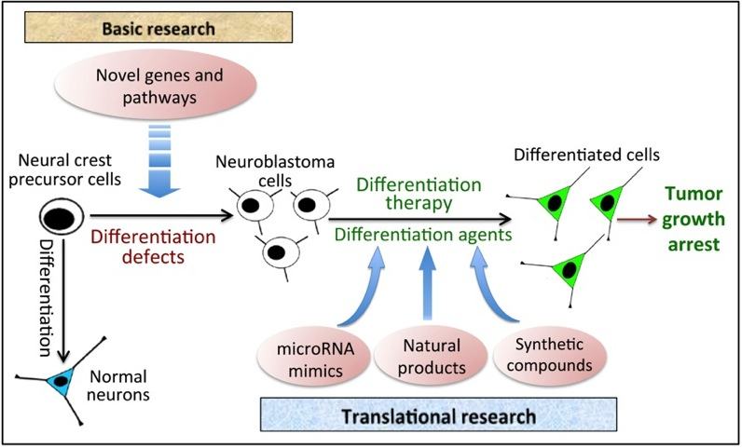
Cancer, Genetics, and Bioinformatics
College of Science and Engineering
Introduction
Cancer Nanomedicines
Materials-Based Platforms for Cancer Detection and Treatment
Dr. Tania Betancourt
Role of epigenetics in stress response & adaptation
Dr. Hong-Gu Kang
There were 1.7 million new cancer cases and 0.6 million cancer deaths in the USA in 2016.
Early detection and prevention can increase cancer survival rates.
Genetic and bioinformatic approaches are crucial for identifying biomarkers, which play significant roles in cancer prevention, detection, and treatment.
College of Science and Engineering has more than ten investigators working on Cancer, Genetics, and Bioinformatics.
The following is a short list of these investigators’ research topics:
  DNA repair gene mutations,
  Epigenetics (e.g., transposable elements and DNA methylation studies),
  Identification of novel gene targets for chemotherapy,
  Nanomedicines for cancer treatment,
  Cancer survival data analysis,
  Novel statistical and bioinformatic methodology development
Nine investigators shared their research in this poster.
Nanomedicines refer to nano-scaled materials that can be injected into the bloodstream and can passively and actively target cancer sites to enable targeted tumor labeling and therapy. Our laboratory has several ongoing projects focusing on related to the application of nanomedicines to cancer imaging (below), therapy (presented in drug delivery and therapeutics poster), and theranostics (combined diagnostics and therapy).
Nanoparticles as Contrast Agents for Cancer Imaging. Aiming to utilize the ability of nanoparticles to target tumors and of near infrared (NIR) light to penetrate into tissue, polymeric nanoparticles loaded with near-infrared fluorescent agents have been developed to enable optical detection of tumors (Figure 1). To achieve higher signal-to-background ratio for imaging, a new type of nanoparticles whose fluorescence is activated by tumor-overexpressed proteases is being developed (Figure 2). Both types of nanoparticles are also being investigated as theranostic agents by incorporation of chemotherapeutic agents within the nanoparticle cores.
Dr. Kang’s lab is investigating the regulatory role of epigenetic factors in defense responses and their associated transposable elements (TEs) in plant immunity and adaptation to stress.
We hypothesize that epigenetic changes are the main responses to environment, which can lead to stress adaptation and/or cancer, and that TEs are the main link between environment and adaptation/cancer (see the model below).
The promoters and/or 5’ proximal regions of many defense genes contain TEs that display heightened chromatin accessibility after pathogen infection, suggesting that TEs were integrated in these genomic regions in response to stress.
Our newly developing hypothesis envisions that the ability to manipulate these genome modifying elements by modulating epigenetic factors will potentially become a critical tool for breeders to accelerate the development of a novel trait.
Stress Responses
Epigenetic Changes
Environment
Transposable
Element
Figure 1. A newly developing hypothesis proposing molecular links between environment and cancer
Genetic Changes
Figure 2. Protease activatable nanoparticles for cancer imaging. Nanoparticles are initially in quenched (“off”) state, but are activated (turned “on”) by proteolytic enzymes overexpressed in tumors leading to 15-fold increased fluorescence.
Adaptation and/or Cancer
Figure 1. Aza-BODIPY-loaded fluorescent nanoparticles used to label breast and ovarian cancer cells.
Figure 2. Distribution of TEs in Arabidopsis. The second inner circle (blue) indicates the density of TEs. The Green histogram (the fifth outer circle) shows the density of TEs whose chromatin accessibility changes in response to infection
Novel Targets and Therapies for Cancer
Drs. Sean Kerwin, Wendi David & Liqin Du
DNA repair gene mutations that predispose cells to cancer cause constitutive activation of damage-responsive cell cycle checkpoints
Dr. L. Kevin Lewis
Statistical and Bioinformatic Analyses for
Cancer Research
Drs. Qiang Zhao, Habil Zare, & Shuying Sun
Non-canonical DNA structures, such as G-quadruplexes and H-DNA may play important roles in genetic mutations leading to cancer and in driving cancer cell proliferation and metastasis.
Drs. Kerwin and David study the processing of these structure by helicases using a combination of techniques including SPR (Figure 1). These studies have resulted in the identification of G-quadruplex-specific helicase inhibitors and molecular probes that are highly selective photochemical cleavage agents for these structures.
Human cells with mutations in genes required for repair of DNA damage have increases in mutations and increased risk for cancer.
Our laboratory has an ongoing project focused on understanding the phenomenon of constitutively activated DNA damage checkpoint responses in DNA repair-deficient cells using the model eukaryotic organism Saccharomyces cerevisiae (budding yeast).
Mutants defective in repair of DNA double-strand breaks (DSBs) spend half of their cell cycle in G₂ phase during normal log phase growth, twice that of wildtype cells (Figure 1).
Mutants defective in NER (nucleotide excision repair) did not exhibit high G₂/M cells, but cells deficient in BER (base excision repair) did. Also, checkpoint genes were needed for high G₂ cells.
The data suggest that only a subset of the lesions occurring naturally in DNA lead to activation of checkpoints, possibly impacted by oxygen-derived free radicals within cells (Figure 2).
Dr. Zhao develops statistical methods for analyzing survival data, which occur frequently in cancer research and clinical trials.
A series of nonparametric tests are developed for treatment comparisons for interval-censored survival data (Figure 1). Package glrt is available in R.
Mean residual life and Cox regression models are used to estimate the effect of covariates (including dimension-reduced gene expression levels) and predict survival.
Dr. Zare is the Principal Investigator of Oncinfo lab.
His research is focused on large-scale network analysis and its application in cancer diagnosis and prognosis, specifically leukemia and melanoma.
Dr. Sun’s research interests are statistical genetics and bioinformatics with a focus on cancer methylation microarray and sequencing data analysis (Figure 2).
Several software packages and statistical methods have been developed to identify methylation patterns, e.g., differential methylation and hemimethylation patterns.
Differentiation therapy plays a key role in treating childhood neuroblastoma.
Dr. Du’s main research interests are (Figure 3): 1) identifying novel druggable genes that control neuroblastoma cell differentiation; 2) discovery of new differentiation agents from various sources of anti-cancer drugs.
A functional cell-based high content screening (HCS) approach developed in Dr. Du’s group has significantly facilitated the high-throughput identification of novel differentiation-controlling genes/drugs.
Figure 1. SPR-based assay for G-quadruplex helicase inhibitors.
Natural products are a proven source of novel anticancer drugs; however, these compounds are often non-selective in their activity, leading to severe dose-limiting toxicities.
Dr. Kerwin studies natural products that are well-tolerated but which display promising anti-cancer effects in vitro and in vivo (Figure 2).
Figure 2. Natural product rooperol inhibits the growth of cancer cells but not normal cells.
Figure 3.
Figure 1. DNA repair-deficient rad52 cells spend approximately 2.7 fold more time in G₂ phase than normal cells.
Figure 2. Model: ROS such as hydroxyl, peroxyl or superoxide anion radicals constantly damage DNA leading to broken strands (DSBs). These lesions are not repaired efficiently in rad52 mutants and DNA damage response systems are constitutively activated.
Figure 1. Survival functions for lung cancer patients in two treatment groups.
Figure 2. An example that explains the importance of studying cancer methylation.

