Slide 1
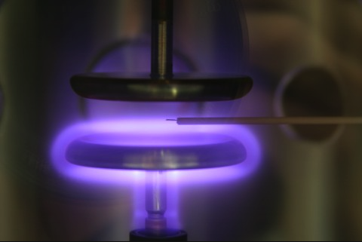
Plasma Sense Amplifier
Sponsor: Texas State University
Faculty Advisor: Dr. Rich Compeau
Notes:
Welcome. I am Guillermo Elizondo, the student project manager for the Plasma Sense Amplifier project, sponsored by Texas State University. We would like to thank you for attending Texas State University’s Senior Design Day. Our goal today, is to introduce you to our project, review progress thus far, and give you an overview of our future tasks.

Slide 2
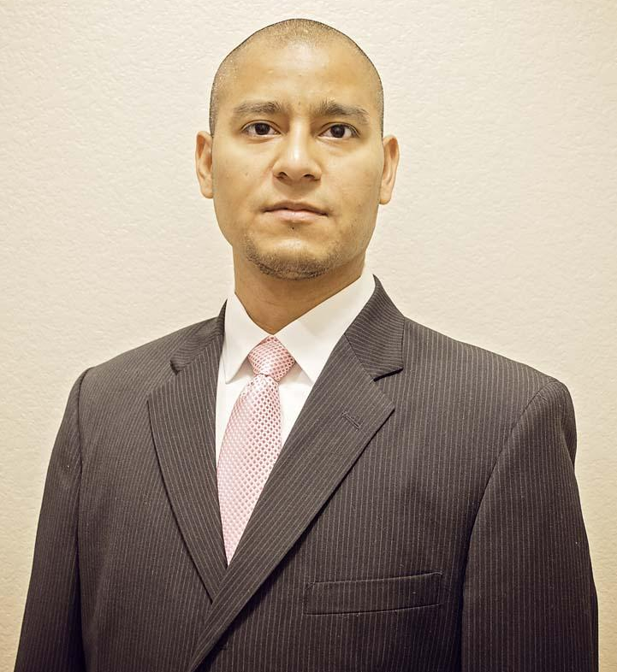
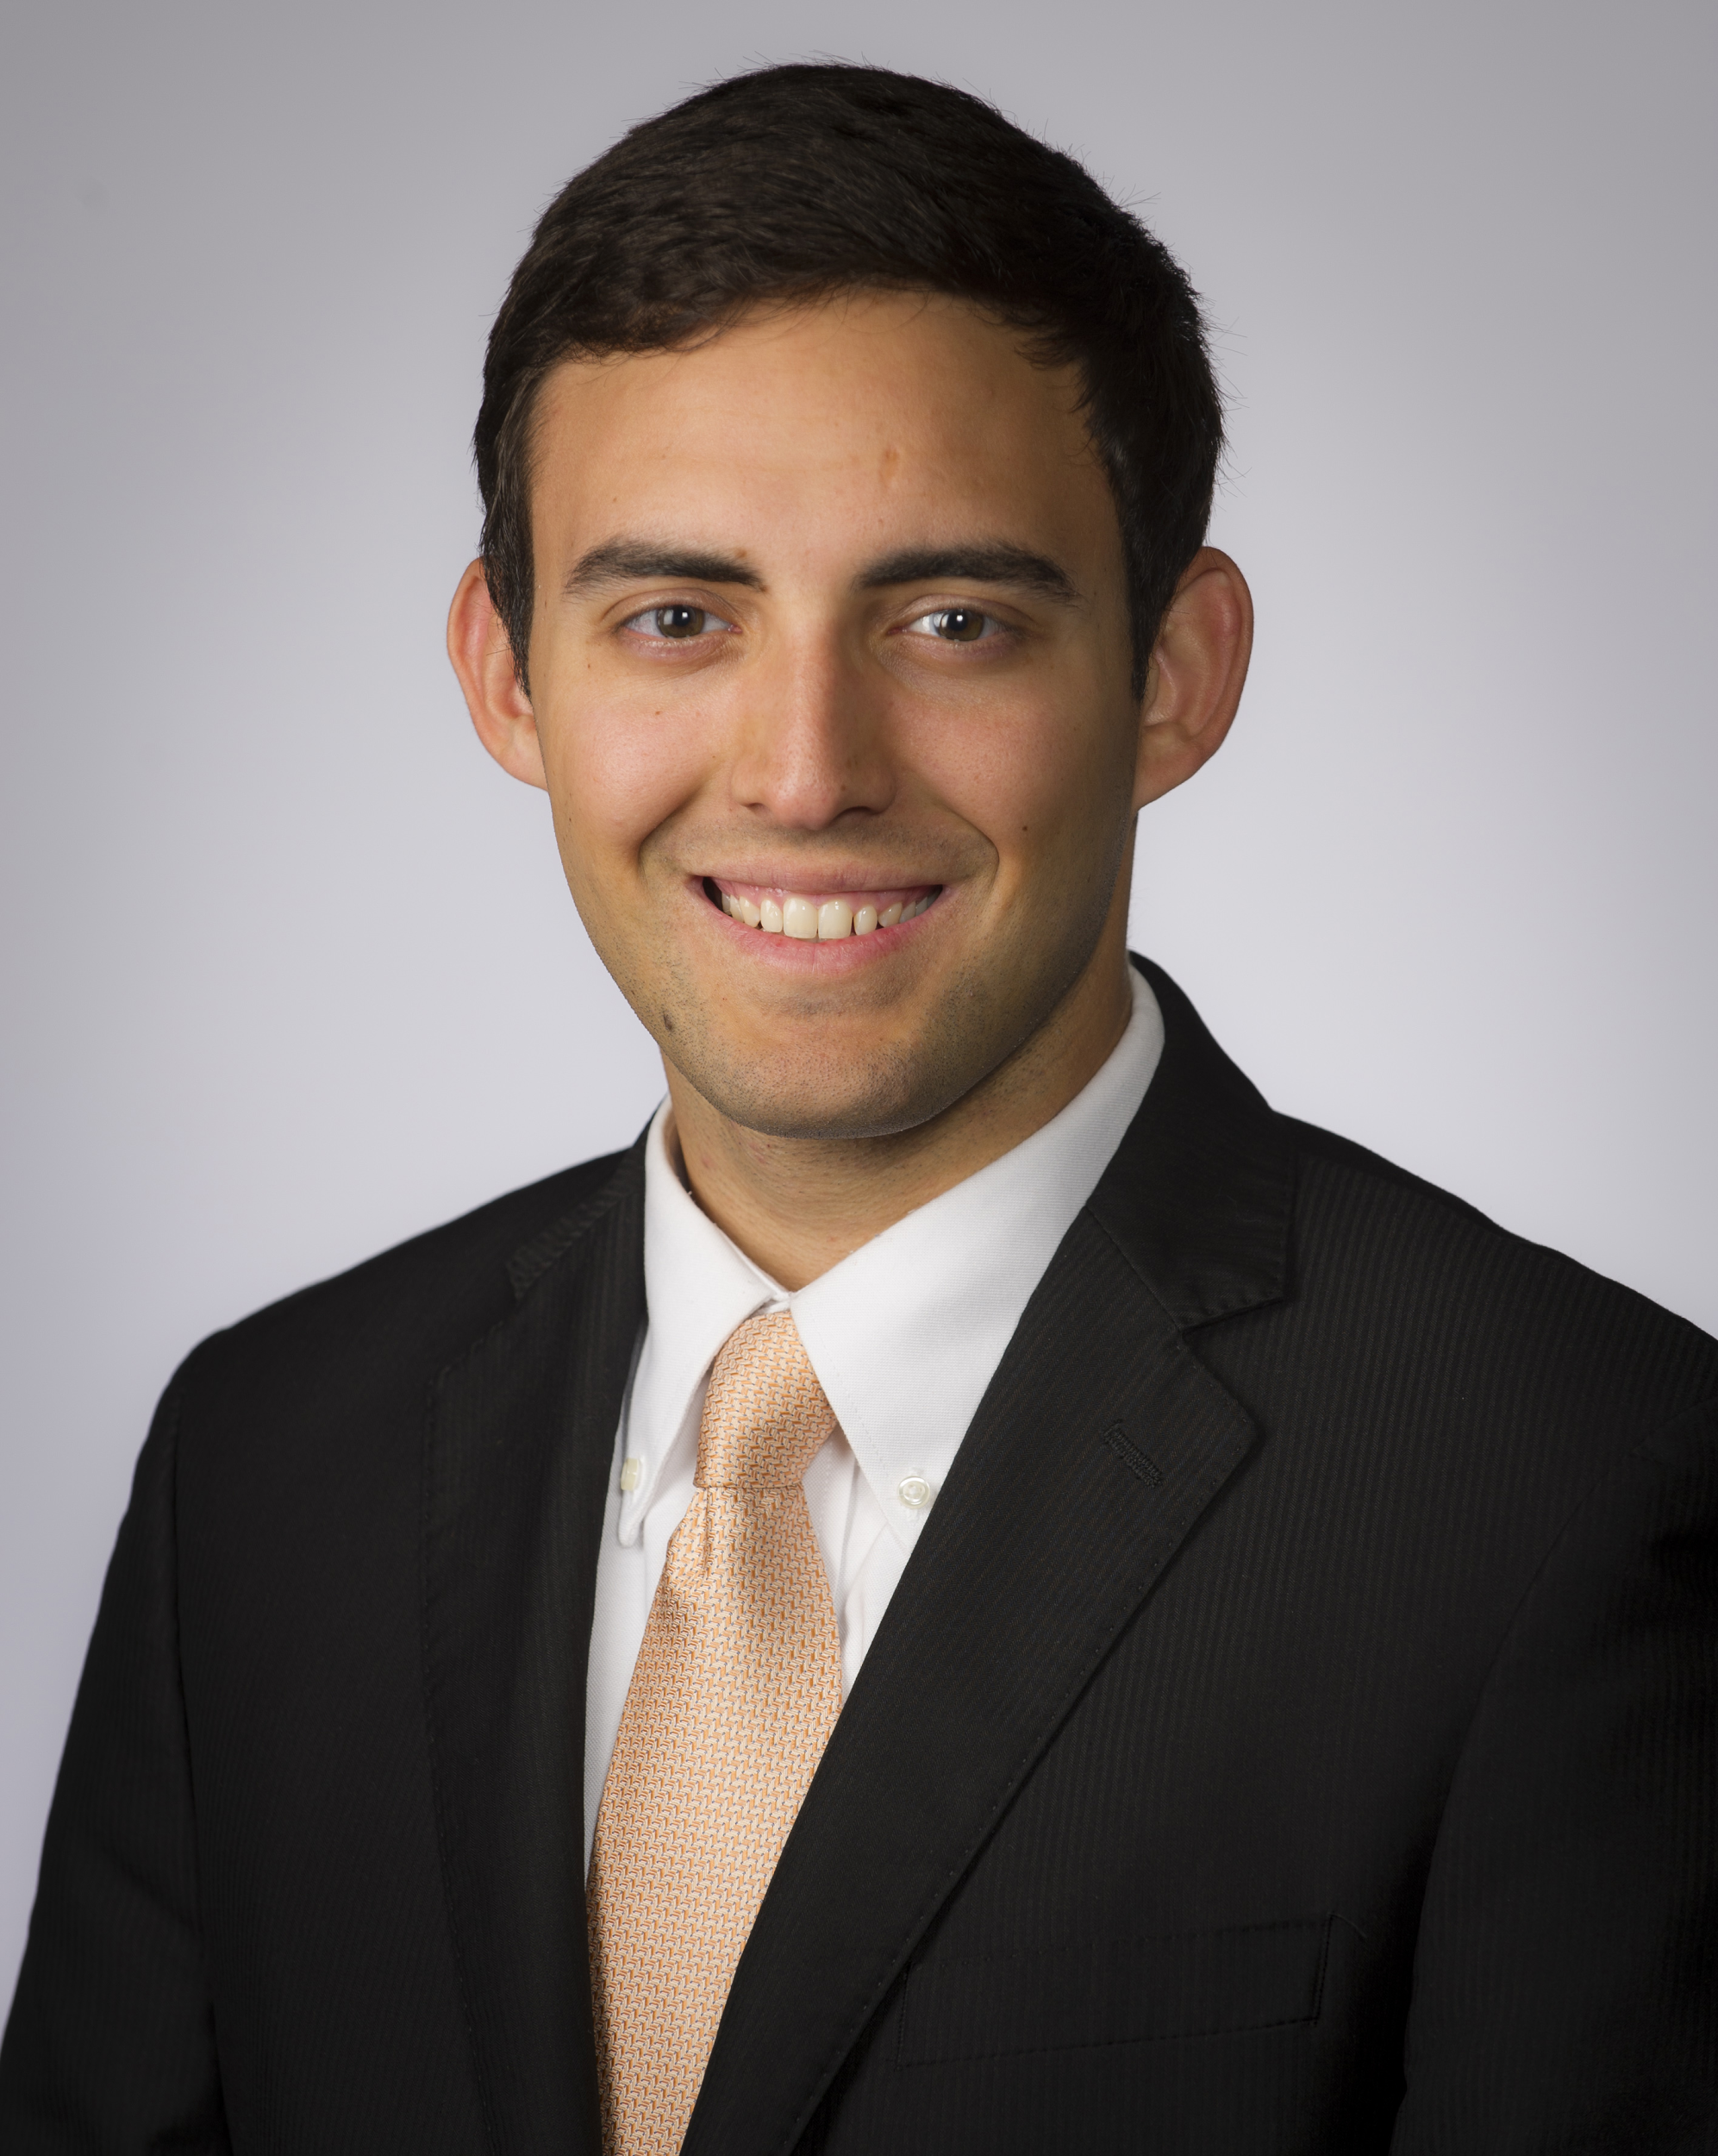
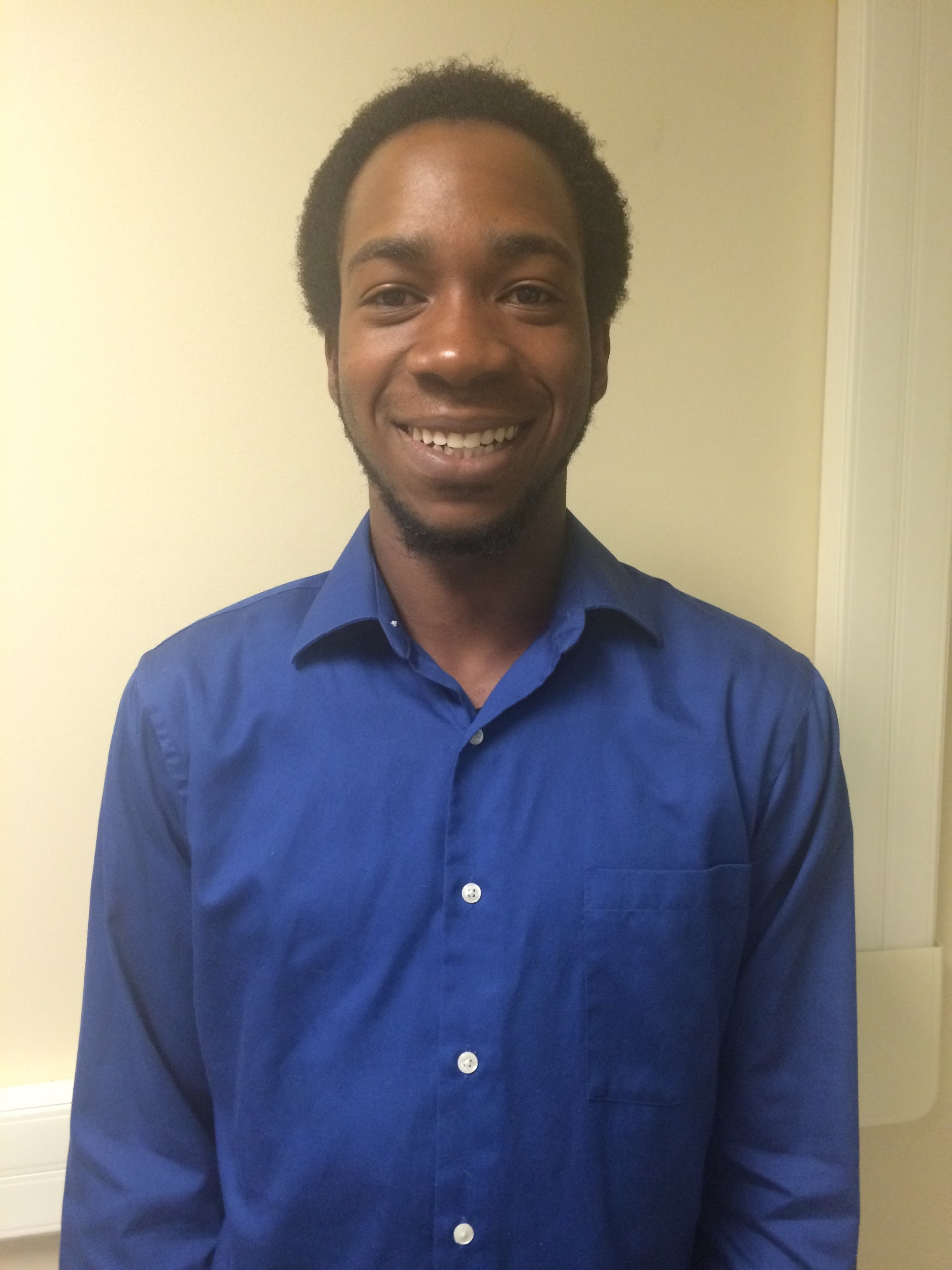
Team Members
Guillermo D. Elizondo Project Manager
Simulation & Design
Daniel Carroll
Research &Transistor-level Design
Nathan Russell
Simulation & Research
Justin Tanksley
Fabrication, Drafting, & Assembly
Notes:
I would like to introduce you to our team. Again, my name is Guillermo Elizondo, and my focus is on Simulation & Design. To my left is Daniel Carroll who will focus on Research & Transistor-level Design. This is Nathan Russell. He will focus on Simulation & Research. And last but certainly not least, this is Justin Tanksley. He will focus on Fabrication, Drafting, & Assembly.

Slide 3
Today’s Presentation Covers
Motivation
Description of Project
Roles & Responsibilities
Progress
Plans for 2nd Semester
Notes:
Our presentation today will cover the motivation for our project, a description of our project, our individual roles and responsibilities, and our plans for the second semester.

Slide 4
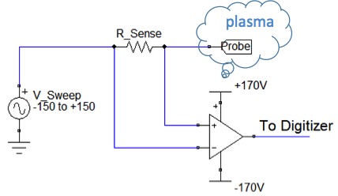
Project Motivation
The problem:
Design and construct safer, more cost-effective Sense Amplifier to measure plasma current
Add an input protection network
Design a dual regulated linear high-voltage power supply with low output current
Why is this important?
Some of the current designs that the research community are using to take plasma measurements are limited in what they can do, are not cost-effective, and/or are unstable.
Project # 1.4
Notes:
We are to design and construct a safer, more cost-effective alternative to taking plasma measurements by designing a sense amplifier with an input protection network that will sense the plasma voltage and level shift it to lab ground. We will also design a dual regulated linear high-voltage power supply with low output current to power the sense amplifier. This project is important because current designs the research community are using have either a limited voltage range, a large amount of distortion, and/or a floating high-voltage supply which can be unsafe and cause the system to be unstable.

Slide 5
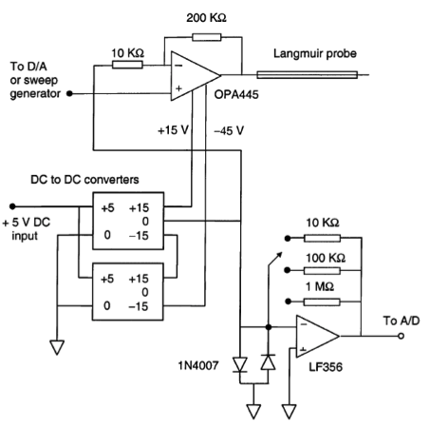
University of Colorado - Boulder
Sweep Circuit
Some of the existing systems are limited in certain areas. In this specific circuit:
Sweep range is limited from -45V to +15V
This is not a floating circuit
Notes:
This is an existing design of a sweep circuit created by the University of Colorado - Boulder. This is not a floating circuit which means that it is rather stable. However, its sweep range is limited to only 60V. In comparison, our circuit will similarly not float, however, our design will have a sweep range of 300V.

Slide 6
Sponsored by Texas State University
Why Texas State University?
Faculty member with research interest in the area
Adequate facilities to design and build the device
Collaboration with The University of New Mexico to test the system
Notes:
Texas State University is the ideal sponsor and is interested in this project because there is a faculty member with previous publications and research interest in the area of plasma. The university has more than adequate facilities for us to design and construct our project, and they will collaborate with the University of New Mexico to examine and assess the system once our project is in the testing phase.

Slide 7
Project Overview
Goals of Project
Stretch Goals of Project
Design and construct a sense amplifier
Add an input protection network
Design and construct a dual linear regulated power supply
Create a Printed Circuit Board for the sense amplifier
Attach a voltage display to potentiometer
Create a Printed Circuit Board for the power supply
Add negative feedback to the sense amplifier
Notes:
Our project goals are to design and construct the sense amplifier along with the power supply. We will also create a printed circuit board for the sense amplifier. A few of our stretch goals include attaching an LCD screen to display the voltage of the potentiometer in the power supply, to create a printed circuit board for the power supply, and add negative feedback to the sense amplifier to improve linearity.

Slide 8
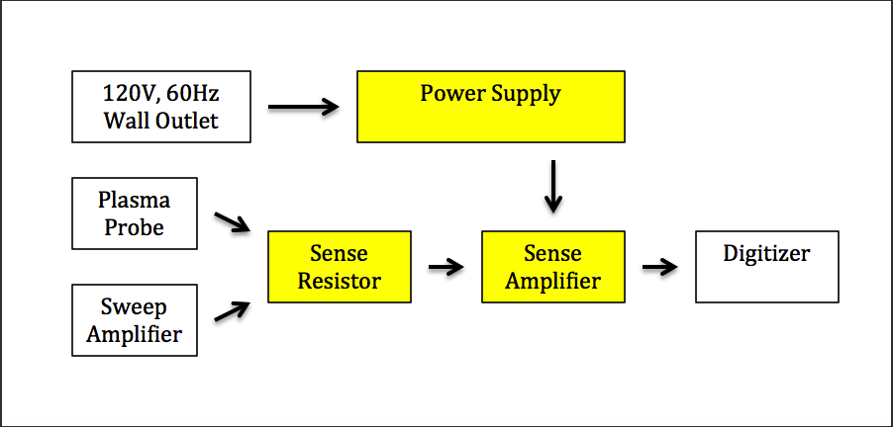
Block Diagram
Notes:
This is a system-level block diagram. Our design project encompasses the elements highlighted in yellow.

Slide 9
Why this is a Good Senior Design Project
Designing and constructing this plasma Sense Amplifier and power supply shall:
Touch on mechanical and electrical engineering aspects
Gain hardware experience
Gain experience with Transistor-level Analog Design
Put the theory that we are learning into action
Put a different appealing graphic here!
Notes:
Designing and constructing this system will touch on mechanical and electrical aspects of engineering. It’ll help us gain hardware and transistor-level analog design experience. This project will also allow us to put the theory that we’re learning in our classrooms into practice.

Slide 10
Project Manager Responsibilities
Project Manager: Guillermo D. Elizondo
Schedule team meetings
Submit a weekly progress report to project sponsor and Senior Design instructor
Monitor project’s milestones
Design and simulate sense amplifier and power supply
Test the performance parameters of the sense amplifier and power supply
Notes:
As the project manager, my roles and responsibilities include: scheduling team meetings, submitting a weekly progress report to our sponsor and instructor. I also monitor and make sure that we complete our project’s milestones. And I will test the performance items of our system as our project progresses. I will now turn it over to my colleague, Justin.

Slide 11
Roles and Responsibilities
Team Member: Justin Tanksley
Research
Finding information on possible enclosures for the board
Determining ease of use safety features such as LEDs, and switches
Board Fabrication and Assembly
Soldering and building the sense amplifier as well as the power supply onto PCBs
Project # 1.4

Slide 12
Major Milestones
Test Plan – February 15, 2016
Characterization Report – April 4, 2016
Final Design Review – April 11, 2016
Final Report & Senior Design Day Presentation – May 3, 2016
Notes:
The Test Plan describes each test case in detail. Each performance item in the Functional Specification is a test case in the Test Plan.

Slide 13
Project Deliverables
Design of sense amplifier and power supply
Working sense amplifier and power supply
Test data on system and components
Notes:
List the MAJOR deliverables only.

Slide 14
Standards
UL 50/50E- Enclosures for Electrical Equipment
Project will be in protected enclosure, wired with a reed switch mounted to the lid
UL 817: Standard for Cord Sets
Project has triaxial cable with +/- 150 V
UL 60950-1
Applies to limited current circuits that could be deemed hazardous (power supply)
IEEE Standard 510-1983
Applies to all direct power supplies
Notes:
UL50/50E - Dustproof, waterproof, tamper-proof
817 - http://u.dianyuan.com/bbs/u/40/1143862680.pdf

Slide 15
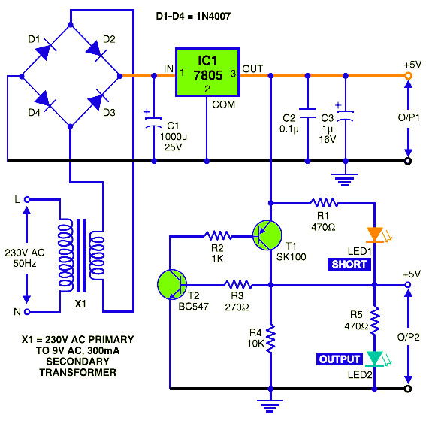
Roles and Responsibilities
Team Member: Nathan Russell
Research
Research designs and technologies applicable to our project.
Simulation
Design and test topspice simulations of the sense amp, and power supply.
Short Circuit Protection
By: circuitdiagram.net

Slide 16
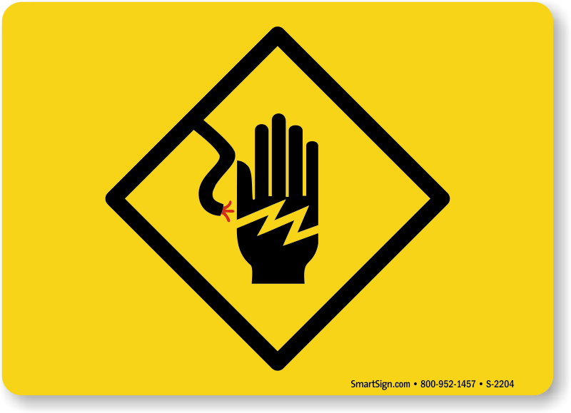
Constraints
Due to the high voltages within the circuit, the sense amplifier and power supply will be needing to have many safety features.
e.g. tamper proof shutoff, secure connections between cables, cables with extra layers of protection, various circuit protection systems, and LED indicators.
High voltages transistors are not easily found, and will cause an increase in expenditures
The power supply will have a voltage constraint due to the line voltage being used for power. As a result, limiting the range of voltages that can be swept by the sense amplifier.
Notes:
Consult your Functional Specification, and create a bulletized list of constraints. Time permitting, say how/why each constraint originates.
The UL50 standard applies to enclosures for electrical equipment, intended to be installed and used in non-hazardous locations, in accordance with the provisions of the National Electrical Code, NFPA 70 [2]. The UL817 standard states that these requirements cover power-supply cords for use as supply connections for appliances, and also cover cord sets for use in extending a branch circuit supply to the power-supply cord of a portable appliance by means of flexible cord in accordance with the National Electrical Code [3]

Slide 17
Challenges & Concerns
Transistor-level Design
Component Selection
Understanding the operation of the analog circuit building blocks for the design schematic of the sense amplifier and power supply
e.g. Current mirrors, cascode, differential pair
Ways to improve linearity in the sense amplifier and how to obtain more sophisticated regulation of the power supply
Notes:
Each component is powered at a different voltage level, have different current gain, and consume different current –

Slide 18
Roles and Responsibilities
Team Member: Daniel Carroll
Transistor-Level Design
Investigate the interfacing of components to understand the building blocks of the sense amp and power supply
Use this knowledge to fine-tune and troubleshoot the design
Research PCB fabrication options and get familiarized with respective PCB layout tools
Project # 1.4

Slide 19
Project Progress
Preliminary Research completed for:
Sense amplifier
Researched the circuitry
High voltage power supply with low output current
safety features
LEDs
Tamper Proofing
Short Circuit Protection
Current limitation using Transformers
Voltage Control
Notes:
Go through this at a good pace. You could spend 30 minutes on this alone – don’t. Just give the overview.

Slide 20
2nd Semester Tasks
Tasks Planned for the Completion of the project:
continue with the simulation of the sense amplifier and power supply
Assemble both the sense amplifier and power supply
Order and assemble printed circuit board (PCB)
Perform test of system
Notes:
Don’t talk to my requirements! Talk to what YOU need to do to finish your project design.

