Slide 1
Campus Policing
Love, Care, and Compassion
Matthew E. Carmichael
Chief of Police

Slide 2
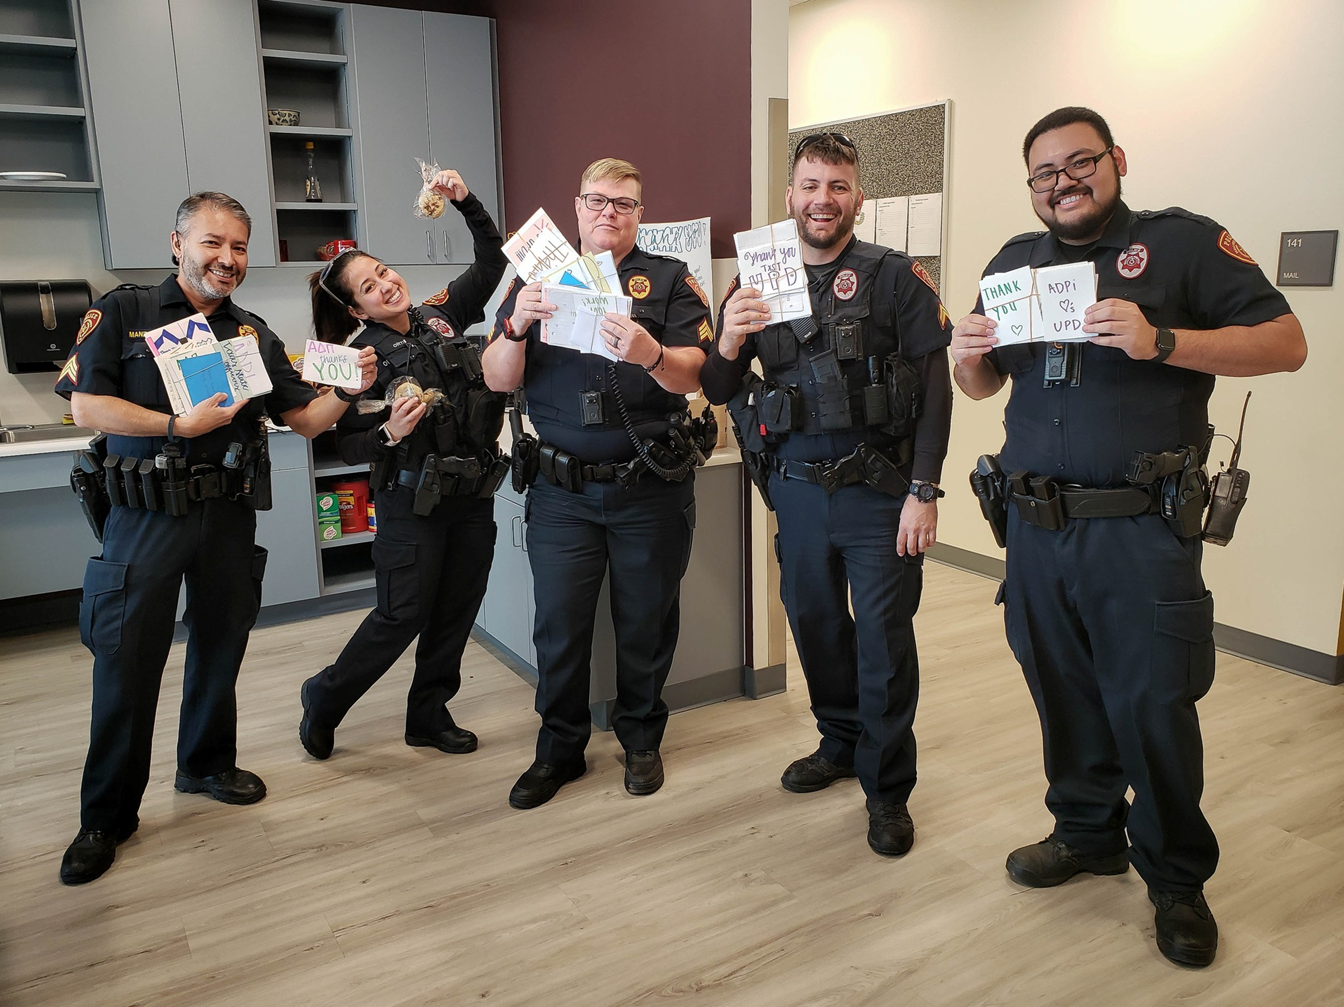
Overview
All about UPD
1
UPD Foundation
2
Love, Care, and Compassion
3
Conclusion
4

Slide 3
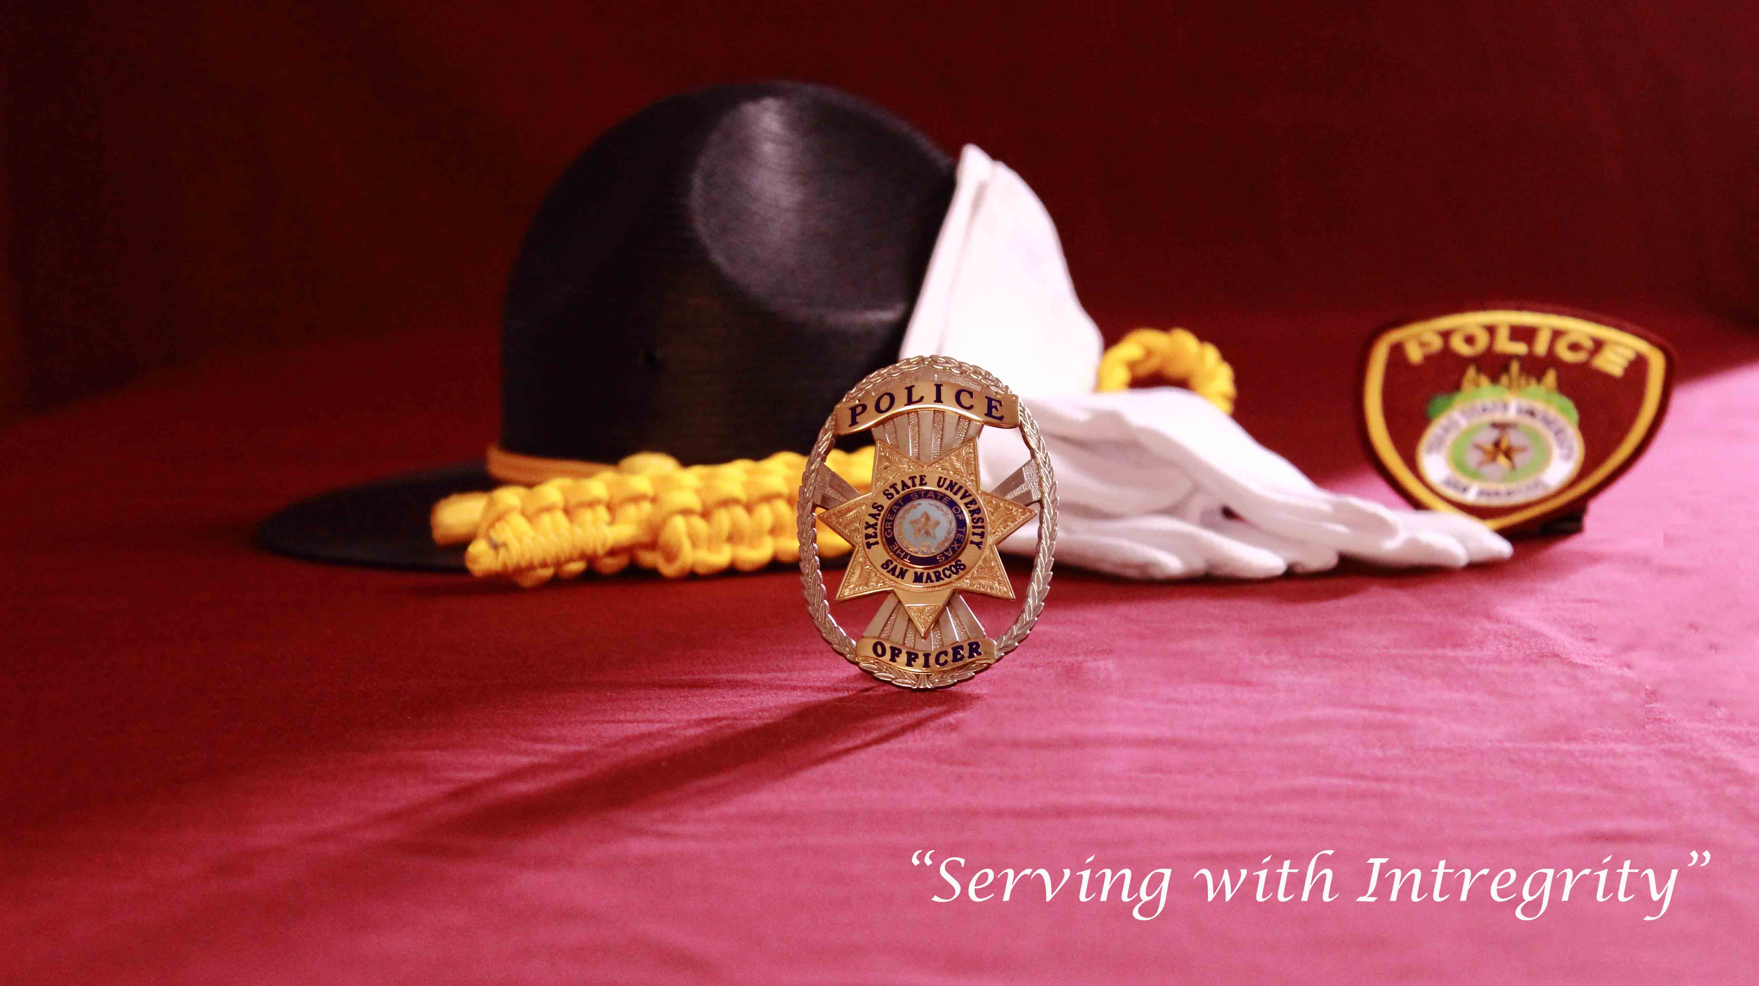
All About UPD
Who Are We?
Alumni
Veterans
Moms, dads, sisters, brothers, aunties, uncles A diverse group of people who are committed to keeping our students safe!
In short, WE CARE

Slide 4
Our Foundation
Pillar 1 — Building trust and legitimacy.
Pillar 2 — Policy and oversight.
Pillar 3 — Technology and social media.
Pillar 4 — Community policing and crime reduction.
Pillar 5 — Officer training and education.
Pillar 6 — Officer safety and wellness.

Slide 5
Love, Care, and Compassion
Can it be taught?
Recruitment, retention, and employee performance
How do we measure LCC?
Police practice LCC everyday

Slide 6
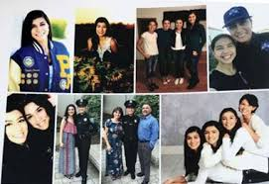
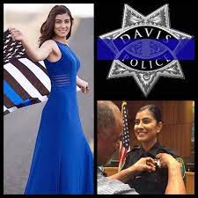
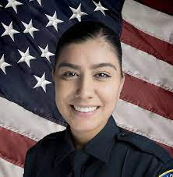
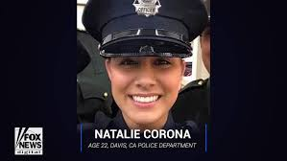
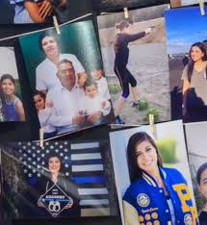
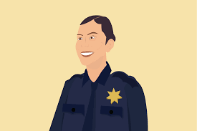
LCC and Policing. Really?

Slide 7
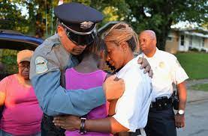
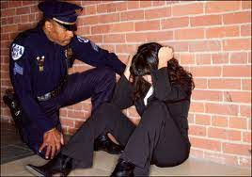
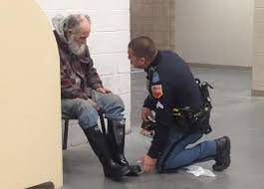
Demonstrate Compassion
Be a good listener
Be empathetic
Be an advocate
Be kind
Say something
Be random
Go for it
Police officers face countless difficult situations that can negatively affect their ability to have a sense of compassion.

Slide 8
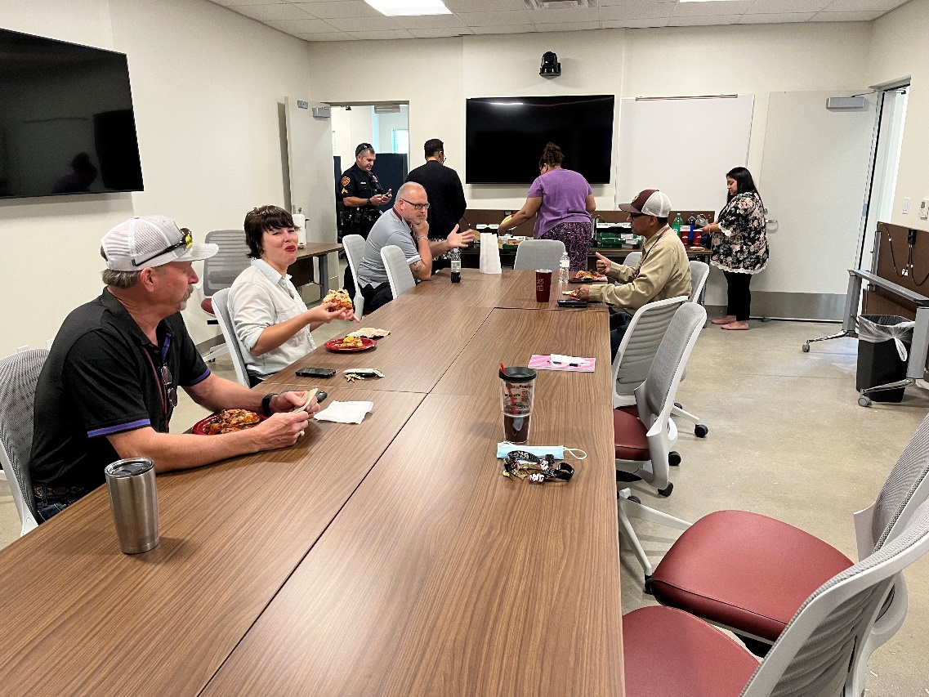
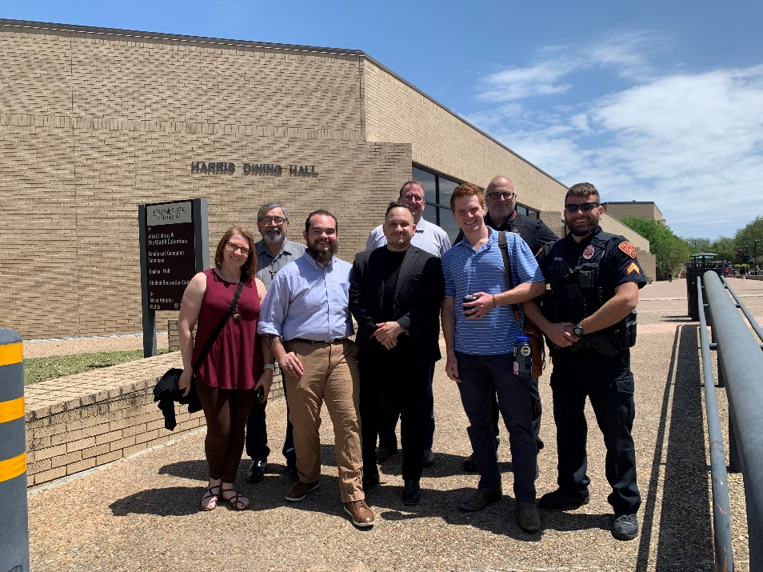
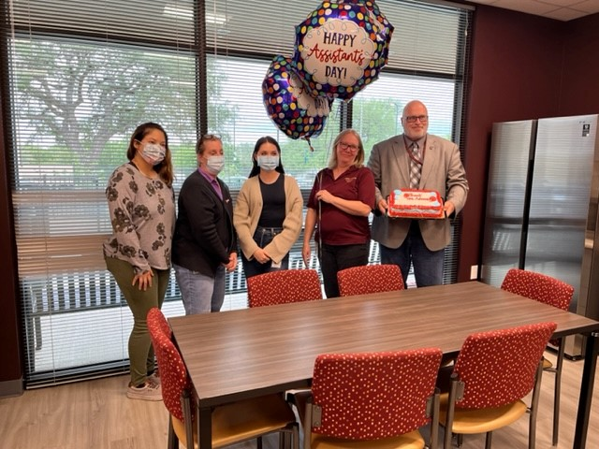
Easy
Difficult
I hate ………
I don’t like …….
I love my …..
I love our …….

Slide 9
Thank you!
My cell: 541-600-6192
chiefmatt@txstate.edu
@txstchiefmatt

