Slide 1
“When You Do Good,”
You Cultivate Compassion
in Your Career
Madyson Flint & Shelby Jimenez
Career Services

Slide 2
1
Framing our Conversation
Career Concepts & Theories
Overview
2
3
Recommendations in Practice (Self & Colleagues)
4
Student Development Theories
5
Recommendations in Practice (Working with Students)
6
Reflection Time
7
Wrapping Up + Q & A

Slide 3
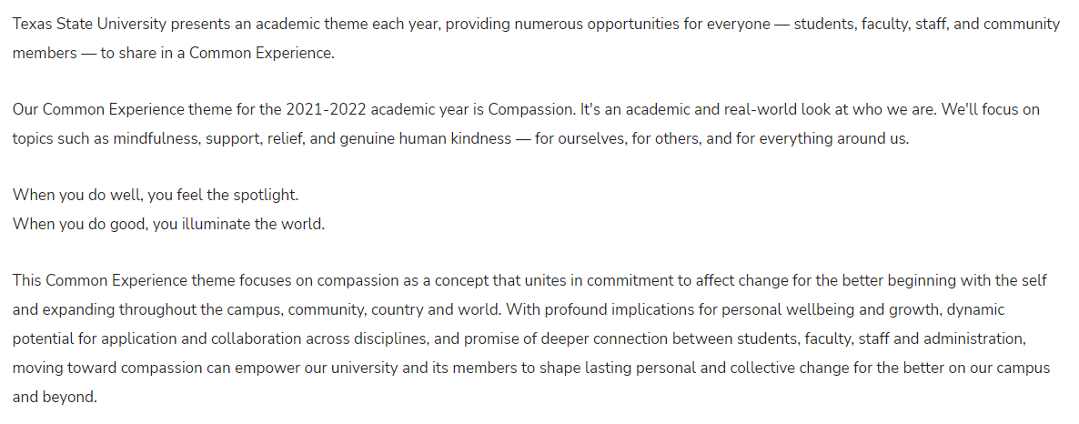
Compassion
“When You Do Good,”
You Cultivate Compassion in Your Career

Slide 4
CAREER CONCEPTS & THEORIES
Career & Work
Definition
Career: “time extended working out a purposeful life pattern through work undertaken by the person” (R. 2)
Work: “an activity that produces something of value for oneself or others” (R. 2)
Purposes
Economic
Social
Psychological
Impact
Image Source (above): https://oecdedutoday.com/preparing-youth-for-work-what-works-career-guidance/
Image Source (right): https://dribbble.com/shots/4542877-Work-is-love-made-Visible
Connected to all life roles
Spillover effect
Positive: Achieved Goals + Fulfillment

Slide 5
CAREER CONCEPTS & THEORIES
Values-Based Approach
Values with high priorities = most important in decision-making
“Making choices that coincide with values is essential to satisfaction” (R. 3)
“The result of role interaction is life satisfaction” (R. 3)
Success depends on ability and aptitude required for role

Slide 6
CAREER CONCEPTS & THEORIES
Values-Based Approach
Moral/religious/political values, but also work specific values, like:
Should guide career decisions
Self-knowledge of work values and commitment to implementing them into career decisions → Satisfaction (R. 3)
No matter what role we serve in here at
Texas State, we are serving students at the end of the day, which is a helping profession.
Stability
High Earnings
Benefits
Helping Individuals
Routine Work
Variety/Change
Influence
Decision Making
Uniqueness
Creativity
Teamwork
Travel
Many, many more

Slide 7
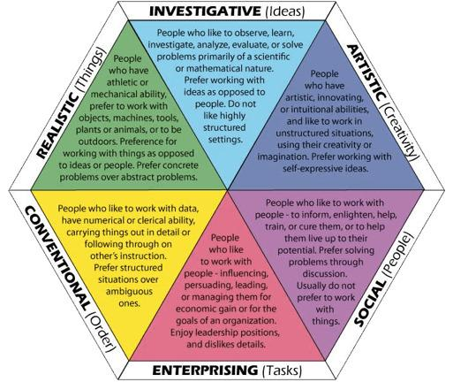
CAREER CONCEPTS & THEORIES
Holland Typology
Career choice is “an expression of, or an extension of, personality into the world of work” (R. 2)
6 Work Personalities
Realistic, Investigative, Artistic, Social, Enterprising, and Conventional
Image Source: https://personalityjunkie.com/holland-code-riasec-career-interests-myers-briggs-types/

Slide 8
CAREER CONCEPTS & THEORIES
Person-Environment-Correspondence
Basic Assumption: Individuals “seek to achieve and maintain a positive relationship with their work environments… [and] the individual and the work environment must achieve some degree of congruence (correspondence)” (R. 2)
Individual meets job requirements + work environment fulfills the individual’s requirements = correspondence/work adjustment
Image Source: https://studyonline.rmit.edu.au/blog/positive-workplace-culture

Slide 9
CAREER CONCEPTS & THEORIES
Person-Environment-Correspondence
Major Tenets of Dawis’ and Lofquist’s theory:
“Work personality and work environment should be amenable” (R. 2)
“Individual needs are most important in determining an individual’s fit into the work environment” (R. 2)
“Individual needs and the reinforcer system that characterizes the work setting are important aspects of stability and tenure” (R. 2)
“Job placement is best accomplished through a match of worker traits with the requirements of a work environment” (R. 2)
Job Satisfaction:
Critical: Abilities (work skills) and values (work needs) aligning
Improving Fit: Attempting to change the environment in which they work or adapting themselves to better fit the work environment

Slide 10
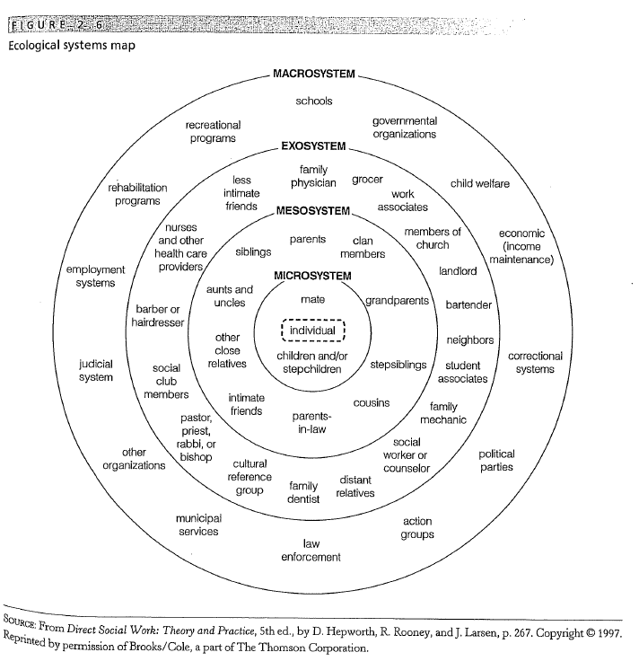
CAREER CONCEPTS & THEORIES
Person-in-Environment
“Individuals influence and are influenced within environmental systems” (R. 2)
“It’s a ‘who’ and ‘where’ approach…” that takes into account “potential influences that can affect learning, thinking, reasoning, decision making, and … behavior” (R. 2)

Slide 11
CAREER CONCEPTS & THEORIES
Happenstance Approach
Mitchell, Levin, and Krumboltz: “Chance events over one’s life span can have both positive and negative consequences” (R. 2)
“Approach the future with a positive attitude and the curiosity and optimism that produces positive results” (R. 2)
“Foster an attitude that takes advantage of unplanned events: … look for solutions to… circumstances and develop strengths based on … past experiences in life and work” (R. 2)
Managing “unplanned events [good or bad] through developing skills” (R.2):
Image Source: https://jamesclear.com/domino-effect
Curiosity
Persistence
Flexibility
Optimism
Risk-Taking

Slide 12
Recommendations in Practice
Self:
Assess where you are in your career, what is providing you satisfaction/what is not, and what you could do to have a better fit or improve the environment you work in
Inquire about meaningful projects that fit your interest that you could be a part of or inquire about solutions to problems you face
Manage workplace/life stress with coping strategies
Reflect on and remember daily your “why” for doing the work that you do serving students
Consider groups of community and seeking/offering mentorship
Working with Colleagues:
Serve as a mentor
Offer and maximize shadowing or training opportunities
Supervisor: Implement these ideas and research additional ideas on positively impacting your workplace/job satisfaction levels of your team (morale; projects fitted to strengths)

Slide 13
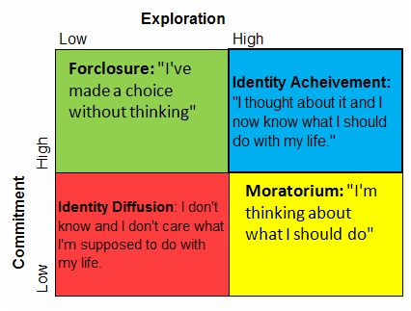
STUDENT DEVELOPMENT THEORIES
Ego Identity Statuses
Identity status as related to resolving crises
Involves exploration of identity
Looks at commitment to identity (R. 4)
Image Source: https://www.pinterest.com/pin/i-like-this-matrix-of-james-marcias-theory-of-identity-formation-discussed-by-herb--85286986683972066/

Slide 14
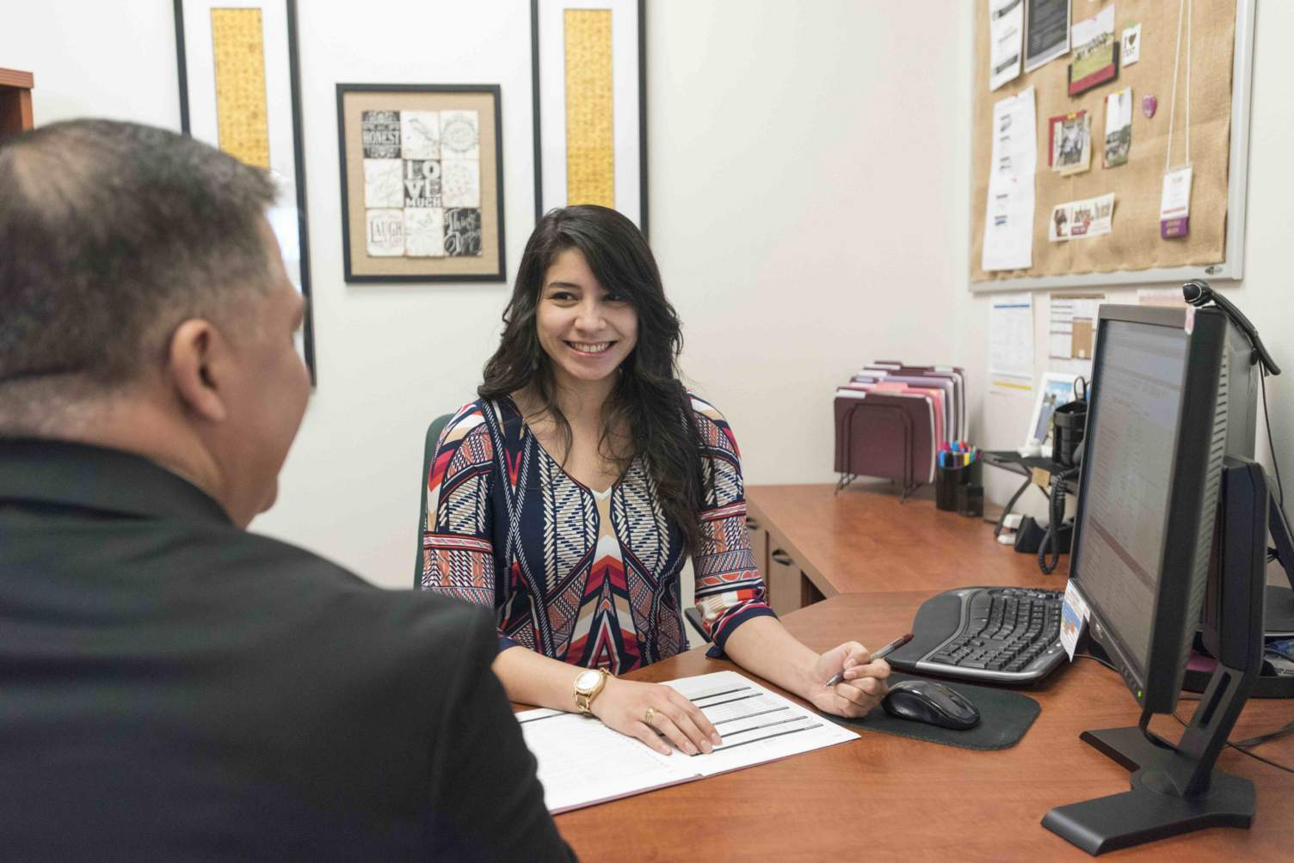
STUDENT DEVELOPMENT THEORIES
Validation
Process
“An enabling, confirming, and supportive process initiated by in- and out-of-class agents that foster academic and interpersonal development” (R. 4)
Building confidence that students can succeed
Agents
Includes instructors, student affairs staff, academic advisors, and more
Effectiveness
The more validation received = Richer and more successful student experience
Significant for all, but key to those “who may doubt their ability to succeed” (R. 4)
Especially beneficial in the beginning of their college career

Slide 15
STUDENT DEVELOPMENT THEORIES
Marginality + Mattering
Feelings of marginality tied to taking on new roles, feeling uncertain about new roles and leads to feeling as if they don’t fit in or don’t matter to anyone
Mattering as defined by Schlossberg: “Our belief, whether right or wrong, that we matter to someone else” (R. 4)
Need the following aspects to feel like they matter:
Attention
Importance
Ego-Extension
Dependence
Appreciated

Slide 16
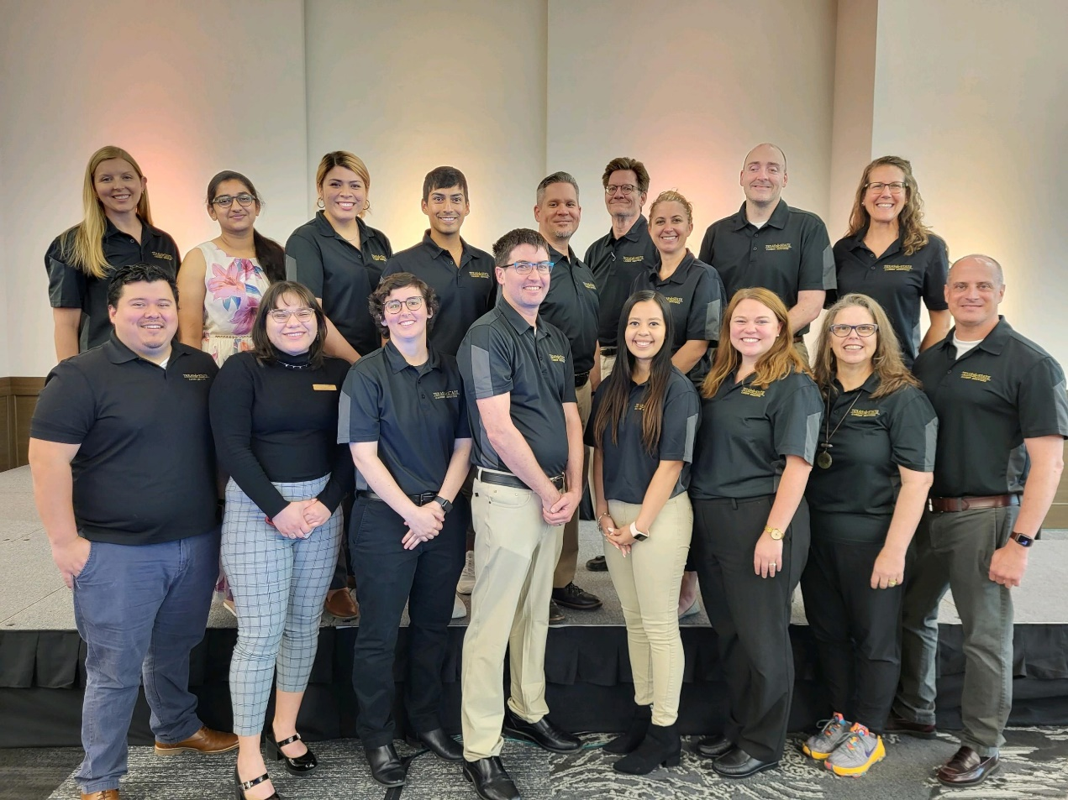
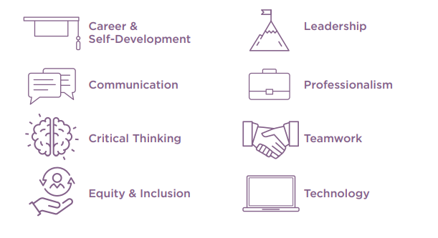
Recommendations in Practice
Working with Students:
Validate students verbally and utilize the concepts of “mattering” to show compassion and care to students regarding their career development within college
Familiarize yourself with Career Services’ resources → provide recommendation and “warm” referrals
Integrate “Career Competencies” into your work developing students
Serve as a mentor/role model (informational interviewing, networking)
NACE Career-Ready Competencies

Slide 17
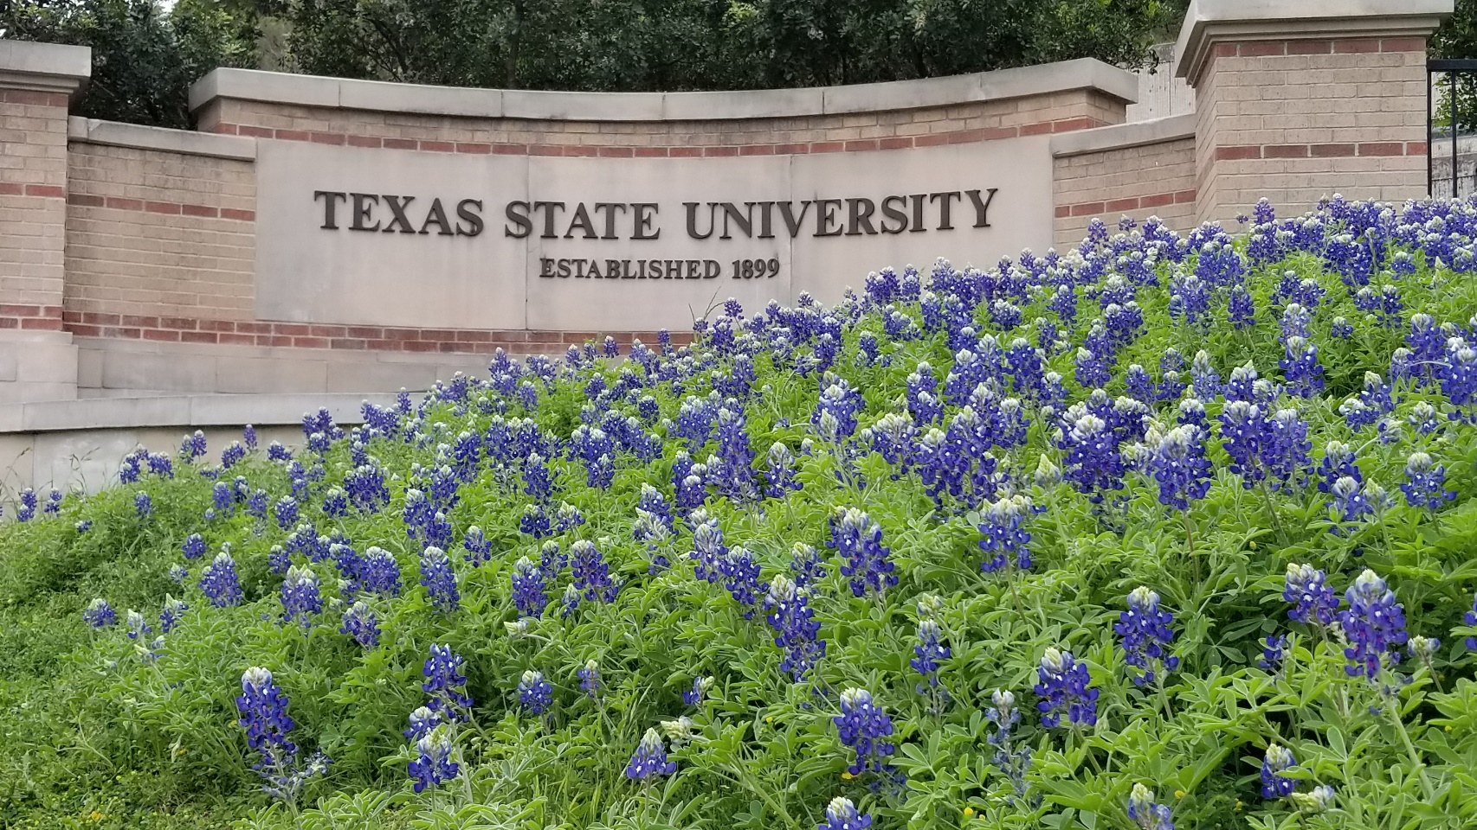
Reflection Time
Self
What is your “why” for doing the work that you do?
What skills/projects do you enjoy most in your role? What are you uniquely good at?
Can you integrate more of that into your role to increase your work fit and satisfaction?
Colleagues
Using your unique skillset, how can you enhance your work environment or your colleagues’ experience of your work environment?
Students
How do you and/or your office support students’ career development?

Slide 18
Resources/References
Career Services’ Website
“Career Counseling & Exploration” Page (https://www.careerservices.txstate.edu/students-alumni/career-exploration.html).
Within the “Self-Assessment” sub-page, there are various career assessments that are available for students to take (as well as some free ones for faculty/staff to access for their own personal use or to get a firsthand look at what resources students can use).
“Are You Career Ready?” Page (https://www.careerservices.txstate.edu/students-alumni/resources-services/career-competencies.html)
This page details NACE’s eight key competencies for career readiness and provides ways to evaluate one’s current competencies and recommended development strategies.
Career Counseling: A Holistic Approach by Vernon G. Zunker.
Career Development Interventions in the 21st Century by Spencer Niles and JoAnn Harris-Bowlsbey.
Student Development in College: Theory, Research, and Practice by Lori D. Patton, Kristen A. Renn, Florence M. Guido, and Stephen John Quaye.
The Happiness Project by Gretchen Rubin.
What Color is Your Parachute? by Richard Nelson Bolles.
2021-2022 Common Experience Book: This Book Will Make You Kinder by Henry James Garrett.
48 Days to the Work You Love by Dan Miller.

Slide 19
Thank you!
Career Services: 512.245.2645
Madyson: MLS332@txstate.edu
Shelby: Shelby@txstate.edu
Madyson: linkedin.com/in/madysonflint/
Shelby: linkedin.com/in/shelbyjimenez/

