Slide 1
Network Authentication - Flex Radio SDR
2.6
Project team members
Project Design Manager | Daniel Scarlett
Senior Design Engineer | Miles O’Keefe
Senior Design Engineer | Samuel Pesek
Senior Design Engineer | Cody Clark

Slide 2
Outline
Background Information
Design Details
Validation Test Plan
Impacts and Issues
Schedule
Budget
Stretch Goals
Future Upgrades
Conclusion

Slide 3
Background Information

Slide 4
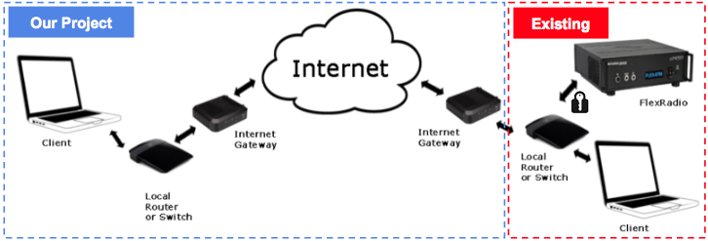
System Diagram
Project: Develop authentication method to access the radio over WAN

Slide 5
History of Remote Access
Telnet - 1960’s
Early remote access technology tools usually “listened” to dedicated ports and relied on relatively insecure passwords. This allowed hackers to monitor certain ports and intercept encrypted data. Due to plain text streams, Telnet was never secure by default.
rlogin, rsh, rcp - 1980’s
Application layer protocol, and just like Telnet, a user could log into the remote system with a password, but rlogin additionally allowed automatic (passwordless) logins for users on trusted remote computers.However, like Telnet, rlogin still used plain text communications over TCP port 513 by default.
SSH - 1990’s
Network protocol, consequently as criteria of remote access software, the next iteration of this technology involved creating a safe tunnel for data. Users may set up SSH tunnels to transfer unencrypted traffic over a network through an encrypted channel. SSH uses public-key cryptography to authenticate the remote computer and allow it to authenticate the user, if necessary.

Slide 6
Design Details

Slide 7
Possible Solutions
Username/Password
Advantages
Easy to implement/deploy and commonly used for both network and system access
Easy to administer - password resets can be done automatically
User familiarity - most used authentication model
Disadvantages
Low security - credentials can be easily stolen
All parts of password transmission can lead to exposure
Users are rationally ignorant - would likely use call signs for login

Slide 8
Possible Solutions
Certificate (PKI)
Advantages
Works behind the scenes - user doesn’t have to do anything
Doesn’t require the transmission of the secret - mitigates all sorts of storage/transmission weak points
Issued by a trusted party - allows for a centralized management system
Disadvantages
Deployment is complex and thus expensive - an external database is needed.
Still requires a password - almost any private key pair storage mechanism is then unlocked with a PIN
Certificate Status reporting and updates are not easy - revoking a user credential that has become corrupted is onerous due to the size and complexity of the infrastructure

Slide 9
Possible Solutions
Cryptographic Key Server
Advantages
High level of confirming authentication of user through the use of cryptography
The existing telnet way of communicating with the radio remains unencrypted which is upgraded to an SSH communication channel providing a secure tunnel traffic
To help keep the radio from being compromised, the client has to authenticate with the key server every (x) amount of time until a session has ended.
For end users, this scheme would make using the radio secure as authentication would occur continuously throughout the session
Disadvantages
Encryption/Decryption is used by the key server which takes up additional resources of processing power used by the microprocessor
Private key must be kept confidential
Connecting to the radio for initial setup would have to be through LAN

Slide 10
Chosen Model
Cryptographic Key Server and Client Model
Username/Password had too weak of security for customer’s requirements
Certificate would be too complex and expensive
Key server is central to radio itself - no external database needed
Use of cryptography is the most secure way of authentication and communication
This method of authentication could prove to work the best with Flex Radio.

Slide 11
Proposed Design
A lightweight cryptographic key server database and the tools used to implement will be compiled onto the radio (eg. Dropbear, GnuPG, openSSH)
Upon bootup of the radio, the key server daemon will listen for requests on its corresponding ports until an authenticated user has been accepted
If the radio has access to the WAN, the location of the key server database is updated in a DynDNS lookup table for the client to find the location of the key server
If the client making the request to the radio are within the LAN address range then SSH access to the radio is automatically opened and the client will then access a startup script to add/delete users

Slide 12
Proposed Design
The client is then enabled to access the radio over WAN via SSH at which time the session begins, invoking a startup script that sends a challenge/response signed and encrypted message to the client (added user)
The client decrypts the message and sends the response message back signed with the private key of the client and encrypted with the public key of the radio
The radio decrypts and validates the message by the digital signature that was signed by comparing against the public key stored in the key server’s database
The client then gains access to the radio’s services

Slide 13
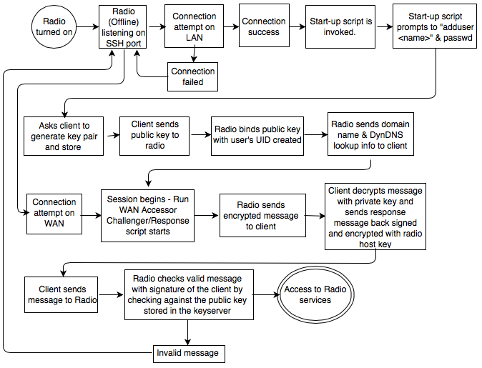
Block Diagram of Proposed Design

Slide 14
Implemented Design
A Raspberry Pi B+ was used to replicate the radio’s specifications
Similar operating system (linux) and microprocessor (ARM)
Didn’t want to damage our client’s provided SDR
The Pi had to be configured in a couple different ways
Default user had to be added that had root and superuser privileges
NOIP’s Dynamic Update Client (DUC) was installed for remote access over WAN
SSH server/client configuration files were altered

Slide 15
Implemented Design
A default user was added with the privileges of root level admin access to add and delete users and groups through LAN
A hostname and domain name were created through a 3rd party source (NOIP.com) free of charge
After downloading and configuring the NOIPS’s dynamic update client (DUC), the Pi was ready for remote access using a URL that was assigned from NOIP’s online hostname tool

Slide 16
Implemented Design
The IP address was dynamically updated from the Pi to ensure the correct network address translation (NAT) would stay current
The user could then SSH into the Pi given the SSH files being configured properly which allowed the client to upload their SSH key pair, only over LAN
Over WAN, the Pi validates the user via key pair and pw

Slide 17
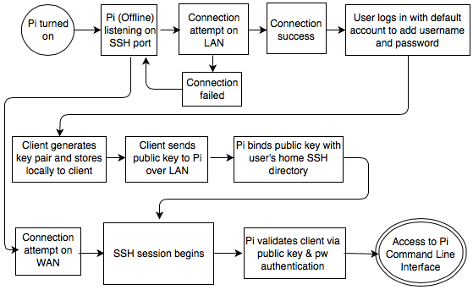
Block Diagram of Implemented Design
Notes:
Didn't have time to produce with errors encountered.

Slide 18
Problems Encountered
Changing customer requirements after 1st semester
Spent a lot of time on research to gain the required knowledge to solve this design
Start-up scripts that would work behind the user’s interface
Challenge/response script that would check validity of user every (x) amount of time
The basic task of cryptographic security between the server/client using the public key method was done through manual configuration of the Pi
Notes:
Initially produced a solution with VPN. Time constraints resulted in start up scripts and Challenge Response not being fully operational.

Slide 19
Validation Test Plan

Slide 20
Validation Test Plan
Test Cases
Default user can access the Pi only over LAN
Restricting access from unauthorized users on LAN/WAN
New user can upload public key only over LAN
User can access Pi over LAN with password authentication
User can access Pi over WAN with public key and pw authentication

Slide 21
Validation Test Results
Test Cases
Default user can access the Pi only over LAN - Pass
Restricting access from unauthorized users on LAN/WAN - Pass
New user can upload public key only over LAN - Pass
User can access Pi over LAN with password authentication - Pass
User can access Pi over WAN with public key and pw authentication - Pass

Slide 22
Impacts and Issues

Slide 23
Impacts and Issues
Societal Impact
Our model would provide the user a safe and secure remote connection to their internet connected SDRs
Environmental Impact
Unauthorized transmission of radio broadcasts
Security Issue
Exposure of a user’s personal information to potential hackers
Ethical Issue
Client doesn’t want the system to be compromised and a hacker to be able to take control of a lot of radios and create mass controllable bots of SDRs

Slide 24
Schedule

Slide 25
Schedule
Fall 2014 Semester
Spring 2015 Semester
17/Sep/14
08/Oct/14
12/Nov/14
05/Dec/14
15/Jan/15
11/Mar/15
30/Mar/15
20/Apr/15
5/May/15
Project Structuring & Conceptual Design
Design Phase 1 Resource problem & potential methods to solve
Design Phase 2 Develop several solutions for problem
Present Potential Solutions
Select a solution to implement
Implement the chosen solution into a working model
CDR Presentat-ion
Validation testing of the chosen model
Deliver Finished product and documents to client

Slide 26
Budget

Slide 27
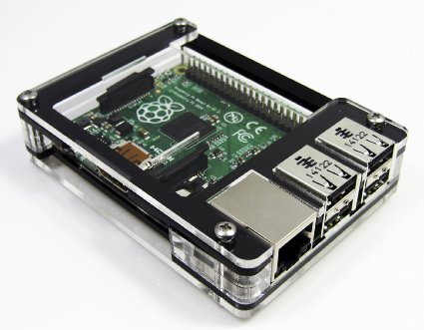
Budget
Development Budget
Research Time
Software Development Hours
Raspberry Pi B+ - $70
Production Budget
Domain & Hosting < $150/yr

Slide 28
Stretch Goals

Slide 29
Stretch Goals
Code all the different necessary scripts that are done behind the scenes of the user
Fully implement a working solution using a Raspberry Pi and a client connected through the internet
Provide a demonstration of a client connecting over WAN to the Pi

Slide 30
Future Upgrades

Slide 31
Future Upgrades
Implement the model into existing radios
Code and implement startup scripts
Expand the use of check session lengths with the use of nonces to continually authenticate the client with the radio
$20 YubiKey used for challenge/response, One Time Password, and securely holding RSA key pairs

Slide 32
Conclusion

Slide 33
Conclusion
This method of authentication will provide the best balance between security/authentication and usability of the application.
The cryptographic use of the encrypted communication channel that SSH uses and the authentication method we will use shall verify a user that has already been added to the keyserver database.
Behind the client interface is where the authentication scheme is used so a user understanding cryptography is unnecessary which makes for a user friendly experience.

Slide 34
Thank You!

