Slide 1
2.8 Team AB Networked orientation sensor (optical) Sponsor: Freescale
Monica Arroyo
Beth Beaver

Slide 2
The Project Summary
Create a networked orientation sensor for a Freescale wind turbine.
Has to give direction
Has to display this data to Proximetry via the Thread mesh network
Must be weather resistant
Cannot interfere with other internal components of turbine itself
1 Degree Resolution
Remote design to run off of a 3V coin cell battery for a year

Slide 3
Background and Motivation
Competing Technology
Magnetometers
Wind Turbines
Intended Use
Motivation
IoT developments (Applications in Connected Home)

Slide 4
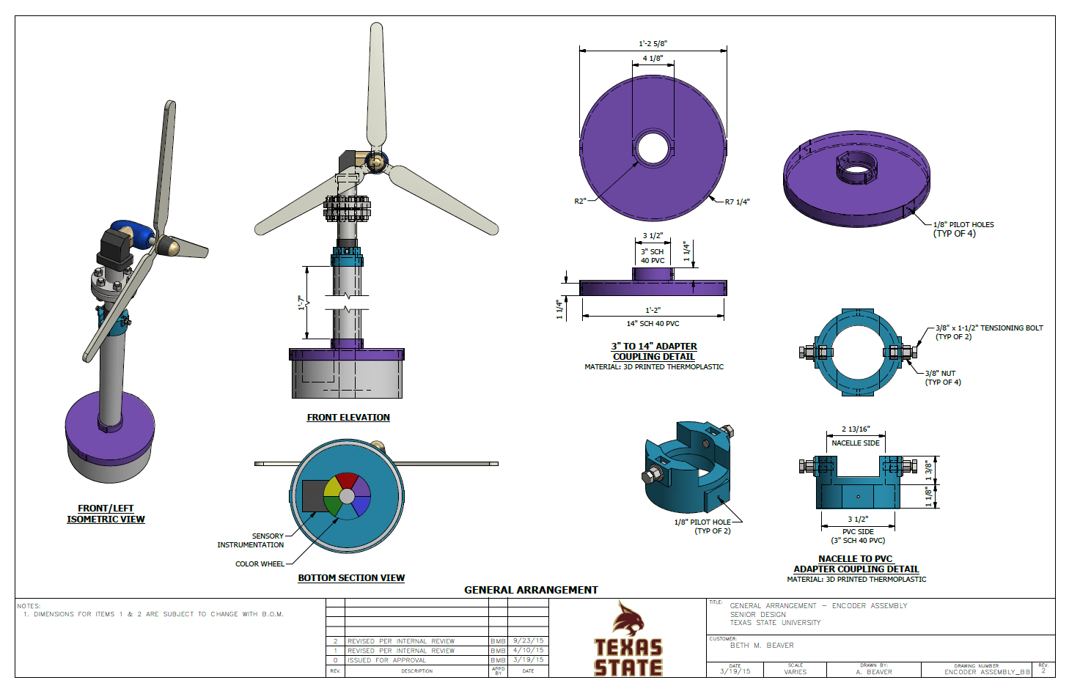

Slide 5
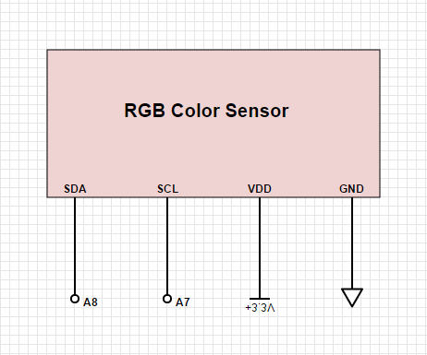
Adafruit Color Sensor
RGB color sensor reads a color and then displays the amount of red, green and blue in each scanned color and outputs the amounts of color in 3 digits.

Slide 6
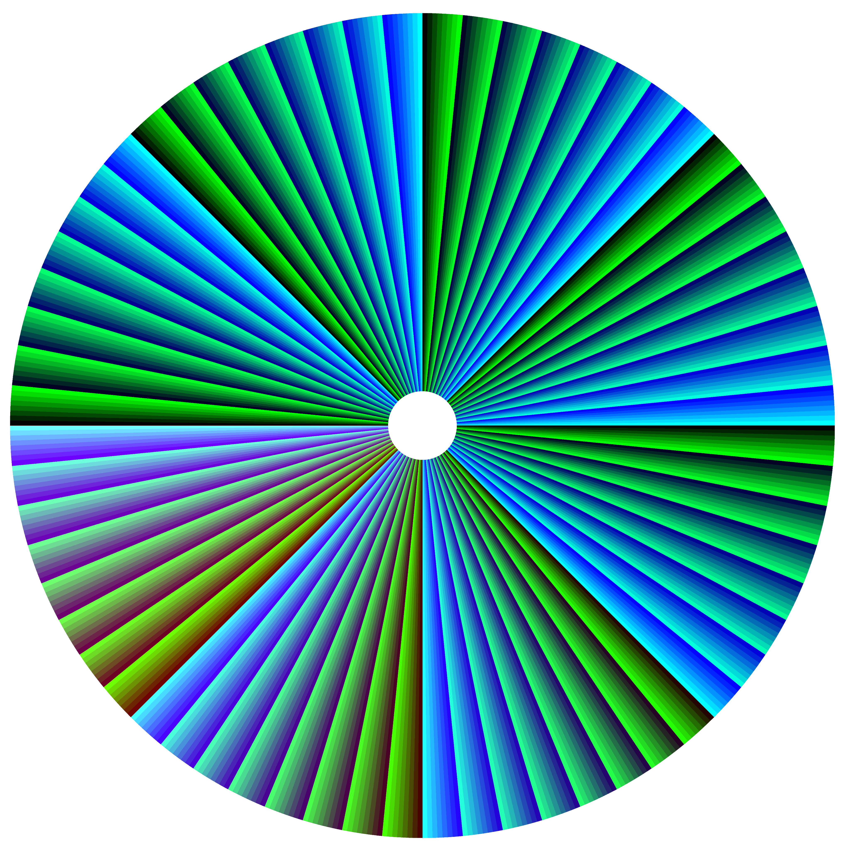
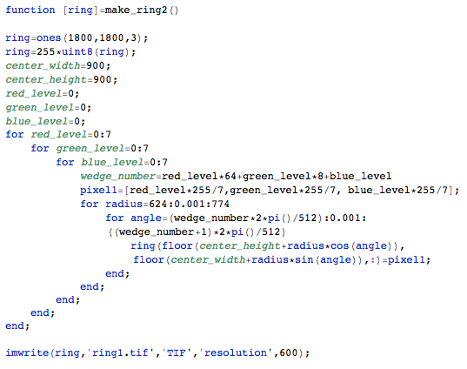
Color Wheel
512 segments
360/512~0.703 resolution
Each segment assigned 9 bit color where red is the most significant 3 bits, followed by green and then blue.
The amount of each color in each segment shifts in a binary pattern
Allows rough precision when absolute precision is not possible
Formulaically derive direction rather than using look-up table
Due to the fact that there is only 1 bit difference between each of the wedges, averaging does not become a concern.

Slide 7
Expected Results/Data
As the wind turbine pivots the direction change is recorded and reported to Proximetry for display.

Slide 8
Budget
3D Print Couplers and 14” Diameter Sleeve-$200
3V coin battery~$2
3 inch PVC sleeve - $5.19
14 inch PVC sleeve ~ $59
Color Sensor~$8.00
Total = $274.19
Tower Setup
TWRPI-MMA8451Q Accelerometer
Provided by

Slide 9
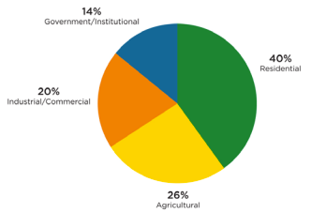
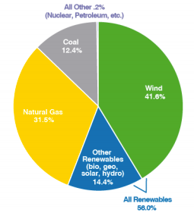
Market
In 2013, 30 megawatts (MW) of new distributed wind capacity was added, representing nearly 2,700 units across the U.S. [1].
Residential applications accounted for 40% of U.S. distributed wind deployed in 2013 [1].
Wind was 42% of all new capacity in 2012 [4].
Over the past 5 years, wind represented 36.5% of all new capacity [4].

Slide 10
References
[1] AWEA – American Wind Energy Association. 2014. U.S. Wind Industry Annual Market Report Year Ending 2013. AWEA, Washington, D.C.
[2] NREL – National Renewable Energy Laboratory. 2013. Figure of Merit – Cost of Energy for Distributed Wind (200 m2 to 1000 m2), 12/19/13. National Renewable Energy Laboratory, Golden, Colorado.
[3] Wiser R. and M Bolinger. 2014. 2013 Wind Technologies Market Report. Lawrence Berkeley National Laboratory, Berkeley, California. Available at http://energy.gov/eere/wind/information-resources.
[4] “2012 U.S. Wind Industry Market Update,” American Wind Energy Association . [Online]. Available at: http://www.awea.org/resources/index.aspx?navitemnumber=506. [Accessed: Nov-2015].

Slide 11
Questions?

