Slide 1
Welcome
FS Updates Meeting
Tuesday October 30, 2018
Please Sign In

Slide 2
AGENDA
Accounts Payable & Travel Updates
Material Management Update: Z_MIGO Instructions
New Employee Introductions
Procurement Updates
IT Business Service Updates
• CRP & DFP Computer Ordering
• Software Review
• Information Security & ADA
Questions

Slide 3
Meeting Reminders
Questions are welcome and encouraged at any time.
Raise your hand and wait for the microphone – so all can hear. Otherwise you’ll just have to repeat it.
State your name and department – let’s all get to know who each other is. This is a good start.
All questions and answers will be included in the final presentation when posted to the PSS website.
NEW ATTENDEES – There is a lot of information covered in these meetings. You can review the last four FS Updates Presentations for a good foundation on how to interface with Financial Services.

Slide 4
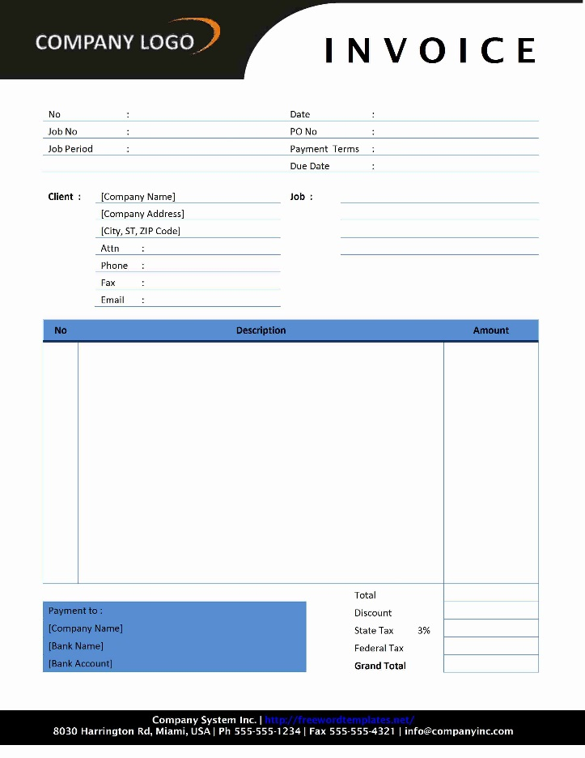
Travel & Accounts Payable Updates

Slide 5
Travel Updates
Non-Reimbursable Travel Expenses RSS 091918A
Be familiar with the allowed and unallowed travel expenses. Refer to the Travel Policies and Procedures and the Travel Office Announcements at Travel Office Website.
Early Bird Check In, TSA Pre-check, fare service and similar fees are not reimbursable. Can be paid for personally.
Coach fares only for employees and students. Traveler can pay for additional fare upgrades personally.

Slide 6
Travel Updates
Non-Reimbursable Travel Expenses con’t:
VIP guests of the University may be allowed to book higher fare classes with Cabinet Officer approval (remember to attach that) and the department must have the funds to cover the additional costs.
Includes air, rail and other transportation options.
Exceptions are allowed with Cabinet Officer approval which must be attached to the Travel Request or Funds Commitment as the travel agencies will contact the Travel Office for approval if a non-coach fare reservation is attempted.
Non-employee contractor travel expenses – include travel in the contract terms and contractor fee to avoid Texas State Travel approval, travel reservations and reimbursement processing.

Slide 7
Travel Updates
Travel Reservation Approvals RSS 082718A
The Travel Office approval is no longer required on reservations made on an approval travel trip (unless a higher fare than coach is selected). Time Saver!!!!
This includes reservations booked through Ascot or Corporate Travel Planners.
Person booking the reservations will be required to provide an approved and accurate travel trip number. Travel Office reviews all reservation detail provided from the TMC.
There is no change to the reservation process for rental cars which currently allows bookings without the Travel Office approval. A valid travel trip number is still required.

Slide 8
Travel Updates
Conference Agendas RSS 101218A
Must attach the final agenda to the Expense Report.
Must adjust meal per diems for any meals included on the agenda.
Must notate if a reception or breakout session included meals.
Adjustments to per diems are necessary to ensure the meal costs are not doubled by payment to third-party and per diems to the traveler.
Must adjust per diems for any business meals the traveler attended.

Slide 9
Travel Updates
Corporate Travel Planners (CTP) Roll Out:
Hope to start in February 2019.
CTP will conduct live training at the University.
Current departments in the test pilot program will go through training first.
As the dates and training locations are confirmed, notifications will start.

Slide 10
Accounts Payable Updates
AP 12 Form – How To Complete RSS 100218B
Used for authorization to purchase alcohol, flowers, food and or refreshments (includes employee only events).
Remember to always include a business purpose.
Same as for any type of purchase (PO, e-NPO or P-Card).
Select the correct type of payment.
Enter the correct funding information.

Slide 11
Accounts Payable Updates
AP 12 Form – How To Complete RSS 100218B cont’d
Make sure the form data matches the PO or e-NPO data.
Complete all sections and obtain the appropriate signatures.
Attach form to the PO or e-NPO documents to save time on the payment.
Attach to the P-Card log if that method is used.

Slide 12
Accounts Payable Updates
EDI Vendor List RSS 100218A
EDI is an Electronically Delivered Invoice (EDI).
Vendor submits electronic invoices that are matched to the PO and PO line.
These vendors are used in the MarketPlace.
PO numbers start with “31”.
Instructions to view invoices on these vendor POs is located at:
View Vendor Invoice & Payment Activity

Slide 13
Accounts Payable Updates
EDI Goods Receipt (GR) Tips RSS 101718A
The following situations need to be understood for responding to the SAP GR emails.
Duplicate invoice is received from EDI vendor. SAP automatically blocks the duplicate from payment and the GR hold is applied.
Item is returned and the vendor submits a new invoice for the replacement but the vendor credit memo has not been received to offset the original invoice.

Slide 14
Accounts Payable Updates
EDI Goods Receipt (GR) Tips RSS 101718A cont’d
Vendor codes the billed items to the wrong PO line. Notify payables@txstate.edu when this occurs as they can reverse the invoice and contact the vendor to submit a correct invoice.
Vendor bills for a greater quantity than on the PO. This should be disputed with the vendor. Notify payables@txstate.edu of the dispute. Note that Dispute Emails will generate from SAP as a reminder to monitor the dispute. Notify payables@txstate.edu when the dispute has been resolved.
If the Account Manager decides to keep the extra items, then send the Account Manager approval to payables@txstate.edu with the funding account information.

Slide 15
Accounts Payable Updates
UDPATE ON: Medical Supply/Item Purchases such as:
Over-the-counter medical supplies and remedies, bug spray, suntan lotion, other topical items or ingestible items, etc.
Legal Counsel and Environmental Health and Risk Management are reviewing this and once completed their recommendations will be communicated.
If you get a budget error notice from AP, please advise when that has been resolved so the payment can be released or it will remain on hold.
2019 Prompt Pay Rate is 6%. It is even more critical to get your invoices to AP on time and ensure all the required dates and actions have been completed.
Refer to the Prompt Pay Compliance slides from August 8, 2018 FS Updates Meeting August 2018 for additional information.

Slide 16
Accounts Payable Updates
Commonly Used GL List – RSS 102918A
Updates completed and posted on the AP website.
Today you can pick up a printed list by the sign-in sheets.
Remember – Invoices cannot be split between the PO and an e-NPO. The entire invoice is only paid one way.
GR EMAIL NOTIFICATIONS – Any suggestions? (SAP is in a freeze for the Annual Support Pack updates, but suggestions are always welcome.)

Slide 17
Material Management Update
Click on the link to MM Resources and Forms.
Scroll down to the Z_MIGO Instructions and select.
Instructions detail the process for entering your department’s GR’s without MM action.
Timely entry of GR’s will prevent the SAP GR emails.

Slide 18
ASSET TRANSFER REFRESH

Slide 19
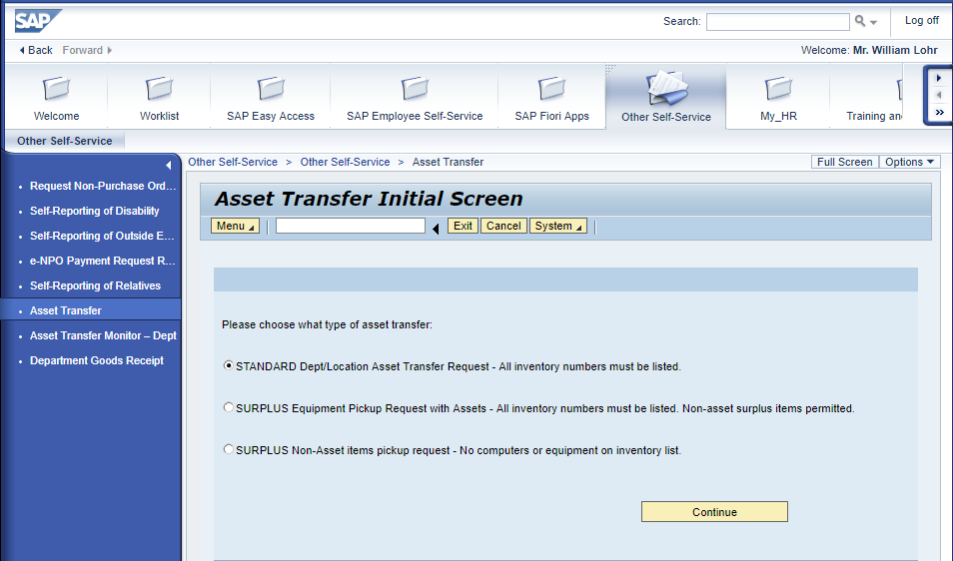

Slide 20
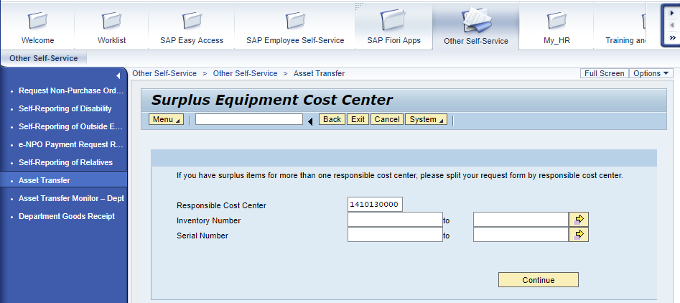
No inventory numbers are needed unless you want to populate a string of consecutive numbers.

Slide 21
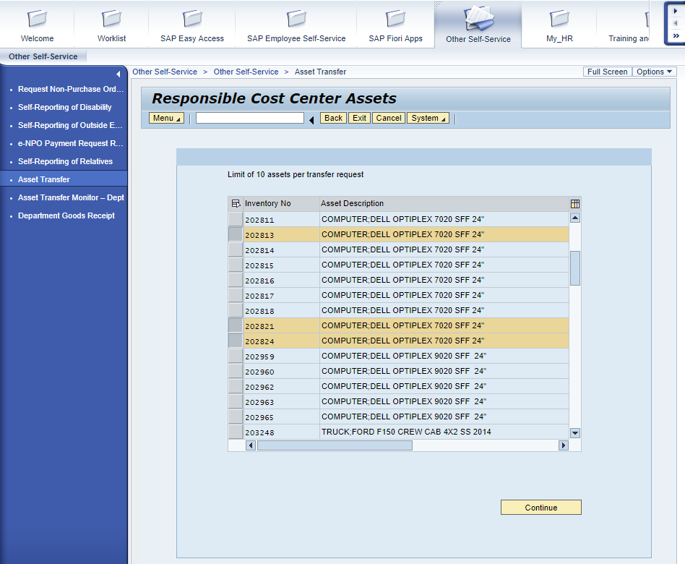

Slide 22
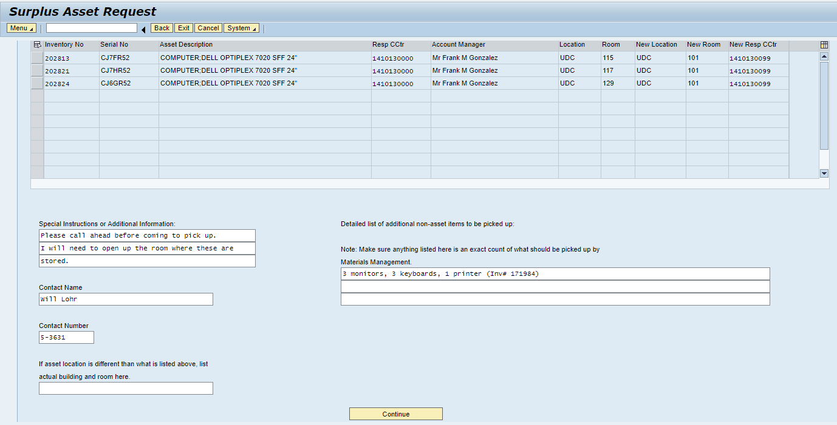

Slide 24
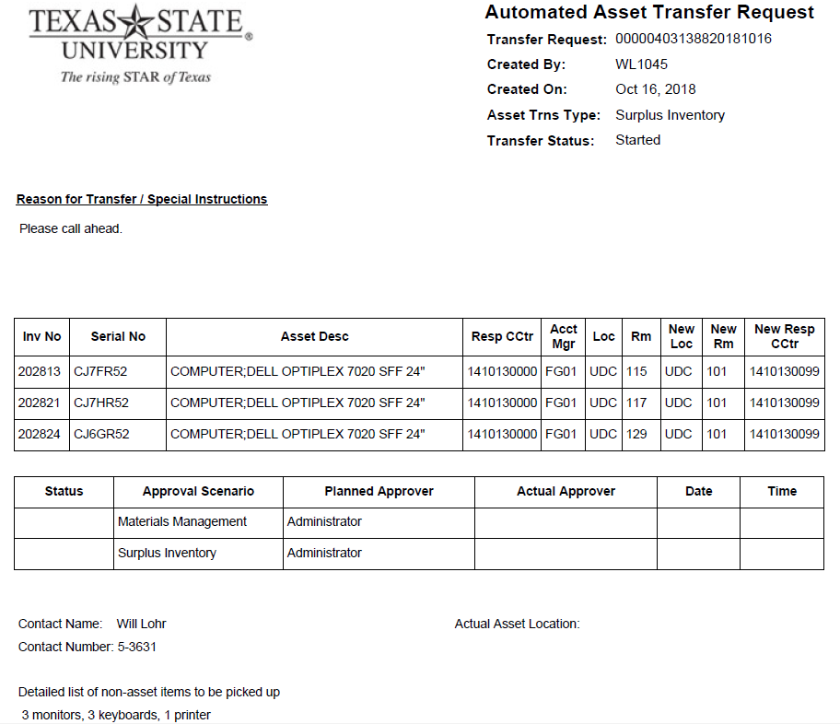

Slide 25
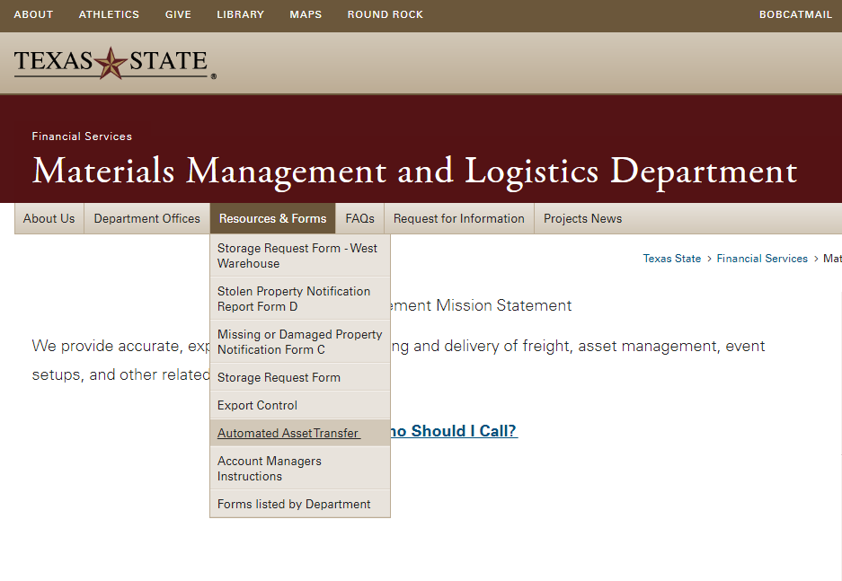
INSTRUCTIONS

Slide 26
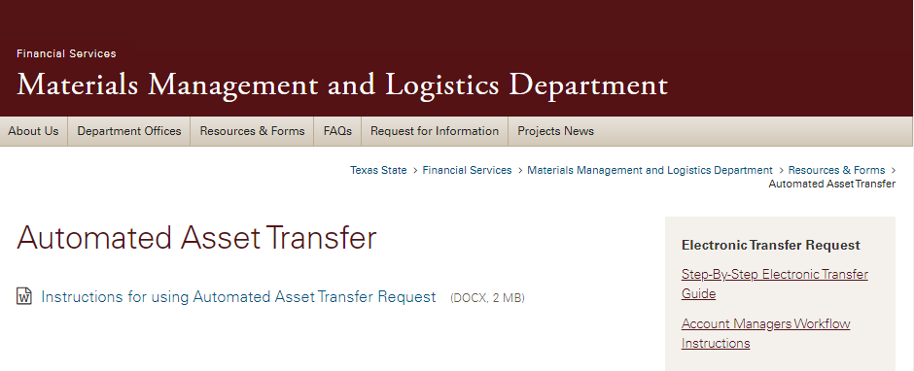
INSTRUCTIONS

Slide 27
Staff Introductions
William Becker – Assistant Director, PSS
Linda Rodriguez – Buyer, PSS
Cynthia Balboa – Procurement Analyst, PSS
Karina De Leon – Administrative Assistant

Slide 28
RSS Feeds
Stay informed on process and form changes that affect these functions.
Instructions for setting up an RSS feed can be found at the following office links:
How to Add RSS Feed for AP
How to Add RSS Feed for Travel
How to Add RSS Feed for Purchasing

Slide 29
Procurement Updates
If a vendor hasn’t been used or updated for 2+years, it has been blocked and you will need to obtain a new vendor maintenance form located on the purchasing site in the forms tab under vendor maintenance.
A vendor update must be processed before you are able to do a PO or process a payment request.
PaymentWorks Updates
Live stream via Skype
HUB Updates

Slide 30
Texas State University – HUB Program
Overall expenditures up
Texas State exceeded the statewide HUB participation published with the semi-annual report for the first six months of FY18
How we compare to our peer universities

Slide 31
Texas State University - HUB Goals

Slide 32
Texas State University - FY18 HUB Participation

Slide 33
Texas State University - Participation by Division

Slide 34
Texas State University - Participation by Category

Slide 35
How we compare to our peer universities
On the published semi-annual list of the top fifty agencies by total expenditures Texas State is number 16.
In regards to the HUB participation % of expenditures, Texas State is number 28.
The following is the comparison of Texas State and our peer emerging research universities.
Ranked %
University of Texas at San Antonio #6 30.10
University of Texas at Dallas #8 24.32
University of North Texas #10 23.08
Texas Tech University #14 20.67
University of Texas at El Paso #23 17.36
Texas State University #28 16.00
University of Houston #30 15.43
University of Texas at Arlington #36 12.45

Slide 36
IT Hardware/Software Procurement

Slide 37
Presenters
IT Assistance Center (ITAC) – Cable Hott
IT Business Services – Jose Rodriguez
ADA – Dr. Milt Nielsen
Information Security Office – Jon Sowell

Slide 38
Hardware
Changes to the CRP Models
PC models are getting 8th generation Intel CPU’s
Many went from 4 to 6 core processors, which means performance when you need it and energy efficiency when you don’t
Base model iMac now has been upgraded to fusion drive
New standard pending approval. XPS 13” 2-in-1

Slide 39
How do I buy it?
The new hardware workflow
We can buy it for you
Simple process ordering hardware - just one form does it all!
https://itac.txstate.edu/forms/hardware-dfp-parts
https://itac.txstate.edu/forms/hardware-dfp-computer.html
https://itac.txstate.edu/forms/hardware-dfp-lab-server.html

Slide 40
Key Ordering Benefits
Order process benefits
Decreases chance of delayed orders
Increases speed and efficiency of workflow by eliminating possible errors, such as GL, storage location values, and other mistakes common to IT equipment ordering
Leverages IT Business Services’ dedicated IT procurement specialists
Narrows the scope of computer models, allowing us to focus discounts on specific product lines and increase buying power with vendors
Better visibility tracking when vendor loses or cancels an order
Increased level of IT lifecycle support

Slide 41
Why the change?
A clearly defined process for all involved
Those who want IT-recommended equipment get a fast, simple process
Those who need quotes have the same level of service - with consultation and with cost savings
Vendor liaison
Involving IT in quotes allows us to better understand how standards should be modified to meet changes in campus needs
If something is working or not, we let them know
Many products have been tested by IT and don’t meet standards

Slide 42
IT Review
TSUS Rules and Regulations, Chapter III, Paragraph 19.3, requires central review and oversight of all university acquisitions of information technology by the vice president for Information Technology, or designee, “including, but not limited to, computing hardware or software, and hosting services, regardless of source of funds.”
Ensure proper software licensing

Slide 43
Workflow Improvements
Purchase Orders
Contracts
Requisitions
Notes:
These may be covered in Software.

Slide 44
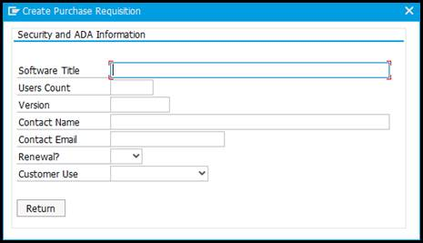
Software purchases

Slide 45
ADA Review
State agencies and institutions of higher education are required to comply with Texas EIR Accessibility statutes and rules to provide accessibility.
TGC 2054.451, enacted in 2005, requires that all state agencies and institutions of higher education, provide state employees and members of the public access to and use of electronic information resources.
1 TAC 206, aligns state web accessibility standards with the federal regulations set forth in Section 508 of the Rehabilitation Act of 1973.
1 TAC 213 enacted state standards for procurement, development, or usage of EIR for people with disabilities and also aligns accessibility standards with the federal regulations set forth in Section 508.
Notes:
These expectations have existed for years. OCR's recent activity is that universities are expected to comply...with no delay. $4.0 Billion in law suits at universities and associated contractors and suppliers.

Slide 46
Other Workflow Issues
Survey questions integrated into SAP
Other requests, with minimal information will receive a Qualtrics Survey
VPAT's are requested within the survey
Notes:
The survey question integration will reduce approval time. The questions are necessary to assess the risk of a given tool.

Slide 47
Survey Questions
POC information with knowledge about the software and its use
Software title and version
Company name and contact information
How will the tool be used? Classroom? Professor's office?
Where hosted?
VPAT
Notes:
These questions if answered completely, even when they are integrated in comments will speed review times.

Slide 48
Future Integrations: Other Software & Automated Thresholds
More than $500
More than 100 users, to include faculty, staff and students
Renewal / Repurchase
User information
Notes:
The focus is on hastening the review process.

Slide 49
Required
Users, supervisors, faculty, support staff are expected to provide an alternative method to complete the task if a disabled person is not able to complete the task within the tool. The process is expected to be immediate. For students, there should no loss of instructional progress, the alternative should be immediate.
Notes:
The purchase of the software is not a statement of ADA compliance, but a tool acquisition, highlighting plans for improvement of compliance.

Slide 50
Information Security Office Review
Texas Government Laws and Codes
TAC 202 – Information security standards for state agencies and higher ed
HB-8 - Relating to cybersecurity for state agency information resources GC 2054.517 – Information Resources and Planning Requirements (HB-8)
Documentation Needed
HECVAT & HECVAT Lite – which to use and why
Service Evaluation Form – More accurate and detailed responses

Slide 51
Why Evaluate?
All software must meet certain standards
New software will always go through this process
Software purchased prior to review process needs to be confirmed as meeting security standards
Access to confidential or private data must be protected by law
Unexpected vulnerabilities may be discovered in software

Slide 52
Submitting Evaluations
When does Information Security receive your requests?*
SAP request is in Account Manager phase
eNPO request is received by IT Business Services
Marketplace request is submitted
*Submit evaluations 30-60 days prior to purchase to expedite

Slide 53
Purchasing
Final Review and Approval

Slide 54
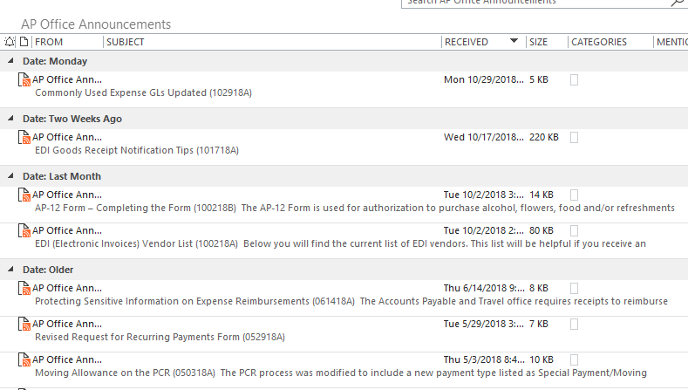
Questions
1. Is there a list of the RSS Announcements?
There is no list, but the tabs on the different websites (i.e. AP, Travel and Procurement) have a tab at the top where they are listed – if you haven’t signed up for the RSS feeds. If you have done that, they are listed in the RSS Subscriptions folder in Outlook.
Once in the selected Outlook folder you can see the announcements with the titles. This is probably the best way to get the list. This is a screen shot of the listing and the topic is before the RSS numbering.

Slide 55
Questions
You can also go to the department’s website and select the Announcement tab at the top. For example:
2. Conference meals- if unable to eat provided box lunch or dinner by conference due to medical needs not met by conference, can per diem be paid? What documentation is required?
If a conference attendee has a medical condition that restricts their diet, they should check with the conference about their restriction and request the food they could eat before attending (normally done at the time of registration). Most conferences do allow for this substitution at no charge or the attendee should request to attend without the cost for the meals since they have dietary restrictions and must obtain meals on their own. If that is not allowed, then the attendee should draft a summary of the conference cost including meals and that they had to purchase their own meal (or meals – defining which ones) and that they are requesting per-diem to pay for those meals in addition to the conference cost. That should be approved by the Account Manager and attached to the expense report along with the conference agenda. As always, an overnight stay is still required in order to be reimbursed for meal per diem.

Slide 56
Questions
3. Student Travel – Can you include or create a workshop for interested departments i.e. travel to other cities, other states?
Student travel is processed the same as employee travel. If they are student employees, they will use TRAVEL Tracks, if not a Funds Commitment will need to be created. Please reference the Travel Office website.
4. Group Student Travel – Travel Requests VS. FC when to use one over the other. What items can be pre-paid? How?
A group of students (at least one student) travel expenses may be added on a sponsoring Texas State employee’s Travel Request. If the students are traveling as a group without a Faculty or Staff member they will need to be on a Funds Commitment.
Airfare and Car rental may be direct billed to the University with encumbrance on an approved Travel Request or Funds Commitment.
Hotels can be prepaid (i.e. check issued before the traveler checks in and the traveler needs to present the check to the hotel at check in) via e-NPO or PO if the hotel has been set up as a vendor in the SAP system.

Slide 57
Questions
5. Travel-can we have GSA rates in TRAVELTracks updated in October?
The GSA tables are input in TRAVLERACKS when allowed by the software. The software only allows for one update and that is effective January of each year. When it is updated the October, November and December rates are not published by GSA yet, so we use the September rate for the remaining months on TRAVEL Tracks. For instance, the rates for January – December of 2019 are entered into the system even though the rates only go through September of 2019 on GSA. The traveler is eligible for the higher rate if not on TRAVEL Tracks. Attach a copy of the current GSA rate to the Expense Report and add an additional meal expense line and a positive amount on the Lodging Reduction expense.
6. Now that you are fully staffed will purchasing be reviewing purchase orders more closely?
The Purchasing office reviews all purchase orders with the same diligence for all purchase orders it receives.
7. When are the departments going to have more training on Purchasing Policies/University Policies? Departments don’t have training like Purchasing but allowed to create PO’s that are reviewed by Purchasing.
All of the purchasing policies have recently been reviewed and updated. Purchasing is currently working on updating its current training curriculum and plan to provide more resources and online support for the university soon. While this continues Purchasing is available to provide training for a department on a case by case basis.

Slide 58
Questions
8. If we purchase pens and pencils as promotional items for giveaways, would we use GL 730900 (promo items – Local Funds) or 730000 (Consumable Supplies)?
If you are buying promotional items, use the promo item GL 730900.
9. Why are we NOW having to do Goods Receipt for services entered on Marketplace?
Vendors in the Marketplace are defaulted to have GR’s or no GR’s done based on what they provide to the University. This applies for both punchouts and non-catalog orders. If you feel like your vendor does not need to have GR’s done, please contact the Purchasing Office at purchasing@txstate.edu.
10. How can you alert buyer that GR is needed? If goods are delivered to a different location or delivery accepted by another person, you may not know that G/R is needed. You assume it went through Materials Management. It should go to purchaser before it goes to Account Manager.
The SAP system is unable to generate a notification of when goods are received. We suggest that all orders be sent to the University Distribution Center shipping address so that the good received can be check in and a GR be processed. In the event that the University Distribution Center address is not used, you will need to collaborate with the individual who is to receive the order notify you upon receiving items.

Slide 59
Questions
8. What is the timeline for CRP process When do areas receive notice? When do departments receive notice of allocations?
Our timeline for the CRP department notification is October of every year
9. IT – Is there a listing of GLs on the IT webpage that shows how approval workflow will be?
There is not a list of GLs on the IT webpage, however, IT is working with Purchasing and Accounts Payable to create a list of the Financial GLs together and perhaps place an asterisk * on the ones that need special routing and approvals.

Slide 60
Thank You!

Slide 61
CONTACTS
General Accounting Office 5-2541 gao@txstate.edu | Procurement & Strategic Sourcing 5-2521 purchasing@txstate.edu
Accounts Payable 5-2777 payables@txstate.edu | Travel Office 5-2775 travel@txstate.edu
Financial Reporting & Analysis 5-2541 financialreporting@txstate.edu | Student Business Services 5-2544 cashier@txstate.edu
Materials Management & Logistics 5-2294 materialsmgt@txstate.edu | Technology Resources (ITAC) 5-4822 itac@txstate.edu

Slide 62
Questions????

Slide 63
Thank you for coming!

