Slide 1
Sales Tax Collection and Remittance Workshop
September 21, 2012
8:30-10:30

Slide 2
Topics of discussion
What is Texas Sales Tax?
Does the University have a current UPPS?
Have Procedures been written to assist University Departments?
Texas Sales Tax Rates
Definitions of Taxable and Non-Taxable Items
Is the University exempt from paying Texas Sales Tax?
Sales Tax Calculation

Slide 3
Topics of discussion (Cont.)
Sales and Use Tax Exemption and Resale Certificates
Surplus Sales
Student Organization Sales
Sales Tax Rules for Out-of-State Purchasers
Sales Tax Rules on Food/Meal Purchases
What is the process for collecting and depositing sales tax?
Frequently Asked Questions
Additional Available Resources

Slide 4
What is Texas Sales Tax?
As per the State of Texas Tax Code Title 2. State Taxation, Subtitle E. Sales, Excise, and Use Taxes, Chapter 151 and the Comptroller of Public Accounts APS 008: State agencies and institutions of higher education must collect all applicable sales tax when making sales to the public:
State 6.25%
City (.25% - 2%)
Transit authority (.25% - 1%)
County (.5% - 1.5%) and
Special purpose district (.125% - 2%)

Slide 5
Does The University have a u.p.p.s. covering Sales tax?
A proposed U.P.P.S. is circulating amongst the Finance & Support Services Division and should be released later in FY2013

Slide 6
Have Procedures Been Written to assist University departments?
A Sales Tax Procedures Manual has been drafted and is being reviewed
The final version should be available on our website later this fall at:
http://www.txstate.edu/payroll/taxspec/TX-Sales-Tax.html

Slide 7
Texas Sales Tax Rates
Current Tax Rates for Texas State University-San Marcos and Round Rock campuses are both 8.25%
Current Sales Tax Rates are available on the State Comptroller’s website at:
http://www.window.state.tx.us/taxinfo/local/index.html

Slide 8
Definitions of Taxable and Non-Taxable Items
Taxable Items –Tax must be collected on all cash sales involving tangible, personal property. The State Comptroller defines this as personal property that can be seen, weighed, measured, felt or touched, or that is perceptible to the senses. See Texas Tax Code Section 151.009.
Non-Taxable Items – No tax is required for many items.

Slide 9
Taxable Items
Clothing – shirts, hats, etc sold by campus departments or bookstore
Computer Programs – sold by ITAC, campus departments or bookstore
Food Items – sold in concession stands, vending machines, campus stores or catered functions to for-profit groups
Books – sold by departments, library or campus bookstore
Rentals – canoes, tubes, towels, etc. rented to visitors to the San Marcos River and the Recreation Center

Slide 10
Taxable Items (cont.)
Parking – sales tax is due for charges to the public
Laundry – sales tax is due on coin-operated washing machines and dryers
Telecommunication – sales tax is due on long distance services
Shipping Charges – sales tax is due on shipping charges

Slide 11
Non-Taxable Items
Conferences for educational purposes
Books, pamphlets, clothing, meals, etc. included in cost of registration
Books, CD’s, pamphlets, clothing, meals, etc. sold separately are taxable
Booth rental
Dues
Fines & Penalties
Subscriptions – 6 months or longer
which are mailed second class

Slide 12
Non-Taxable Items (Cont.)
Advertising sold
Publications
Newspapers
Magazines

Slide 13
Is The University Exempt from Texas Sales Tax?
Yes, the University is exempt from paying Texas sales tax when goods or services are purchased
The University collects sales tax from sales of goods and services on-campus and remits to the State of Texas

Slide 14
Sales Tax Calculation
Tax Calculated Based on Gross Sales: Multiply total taxable sales x current sales tax rate
Book Sale $50
Tax rate X .0825
Sales Tax $ 4.13
Total Sale $54.13
Tax Included: Divide the total taxable sales by the sales tax rate to determine the net taxable sale
T-Shirt including tax $15
Tax rate +1 1.0825
Net Sale $13.86
Tax $1.14

Slide 15
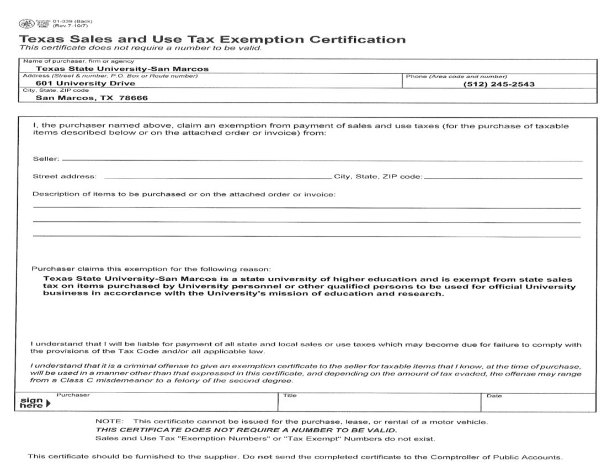
Sales and use Tax Exemption certificate
This form is available on our website at:
http://www.txstate.edu/payroll/taxspec/TX-Sales-Tax/contentParagraph/00/content_files/file0/Texas%20Sales%20&%20Use%20Tax%20Exemption%20Certification.pdf

Slide 16
Sales and use Tax Exemption certificate
“I understand that it is a criminal offense to give an exemption certificate to the seller for taxable items that I know, at the time of purchase, will be used in a manner other than that expressed in this certificate, and depending on the amount of tax evaded, the offense may range from a Class C misdemeanor to a felony of the second degree.”

Slide 17
Sales Tax Exemption Certificates accepted for on-campus purchases
State Agencies and other exempt organizations may present a sales and use tax exemption certificate when purchasing goods and services on campus
The certificate must be kept on file by the selling department following the retention schedule
The certificate has no required Texas Sales Tax Exemption number
The certificate must be signed by the purchaser

Slide 18
Sales Tax Exemption Certificates used for off-campus purchases
Campus departments must present a Texas sales and use tax exemption certificate when purchasing goods and services off-campus
This certificate does not require a number to be valid, however, if asked for a number, use the University’s Sales Tax number:
1-74-6002248-0
The certificate must be completed and signed by the purchaser

Slide 19
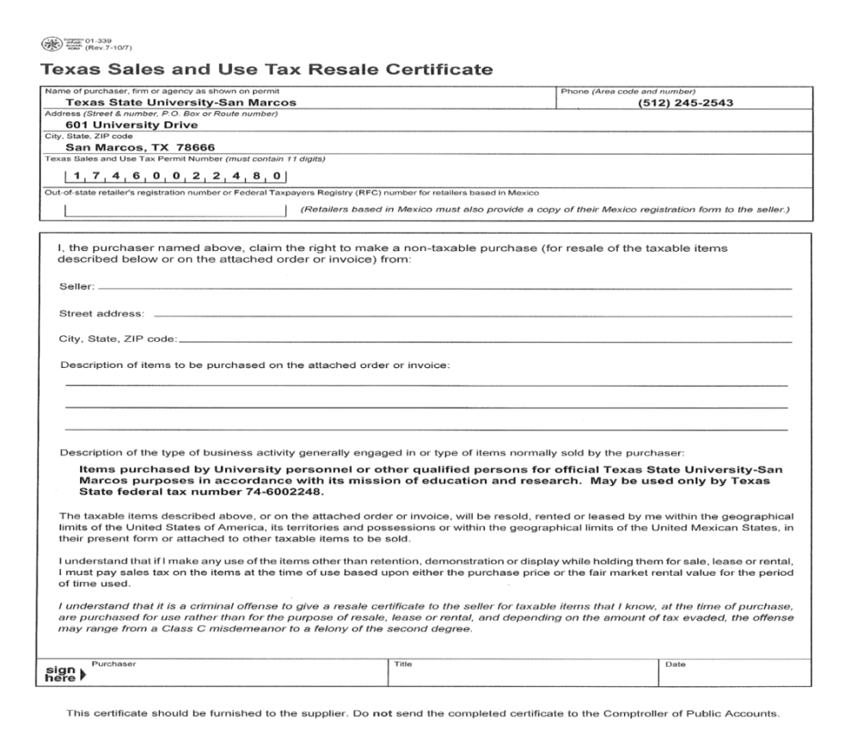
Sales Tax and Use Resale Certificate
This form is available on our website at:
http://www.txstate.edu/payroll/taxspec/TX-Sales-Tax/contentParagraph/00/content_files/file/Texas%20Sales%20&%20Use%20Tax%20Resale%20Certificate.pdf

Slide 20
Texas Sales and Use Tax Resale Certificate (Cont.)
“I understand that it is a criminal offense to give a resale certificate to the seller for taxable items that I know, at the time of purchase, are purchased for use rather than for the purpose of resale, lease or rental, and depending on the amount of tax evaded, the offense may range from a Class C misdemeanor to a felony of the second degree. “

Slide 21
ReSale Tax Exemption Certificates for On and off-campus purchases
Purchasers must present a Texas sales and use resale certificate when purchasing goods and services intended for resale
This certificate does require a number to be valid. For Texas State purchasers, the Resale Tax Exemption number is:
1-74-6002248-0
The certificate must be completed and signed by the purchaser

Slide 22
Surplus Sales
All surplus property must be sold by the University Materials Management Department.
Sales of computers, printers, typewriters and other tangible, personal property to non-state agencies should be charged sales tax, unless proof of tax exemption is provided.
Sales of vehicles licensed for highway use are exempt from sales tax as they are subject to the Motor Vehicle Sales Tax collected by the county tax assessor-collector.

Slide 23
Student Organizations sales
University Student Organizations may hold a “One-Day, Tax-Free Sale” each month.
Primary purpose of the organization must “not” be to engage in business or generate a profit
Purpose of the sale must be to raise funds for the organization
Individual item sales must not exceed $5,000 unless they are manufactured by the organization or donated to the organization and not sold back to the donor

Slide 24
Sales tax Rules for Out-Of-State Purchasers
Sales Tax is charged based on where the possession of the item takes place
If a department sells an item to an
out-of-state purchaser and ships to an out-of-state address, the sale will be tax exempt
If a department sells an item to an
out-of state purchaser and ships to an in-state address, the sale will be taxable

Slide 25
Sales Tax Rules for Out-Of- State Purchasers (Cont.)
If a department sells an item in person even though they may live out-of-state, the sale will be taxable

Slide 26
Sales Tax rules on University Food/Meal Purchases?
If the University is purchasing directly by using a University P-Card or Purchase Order, a completed Sales Tax Exemption Certificate should be provided.
Current University Policies (UPPS’s and PPS’s) are being re-written and updated.

Slide 27
Sales Tax rules on University Food/Meal Purchases (C0nt.)
If an employee will be reimbursed by the University, they are not eligible to use a Sales Tax Exemption Certificate and should include any sales tax paid in their reimbursement request.
If the purchase is for personal use, the buyer is not eligible to use a Sales Tax Exemption Certificate and must pay the tax.

Slide 28
What is the process for collecting and depositing sales tax?
Departments are responsible for collection of revenue and related sales tax liability
Deposits must be made within three business days to the Cashier’s Office in Student Business Services

Slide 29
What is the process for collecting and depositing sales tax? (Cont.)
Departments should follow UPPS. 03.01.05 University Income Recognition and Associated Cash-Handling Procedures when depositing these funds
Student Business Services will prepare the monthly State Sales Tax Return and submit to the State by the 20th day of the following month

Slide 30
Frequently Asked Questions
What is taxable?
How much sales tax do I collect from my customers?
What tax rate do I use?
Am I required to separately state the sales tax amount to my customers?
Is rounding permitted when computing sales tax?
If I do not collect the sales tax or collect an incorrect amount, who is responsible for paying sales tax to Student Business Services’ Cashiers Office, who in turn will deposit the taxes with the State Comptroller’s Office?
Are the delivery or shipping charges taxable?
What is the retention schedule of Sales Tax Records maintained by University Departments?

Slide 31
What is taxable?
Texas tax law refers to tangible personal property and taxable services as taxable items. Each sale of a taxable item is taxable unless a specific exemption applies.

Slide 32
How much sales tax do I collect from my customers?
You should calculate the amount of sales tax by multiplying the tax rate by the sales price of the taxable item. A Tax Rate Locator tool is available on the Window on State Government at: https://ourcpa.cpa.state.tx.us/atj/addresslookup.jsp
Sales tax = sales price of a taxable item multiplied by the tax rate
Ex: The Math Department may sell a t-shirt for $10 and should use the sales tax rate of 8.25% for San Marcos – located in Hays County. The amount of $.83 sales tax should be computed. The total price charged to the customer should be $10.83.

Slide 33
What tax rate do I use?
The Texas state sales and use tax rate is 6.25%, but local taxing jurisdictions (cities, counties, special purpose districts, and transit authorities) may also impose sales and use tax up to 2% for a total maximum combined rate of 8.25%. You will be required to collect both state and local sales and use tax.
For information about the tax rate for a specific area, see Local Sales and Use Tax Rate Information on the Comptroller’s website.

Slide 34
Am I required to separately state the sales tax amount to my customers?
Yes, you must state separately the sales tax amount on your invoice or receipt unless you provide a written statement to the customer that the sales price includes sales tax. The "tax included" statement must be displayed where people would normally be advised of the terms of the sale (e.g., brochures, invoices, contracts, signage). If you use a written statement that sales tax is included in the sales price, you have collected sales tax and must report the collected tax by backing it out of the total amount received.

Slide 35
Is rounding permitted when computing sales tax?
When you compute the sales tax by multiplying the tax rate against the sales price, you should go out to the third decimal place. If the third decimal place is equal to or greater than 5, you should round up to the next cent. If the third decimal place is 4 or less, then you should round down to the next cent. For example, you sell a taxable item for $250 and must charge 8.25% tax. If you multiply the tax rate against the sale price, it is $20.625. Because the third decimal place is a 5, you would round up and charge $20.63. You can also use a rate chart.

Slide 36
If I do not collect the sales tax or collect an incorrect amount, who is responsible for paying sales tax to SBS Cashiers Office, who will deposit the taxes with the State?
As a seller, you are responsible for collecting and remitting the correct amount to Student Business Services’ Cashiers Office, who in turn will deposit the taxes with the State Comptroller’s Office. If you do not collect and remit the correct amount, your department will owe any additional tax plus you may be assessed penalties and interest.

Slide 37
Are the delivery or shipping charges taxable?
Shipping and handling charges are taxable if the charges are associated with the sale of taxable goods or service.
For example, you sell a sofa to a customer for $500. You agree to deliver the sofa and charge separate fee of $50 for delivery. Because your sale of the sofa is taxable, your $50 delivery charge is also taxable. You should collect sales tax on $550.
In contrast, if you sold a similar sofa for $500 to another customer who issues you a properly completed resale or exemption certificate, then your sale and the delivery charge are exempt. If you deliver the sofa for a fee of $50, the delivery charge is not taxable. You do not collect sales tax on the $550.

Slide 38
Are the delivery or shipping charges taxable? (Cont.)
In contrast, if you sold a similar sofa for $500 to another customer who issues you a properly completed resale or exemption certificate, then your sale and the delivery charge are exempt. If you deliver the sofa for a fee of $50, the delivery charge is not taxable. You do not collect sales tax on the $550.

Slide 39
Are the delivery or shipping charges taxable? (Cont.)
Note: "Delivery," "shipping," or "postage" on an invoice represents delivery charges. Please refer to Rule 3.303. Please note that separately stated charges for postage are not taxable when billed by the seller to a client if the cost of the postage was incurred by the seller at the request of the client to distribute tangible personal property to third party recipients designated by the seller's client.

Slide 40
What is the Retention Schedule for Sales tax records?
Sales Tax records should be retained by the campus departments for the current year and the previous 3 years.

Slide 41
Additional available resources
For information on collecting and reporting local sales and use tax, ask for publication 94-105 "Guidelines for Collecting Local Sales and Use Tax" (PDF, 9.74MB)
For a list of local tax rates ask for publication 96-132 "Texas Sales and Use Tax Rates." The state also provides tax rate cards for all combined tax rates. The tax rate for sales and use taxes are the same. See Purchases/Use Tax for additional information.

