Slide 1
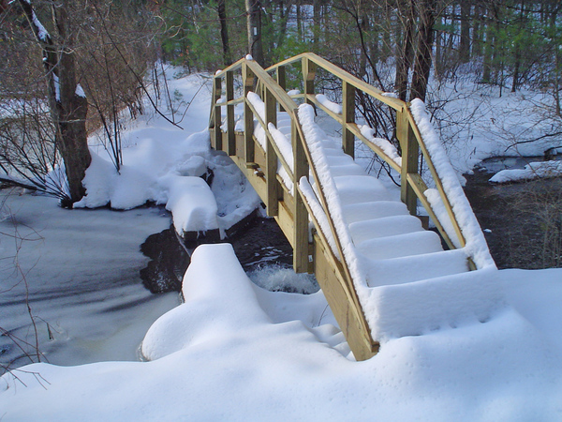
Texas CCRS
vs
Texas Adult Education Content Standards
A Comparison of Math and Writing Standards

Slide 2
Writing Standards Comparison Texas CCRS Standard Texas Adult Education Content Standard
I. Writing A) Compose a variety of texts that demonstrate clear focus, the logical development of ideas in well-organized paragraphs, and the use of appropriate language that advances the author’s purpose. I.A.1 – Determine effective approaches, forms, and rhetorical techniques that demonstrate understanding of the writer’s purpose and audience. | Strand 1 – Determine Purpose Benchmarks: As learners progress across levels, benchmarks become more challenging and are completed with increasing independence.
1. A.1 – Determine effective approaches, forms, and rhetorical techniques that demonstrate understanding of the writer’s purpose and audience.
1.A.1.a – Prepare a topic proposal that specifies and justifies the topic, audience, and purpose.
1.A.1.b – Identify the types of writing (e.g., informational, analytical, polemical) and forms of writing (e.g., letter, editorial, essay) that are appropriate for the writer’s particular purpose and audience.
1.A.1.c – Recognize rhetorical techniques appropriate to the purpose, audience, and form of a particular composition. | Sec 2.Strand 1.Level 6 – Determine the purpose and audience for communicating in writing independently.

Slide 3
Writing Standards Comparison Texas CCRS Standard Texas Adult Education Content Standard
I. Writing A) Compose a variety of texts that demonstrate clear focus, the logical development of ideas in well-organized paragraphs, and the use of appropriate language that advances the author’s purpose. I.A.2 – Generate ideas and gather information relevant to the topic and purpose, keeping careful records of outside sources. | Strand 2 – Organize Information Benchmarks: As learners progress across levels, benchmarks become more challenging and are completed with increasing independence.
I.A.2 – Generate ideas and gather information relevant to the topic and purpose, keeping careful records of outside sources. | Sec. 2.Strand 2.Level 6 – Independently plan and organize information using a variety of resources and strategies to produce a legible and comprehensible draft.
1.A.2. – Generate ideas and gather information relevant to the topic and purpose, keeping careful records of outside sources. | Sec. 2.Strand 2.Level 6 – Independently plan and organize information using a variety of resources and strategies to produce a legible and comprehensible draft.
1.A.2.a – Utilize effective pre-writing strategies: outline and prioritize ideas, anticipate questions that might be raised by readers, and identify appropriate primary and secondary source material.
1.A.2.b – Evaluate the reliability of possible sources and prepare an annotated bibliography. Sec. 2.Strand 2.Level 6

Slide 4
Writing Standards Comparison Texas CCRS Standard Texas Adult Education Content Standard
I. Writing A) Compose a variety of texts that demonstrate clear focus, the logical development of ideas in well-organized paragraphs, and the use of appropriate language that advances the author’s purpose. 1.A.3 – Evaluate relevance, quality, sufficiency, and depth of preliminary ideas and information, organize material generated, and formulate a thesis.
1.A.3 – Evaluate relevance, quality, sufficiency, and depth of preliminary ideas and information, organize material generated, and formulate a thesis.
1.A.3.a – Craft a thesis statement that articulates a position and logically organize relevant evidence and examples that support the thesis statement.
1.A.3.b – Become familiar with the various forms of plagiarism related to both textual and electronic sources and appropriately cite all borrowed materials.
1.A.3.c – Demonstrate familiarity with different perspectives on a topic in addition to the writer’s. Marshal evidence to accomplish the writer’s purpose for the specified audience.

Slide 5
Writing Standards Comparison Texas CCRS Standard Texas Adult Education Content Standard
I. Writing A) Compose a variety of texts that demonstrate clear focus, the logical development of ideas in well-organized paragraphs, and the use of appropriate language that advances the author’s purpose. I.A.5 – Edit writing for proper voice, tense, and syntax, assuring that it conforms to standard English, when appropriate. | Strand 5 – Edit Writing Benchmarks: As learners progress across levels, benchmarks become more challenging and are completed with increasing independence. Sec. 2.Strand 5.Level 6 – Undertake multiple re-readings of text in order to make comprehensive edits for: a) Grammar verb tenses including past perfect progressive and future perfect progressive tenses, past unreal conditionals, modals in past tense, b) Varied sentence structures with phrases and clauses, c) the active voice d) Spelling, punctuation, capitalization, language usage.
I.A.5.d - Improve coherence by increasing logical connections within and between sentences.
I.A.5.e - Edit for correct sentence structure (e.g., subordination, coordination). | Sec. 2.Strand 5.Level 6 – Undertake multiple re-readings of text in order to make comprehensive edits for: Varied sentence structures with phrases and clauses,
I.A.5.f - Consult reference guides for citation conventions, grammar, mechanics, and punctuation. | Sec. 2.Strand 5.Level 6 – Undertake multiple re-readings of text in order to make comprehensive edits for: Sec. 2.Strand 5.Level 6.a – Grammar verb tenses including past perfect progressive and future perfect progressive tenses, past unreal conditionals, modals in past tense,
I.A.5.g - Use a variety of proofreading techniques to compensate for the limitations of automated aids such as electronic spell and grammar checks. | Sec. 2.Strand 5.Level 6 – Undertake multiple re-readings of text in order to make comprehensive edits for: Sec. 2.Strand 5.Level 6.d – Spelling, punctuation, capitalization, language usage.

Slide 6
Math Standards Comparison Texas CCRS Standard Texas Adult Education Content Standard
II) Algebraic Reasoning B) Manipulating expressions | Strand 12 – Order of Operations and Linear Equations Benchmarks: As learners progress across levels, benchmarks become more challenging and are completed with increasing independence.
II.B.1 – Recognize and use algebraic (field) properties, concepts, procedures, and algorithms to combine, transform, and evaluate expressions (e.g. polynomials, radicals, rational expressions) | Sec. 2.Strand 12.Level 6.a – Solve linear equations with one variable using strategies such as the distributive property and/or transposition. Sec. 2.Strand 12.Level 6.b – Add and subtract polynomials Sec. 2.Strand 12.Level 6.c – Factor binomials and trinomials using strategies such as greatest common factor, difference of two squares, and/or x² + bx + c form
II.B.1.a – Use the algebraic (field) properties (e.g. commutative, associative, distributive) and order of operations to transform expressions to equivalent expressions
II.B.1.b – Use the algebraic (field) properties and order of operations to evaluate variable expressions when given the value of the variables
II.B.1.c – Explain why the algorithms and procedures used to transform algebraic expressions are valid

Slide 7
Math Standards Comparison Texas CCRS Standard Texas Adult Education Content Standard
III) Geometric Reasoning A) Figures and their properties | Strand 7 – Area, Perimeters, and Angles Benchmarks: As learners progress across levels, benchmarks become more challenging and are completed with increasing independence.
III.A.3 – Recognize and apply right triangle relationships including basic trigonometry
III.A.3a – Apply the Pythagorean Theorem and its converse to solve real-life situations in two and three dimensions
III.A.3.b – Apply Pythagorean triples and special right triangle relationships to solve problems
III.A.3.c – Solve right triangle situations using sine, cosine, and tangent | Sec. 2.Strand 7.Level 6.A – Use basic trigonometric functions – sine, cosine, and tangent.

Slide 8
Math Standards Comparison Texas CCRS Standard Texas Adult Education Content Standard
II) Algebraic Reasoning D) Representations 1) Interpret multiple representations of equations and relationships | Strand 10 – Graphs and Charts Benchmarks: As learners progress across levels, benchmarks become more challenging and are completed with increasing independence.
II.D.1.a – Interpret graphical representations of equations | Sec. 2.Strand 10.Level 6.a – Interpret, represent, and identify trends and/or make inferences and draw conclusions from complex graphs, schedules, tables, and diagrams.
II.D.1.b – Understand how variables can be used to express generalizations and represent situations
II.D.1.c – Recognize the solution(s) to an equation from a table of values | Sec. 2.Strand 10.Level 6.a – Interpret, represent, and identify trends and/or make inferences and draw conclusions from complex graphs, schedules, tables, and diagrams.
II.D.1.d – Describe numerical patterns using algebraic expression and equations in closed or recursive forms, such as arithmetic sequences

