Slide 2
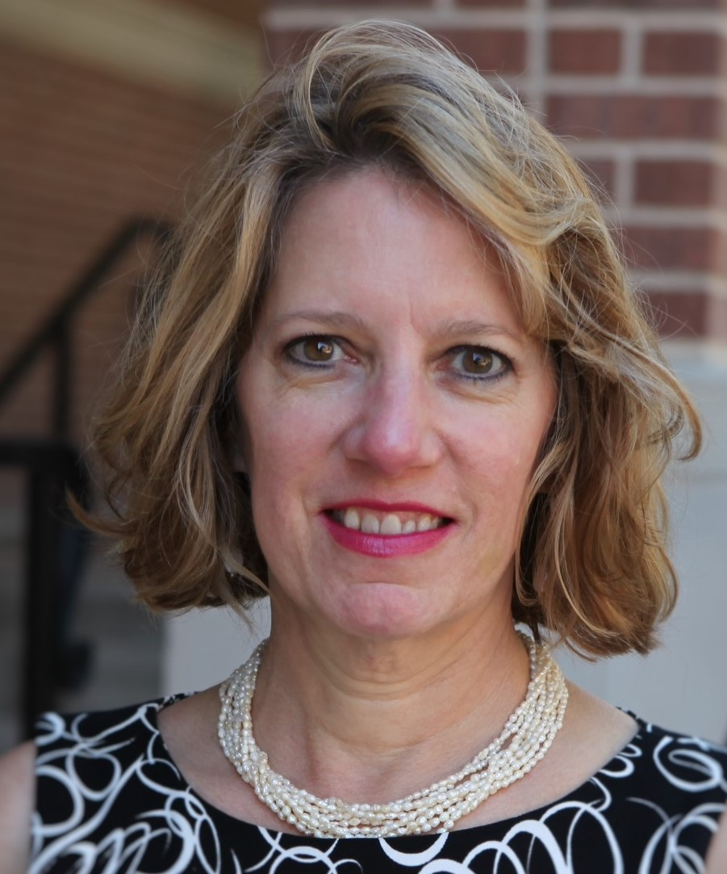
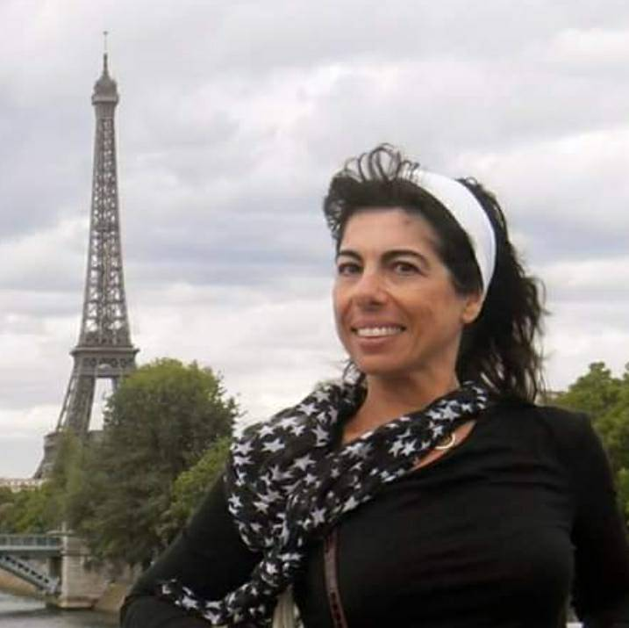
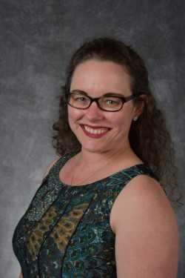
Happy + Healthy Collaborators
Rebecca Davio,
PhD
Institute for Government
Innovation
Moira DiMauro-Jackson,
PhD
Modern Languages
Andrea Dennison,
PhD
School Psychologist

Slide 3
Urgent Need
-Marginalized populations:
71% San Marcos school children are economically disadvantaged
-Experience higher levels of stress and trauma
-Fragmented … not centralized
Need Rationale

Slide 4
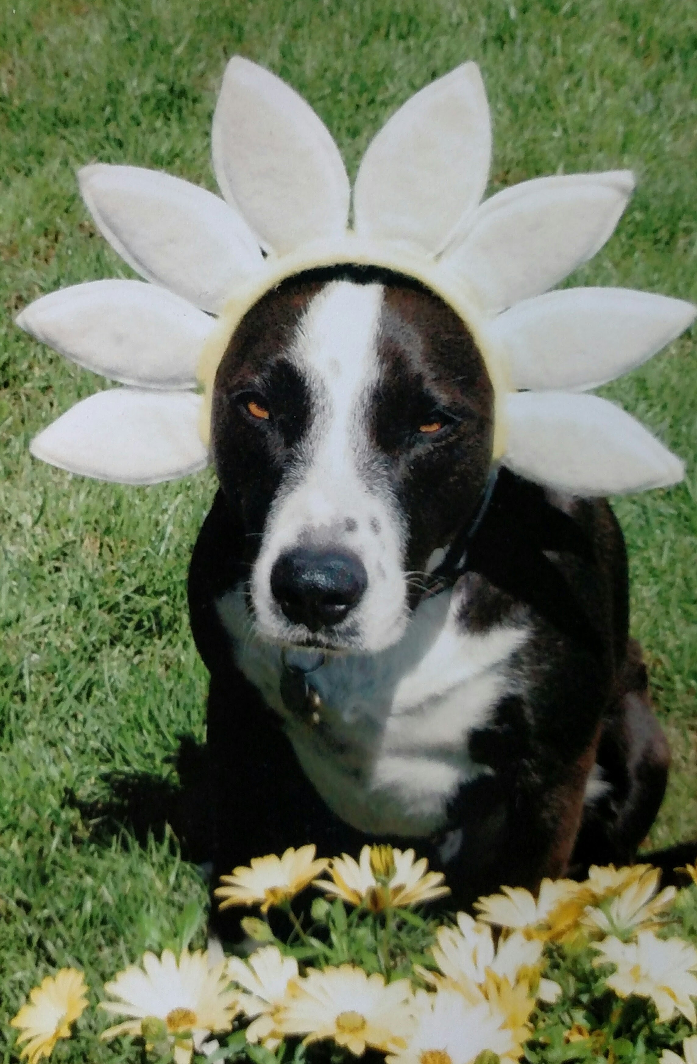
Innovation and creativity

Slide 5
RelaxaTION
EmoTION
CreaTION
NutriTION
CogniTION
AcTION
ConnecTION*
Innovation and creativity
Notes:
Action=movement, physical, physiological, yoga, dance, walking, sports
Creation=art, music, theater, pottery, visualization, writing
Nutrition=cooking and gardening
Relaxation=breathing, meditation, sleep, progressive relaxation (w/o stressball) smell and blow flower
Emotion = naming emotions, emotions database, 24 words for love in Italian, compassion
Connection=community, connection with others, strangers, alive, dead, pets, reflecting and remembering, talking and listening, volunteering, giving to others
Rejuvination=sleep, gratitude, Positive thoughts

Slide 6
Innovation and creativity

Slide 7
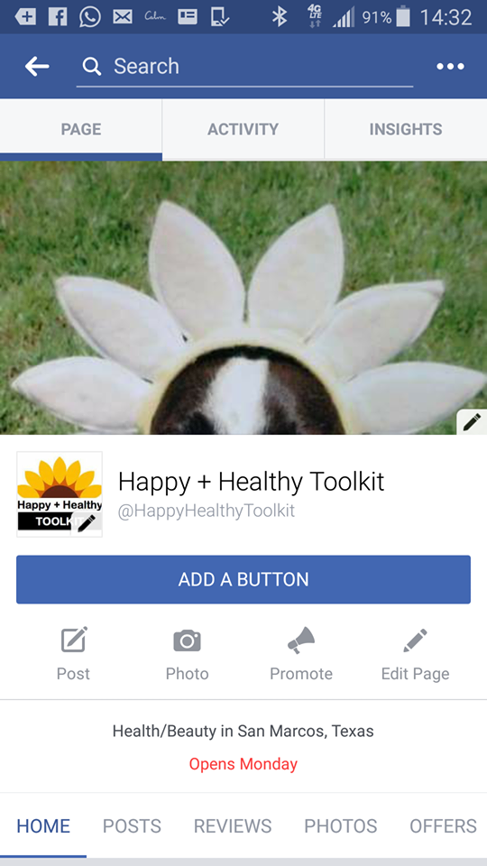
Innovation and creativity

Slide 8
Benefits
Increase coping skills
Increase self confidence
Improve grades and attentiveness
Improve Health and Happiness
Reduce depression
Impact

Slide 9

Implications
Special Olympics
Children and adults with disabilities
English Language Learners
Immigrant children
General community
Committment

Slide 10

Need seed money for curriculum development and Toolkit production
Develop additional grant applications
Potential partners: Golisano Foundation, Michael and Susan Dell, St. David’s Foundation

