Slide 1
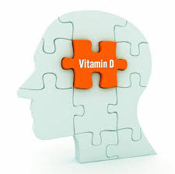
The Role of Vitamin D and Health: Are you Deficient?
Marylyn Kajs-Wyllie
RN,MSN,APRN,CNRN,CCRN,SCRN
Clinical Associate Professor,
St. David’s School of Nursing

Slide 2
Objectives
Describe the physiologic functions of Vitamin D.
Relate the effects of Vitamin D deficiency to multiple disease states.
Identify the influence of Vitamin D deficiency on health.
Determine if you are at risk for Vitamin D deficiency.

Slide 3
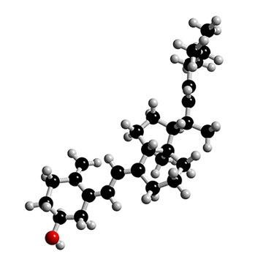
Vitamin D: What is it?
Fat soluble vitamin (stored in fat)
Hormone precursor
acts more like a hormone than a vitamin
Related to steroid hormones
“neurosteroid”, endogenous, synthesized from cholesterol, regulator of a number of genes
Exists in 2 forms
D3, D2
The Sunshine Hormone

Slide 4
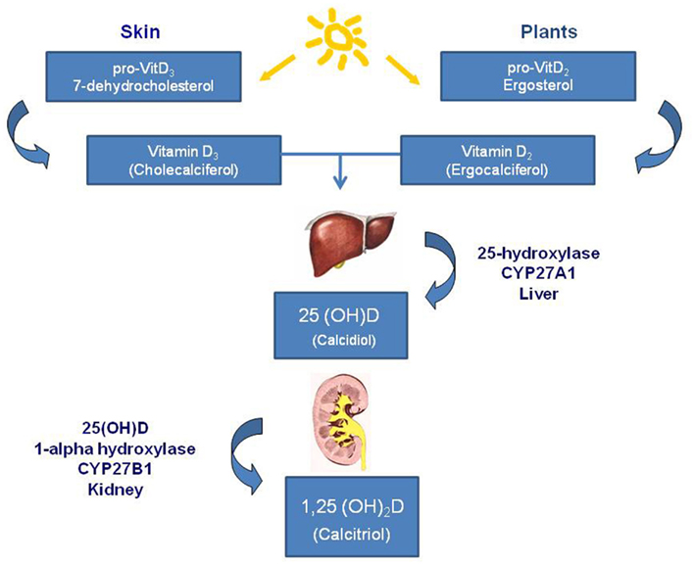
H
Y
D
R
O
X
Y
L
A
T
I
O
N
S
Y
N
T
H
E
S
I
S
Vit D2 & D3 are
biologically inert and
Require two separate
hydroxylations
to give rise to active form.
Vuolo, L. et.al. (2012). Vitamin D and cancer. Front. Endocrinol. doi: 10.3389/fendo.2012.00058

Slide 5
Active vs. Inactive Vitamin D
1,25 dihydroxyvitamin D is the physiologically active form (serum half-life = 4-6 hours)
The inactive 25-hydroxy-VitD3 most often measured clinically in the serum
Indicator of Vit D stores in the body
Reflects amount of Vit D derived from both food & sun
2-3 week half-life

Slide 6
HypoVitaminosis D
Sufficient Vitamin D
Serum 25(OH)D >30 ng/ml
Vitamin D Insufficiency
Serum 25(OH)D 21-29 ng/ml
Vitamin D Deficiency
Serum 25(OH)D < 20 ng/ml (<50nmol/L)
Mild (20-30ng/nl), moderate (5-10 ng/ml), severe (<5ng/ml)

Slide 7
Optimal Level to Prevent Disease?
30-100 ng/ml
60-100 ng/ml
Target higher end

Slide 8
Vitamin D Receptors
Present in most tissues and cells in the body
Epithelial cells
Osteoblasts
Myocytes
Pancreatic cells
Antigen-presenting cells
Cortical neurons and glia (microglia, astrocytes,
oligodendrocytes)

Slide 9
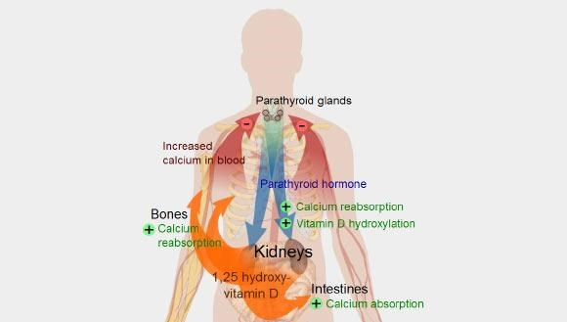
Primary Function
Calcium absorption
Deficiency: osteopenia, osteoporosis, osteomalacia, rickets
Calcium regulation in the human body. The role of vitamin D is shown in orange. Receptors in small bowel enterocytes enhance calcium and phosphorus absorption, and bone receptors stimulate mineralization of newly formed bone. (from en.wikipedia.org/wiki/vitamind )

Slide 10
Other Physiologic Functions of Vitamin D
Modulates immune system/pro-inflammatory cytokines= reduction of inflammation
Deficiency: arthritis, lupus, IBS, Multiple sclerosis
Inhibits Cell growth/angiogenesis/differentiation
Deficiency: cancer (prostrate, breast, colon)
Glucose metabolism/pancreatic B-cell function/ insulin sensitivity
Deficiency: diabetes mellitus

Slide 11
Physiologic Functions of Vitamin D
Influences smooth muscle tone, endothelium, cardiomyocytes, controls intracellular Ca+, RAAS
Deficiency: cardiovascular disease, hypertension, stroke
Anti-oxidative/neuroprotective
Deficiency: dementia, Alzheimer's, schizophrenia, depression
Neuromuscular stability
Deficiency: myofascial pain, musculoskeletal pain, myopathy

Slide 12
At Risk for Vitamin D Deficiency
Lower circulating Vitamin D
Inadequate sun exposure in chronically ill, institutionalized or homebound
poor dietary intake
Aging (> 50 years)
Obesity (body mass index > 30 kg/m2)-body fat sequesters the vitamin
Sun protective clothing/sunblock (SPF 30)

Slide 13
The UV energy is insufficient for cutaneous
Vitamin D synthesis from November through February
The UV energy is sufficient for cutaneous Vit D synthesis all year long
From www.health.harvard.edu

Slide 14
Known Fact…
People
People with darker skin such as African Americans or Hispanics have much lower Vit D levels than those with lighter skin
Elderly have thinner skin, less 7-Dehydrocholesterol

Slide 15
Likely Benefits of Vit D Supplementation
Prevention and treatment of bone disease
Osteopenia, osteoporosis
Hip fracture, nonvertebral fractures
> 65 yrs, 800-2000 IU/day (indefinitely)
Fall Prevention
22% reduction (improved muscle function)
> 65 yrs, 800-5000 IU/day (indefinitely)
Haines,S.T., and Park,S.K. (2012). Vitamin D Supplementation: What’s known, what to do and what’s needed. Pharmacotherapy, 32(4): 354-382

Slide 16
Unproven Benefits of Vit D Supplementation: Prevention/Treatment
Cardiovascular disease- hypertension, heart failure
Endocrine disorders- diabetes, glycemia
Respiratory Diseases- asthma, COPD
Infectious Diseases- tuberculosis, URI
Neurologic diseases
Multiple sclerosis, depression, dementia/Alz
Haines,S.T., and Park,S.K. (2012). Vitamin D Supplementation: What’s known, what to do and what’s Needed. Pharmacotherapy, 32(4): 354-382.

Slide 17
Does Vit D Supplementation Prevent Cancer?
Colorectal cancer
50% of patients had Vit D deficiency
Higher levels of Vitamin D, lower incidence or decreased mortality
No difference with supplementation
Possibly reduces proliferation of epithelial cells in the intestinal mucosa
Huncharek,M. et.al.(2009). Colorectal cancer risk and dietary intake of calcium, vitamin D2, and dairy products: A meta-analysis of 26,335 cases from 60 observational studies. NutrCancer; 61; 47-69.
Ng,K.et.al.(2011). Vitamin D status in patients with stage IV colorectal cancer: Findings from Intergroup Trial. J. Clin Oncology; 29: 1599-1606.

Slide 18
Vitamin D Supplementation and Breast Cancer
>800 IU/day vs. 400 IU/day less likely to develop during 5 year follow up
No influence on recurrence of breast cancer
Robien,K. Cutler,G.J., Lazovich, D. (2007). Vitamin D intake and breast cancer risk in postmenopausal women: The Iowa women’s health study. Cancer Causes Control; 18: 775-782.
Jacobs, E.T., Thomson,C.A., Flatt,S.W., et.al (2011). Vitamin D and breast cancer recurrence in the Women’s Healthy eating and Living (WHEL) study. Am J Clin Nutr; 93: 108-117.

Slide 19
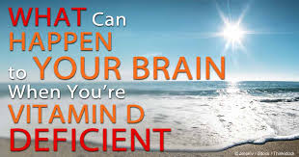
Association of Vitamin D Deficiency and Neurologic Disorders
Epidemiological studies

Slide 20
Affects of Vitamin D on Brain Function
Active form of Vitamin D is synthesized and eliminated in the brain
Numerous Vitamin D receptors in cortical neurons, and glia
Enzymes involved in metabolism of Vitamin D also expressed in brain cells
Metabolites of Vitamin D reported in CSF
Holmoy,T. & Moen,S.M. (2010). Assessing vitamin D in the central nervous system. Acta Neurol Scand. 122: 88-92.

Slide 21
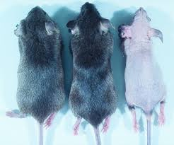
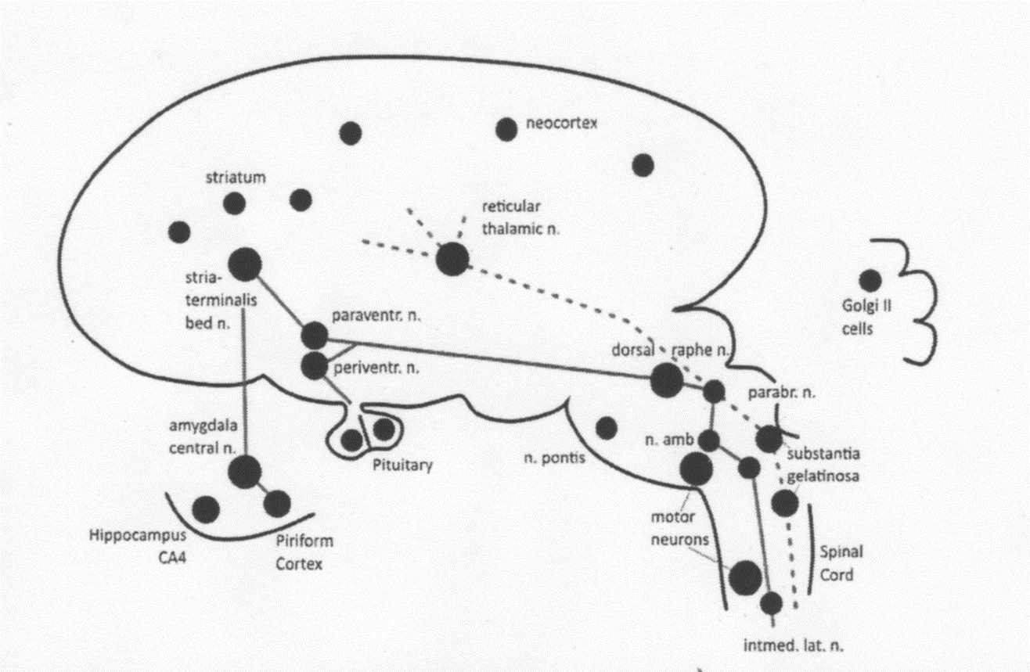
Vitamin D Receptors (VDR) in Brain
VDR also in spinal cord &
peripheral
neurons
DeLuca,G.C., Kimball,S.M., Kolasinski.J., Ramagopalan,S.V. & Eberes,G.C. (2013).
Review: the role of vitamin D in nervous systems health and disease. Neuropathology
and Applied Neurobiology, 39: 460.

Slide 22
www.VitaminDWiki.com

Slide 23
Vitamin D affects the development of neurons as well
as their maintenance and survival.

Slide 24
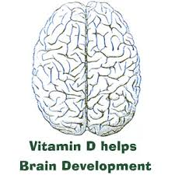
Vitamin D and the Brain
Influences brain development:
cell growth, neuronal differentiation, axonal connectivity, neurotransmitter function, brain structure, learning, memory,
Crucial role in neuroprotection, neurotransmission and neuroplasticity
Regulates catecholamine levels
Synthesizes acetylcholine, serotonin and dopamine

Slide 25
Role of Vitamin D in Brain Function
Targets factors that lead to neurogeneration
Anti-ischemic factors
Good level promotes neurotrophic growth factors: NGNF, BDNF,GDNF
Deficiency causes programmed death of the neurons (apoptosis)-proposed mechanism
DeLuca,G.C., Kimball,S.M., Kolasinski.J., Ramagopalan,S.V. & Eberes,G.C. (2013). Review: The role of vitamin D in nervous systems health and disease. Neuropathology and Applied Neurobiology, 39: 460.

Slide 26
Links of Vitamin D Deficiency
Cognition (Alzheimer’s)
Chronic Pain
Multiple Sclerosis
Parkinson’s Disease
Migraines
Myopathy
Stroke
Fibromyalgia
Seizures
Sleep Disorders/Restless Leg
Vitamin D-mentia

Slide 27
Are You Deficient? If so, What do you do?

Slide 28
Recommendations
Institute of Medicine (2010)
Ross, et al. (2011).IOM committee, National Academies Press.
The Endocrine Society’s Clinical Guidelines
Holick, et.al (2011). Journal of Clinical Endocrinology & Metabolism; 96(7): 1911-1930.
Reviews of Therapeutics (2012)
Haines & Park, Pharm D. Pharmacotherapy; 32(4): 354-382.

Slide 29
Who is Screened ……
Complaints of non-specific musculoskeletal pain
Hx of inadequate dietary intake of Vitamin D
Indoors: Homebound/institutionalized, high latitudes, inadequate sun exposure
Hx of renal or hepatic disease, osteoporosis
Chronically ill, elderly
Post-menopausal or pregnant/lactating

Slide 30
Consider Screening
Major depression syndrome
Rheumatoid arthritis
Cardiovascular disease
Osteoporosis
Chronic fatigue syndrome

Slide 31
Consider Screening
Chronic Drug use:
Anti Epileptic Drug use especially Dilantin and Phenobarb
Corticosteroids
Azole antifungals
Antiretrovirals
These drugs cause destruction of 25(OH)D and 1,25(OH)2D

Slide 32
Rescreen?
Re-test high-risk individuals every 5 years if not on supplementation
Otherwise annually when on maintenance dose

Slide 33
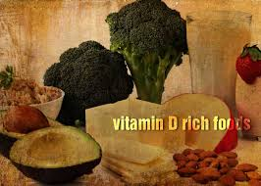
Dietary sources of Vitamin D
Cod liver oil: 1 tablespoon = 1360 IU
Wild-caught salmon, cooked (3.5oz)= 360 IU
Mackerel, cooked (3.5 oz) = 340 IU
Tuna fish (canned in oil) 3oz = 200 IU
Sardines with bones (in oil) 1.75 oz = 250 IU
Fortified milk/orange juice (1 cup) = 98 IU
Egg yolk = 20 IU
Fortified ready-to-eat cereals (3/4-1 cup) = 40 IU

Slide 34
Prevention and Treatment
“sufficient data do not yet exist for health care professionals to routinely recommend the use of vitamin D supplements to healthy patients younger than 65 years or for the treatment of any disease state other than musculoskeletal indications”
-IOM report (2010), Endocrine CPGs (2011)

Slide 35
How much do I take?
Dose of supplementation to achieve good levels theoretically unknown
But twice the upper limit of normal Vit D would not cause any toxicity
Unknown long term effects of Vit D supplementation or long term effects of Vit D toxicity

Slide 36
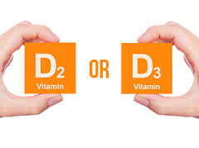
Maintenance Supplementation*
Adults 19- 50 yrs - 600 IU/d
Adults 50-70 yrs 800 IU/d
If obese or if on certain medications, need 2-3 x more Vit D for their age group
Supplement for Fall prevention
Can be taken on empty stomach or with meal (does not require dietary fat for absorption)
*Endocrine Society CPGs (2011)

Slide 37
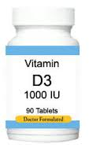
Treatment of Deficiency (<20ng/l)
Vitamin D3 >3 times as effective as D2 and has more sustained blood levels
Initially: 50,000 IU Vit D2 or D3 orally, once weekly for 6-8 weeks or longer
Change to 800-1000 IU daily
Option: IM cholecalciferol (D3) in one to two doses/year
Avoid single large doses of 300,00-500,00 IU

Slide 38
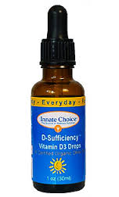
Treatment of Insufficiency (20-30 ng/ml)
800-1000 D3 IU daily
Raises 25(OH)D level to 30 ng/ml over 3 months
Measure levels 8-12 weeks after initiation

Slide 39
What dose for Supplementation?
Adequate Sun exposure:
Adults 18-50 - 200 IU/d
Adults 51-70- 400 IU/d
Adults > 70 – 800-1000 IU/d
Inadequate Sun exposure & high-risk populations
800-1000 IU daily

Slide 40
Vitamin D Products Available in USA
Vitamin D Form Dosage Form Strength Cost/Month
Ergocalciferol Capsule 50,000 IU* $$
(Vitamin D2)
Solution 8000 IU/ml $$
Cholecalciferol tablet, chewable 400 IU $
(Vitamin D3) tablet
capsule 1000, 2000 IU $
Capsule 5,000 IU, $
10,000 IU $$
50,000 IU $
Drops 400 IU/drop
1000, 2000 IU/ $$
Solution 400 IU, 5000 IU $$
Spray 1000 IU, 5000 IU/ $$
Haines & Park (2012). Pharmacotherapy, 32(4), p. 376. * prescription needed

Slide 41
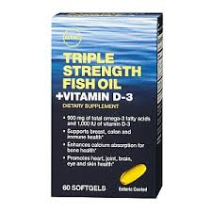
Vitamin toxicity
Rare ; excess Vitamin D3 is destroyed by sunlight
Levels > 150 ng/ml
Hypercalcemic effects on organs, hypercalcuria, and renal failure, N/V, anorexia, wt.loss
Cannot get toxic with sun exposure

Slide 42
Monitoring levels
77% of Americans are considered deficient
Assess levels of Vitamin D with seasonal variation and maintain normal accepted levels
25 (OH) Vit D levels checked during winter months (Jan & Feb in Northern Hemisphere-the seasonal trough)

Slide 43
Is Sunshine enough?
Variable absorption based on body fat
More body fat, need 2-3x more Vit D to maintain level
Recommendation: “dosing” supplement
5-30 minutes sunlight between 10am & 3pm
Artificial UVB radiation (tanning bed) not reliable
Provides 10, 000 IU of 25 (OH) Vit D in fair skinned people

Slide 44
Interesting Fact…
Vitamin D produced in the skin may last at least twice as long in the blood compared with ingested vitamin D

Slide 45
Conclusion
IOM recommendations of Vit D supplementation recommended is 600 IU/d, (800 IU if >70)
These are dietary recommendations and not for disease states
– These levels are still not known
25(0H)D blood level above 30ng/ml may have additional health benefits in reducing the risk of some diseases

Slide 46
Other Conclusions
Sun exposure best way to obtain Vit D
Difficult to obtain adequate amount of Vit D from diet alone
Screen and supplement at risk individuals
Epidemiological studies have suggested a strong association of Vitamin D deficiency and development of certain neurological diseases (low levels found in these patients)

