Slide 1
Process Improvement for a High-Mix, Labor-Intensive Production System with Unknown Stochastic Demand
Gina Adibi, Sam Ruiz,
Andrew Schneider and Meghan Travis
Industrial Engineering - Capstone Design Project 2015
Supervisor: Dr. Jesus Jimenez and Dr. Tongdan Jin

Slide 2
Content
Background & Problem Statement
System Configuration
Methodology
Simulation Optimization
Results & Recommendations

Slide 3
Background
This capstone design project targets the manufacture and assembly of insulated material for airplanes.
The system is labor intensive.
The product is custom-made.
Product demand is highly variable.
Company has requested to keep their name confidential.

Slide 4
Background
Product Mix | Demand
 | Low | Medium | High
Low
Medium
High | X | X | X

Slide 5
Problem Statement
Objective: improve the throughput by at least 10% by:
Clustering similar parts into families using group technology (GT)
Designing GT cells using single piece flow assembly lines
Determine required number of operators per cell
Company is experiencing the following problems:
Losing money due to unmet customer demand
Long cycle times and high work-in process (WIP) levels
Significant quality problems
Demand will experience a significant increase over the next few months

Slide 6
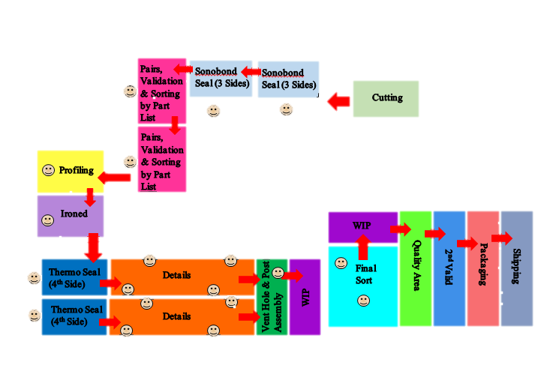
System Configuration
Detail Family
= Operator Indicator
Add these operations when the kit has special features however occurrence is low

Slide 7
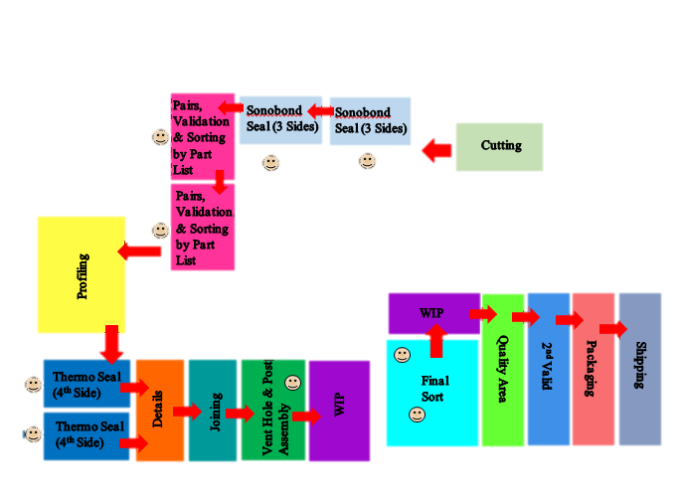
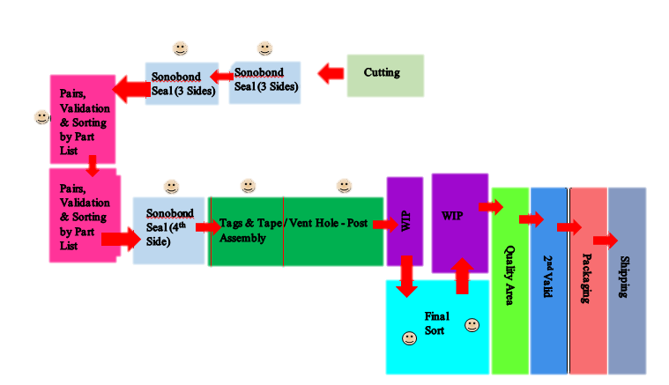
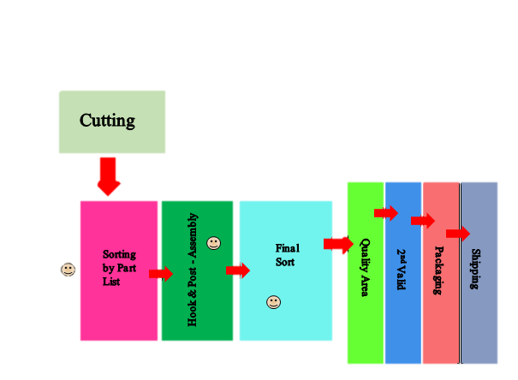
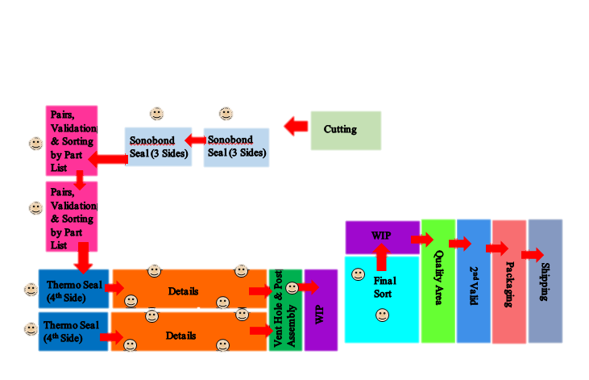
System Configuration
= Operator Indicator
Joining Family
Primary Family
PRODUCT FAMILIES
Add these operations when the kit has special features however occurrence is low
Sealing & Detail Family
Felt
Family

Slide 8
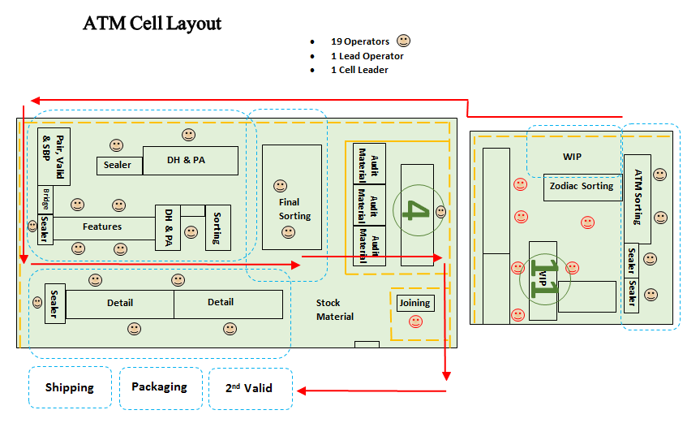
System configuration

Slide 9
Simulation
Witness Simulation enabled us to build a baseline model of the manufacturing process including equipment, labors, buffers, process time variability, and layout.

Slide 10
Methodology
Description of Cells Generated Through ROC Algorithm
 | Final Cluster Generated Through Rank Order Clustering
 | Sonobond Seal 3 Sides | Pairing and Sorting | Sonobond Seal 4th Side | Thermo Seal 4th Side | Detailing | Press | Profiling | Joining | Vent Hole & Post Assembly
Parts
Detail | 1 | 1 | 0 | 1 | 1 | 1 | 1 | 0 | 0
Sealing & Detail | 1 | 1 | 0 | 1 | 1 | 0 | 0 | 0 | 0
Primary | 1 | 1 | 1 | 0 | 0 | 0 | 0 | 0 | 1
Joining | 1 | 1 | 0 | 1 | 1 | 0 | 1 | 1 | 1
Felt | 0 | 1 | 0 | 0 | 0 | 0 | 0 | 0 | 1

Slide 11
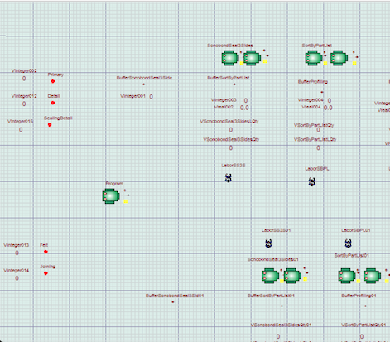
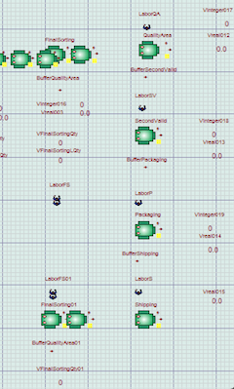
Group Technology Cell Model
U-shape layout
Machine placement based on characteristics of kit families

Slide 12
Simulation Optimization
Maximize throughput by changing number of stations and laborers for each station.
WITNESS defaults to Simulated Annealing Algorithm.
In this simulation optimization, the simulation length was 1 year or 230,400 minutes assuming 16 hour shifts in a day.
Experiment ran 222 scenarios with 5 replications for each scenario.

Slide 13
Results
 | Station | Operator Outcome
1 | Sonobond Seal 3 Sides | é
2 | Sorting By Part List | é
3 | Profiling | é
4 | Press | −
5 | Thermo Seal 4th Side | −
6 | Sonobond Seal 4th Side | −
7 | Details | −
8 | Joining | −
9 | Vent Hole & Post Assy | é
10 | Final Sort | é
11 | Quality Area | −
12 | 2nd Valid | −
13 | Packaging | −
14 | Shipping | −
Throughput Straight-Line Model: 1210
Throughput before Optimization: 1495
Throughput after Optimization: 1658
Throughput rate was improved by 37.07%
WIP for Straight-Line Model = 4855
WIP for U-Shaped Model = 4410
Percentage Decrease 9.2%

Slide 14
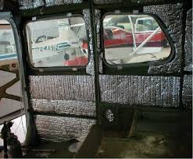
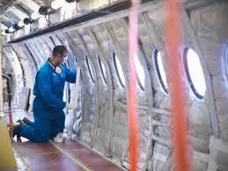
Recommendations and Future Work
Shorter setup
Recommend higher quality machines
Generate cross-trained workers and
place them on a rotational work cycle
Build a user interface so the company can
forecast labor requirements on a monthly basis
Gain more insight to highly variable demand and custom products

Slide 15
Acknowledgements
Special thanks to:
Anonymous Sponsor and The Lanner Group*
*Sponsor of WITNESS simulation language

