Slide 1
Compassion Through Community Ties – Enacting Meaningful Change
Noel Fuller and Cheri Hatcher
Adult, Professional, and Community Education Doctoral Program
Texas State University

Slide 2
1
Basic Tenets of Community Learning Exchange (CLE)
2
Theory of Change and it’s relevance to the TXST Community
Overview
3
Assess Self Compassion and its impact on your Organization/Community
4
Development Community Action Plans using newfound knowledge

Slide 3
Community Learning Exchange
The CLE framework teaches us to value Relationships, Assests, Stories, Place, Politic, and Action within our Community. The spirit of the framework is finding what is good in people and is predicated on building healthy and deeply caring relationships within our communities.
Insert own image here
Notes:
In the "CLE vernacular community is a process as much as it is a physical tangible place community is not something that stands alone but is a generative structure and formed by a set of ideas practices struggles hopes and dreams it is a set of questions that challenges assumptions principles in ways of being community is where we make meaning transform meaning and work together for the common good." Most importantly it is where people come together with the intent to build teach and learn with each other. (Guajardo et al., 2016, p. 5). CLE participants can begin to come together and share their collective gifts in order to understand their collective challenges from multiple perspectives and then to Co construct solutions to those challenges that win and acted together can lead to sustained and empowering action and change (Guajardo et al., 2016, p. 4)

Slide 4
Theory of Change
Outcomes framework to identify interventions for an expected outcome
Mapping the initiatives/steps for goal achievement
Links activities for achievement of long-term goals
Improves evaluation/assessment of initiatives
Notes:
Theory of Change (ToC) is a rigorous PARTICIPATORY process whereby groups and project stakeholders identify conditions they believe have to unfold for their long-term goals to be met. These conditions are modeled as outcomes and arranged graphically in a causal framework.
Practitioners also make assumptions about how and why proposed interventions will lead to the expected outcomes. Airing assumptions is one of the most valuable parts of the process. ToC requires participants to be clear on long-term goals, identify measurable indicators of success, and formulate actions to achieve goals.
The work often starts by gathering together the stakeholders of a program or community, a group that may involve internal customers, grant makers, content experts, project designers, evaluators, external customers, community residents, and other constituents. The theory unfolds as the stakeholders work backward from the long-term impact they’re seeking to achieve through specific goals, strategies, and milestones. At each step, they carefully probe the assumptions that underpin their beliefs about what will work and why and how it is likely to have the effect they anticipate.

Slide 5
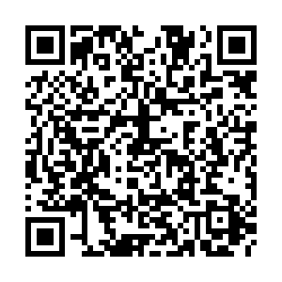
Relevance to TXST Employees
Using your Mobile Device/Computer, navigate to:
PollEv.com/noelfuller090

Slide 6
Barriers to Change
Overcoming
Barriers
Lack of Clarity
Ineffective communication
Change fatigue
Conflicting personalities
Lack of ownership/governance
Theory of Change
Engaging Community Learning Exchanges
Modern Communication Strategy
Allocate adequate resources
Providing Gracious Space for all stakeholders
Notes:
Lack of Clarity: helping internal and external stakeholders understand the value of change and its benefits on their day to day tasks is important. Stakeholders who are unaware of the benefits of any change will be more fearful than excited about the change. Preparing a Theory of Change chart where the current, transition and future states of the organization are clearly explained. It sets the right expectations among the employees, eliminates confusion, and encourages cooperation.
Ineffective Communication: Without proper communication between everyone involved in the change process, the program and execution of change initiatives will fail. Engage the assets you may already have, such as digital platforms like MS Cloud services, Teams and group calendars that go beyond the traditional medium of communications and help stakeholders learn about changes in real time.
Change Fatigue: Organizations often go through a lot of transformation over the course of a year, between simultaneous macro and micro projects focus and motivation can wane. It is important to consider these factors and be flexible to make changes to the project in the implementation phase, integrating all important information into one place, such as creating a Theory of Change, gaining insights to make data-driven decisions, which will make the project successful.
Lack of ownership/buy-in: Senior leaders and other change agents cannot isolate themselves and think their opinions and experiences are the only ones that matter. Often, change strategies fail because leaders overlook their community assets and the implications of the change for all stakeholders. All stakeholders can help identify areas where change is required, if leaders resist or delay in providing this opportunity, it will be difficult for stakeholders to bring about expected changes. Lacking leadership support during implementation can also lead to low morale and derail the implementation. Its important for leaders to strongly support the change, play a supportive part in planning for the change, and communicating with all stakeholders. Leaders have to be wholeheartedly involved in the change and put efforts on convincing people and gaining their support.
Gracious Space: community learning exchanges are most authentic when we welcome the wisdom and gifts of all participants; the engagement process is dynamic when we interact with the intention of building relationships first and engaging in learning tasks after those relationships are first honored asking ourselves if we can take what we learn to better honor the spirit and power of place as well as the wisdom of people in our own communities (Guajardo et al., 2016).

Slide 7
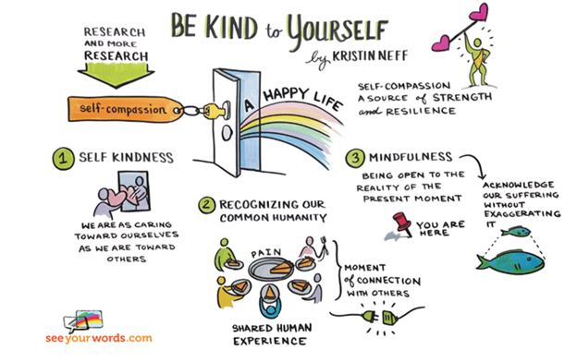
Self Compassion
Acknowledging shared human experience (Neff, 2003)
Practicing Mindfulness
Developing an authentic desire to help
Decreases
Shame
Thought Suppression
Negative Stress
Over-Analyzing (Neff & Lamb, 2009)
Depression and Anxiety (Doty, 2017)
Notes:
Do you consider yourself a barrier to change? How we show up in our communities of learning can create barriers for effective change. Thinking about this – how do you express self-compassion? There has been an explosion of research on compassion in the last 10 years, but out of that research some clear connections have been made about having self-compassion. Neff identifies three main elements of self compassion self kindness or having the ability to refrain from harsh criticism, the ability to recognize your own humanity or the fact that each of us is imperfect and each of us experiences pain, and the ability to maintain a sense of mindfulness or non biased awareness of experiences even if they are painful. Self compassion is not dependent on social comparisons or personal success it's more about recognizing and accepting your flaws which is a process that often leads to growth and personal development. Self compassion has been studied in relation to goal achievement and motivation and correlate's with some dimensions of higher performance such as negative associations with procrastination or maladaptive perfectionism, promoting the enjoyment of goal driven outcomes, a more self accepting style toward improvement and criticism, and a demonstrated ability to express compassion for others.
Examples self-compassion is: practicing mindfulness, externalize your inner critic, practice forgiveness, develop a growth mindset, express gratitude, find the humanity (even in our faults) over isolation.

Slide 8
Individual Activity
On your own, reflect and answer the following:
How do you respond when someone you care about is feeling bad/struggling?
How do you respond when you feel bad or are struggling?
What is something in your job that you do well?
Name someone you work with who has supported you?
What do you consider your biggest motivator in your work at Texas State?

Slide 9
Self Compassion
Theory of Change
Notes:
To effectively overcome the barriers to change, we can use these two assets: Self-compassion and a Theory of Change.

Slide 10
Theory of Change -Action Planning
Revise
Clarify Goals
What's the Ultimate Impact?
Will this be Sustainable?
Identify Strategies
Initiatives
Campaigns
Collaborations
Connect Strategies to Outcomes
Drawing Lines from Initiatives to Goals
Benchmarking
Test Relevance with Stakeholders
Discuss Planning
Revise as Needed
Brainstorm Assumptions
Evaluate/Assess
Notes:
PRO TIP! Before you get started; we suggest working backwards:
• After laying out the long-term goals and a simple change framework, comes a more detailed stage of the mapping process.
• Building upon the initial framework, we continue to map backwards until we have a framework that tells the story we think is appropriate for the purposes of planning.
• Sometimes, this will require much more detail because stakeholders want to identify the “root” causes of the problem they hope to resolve.
• In other cases, the map will illustrate three or four levels of change, which display a reasonable set of early and intermediate steps toward the long term goal.

Slide 11
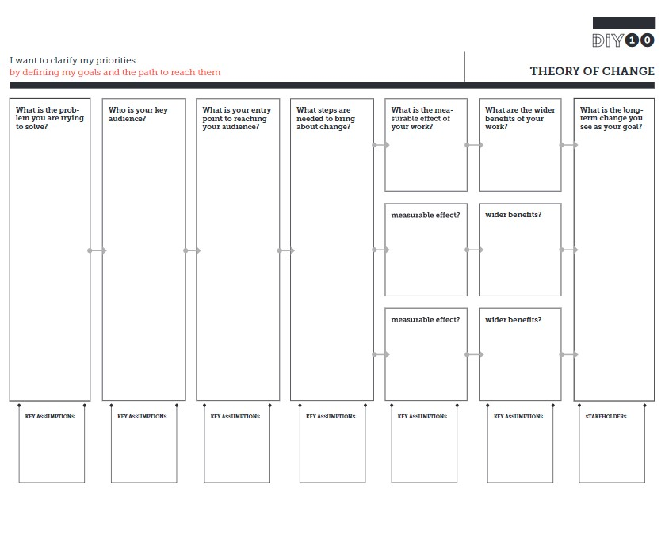
Action Plan Activity
Notes:
STOP! Don’t forget to start at the end!

Slide 12
Thoughts/Reflections

Slide 13
Thank you!
512.245.1622 (Noel)
713.259.9063 (Cheri)
nf1071@txstate.edu (Noel)
chatcher@txstate.edu (Cheri)
Agriculture Building, Suite 201 (Noel)
Education Building, Suite 4049 (Cheri)

