Slide 1
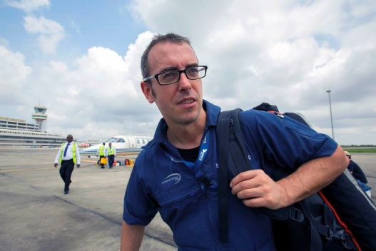
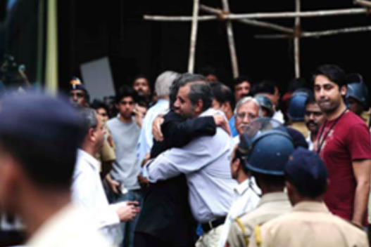
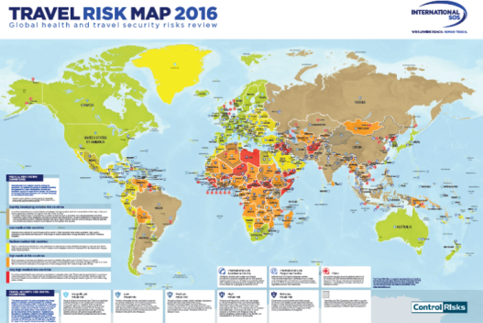
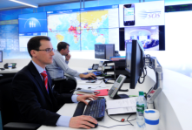
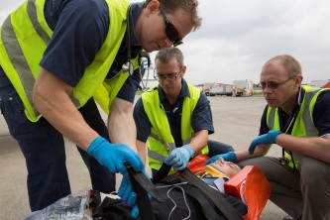
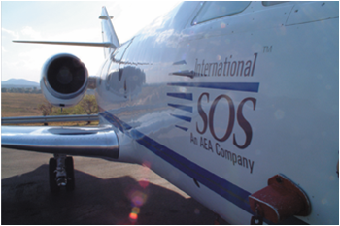
24/7 Security & Medical Assistance while traveling internationally
Robin Wyatt, Senior Account Manager
& Medical Service Project Manager

Slide 2
Agenda
Why your University has partner with International SOS?
What does it mean to be a member?
Prior to Travel
While Traveling
During an Emergency
Questions & Answers

Slide 3
Travel Risk Mitigation
While Traveling
Crisis Management
Risk Management
Prior to Travel
In an Emergency
While Traveling
In an Emergency
Prior to Travel
Mitigate Financial Risk
Mitigate Health & Safety Risk
Insurance
Provider

Slide 4
Why do Universities partner with Intl.SOS?
Single Point of Contact for Travelers to get help anywhere in the world
Access to Vetted Intelligence with Actionable Advice
Coordination & support of all parties
Real time Visibility & Control of your travel risk exposure
Ability to point travelers to Vetted Providers Globally
Ability to Identify, Communicate & Assist affected Travelers within minutes

Slide 5
International SOS Program
Scholastic Comprehensive Membership
Membership # 11BCAS650352

Slide 6
BEFORE TRAVEL
MEMBERSHIP
Membership # 11BCAS650352

Slide 7
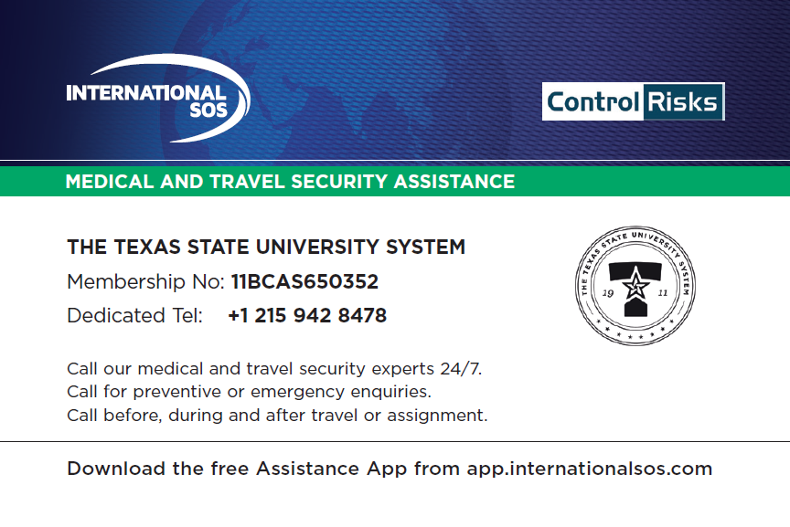
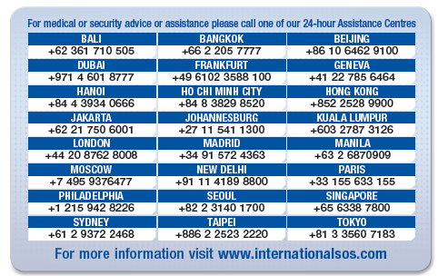
Prior to Travel
Membership # 11BCAS650352

Slide 8
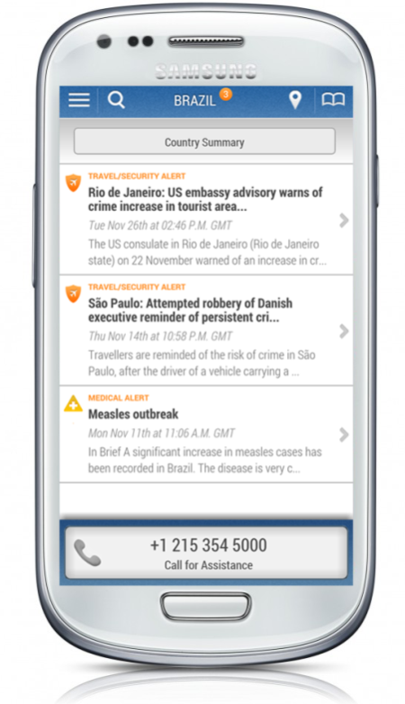
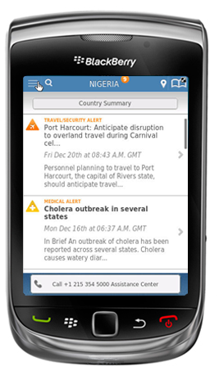
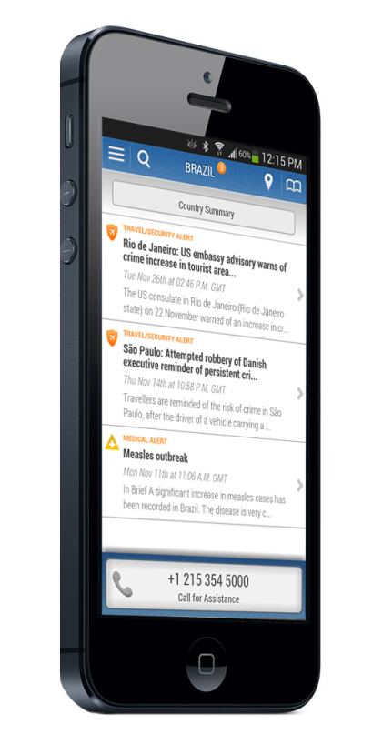
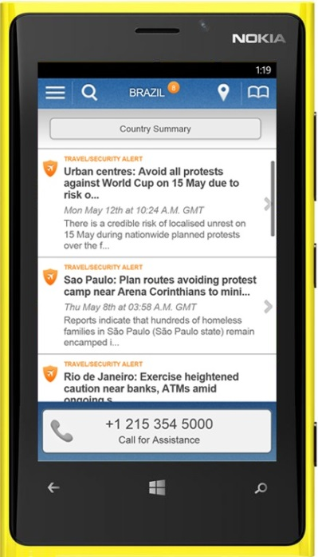
Prior to Travel
Download the Assistance App
Android OS 2.3 and higher
BlackBerry
OS 6.0 – 7.0
iPhone
iOS 4 and higher
Windows
OS 8.0 and higher
Membership # 11BCAS650352

Slide 9
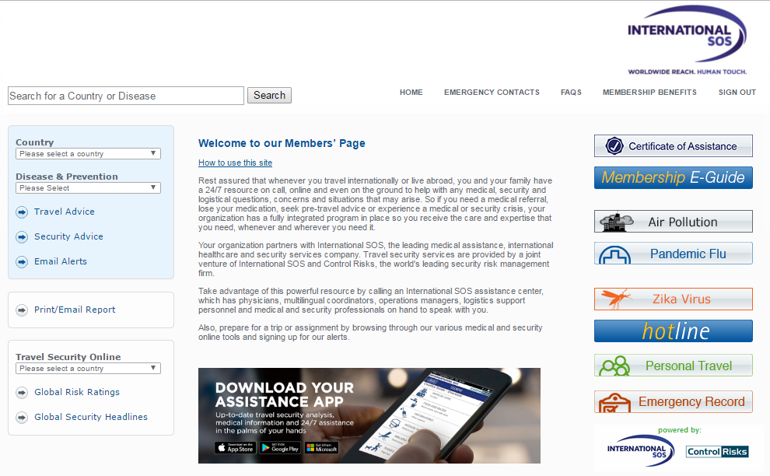
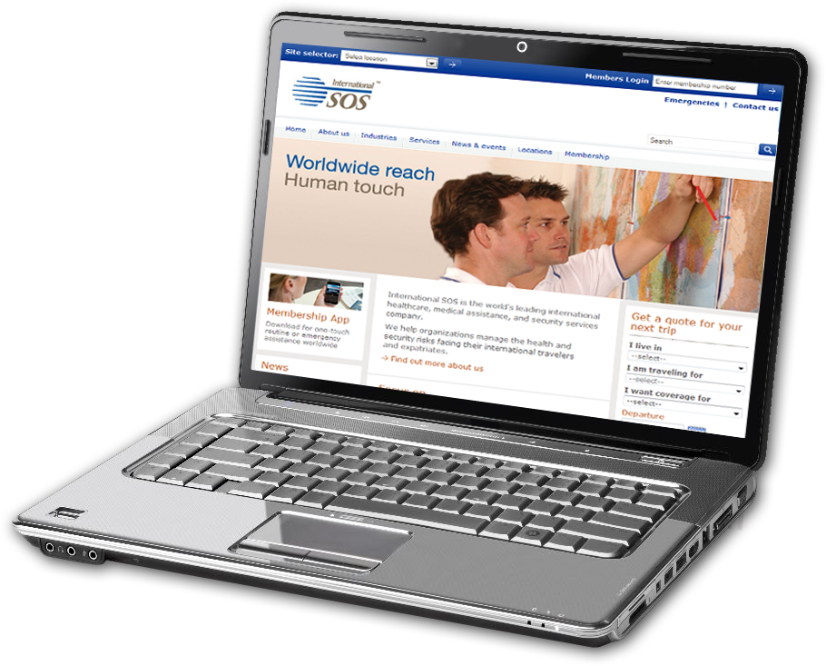
Prior to Travel
www.internationalsos.com
Membership # 11BCAS650352

Slide 10
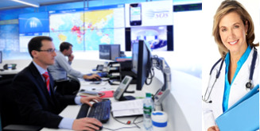
Prior to Travel
24/7 Medical & Security Assistance
Extreme
weather
Heightened security at check points
Road and rail infrastructure problems
Terrorism threats
Airlines strikes and other industrial action
Problems or limitations of medical infrastructure
Disease
outbreaks
Membership # 11BCAS650352

Slide 11
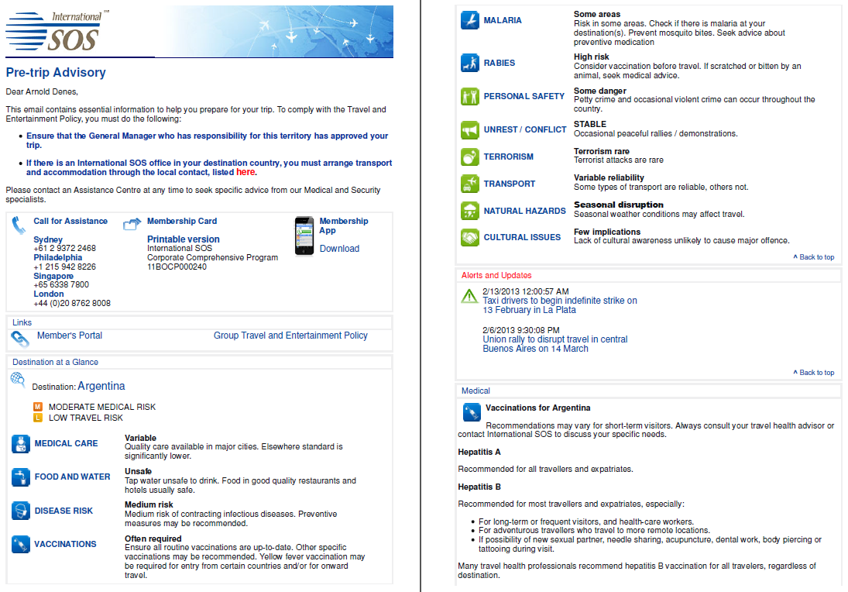
Prior to Travel
Membership # 11BCAS650352

Slide 12
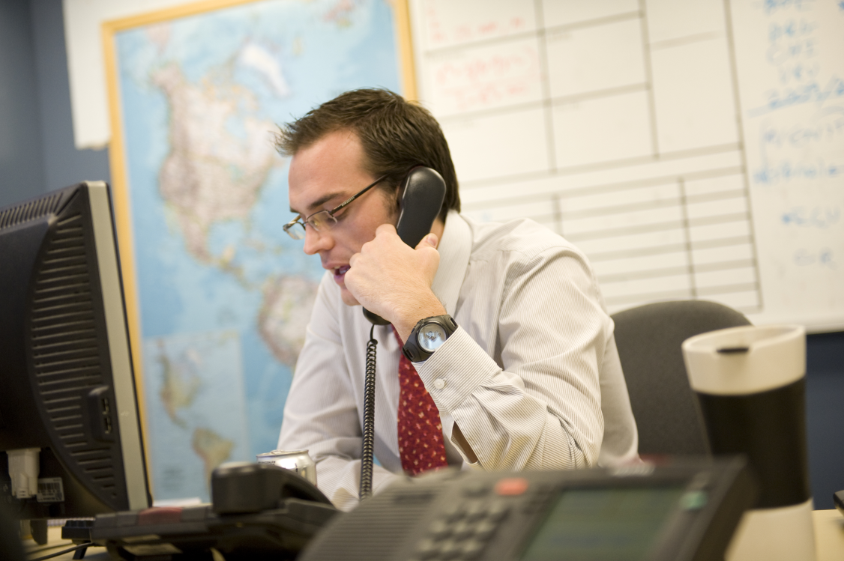
Prior to Travel: One-on-One Tailored Pre-Travel Briefing
Call Intl.SOS at +1.215.942.8226 or email securitysupport@intlsos-cr.com
What are we looking for?
Risk Management
Location – Be specific and include side trips and excursions
Dates – What is happening while you are there?
Activity – What are you doing there?
Traveler Profile – Level of travel experience, Language capability, student or faculty
Lodging – student housing, private house, hotel – safety standards?
Transportation – taxi, public transportation, local national, self-drive
Local support – Who can help you?
Communication – With each other; with your host/faculty leader, with Intl.SOS
Exposure – 1 week, 1 month, 1 semester; More time = more risk
Membership # 11BCAS650352

Slide 13
WHILE TRAVELING
MEMBERSHIP
Membership # 11BCAS650352

Slide 14
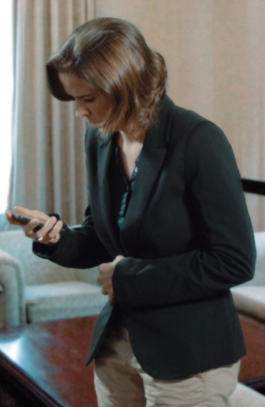
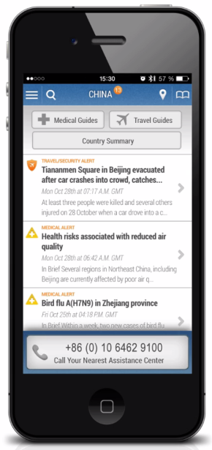
While Traveling
Assistance APP
Automatic Email Alerts
Call 24/7 for Security & Medical Assistance
Membership # 11BCAS650352

Slide 15
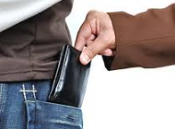
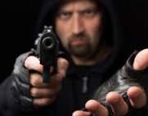
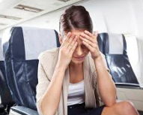
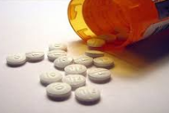
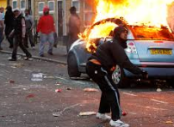
Lost or stolen wallet or purse
Tooth ache
Lost medication
Sick while traveling
Taxi left me
Lost or stolen passport
During an Emergency
Breathing problems
MEMBERSHIP
Language and cultural barriers
Fall or injury
Extreme weather
Civil unrest or protests
Car accident
Food poisoning
Membership # 11BCAS650352

Slide 16
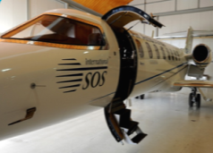
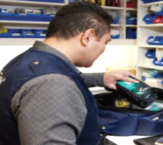
During an Emergency
Simple Process = Call International SOS
Security Support - Phone & On the Ground
Medical Support - Phone & On the Ground
Remote Facilities & Clinics & Vetted Network of Providers
Aviation Resources
Medical Supply Chain
Aviation Resources
Membership # 11BCAS650352

Slide 17
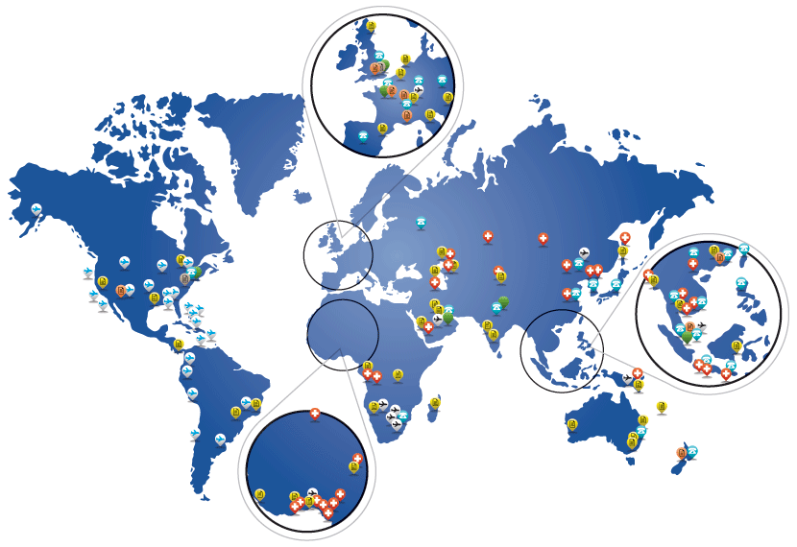
International SOS at a Glance
Over 11,000 Employee
Speaking over 99 languages
Over half being Medical Professionals & Security Experts.
Presence in 92 countries inclusive of
27 Assistance Centers,
56 Clinics,
850 remote sites
8 Air Ambulances
Over 11,000 calls for help per day
Evacuation every 20 minutes
Membership # 11BCAS650352

Slide 18
Travel Tips
DO download the Intl.SOS app for the latest alerts, access to information and phone numbers
DON’T know what to do? – Call Intl.SOS at +1.215.942.8478 or email securitysupport@intlsos-cr.com
DO create your MyTrips profile and enter in your travel itinerary or use the “Forward My Trip” functionality if booking outside your travel agency.
Membership # 11BCAS650352

Slide 19
Questions?

Slide 20
Thank You

