Slide 1
Find Me the Money!!

Slide 2
What can PIVOT do for me?
Find funding opportunities worldwide
Monitor, track, and share funding opportunities
Search for collaborators within or outside your organization
Share your information so others can identify you as a potential collaborator
Update pertinent profile information on your own, e.g. expertise, keywords, associations, and honors

Slide 3
Let’s Get Started
Go directly to the PIVOT website: https://pivot.proquest.com/funding_main
OR….
Go to Texas State home page.
Type PIVOT in the search engine box.
Select “PIVOT Funding Database: AVP-Research and Federal Relations.”
Locate link at the end of the first paragraph: Pivot (https://pivot.proquest.com/funding_main).
Click on link.

Slide 4
pivot Home Page

Slide 5
Sign Up for an Account
Locate the “Sign Up” button at the top right corner of your screen and click.

Slide 6
Use YOUR Texas State Email

Slide 7
House is Home

Slide 8
Funding Page

Slide 9
Quick Search
Similar to Google search and will provide a large range of results
Can search by text (keyword) or by sponsor

Slide 10
Search Filters
Activity Location – Where the grant may be used (defaults to U.S. or Unrestricted)
Citizenship/Residency – Applicant’s required citizenship/residency (defaults to U.S. or Unrestricted)
Submission type – Possible restrictions
Limited – Some type of restriction or “limit” imposed by the sponsor (e.g. only one proposal may be submitted by institution)
Other internal coordination – Restriction that requires some level of coordination at the university level prior to submission (e.g. ranking requirement, limit on number of time an applicant can submit)
Top funding types – Required use of funds

Slide 11
Top sponsor types – Organization providing the funds
Top Requirements – Type of agency that may apply
Top Keywords – Keywords that appear the most throughout all solicitations within the search results
The number to the right illustrates the number of solicitations that are relevant to these criteria or the number of times these descriptors appear within the solicitation.

Slide 12
You can Sort your results by Relevance, Title, Sponsor Name, Deadline, or Amount. The system automatically defaults to Relevance.

Slide 13
Narrowing Your Results

Slide 14
Limit to Research Funding

Slide 15
Limit to Research Funding & Academic Institutions

Slide 16
Advanced Search Options
Advanced search options exist for both funding and profile searches. To conduct an advanced search, select either the Funding or Profiles tab and click on Advanced Search.

Slide 17
Advanced…

Slide 18
Advanced…
Match all fields (default) – Retrieves all funding opportunities that match ALL of your selected search criteria, e.g. sustainability + NSF will only retrieve results that reference BOTH
Match any fields – Retrieves funding opportunities that match ANY of your selected criteria, e.g. sustainability + NSF will retrieve any results that reference EITHER
Use “OR” – Retrieves all records containing either key words
Use “AND” – Retrieves all records containing both keywords
Search by All Fields (default), Abstract, Title, Sponsor, or Sponsor ID

Slide 19
Additional Search Limits
The same filter criteria that are available after a search is conducted are available for input to limit an advanced search. Limit your search immediately by using these criteria, or wait until your search has been initiated to filter your results.

Slide 20
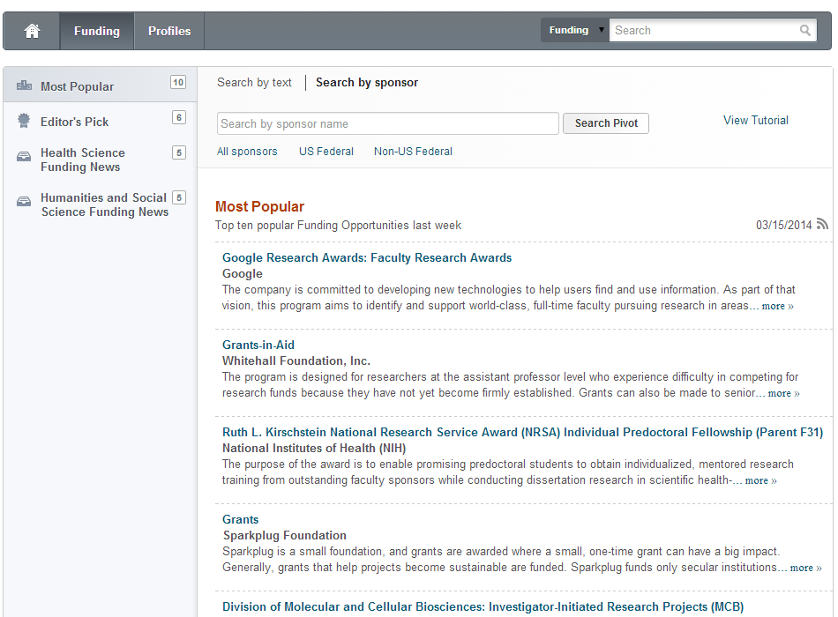
Search by Sponsor

Slide 21
Search All Sponsors
Search for sponsors directly by entering the sponsor name in the search box.
OR browse through all sponsors by sponsor type or alphabetically by name.

Slide 22
Search U.S. Federal Sponsors

Slide 23
Search Non- U.S. Federal Sponsors

Slide 24
Search by Sponsor/Agency

Slide 25
Advanced Search for Profiles
Profile tab defaults to associated institution’s profiles for browsing.
Quick search directly from this page - will default to search ONLY your institution.
Click on Advanced Search for more options.

Slide 26
Advanced Profile Search
Search inside or outside your institution
Search for names or keywords that appear in publications, CVs, expertise, etc.
Search by name
Use the drop down options on Degree, Role, Association or Society, Affiliation, or Country to further limit your search.

Slide 27
Profile Search Results

Slide 28
Set to Active, Track, Share, or Export
Set to Active – Funding opportunities that you have identified and are interested in pursuing.
Track – Funding opportunities that you want to monitor, but are less crucial than your Active opportunities.
Share – Share funding opportunities and saved searches with colleagues.
Export – Export full records, specific fields, and search strategies to save data.
To utilize one of these options, check the box next to the appropriate funding opportunities and then click Track, Set to Active, Share, or Export.

Slide 29
Click Set to Active and you will be prompted to assign a tag to the opportunity. Click Add. You will receive an email if the solicitation is updated and it will appear under Active opportunities on your homepage.
Set to Active

Slide 30
Track
Click Track and you will be prompted to assign a tag to the opportunity. Click Add. You will receive an email if the solicitation is updated and it will appear under Tracked opportunities on your homepage.

Slide 31
Share
Click Share and enter the recipient name or email address. If it is someone within your organization, their name and email should automatically populate. Shared opportunities will appear under the Shared tab on your homepage.

Slide 32
Export
Click Export and select the appropriate format. You can export the full record, standard fields, or select the fields you want to save. Click Submit.

Slide 33
Homepage Display

Slide 34
Example
Link to official solicitation website
General funding information, including amount, requirements, abstract, etc.
Option to track, make active, or share
Potential collaborators both within and outside your institution
Contact information for funding queries

Slide 35
Collaborate
Click on the Potential Collaborators link on the funding solicitation display page. The database will pull profile matches that it deems relevant to the solicitation. Filter results by institution, department, or role. Click on an individual’s name to see contact information, expertise, publications, affiliations, degrees, and keywords.

Slide 36
Questions? Ask
Matthew Winn
C3 Pre-Award Research Coordinator
mwinn@txstate.edu 512-245-0040
or
Lisa M. Westerbeck
C3 Post-Award Research Coordinator
lisa@txstate.edu 512-245-1356
Center for Communication, Collaboration & Creativity
College of Fine Arts and Communication
Texas State University

