Slide 1
IE 4390 CAPSTONE DESIGN
SPRING 2015
INSULATED CONCRETE FORM
PRE-ENGINEERED CONSTRUCTION
DAVID HOLT, MICHAEL MULLEN, MATTHEW SNEAD
DR. MICHELLE LONDA

Slide 2
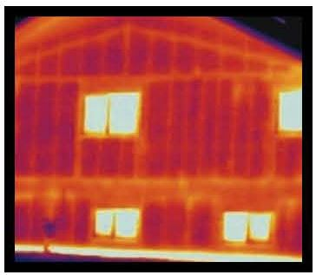
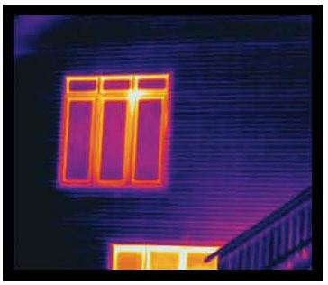
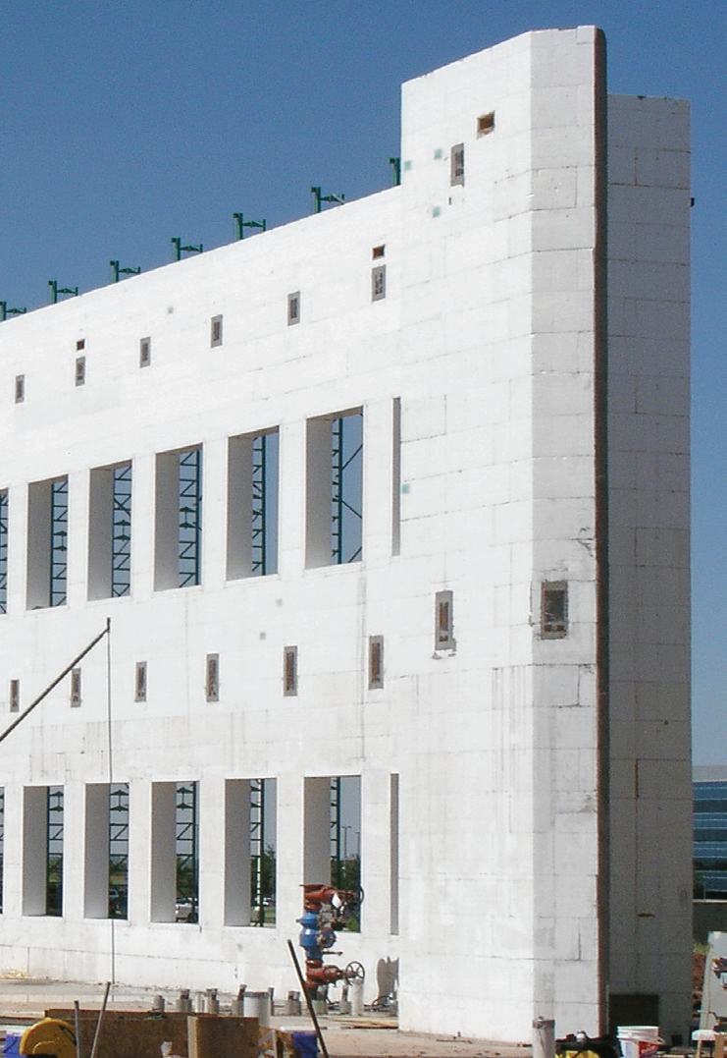
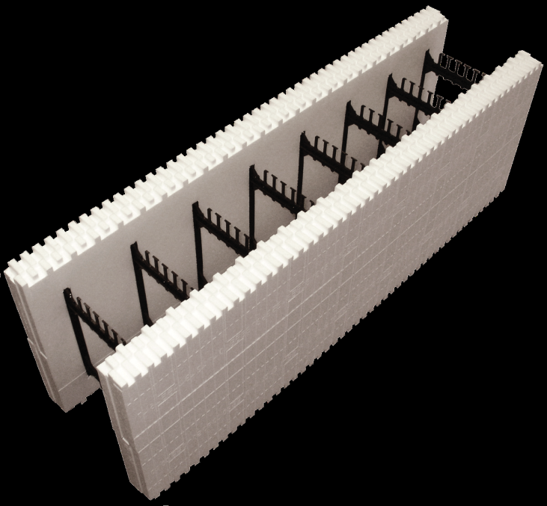


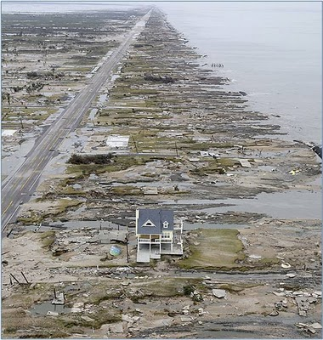
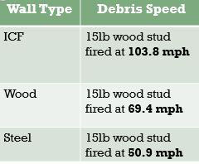
MOTIVATION
Sustainable Building Systems will lead the transformation of the building and construction industry
  Reduce the cost of ICF manufacturing.
    10% more than standard construction
  Practicing sustainable building techniques.
  Developing innovative materials and processes.
Insulating Concrete Forms (ICFs)
  Stacked Hollow EPS Foam Blocks or Panels
  Reinforced with Rebar
  Filled with Concrete
Broad Impact
  ICF structures will last centuries while wood only lasts decades
  Manufacturing pre-engineered wall systems will create a skilled work force
Benefits
  Reduction in energy use (32% to 44%)*
  Less construction waste
  No mold
  Safe and Strong
  More people saving $ and making $

Slide 3
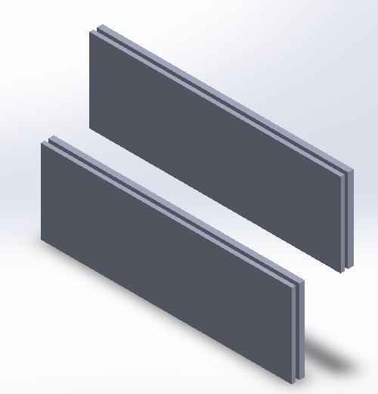
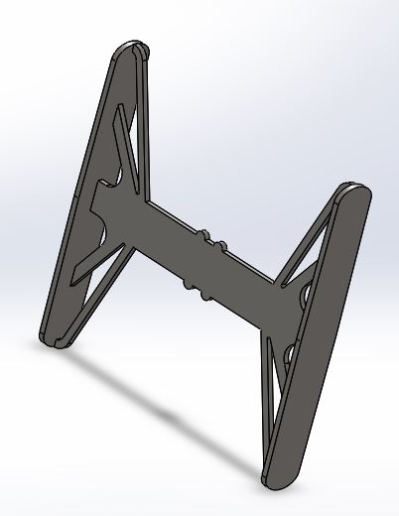
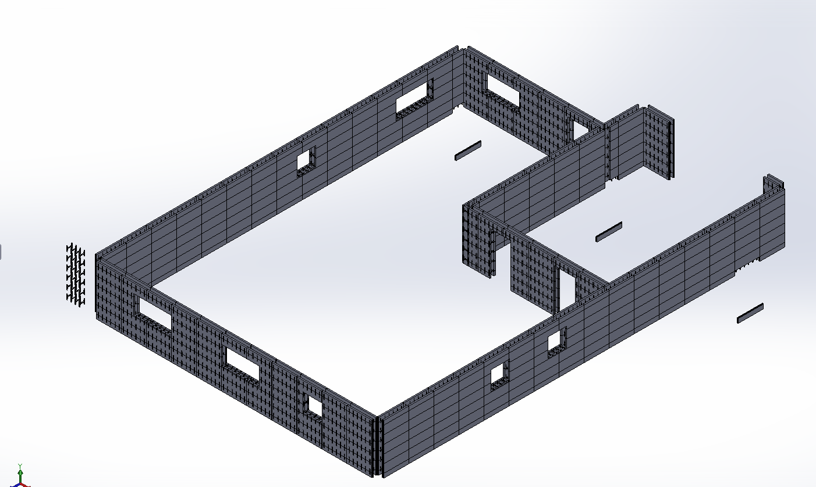
PRODUCT DESIGN
Polystyrene Connectors
  6 x 5 ½ Connectors
  Provides Horizontal Stability
  Allows a medium to attach interior drywall and exterior siding
Expanded Polystyrene Panel
  2 x 48” x 16” x 2.5”
  Concrete obtains 28 day cure in 7 days
  Effective R value of 50
Stream line manufacturing
  50% reduction in home construction time
  Zero waste
  Used in any floor design

Slide 4
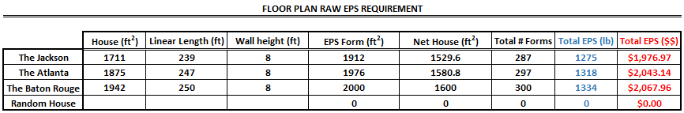
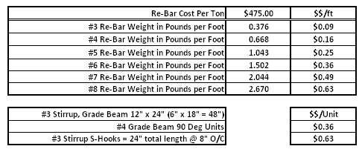
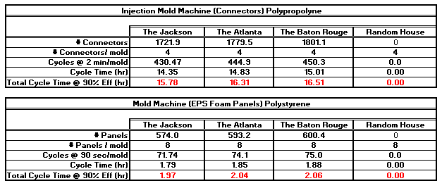

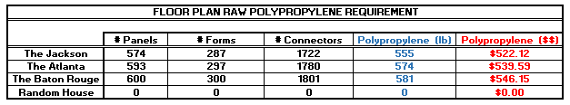
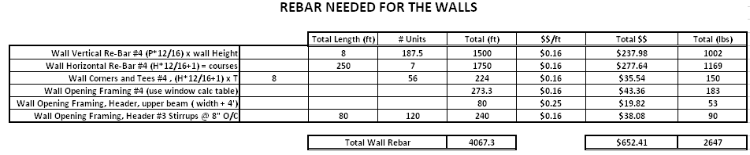
RAW MATERIAL ALLOCATION
EPS PANEL / FORMS
POLYPROPYLENE CONNECTORS
MACHINE REQUIREMENTS/CYCLE TIMES
REBAR CACLULATIONS
Notes:
Redo the Excel - Formats

Slide 5
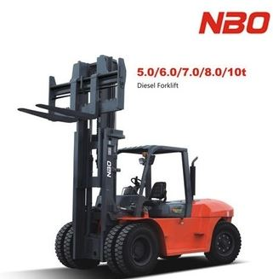
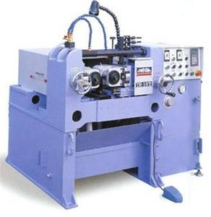
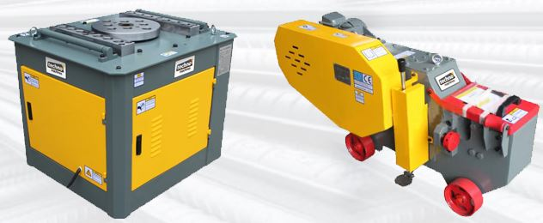
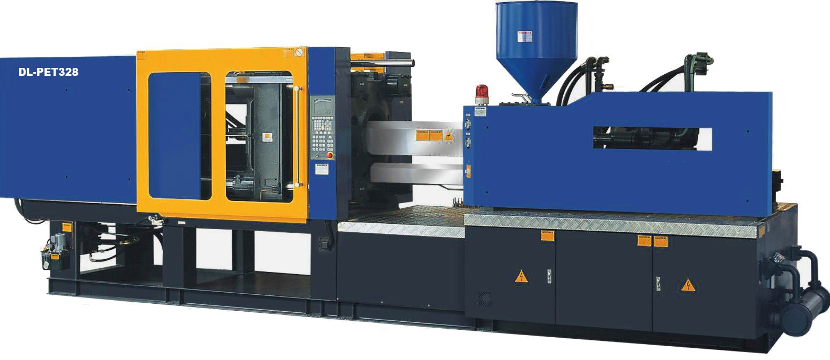
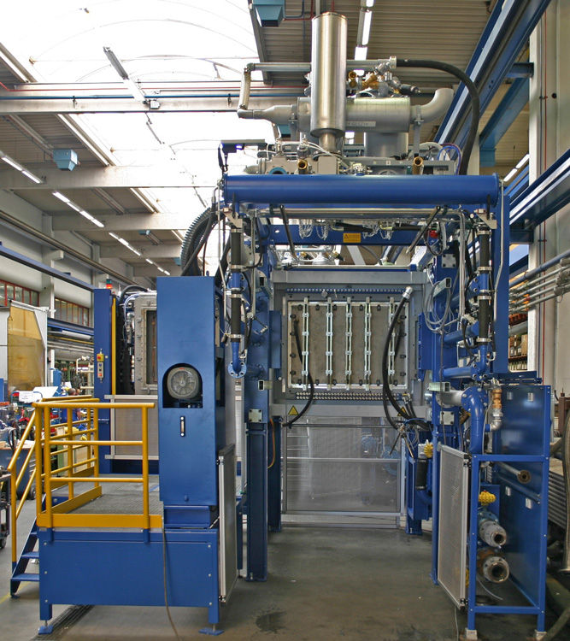
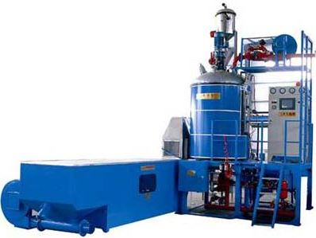
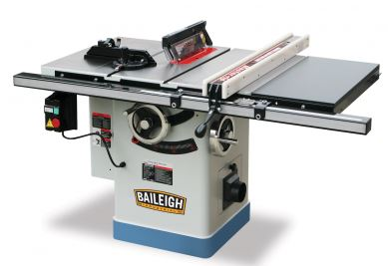
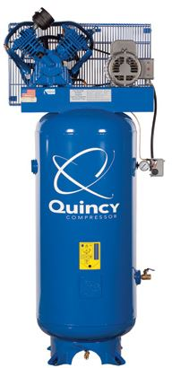
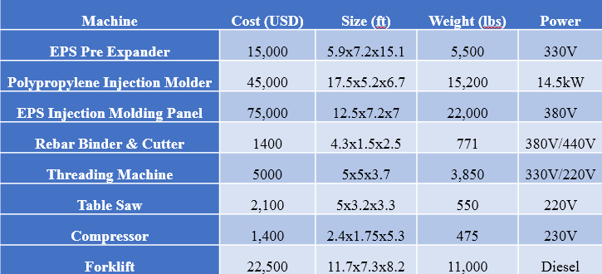
MACHINE/TOOLING
EPS PRE EXPANDER
POLYPROPYLENE INJECTION MOLDER
EPS INJECTION MOLDING MACHINE
REBAR BINDER & CUTTER
REBAR THREADING MACHINE
TABLE SAW
AIR COMPRESSOR
FORKLIFT

Slide 6
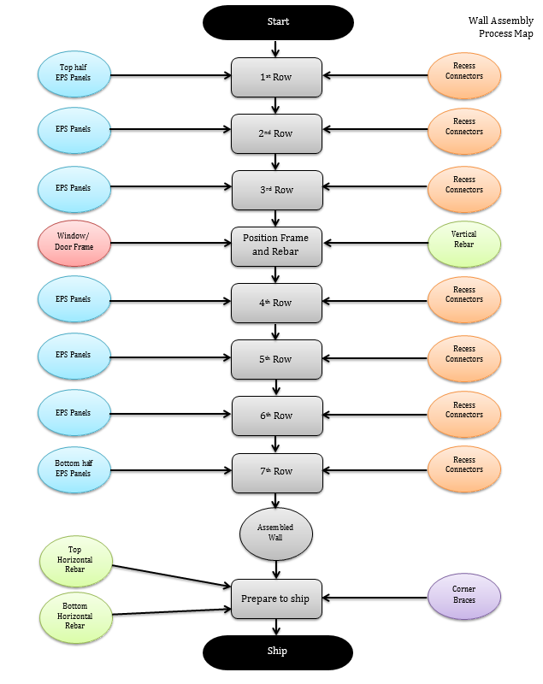
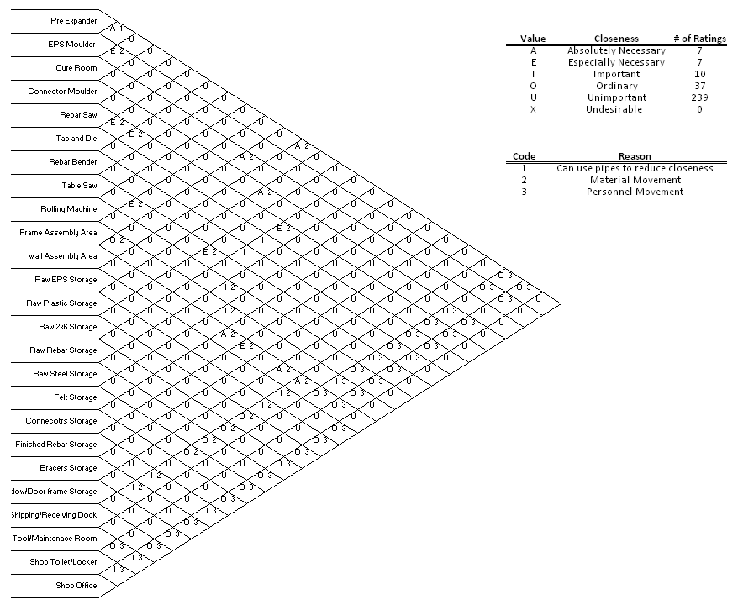
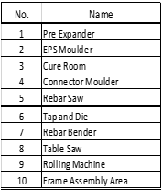
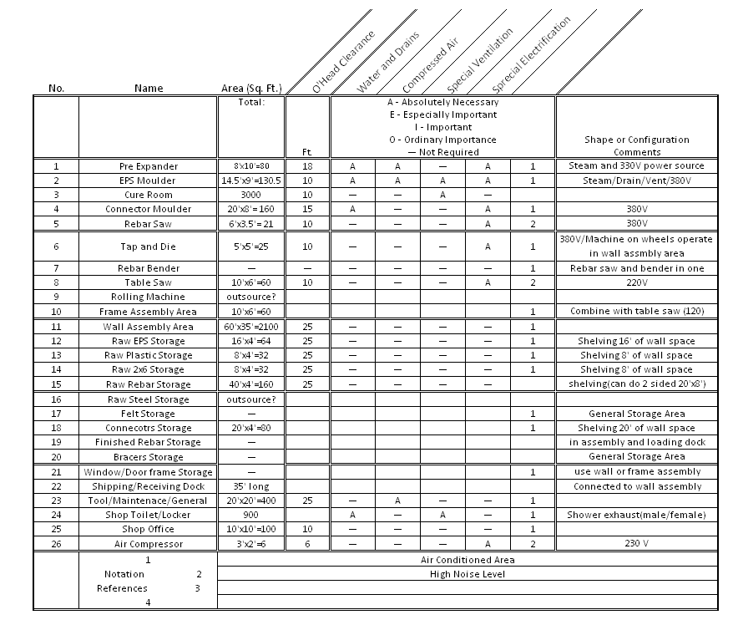
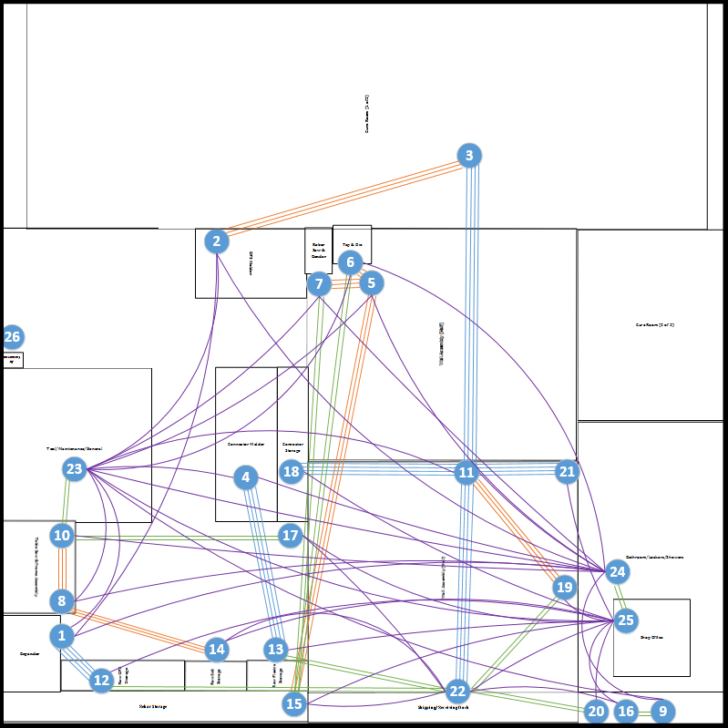
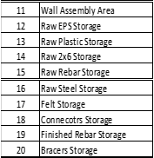
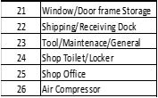
FACILITY DESIGN OPTIMIZATION
Process Maps
Relationship Diagram
Space Requirements
Layout Planning
Facility Layout

Slide 7
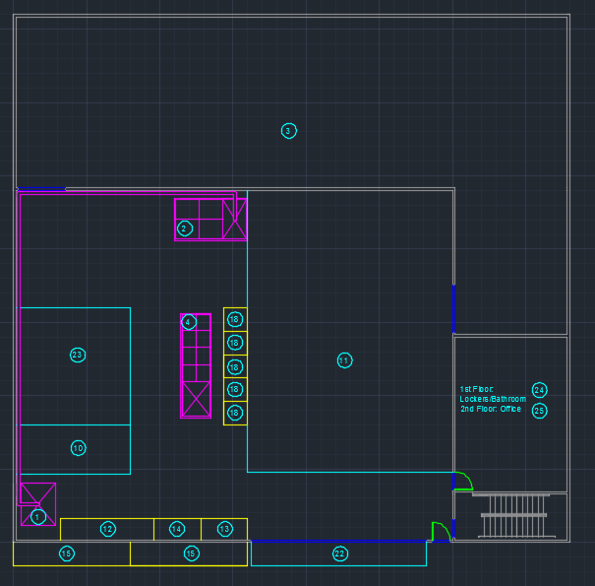
FACILITY DESIGN

Slide 8
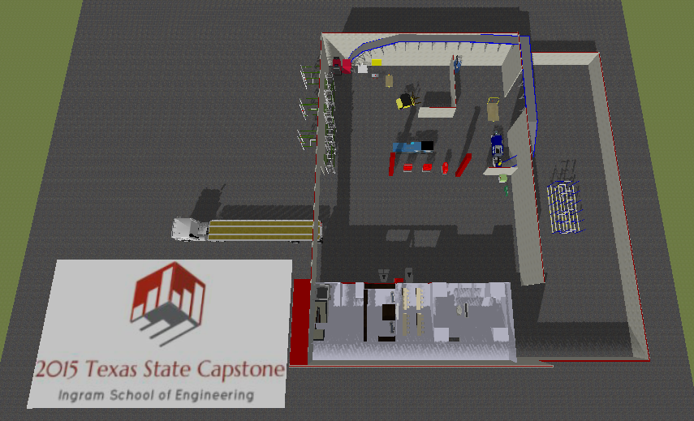
FACILITY DESIGN
Designed Facility using SIMIO

Slide 9
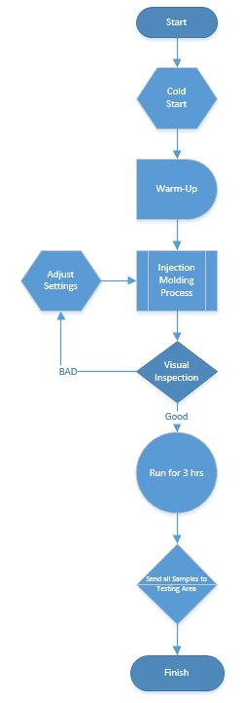
QUALITY CONTROL PLAN
Three week’s of cold start-up production
  Morning
  Afternoon
  Evening
Tensile Strength –
  1200 psi LSL
Flexural Strength –
  Minimum rotational flex is 90°twist without a fracture
Continual Testing
  New production run
  Material Batch Change
  1000 lbs. of raw material of same batch

Slide 10
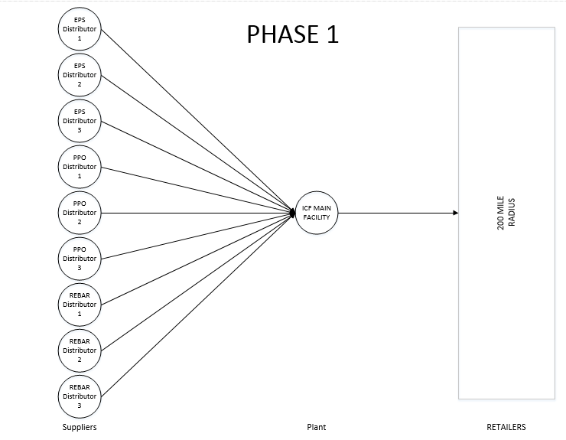
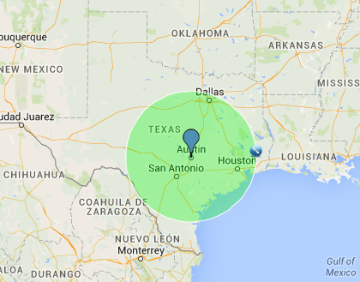
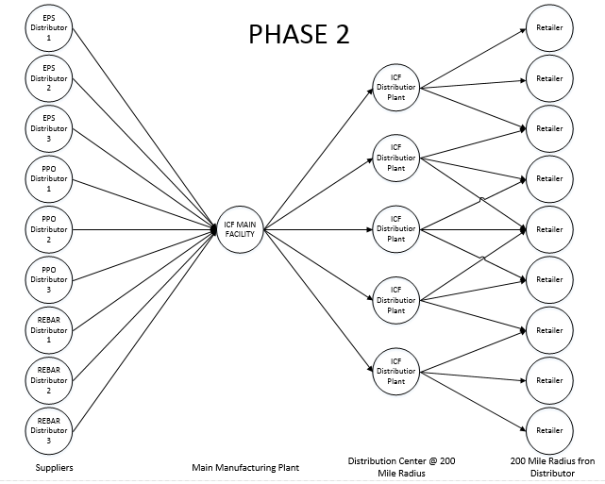
SUPPLY CHAIN
PHASE ONE
  SINGLE FACTORY – SERVICE A 200 MILE RADIUS
  SUPPLY CHAIN MODEL
PHASE TWO
  CENTRAL FACTORY – SERVICE A 200 MILE RADIUS
  DISTRIBUTION CENTERS – SERVICE AN ADDITIONAL 200 MILES

Slide 11



ACKNOWLEDGEMENTS
Indirect Sponsor - David Schreiber
Advisor - Dr. Michelle Londa
This project has no official sponsorship by any industry or company
David Holt
Matthew Snead
Michael Mullen

