Slide 1
Welcome
Eric Algoe – Vice President for Finance and Support Services
Carole Clerie – Assistant Vice President for Human Resources

Slide 2
Special Thanks - PDAC
Jen Aguirre, Staff Council/ITAC
Lisa Apostolo, ITAC
Dani Artaza, Human Resources
Alicia Barthel, Institutional Inclusive Excellence
Joe Fuller, ITAC
Noel Fuller, Staff Council
Tamara Johnson, Human Resources
Laramie McWilliams, Student Affairs
Jeremy Thomas, Human Resources
Samantha Williams, Human Resources
Amy Wong, Academic Affairs/Round Rock

Slide 3
Special Thanks - Presenters
Lark Doley
Rebecca Ray
Matthew Carmichael
Erika Nielson
Noel Fuller
Cheri Hatcher
Cynthia Hernandez
Lisa Lloyd
Madyson Flint
Shelby Jimenez
Courtney McKenzie
Elma Clarke
Andrea Hilkovitz
Brian Smith
Shetay Ashford-Hanserd
Shailen Singh
Mitzie Rojas
Lisa Cruces
Cassandra LeClair

Slide 4
Special Thanks - Volunteers

Slide 5
Compassionate Leadership
Lark Doley, Distinguished Toastmaster
2018-19 Toastmasters International President
Notes:
Good morning! I am honored to be with you today to discuss the topic of Compassionate Leadership.
How compassionate do you consider yourself?
What is the your most recent compassionate act?
How do you regularly demonstrate compassionate leadership in the workplace?
These are topics we will explore today.
When I look back on my long professional career, I believe that compassionate leadership began for me with a very simple act in my early 20s when I joined Texas Instruments. During the new employee orientation, we were told to address all employees by their first names, including corporate executives. That Texas Instruments policy set the stage for me to address everyone on a first name basis from that day forward. That policy put every employee on equal footing, all on the same level, without titles. For me, that was the beginning of authentic leadership, human leadership, the beginning of compassionate leadership.
Throughout my professional career, I have had the extreme good fortune to work for positive, supportive managers, all except one. When my husband was diagnosed with advanced stage cancer in 2011, I found out how truly compassionate my manager and the company Maximus were. And, again in 2019 when I had the positive opportunity to travel the world for Toastmasters for 9 weeks, I found them to be compassionate to let me take that time off work.
Even the one negative manager I had in my first management role taught me the value of compassionate leadership because he was anything but compassionate. These experiences put me on the path to compassionate leadership at a young age and I believe these experiences have served me well, as we discuss the topic of “compassionate leadership” today.

Slide 6
Introduction
During the last two years of the pandemic, our world has experienced a storm of change. We were forced to find new ways to work, new ways to live. We learned the importance of our mental health. Hopefully, we have become more compassionate in every aspect of our lives, at work toward our co-workers, within our communities, with our families, with our friends, and even with strangers.
With the pandemic waning, what have we learned? How can we demonstrate more compassion?
Notes:
The topics of compassion and compassionate leadership have become even more important since the pandemic.
During the last two years, our world has experienced a storm of change resulting from a global pandemic. Governments, businesses, organizations, schools, families, and individuals have been challenged as never before. We were forced to find new ways to work, new ways to live. We learned the importance of our mental health. Hopefully, we have also become more compassionate in every part of our lives, at work toward our co-workers, within our communities, with our families, with our friends, and even with strangers. Because we were isolated without the ability for physical human interaction, many of us withdrew from our normal activities.
With the pandemic waning, what have we learned?
How can we demonstrate more compassion?
We have learned that we need to practice self-compassion and compassion for others in every aspect of our lives.

Slide 7
Agenda
Definitions
Compassionate Leadership Behaviors
7 Inspiring Traits of Compassionate Leadership
Wise Compassionate Leadership Model
Compassionate Leadership Actions
Notes:
Our agenda today consists of 5 topics.
Let’s get started.

Slide 8
Topic 1: Definitions

Slide 9
Compassion
The etymology of "compassion" is Latin, meaning "co-suffering."
Compassion is the emotional response when perceiving suffering and involves an authentic desire to help.
The same areas of the brain associated with pleasure and reward are activated when we perform compassionate acts.
Qualities of compassion include patience and wisdom; kindness and perseverance; warmth and resolve.
An article by the Clinical Psychology Review suggests that "compassion consists of three facets: noticing, feeling, and responding”.
Notes:
The etymology of "compassion" is Latin, meaning "co-suffering.“
Compassion involves allowing ourselves to be moved by suffering and experiencing the motivation to help alleviate and prevent it. An act of compassion is defined by its helpfulness. Qualities of compassion are patience and wisdom; kindness and perseverance; warmth and resolve. It is often, though not inevitably, the key component in what manifests in the social context as altruism. The difference between sympathy and compassion is that the former responds to others' suffering with sorrow and concern whereas the latter responds with warmth and care.^{[3]} An article by the Clinical Psychology Review suggests that "compassion consists of three facets: noticing, feeling, and responding."^{[4]} This means that compassion is a verb.
Compassion consists of three major requirements: People must feel that troubles that evoke their feelings are serious, the understanding that sufferers' troubles are not self-inflicted, and ability to picture oneself with the same problems in a non-blaming and non-shaming manner.^{[18]} The importance of identifying with others for compassion is contrasted by the negative physical and psychological effects of abandonment.
In one study conducted by Jill Rilling and Gregory Berns, neuroscientists at Emory University, subjects' brain activity was recorded while they helped someone in need. It was found that while the subjects were performing compassionate acts the caudate nucleus and anterior cingulate regions of the brain were activated, the same areas of the brain associated with pleasure and reward.
Ranked a great virtue in numerous philosophies, compassion is considered in almost all the major religious traditions as among the greatest of virtues.
Compassion is often a characteristic element of democratic societies.^{[18]} The compassion process is highly related to identifying with the other person because sympathizing with others is possible among people from other countries, cultures, locations, etc. A possible source of this process of identifying with others comes from a universal category called "Spirit." The role of compassion as a factor contributing to individual or societal behavior has been the topic of continuous debate.^{[23]} In contrast to the process of identifying with other people, a complete absence of compassion may require ignoring or disapproving identification with other people or groups.^{[18]} Earlier studies established the links between interpersonal violence and cruelty which leads to indifference.^{[24][25]} Compassion may have the ability to induce feelings of kindness and forgiveness, which could give people the ability to stop situations that have the potential to be distressing and occasionally lead to violence.^{[26]}

Slide 10
Compassion “Formula”
Notes:
Empathy is widely understood as being able to resonate with someone else’s feelings, effectively being able to metaphorically put yourself in someone else’s shoes and feel with someone in their given circumstances. This can lead to people feeling recognised and valued (Sinclair et al, 2016). Compassion takes this a step further. It is about recognising the circumstances of another person or group of people and, critically, feeling compelled to take action to improve those circumstances.
To take this concept a little further, some writers have highlighted that compassion doesn’t have to be in response to suffering, but can simply be about understanding others and taking action to improve their circumstances, for example in the workplace this might be through development and coaching (Boyatzis et al, 2013), and so in this way compassion can be seen to be a basis for continuous improvement.
Research has found that a lack of empathy in organisations is associated with unethical practice (Dietz and Kleinlogel, 2014), and leadership practices which lead to reduced staff wellbeing and reduced performance (Mathieu et al, 2014; Schyns and Shilling, 2013).
Examples:
■ Pharmaceutical companies who have vastly increased the price of life enhancing and life-saving drugs, putting profit over people and demonstrating a lack of compassion for vulnerable and sick individuals and their families.
■ Car manufacturers who have been found to be cheating on their emissions tests, demonstrating unethical behaviour and a lack of compassion for our environment
You might recognise practice where, for example:
■ Managers are only interested in targets being delivered, with no interest in how that happens or in the people who deliver them;
■ Organisational change is implemented with no meaningful consultation with staff;
■ People are dealing with wider life issues such as bereavement and illness and managers are insisting that those things should be kept separate from work; and
■ People are expected to deliver more work with fewer resources due to budget cuts and pressure to increase profits. Such practices can lead to staff feeling undervalued, unappreciated, de-humanised and pressurised, which generates suffering.
So we can see that empathy and compassion are ethical issues, because when they’re not demonstrated, unethical practices can thrive and go unchallenged (Holt and Marquess, 2012) and people, both within and out-with the organisation, can suffer.
And empathy and compassion are also about productivity. Where people experience suffering, stress and strain in the workplace and beyond, often they are absent from work, and if they are in work, they are not motivated or indeed able to give their best effort.

Slide 11
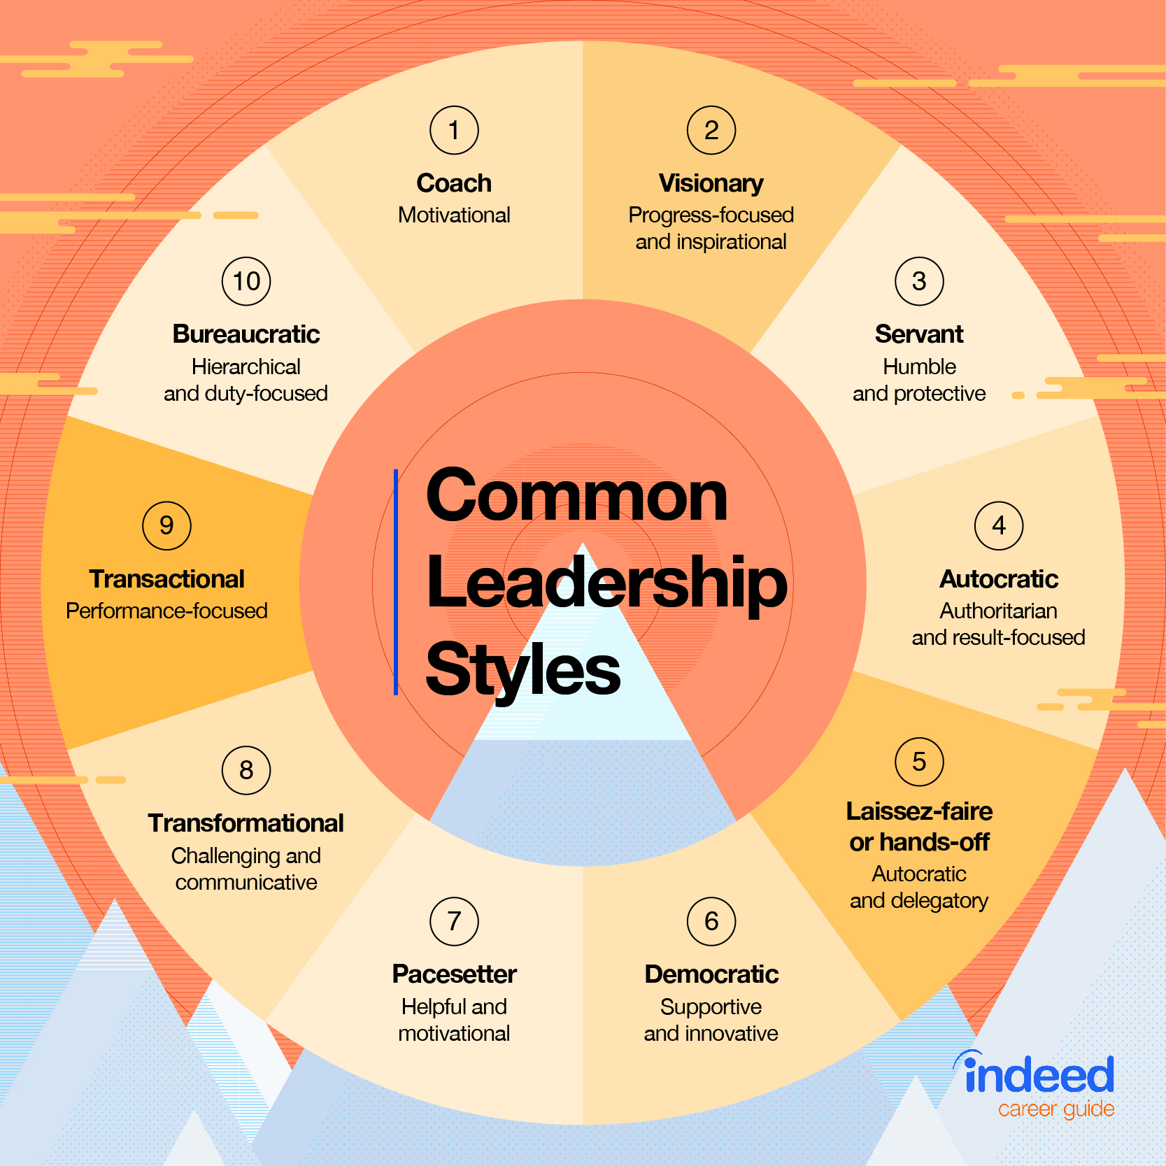

Slide 12
Which leadership styles are compassionate?

Slide 13
Compassionate Leadership
The Center for Compassionate Leadership defines:
Compassion as the awareness of the suffering of another combined with the desire to take action to relieve that suffering
Leadership as the process by which clear direction and goals for an organization or team are set, combined with the ability to influence team members to make progress toward the goals
Compassionate leadership consists of treating those you lead with compassion and creating a culture of compassion where everyone can flourish.
Notes:
The Center for Compassionate Leadership defines compassion as the awareness of the suffering of another combined with the desire to take action to relieve that suffering. Compassionate leadership consists of treating those you lead with compassion in all situations and creating a culture of compassion that supports the flourishing of everyone within that culture. There are three important things to highlight in this definition. Compassion is primary in the relationship between compassion and leadership.
What Is the Definition of Compassionate Leadership? — Center for Compassionate Leadership
At the Center for Compassionate Leadership, we believe that compassion and leadership not only support each other, but also amplify their respective impacts on teams and organizations. There is no doubt that compassion is vitally needed in the world today, and we see leaders as accelerators to grow compassion to address what ails the world today.
In order to define compassionate leadership, we should start with its component parts. Compassion simply defined is the awareness of the suffering of another combined with the desire to take action to relieve that suffering. Leadership is the process by which clear direction and goals for an organization or team are set combined with the ability to influence team members to make progress toward the goals.
In our work around the research and implementation of compassionate leadership throughout the world, our findings have led us to the following definition:
Compassionate leadership consists of treating those you lead with compassion in all situations and creating a culture of compassion that supports the flourishing of everyone within that culture.

Slide 14
Barriers to Compassion in the Workplace

Slide 15
Recruitment and Retention
Collaboration
Service
Engagement
Innovation
Adaptability
Worline and Dutton (2017)
Notes:
In summary then, there is increasing research evidence to show that empathy and compassion in the workplace are related to a number of positive outcomes related to improved employee wellbeing, increased productivity and reduced cost to the business. Worline and Dutton (2017) summarise this well.

Slide 16
Self-Compassion
Self-compassion is a process of self-kindness and accepting suffering as a quality of being human. It has positive effects on a person’s happiness, optimism, wisdom, and openness.
We can demonstrate self-compassion through relaxation, meditation, and reflection, which encompass the technique known as Mindful Self-Compassion (MSC). (Boyatzis et al, 2006, and Jazaieri et al, 2013:24)
Research indicates that self-compassionate individuals experience greater psychological health than those who lack self-compassion.
Self-compassion is a necessary first step in embedding compassion in the workplace.
Notes:
Self-compassion is a process of self kindness and accepting suffering as a quality of being human. It has positive effects on subjective happiness, optimism, wisdom, curiosity, agreeableness, and extroversion.^{[56]} Kristin Neff and Christopher Germer have identified that there are three levels of activities that thwart self-compassion and they are self-criticism, self-isolation and self-absorption, they equate this to fight, flight and freeze responses.^{[57][58]} It has been found that parenting practices contribute to the development of self-compassion in children. Maternal support, secure attachment, and harmonious family functioning all create an environment where self-compassion can develop. On the other hand, certain developmental factors (i.e., personal fable) can hinder the development of self-compassion in children.^{[59]}
For increasing compassion in the workplace to self and others, authentic leadership centered on humanism and nourishing quality interconnectedness are considered as the key.^{[60]} Judith Jordan's concept of self-empathy is similar to self-compassion, it implies the capacity to notice, care and respond towards the ones own felt needs. The strategies of self-care involve valuing oneself, thinking about one's ideations of needs compassionately, and connecting with others in order to conversely experience renewal, support, and validation. Research indicates that self-compassionate individuals experience greater psychological health than those who lack self-compassion.^{[61][62]}
Research is emerging to demonstrate some key techniques which might help us to demonstrate compassion towards ourselves:
Mindful Self-Compassion
The technique of Mindful Self-Compassion (MSC) has been found to increase compassion for self and others, and satisfaction with life, as well as decreasing stress, anxiety and depression (Jazaieri et al, 2013:24)
Relaxation
Training in relaxation techniques has been found to reduce heart rate and blood pressure and even reduce angry thoughts in people suffering from the effects of stress, and the training appears to be most successful when there is a focus on external surroundings, rather than on oneself (Boyatzis et al, 2006)
Meditation
There is also increasing evidence to show the benefits of meditation both generally and in particular for those experiencing stress (Boyatzis et al, 2006) and meditation has also been used as a fundamental part of compassion
training, which has generated positive outcomes both for the person demonstrating the compassion and others who receive the compassion (see below).
In relation to both relaxation and meditation, Boyatzis et al, 2006;18) find that: “Engaging in these activities may…facilitate a leader’s efforts to show compassion for others within the organization while operating in a stressful role.”
So demonstrating compassion towards yourself leads to improvements in your own moods, feelings and resilience, and in addition makes you more able to demonstrate compassion towards others. If we accept that a core part of compassion is taking action to improve circumstances, then compassion in the workplace can be seen to be linked to improvements in our organisations and it is therefore also important to understand how we can develop compassion in others.
Reflection
Structured reflection on our actions and behaviour can help us to make sense of the circumstances around us, learn from experiences and understand ourselves better, and improve our responses and actions going forward and so regular reflective practice can arguably also improve our capacity for compassion and improvement

Slide 17
Topic 2: Compassionate Leadership Behaviors

Slide 18
Compassionate Leadership Behaviors
Integrity
Authenticity
Accountability
Presence
Dignity
Empathy
Notes:
University of Louisville, 2015
Being seen as a leader who always acts with integrity and ethics, displaying a real sense of purpose by:
Talking about your most important values and beliefs;
Specifying the importance of having a strong sense of purpose;
Considering the moral and ethical consequences of decisions;
Emphasizing the importance of a collective sense of mission.
Authenticity
Self-awareness: the ability to understand your own thoughts, emotions and behaviors.
Transparency: the ability to be honest and candid — especially when you're wrong or make a mistake.
Emotional intelligence: self-regulation, motivation, empathy, social awareness and good relationships with others
Empathy
Empathy allows us to feel safe with our failures because we won’t simply be blamed for them.
Empathy allows leaders to build and develop relationships with those they lead.
It encourages leaders to understand the root cause behind poor performance.
Being empathetic allows leaders to help struggling employees improve and excel.
Accountability
Accountability is a key component in leadership. Essentially, it is the act of holding yourself accountable to others. To be an effective leader, you must be able to hold yourself accountable for your actions and decisions, as well as the actions and decisions of those who report to you.
Presence
Leadership presence can be described as the aura that a leader gives off. This presence comprises various factors, including body language, communication style, and tone. A leader with a strong presence can inspire confidence in those around them and motivate employees to achieve great things.
Dignity
Ram defines dignity leadership as a mindful commitment to lead to preserve personal, intersubjective, and processual dignities in an organization. Mindful Leadership Ram Mahalingam developed a Mindful Leadership Program, an interdisciplinary leadership development program, to nurture a unique personalized vision for mindful leadership with a commitment to dignity.
Dignity is not the same as respect. This is the most common misconception that I encounter when introducing the concept to people and organizations. Dignity is something we are born with—it is our inherent value and worth. We have little trouble seeing it when a child is born; there is no question about whether she or he is something of value. In fact, we would say that infants are invaluable, priceless and irreplaceable. How do we treat something that is invaluable, priceless and irreplaceable? We give it our utmost care and attention. Even though we are all born worthy of this care and attention, we are born vulnerable to having our dignity violated. Treating others with dignity, then, becomes the baseline of our interactions. You don't have to do anything to deserve dignity. Respect, on the other hand, needs to be earned. If I say I respect someone, that person has done something remarkable to earn my respect. I feel admiration for her. She is a role model for how I want to be in the world.
What is dignity consciousness, and why is it important?
People have no idea how much dignity dominates our desire to be treated well and to be in relationships that make us feel safe, seen, heard and valued. When we learn how to honor dignity, it creates strong, healthy relationships and an enduring sense of well‑being. Dignity consciousness gives us the internal, emotional scaffolding that enables us to live our lives in full extension and to contribute to the well-being of those around us.

Slide 19
Compassionate Leadership Behaviors
Notes:
University of Louisville, 2015
Being seen as a leader who always acts with integrity and ethics, displaying a real sense of purpose by:
Talking about your most important values and beliefs;
Specifying the importance of having a strong sense of purpose;
Considering the moral and ethical consequences of decisions;
Emphasizing the importance of a collective sense of mission.

Slide 20
Compassionate Leadership Behaviors
Notes:
University of Louisville, 2015
Authenticity
Self-awareness: the ability to understand your own thoughts, emotions and behaviors.
Transparency: the ability to be honest and candid — especially when you are wrong or make a mistake.
Emotional intelligence: self-regulation, motivation, empathy, social awareness and good relationships with others

Slide 21
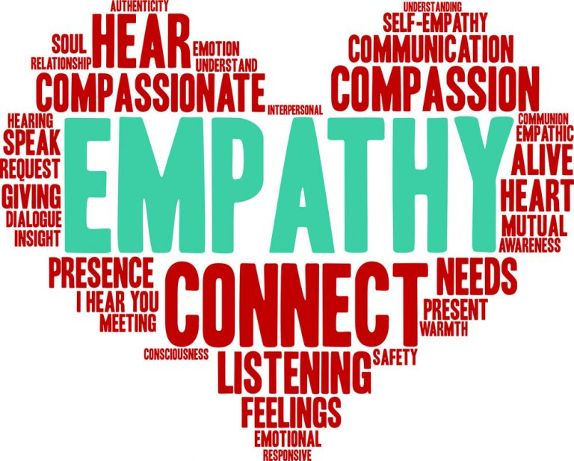
Compassionate Leadership Behaviors
Notes:
University of Louisville, 2015
Empathy
Empathy allows us to feel safe with our failures because we won’t simply be blamed for them.
Empathy allows leaders to build and develop relationships with those they lead.
It encourages leaders to understand the root cause behind poor performance.
Being empathetic allows leaders to help struggling employees improve and excel.

Slide 22
Compassionate Leadership Behaviors
Notes:
University of Louisville, 2015
Accountability
Accountability is a key component in leadership. Essentially, it is the act of holding yourself accountable to others. To be an effective leader, you must be able to hold yourself accountable for your actions and decisions, as well as the actions and decisions of those who report to you.

Slide 23
Compassionate Leadership Behaviors
Notes:
University of Louisville, 2015
Presence
Leadership presence can be described as the aura that a leader gives off. This presence comprises various factors, including body language, communication style, and tone. A leader with a strong presence can inspire confidence in those around them and motivate employees to achieve great things.

Slide 24
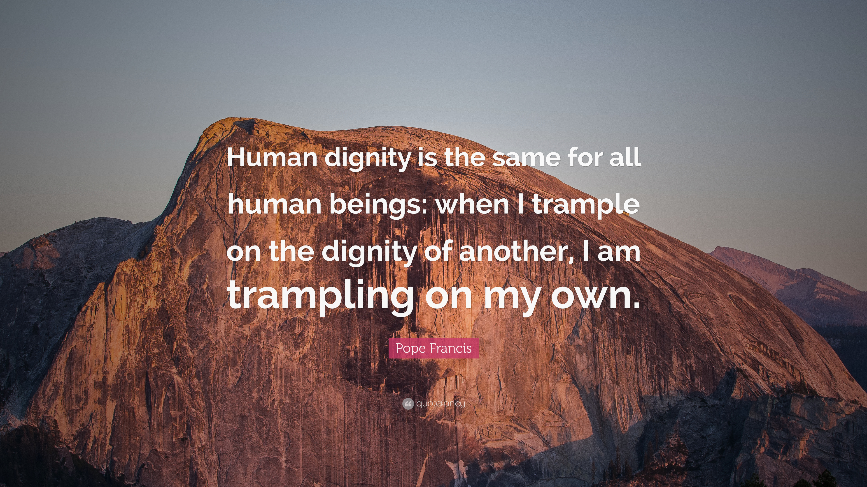
Compassionate Leadership Behaviors
Notes:
University of Louisville, 2015
Dignity
Ram defines dignity in leadership as a mindful commitment to lead to preserve personal, intersubjective, and processual dignities in an organization. Ram Mahalingam developed a Mindful Leadership Program, an interdisciplinary leadership development program, to nurture a unique personalized vision for mindful leadership with a commitment to dignity.
Dignity is not the same as respect. This is the most common misconception that I encounter when introducing the concept to people and organizations. Dignity is something we are born with—it is our inherent value and worth. We have little trouble seeing it when a child is born; there is no question about whether she or he is something of value. In fact, we would say that infants are invaluable, priceless and irreplaceable. How do we treat something that is invaluable, priceless and irreplaceable? We give it our utmost care and attention. Even though we are all born worthy of this care and attention, we are born vulnerable to having our dignity violated. Treating others with dignity, then, becomes the baseline of our interactions. You don't have to do anything to deserve dignity. Respect, on the other hand, needs to be earned. If I say I respect someone, that person has done something remarkable to earn my respect. I feel admiration for her. She is a role model for how I want to be in the world.
What is dignity consciousness, and why is it important?
People have no idea how much dignity dominates our desire to be treated well and to be in relationships that make us feel safe, seen, heard and valued. When we learn how to honor dignity, it creates strong, healthy relationships and an enduring sense of well‑being. Dignity consciousness gives us the internal, emotional scaffolding that enables us to live our lives in full extension and to contribute to the well-being of those around us.

Slide 25
Compassionate Leadership Behaviors
Integrity
Authenticity
Accountability
Presence
Dignity
Empathy
What are YOUR strongest leadership behaviors?

Slide 26
Topic 3: 7 Inspiring Traits of Compassionate Leadership

Slide 27
Compassionate Leadership Inspiring Traits
Learning
Standards
Passion
Influence
Removing barriers
Impact
Team
7 Inspiring Traits of Compassionate Leadership (entrepreneur.com)
By Sherrie Campbell
Notes:
7 Inspiring Traits of Compassionate Leadership (entrepreneur.com)
To be great, leaders must have the necessary empathy to inspire understanding and knowledge in team members. Empathy is key. Empathy begins with taking an understanding of life from the experience and perception of another. When empathy is present, defensiveness decreases and something positive replaces it. Empathy opens doors and removes confusion. It softens the minds and hearts of others. When people are open, this is exactly when the compassionate leader can be more creative in solving problems in ways that drive productivity and long-term success. To follow are seven traits of compassionate leadership.
1. Continuous learning is the foundation of all effective leadership.
Compassionate leaders understand that no matter how great they think they are, they are still surrounded by other intelligent people who are full of ideas that can enhance their skills and knowledge to lead even more effectively. When leaders operate as if they know everything, they harden themselves to new ideas by stubbornly assuming they have nothing more to learn to be effective in their role. There is no compassion in that mindset. Leadership requires learning. Leadership is the sum total of mistakes made, and the learning and growing it takes to remain patient, yet persistent, in their objectives. Compassionate leaders possess the modesty to continually seek feedback under the belief system they can only grow their team to the extend they grow themselves.
2. Standards
Compassionate leaders hold themselves and their ethics to high standards. These leaders are ethical and expect every one of their team members to be the same. Ethics are the building blocks upon which success of any kind is based. These types of leaders strive for nothing less than excellence. Some team members may not be used to an environment where excellence is expected of them. To inspire them, compassionate leaders show high levels of integrity in their daily actions. This helps to gain the trust and confidence of team members who are new or unsure.
These types of leaders trust team members will live up or down to their expectations; therefore, they set the bar high on quality but keep it within reach. When quality is expected, team efforts naturally increase.
3. Passion
Compassionate leaders understand that people who are driven want to be part of something meaningful and influential. These leaders hold a deep concern for how their team members feel and what they’re getting out of their work experience. They do all they can to inspire team members to give nothing less than their best.
Leading requires the skill to inspire passion in others who may not know how to get in touch with it on their own. These leaders encourage team members to approach every task they do, down to the smallest details, with determination. These types of leaders are powerful because they understand that success comes to those who fully dedicate themselves to a cause. Compassionate leaders know there is nothing more powerful than a person who is driven from their heart.
4. Influence
Compassionate leaders seek influence, not authority. They don’t demand, they encourage. They lead with hope. They guide, acknowledge and support team members to combine their efforts, skills, talents, insights, passion, enthusiasm and commitment to work together for the greater good.
These types of leaders find their purpose in bettering the lives of others. Compassionate leaders use the power of their role to lead others into the discovery of their own unique power. They view the growth and development of the people they lead and the communities they serve as the great makers of their success.
5. Removing barriers.
Compassionate leaders immerse themselves in the daily grind with their team, helping them face and solve problems harming productivity or hindering reciprocal communication when closing deals. Removing barriers is twofold. Leaders have to understand the internal emotional patterns of each team member, which patterns hold them back and which promote them into success. Leaders need to help team members work through their defeatist thoughts and encourage new patterns of thinking to help them be more successful going forward. Once team members start thinking in terms of success rather than failure, leaders have the role of helping team members talk through ways to remove any external barriers with others they may face when closing deals.
When team members stop bringing leaders obstacles to overcome, their days as a leader will soon end.
6. Impact
Compassionate leaders live to help others and make no room for selfishness on the teams they lead. Greed has no place to prosper when selfishness is not part of the program. These leaders live with an attitude of abundance and prefer to look at what team members need rather than at what team members aren’t doing. Compassionate leaders make no room for pessimism. They view challenges with interest rather than dread. This attitude sets the tone for team members and keeps morale high.
For these leaders, success is less about riches or fame and more about having a deep and lasting positive impact on all who are served. The compassionate leader seeks to understand people, knowing that understanding is the doorway into having the greatest impact on guiding others.
7. Team
Compassionate leaders hold the wisdom that great things in life or business are never accomplished by one person. Excellence is a group effort, whether that be a team, a company, a society or an entire civilization. For teams to succeed, they need leaders who support and guide them to stay focused, especially when the stakes are high.
Compassionate leaders bring their team members together to work as a functional unit. They lay the groundwork for their team to have the best chance of success, and then take great joy in sitting back and watching team members shine individually and collectively. These leaders have no problem taking the lead when the team is in danger and no problem stepping to the side to allow their team to experience the successes they have accomplished on their own.
WRITTEN BY
Sherrie Campbell
Sherrie Campbell is a psychologist in Yorba Linda, Calif., with two decades of clinical training and experience in providing counseling and psychotherapy services. She is the author of Loving Yourself: The Mastery of Being Your Own Person. Her new book, Success Equations: A Path to an Emotionally Wealthy Life, is available for pre-order.

Slide 28
Learning
Training programs for compassionate leadership are outlined in the National Forum for Health and Wellbeing at Work “Compassion at Work Toolkit”.
Notes:
1. Learning
Compassionate leaders understand that no matter how great they think they are, they are still surrounded by other intelligent people who are full of ideas that can enhance their skills and knowledge to lead even more effectively. When leaders operate as if they know everything, they harden themselves to new ideas by stubbornly assuming they have nothing more to learn to be effective in their role. There is no compassion in that mindset.
Leadership requires learning. Leadership is the sum total of mistakes made, and the learning and growing it takes to remain patient, yet persistent, in their objectives. Compassionate leaders possess the modesty to continually seek feedback under the belief system they can only grow their team to the extent they grow themselves.
Example: Continuously asking the team for their ideas to improve the department. Yesi always had improvement ideas.
There are many training programs for compassionate leadership. The National Forum for Health and Wellbeing at Work has created a Compassion at Work Toolkit that outlines training opportunities for compassionate leaders.

Slide 29
Standards
Notes:
2. Standards
Compassionate leaders hold themselves and their ethics to high standards. These leaders are ethical and expect every one of their team members to be the same. Ethics are the building blocks upon which success of any kind is based. These types of leaders strive for nothing less than excellence. Some team members may not be used to an environment where excellence is expected of them. To inspire them, compassionate leaders show high levels of integrity in their daily actions. This helps to gain the trust and confidence of team members who are new or unsure.
These types of leaders trust team members will live up or down to their expectations; therefore, they set the bar high on quality but keep it within reach. When quality is expected, team efforts naturally increase.
Example: Our class evaluations continually increased.

Slide 30
Passion
Notes:
3. Passion
Compassionate leaders understand that people who are driven want to be part of something meaningful and influential. These leaders hold a deep concern for how their team members feel and what they’re getting out of their work experience. They do all they can to inspire team members to give nothing less than their best.
Leading requires the skill to inspire passion in others who may not know how to get in touch with it on their own. These leaders encourage team members to approach every task they do, down to the smallest details, with determination. These types of leaders are powerful because they understand that success comes to those who fully dedicate themselves to a cause. Compassionate leaders know there is nothing more powerful than a person who is driven from their heart.

Slide 31
Influence
Notes:
4. Influence
Compassionate leaders seek influence, not authority. They don’t demand, they encourage. They lead with hope. They guide, acknowledge and support team members to combine their efforts, skills, talents, insights, passion, enthusiasm and commitment to work together for the greater good.
These types of leaders find their purpose in bettering the lives of others. Compassionate leaders use the power of their role to lead others into the discovery of their own unique power. They view the growth and development of the people they lead and the communities they serve as the great makers of their success.
Example: Edinburg example of a supervisor whose goal was to promote everyone out of his team within a year.

Slide 32
Removing Barriers
Notes:
5. Removing barriers.
Compassionate leaders immerse themselves in the daily grind with their team, helping them face and solve problems harming productivity or hindering reciprocal communication when closing deals. Removing barriers is twofold.
Leaders have to understand the internal emotional patterns of each team member, which patterns hold them back and which promote them into success. Leaders need to help team members work through their defeatist thoughts and encourage new patterns of thinking to help them be more successful going forward.
Once team members start thinking in terms of success rather than failure, leaders have the role of helping team members talk through ways to remove any external barriers with others they may face when closing deals.
When team members stop bringing leaders obstacles to overcome, their days as a leader will soon end.
Example: Remote workers picking up their computer equipment. Two days in the hot sun to do this. Our responsibility instead of the temporary agencies’ responsibility. Removed this barrier by making the agencies responsible.

Slide 33
Impact
Notes:
6. Impact
Compassionate leaders live to help others and make no room for selfishness on the teams they lead. Greed has no place to prosper when selfishness is not part of the program. These leaders live with an attitude of abundance and prefer to look at what team members need rather than at what team members aren’t doing.
Compassionate leaders make no room for pessimism. They view challenges with interest rather than dread. This attitude sets the tone for team members and keeps morale high.
For these leaders, success is less about riches or fame and more about having a deep and lasting positive impact on all who are served. The compassionate leader seeks to understand people, knowing that understanding is the doorway into having the greatest impact on guiding others.
Example: Receiving a text from a former employee about how much he misses me. No reflection on the current manager!

Slide 34
Team
Notes:
7. Team
Compassionate leaders hold the wisdom that great things in life or business are never accomplished by one person. Excellence is a group effort, whether that be a team, a company, a society or an entire civilization. For teams to succeed, they need leaders who support and guide them to stay focused, especially when the stakes are high.
Compassionate leaders bring their team members together to work as a functional unit. They lay the groundwork for their team to have the best chance of success, and then take great joy in sitting back and watching team members shine individually and collectively. These leaders have no problem taking the lead when the team is in danger and no problem stepping to the side to allow their team to experience the successes they have accomplished on their own.
Example: Holiday celebrations. Monthly meetings with recognition of each team member’s contribution to the success of the team.

Slide 35
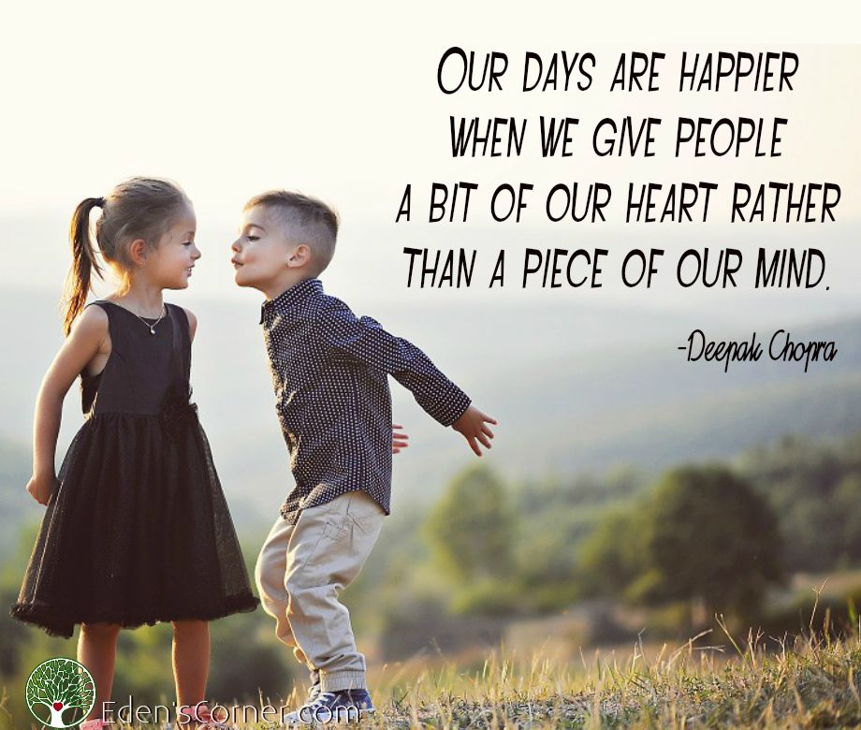
Compassionate Leadership Inspiring Traits
Learning
Standards
Passion
Influence
Removing barriers
Impact
Team
What are YOUR most inspiring leadership traits?
7 Inspiring Traits of Compassionate Leadership (entrepreneur.com)
By Sherrie Campbell
35
Notes:
7 Inspiring Traits of Compassionate Leadership (entrepreneur.com)
To be great, leaders must have the necessary empathy to inspire understanding and knowledge in team members. Empathy is key. Empathy begins with taking an understanding of life from the experience and perception of another. When empathy is present, defensiveness decreases and something positive replaces it. Empathy opens doors and removes confusion. It softens the minds and hearts of others. When people are open, this is exactly when the compassionate leader can be more creative in solving problems in ways that drive productivity and long-term success. To follow are seven traits of compassionate leadership.
1. Learning
Compassionate leaders understand that no matter how great they think they are, they are still surrounded by other intelligent people who are full of ideas that can enhance their skills and knowledge to lead even more effectively. When leaders operate as if they know everything, they harden themselves to new ideas by stubbornly assuming they have nothing more to learn to be effective in their role. There is no compassion in that mindset. Leadership requires learning. Leadership is the sum total of mistakes made, and the learning and growing it takes to remain patient, yet persistent, in their objectives. Compassionate leaders possess the modesty to continually seek feedback under the belief system they can only grow their team to the extend they grow themselves.
2. Removing barriers.
Compassionate leaders immerse themselves in the daily grind with their team, helping them face and solve problems harming productivity or hindering reciprocal communication when closing deals. Removing barriers is twofold. Leaders have to understand the internal emotional patterns of each team member, which patterns hold them back and which promote them into success. Leaders need to help team members work through their defeatist thoughts and encourage new patterns of thinking to help them be more successful going forward. Once team members start thinking in terms of success rather than failure, leaders have the role of helping team members talk through ways to remove any external barriers with others they may face when closing deals.
When team members stop bringing leaders obstacles to overcome, their days as a leader will soon end.
3. Impact
Compassionate leaders live to help others and make no room for selfishness on the teams they lead. Greed has no place to prosper when selfishness is not part of the program. These leaders live with an attitude of abundance and prefer to look at what team members need rather than at what team members aren’t doing. Compassionate leaders make no room for pessimism. They view challenges with interest rather than dread. This attitude sets the tone for team members and keeps morale high.
For these leaders, success is less about riches or fame and more about having a deep and lasting positive impact on all who are served. The compassionate leader seeks to understand people, knowing that understanding is the doorway into having the greatest impact on guiding others.
4. Standards
Compassionate leaders hold themselves and their ethics to high standards. These leaders are ethical and expect every one of their team members to be the same. Ethics are the building blocks upon which success of any kind is based. These types of leaders strive for nothing less than excellence. Some team members may not be used to an environment where excellence is expected of them. To inspire them, compassionate leaders show high levels of integrity in their daily actions. This helps to gain the trust and confidence of team members who are new or unsure.
These types of leaders trust team members will live up or down to their expectations; therefore, they set the bar high on quality but keep it within reach. When quality is expected, team efforts naturally increase.
5. Influence
Compassionate leaders seek influence, not authority. They don’t demand, they encourage. They lead with hope. They guide, acknowledge and support team members to combine their efforts, skills, talents, insights, passion, enthusiasm and commitment to work together for the greater good.
These types of leaders find their purpose in bettering the lives of others. Compassionate leaders use the power of their role to lead others into the discovery of their own unique power. They view the growth and development of the people they lead and the communities they serve as the great makers of their success.
6. Passion
Compassionate leaders understand that people who are driven want to be part of something meaningful and influential. These leaders hold a deep concern for how their team members feel and what they’re getting out of their work experience. They do all they can to inspire team members to give nothing less than their best.
Leading requires the skill to inspire passion in others who may not know how to get in touch with it on their own. These leaders encourage team members to approach every task they do, down to the smallest details, with determination. These types of leaders are powerful because they understand that success comes to those who fully dedicate themselves to a cause. Compassionate leaders know there is nothing more powerful than a person who is driven from their heart.
7. Team
Compassionate leaders hold the wisdom that great things in life or business are never accomplished by one person. Excellence is a group effort, whether that be a team, a company, a society or an entire civilization. For teams to succeed, they need leaders who support and guide them to stay focused, especially when the stakes are high.
Compassionate leaders bring their team members together to work as a functional unit. They lay the groundwork for their team to have the best chance of success, and then take great joy in sitting back and watching team members shine individually and collectively. These leaders have no problem taking the lead when the team is in danger and no problem stepping to the side to allow their team to experience the successes they have accomplished on their own.
WRITTEN BY
Sherrie Campbell
Sherrie Campbell is a psychologist in Yorba Linda, Calif., with two decades of clinical training and experience in providing counseling and psychotherapy services. She is the author of Loving Yourself: The Mastery of Being Your Own Person. Her new book, Success Equations: A Path to an Emotionally Wealthy Life, is available for pre-order.

Slide 36
Topic 4: Wise Compassionate Leadership Model

Slide 37
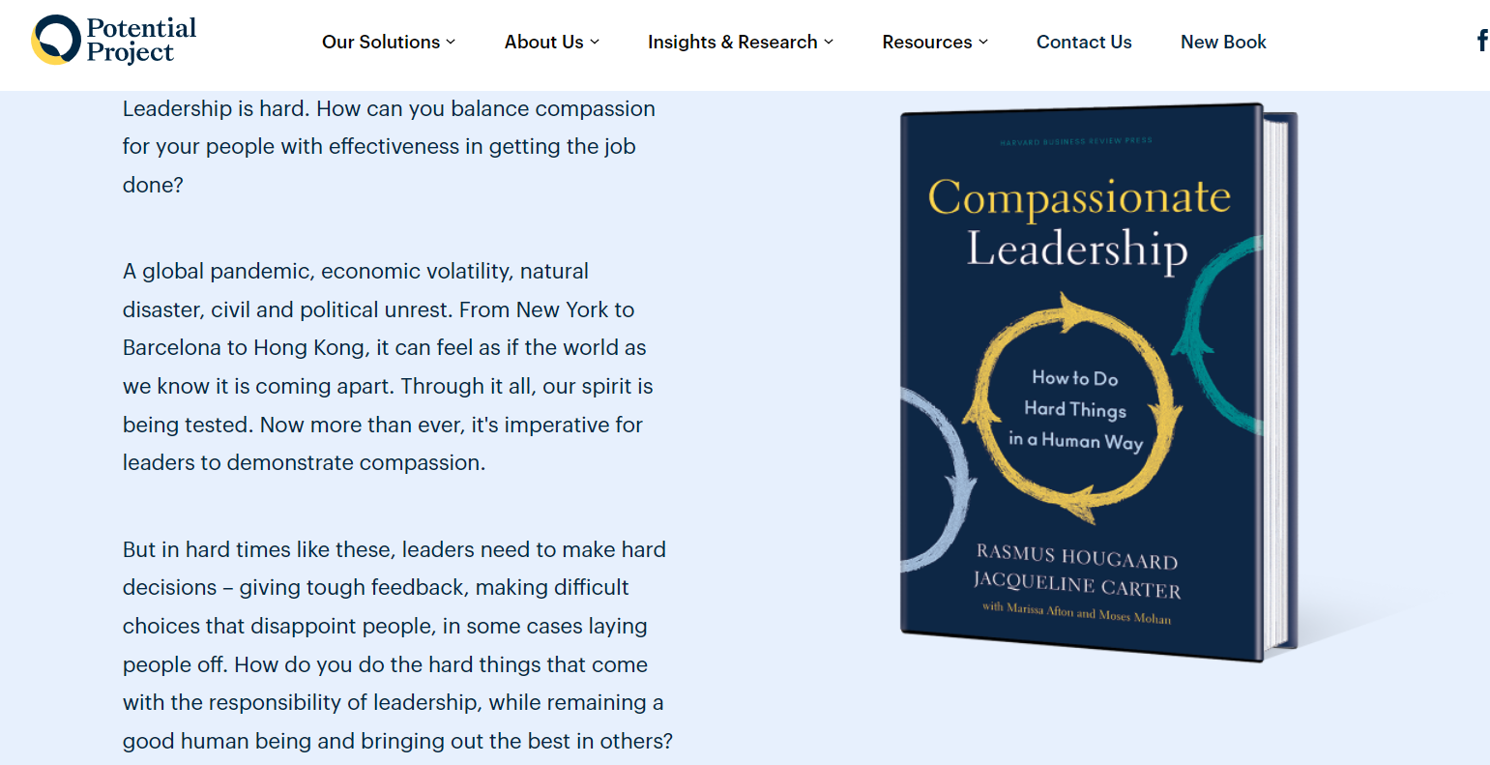

Slide 38
Wise Compassion Flywheel
Source:
Compassionate Leadership
How to Do Hard Things in a Human Way
By Rasmus Hougaard, Jacqueline Carter, Marissa Afton, Moses Mohan

Slide 39
Wise Compassion Flywheel
Notes:
Caring Presence: Example – Laying off valued employees at Texas Instruments
Caring Courage: Example – Carrie Thomas meeting with the employees in Midland to tell them that the site was closing.
Caring Candor: Example – My work at DBM.
Caring Transparency: Example – At the onsite of Covid, there were so many unknowns. Being open about what we knew and didn’t know was important. And proactively letting the team know as soon as decisions were made and making myself available to answer questions.

Slide 40
Wise Compassion Leadership Matrix
Source:
Compassionate Leadership
How to Do Hard Things in a Human Way
By Rasmus Hougaard, Jacqueline Carter, Marissa Afton, Moses Mohan
Which quadrants do you use most often?
How can you move your leadership responses to Quadrant 2?
Notes:
In quadrant 1, at the top left, leaders care for people – which is great – but they tend to avoid the tough parts of leadership like giving hard feedback. In quadrant 3, bottom left, leaders are ineffective and indifferent, operating in a mode that is the opposite of mindful. Lacking both compassion and wisdom, these leaders appear to their followers as uncaring and unprofessional. In quadrant 4, at the bottom right, leaders are effectively executing on their business objectives, but have little compassion.
Finally, in quadrant 2, at the top right – wise compassion – leaders deliver the best results. Leaders operating in this mode are balancing concern for their people with the need to move their organizations
forward in an efficient, productive manner. When tough action is needed, they get it done with genuine caring for people’s feelings and well-being.

Slide 41
Topic 5: Compassionate Leadership Actions

Slide 42
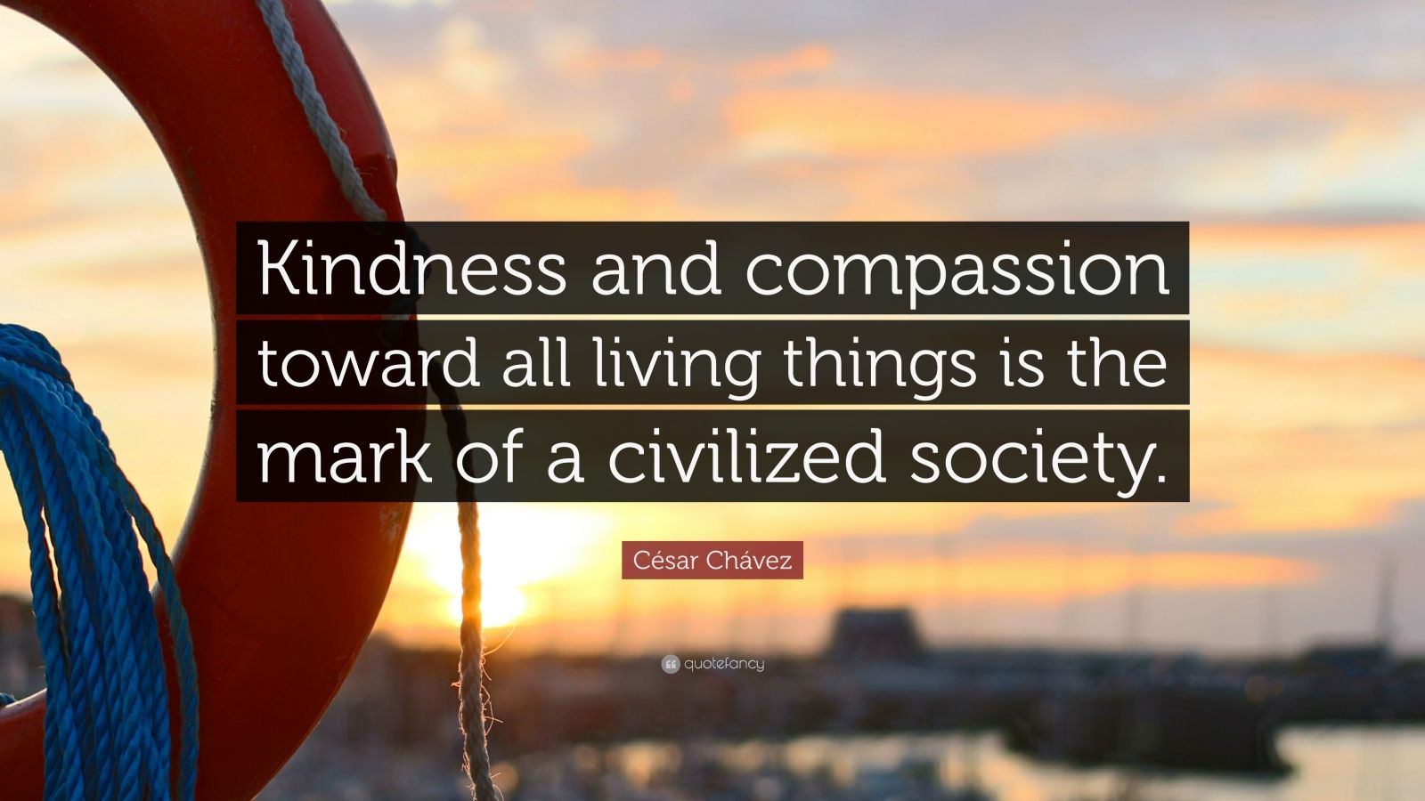

Slide 43
5 Action Steps
Earn trust with authenticity
Engage in deep, meaningful conversations
Empower others to effect change
Evaluate effectiveness of programs and processes
Elevate our environment and culture through encouragement

Slide 44
Earn Trust with Authenticity
Notes:
We have already defined authenticity.
Authenticity
Self-awareness: the ability to understand your own thoughts, emotions and behaviors.
Transparency: the ability to be honest and candid — especially when you are wrong or make a mistake.
Emotional intelligence: self-regulation, motivation, empathy, social awareness and good relationships with others
Authenticity is hold we build trust. Build a relationship with each member of your team by being open, honest, and authentic to earn their trust.
My manager Tom used to come into our work area daily and tell us stories about his sons, the crazy things they did, like putting all the children’s shoes in the wastebasket while they were all supposed to be taking a nap. These stories made Tom human to each of us, and by sharing his personal stories, it give us the right to share ours. It was a compassionate workplace, where we developed trusting relationships with one another.
Learn as much as you can about each member of your team by asking open-ended questions.
Examples:
What do you want to contribute through your role here?
What do you want to learn in your role here?
What do you consider your strengths?
How do you want to improve?
What can I do to support you?
What challenges are you encountering that are impacting your role?
What could I do better? How can I more effectively support you?
How can we improve our team/department/organization?

Slide 45
Engage in Meaningful Conversations
Notes:
You can only engage in meaningful conversations after you have earned the trust of your team members.
Then you must make time for these meaningful conversations.
Set up a regular time to meet with each team member and plan the topics for this meeting.
Ask the team member for the topics they want to discuss and add to these topics.
Then listen first and ask questions. Speak last!

Slide 46
Barriers to Compassion in the Workplace
Worline and Dutton (2017)

Slide 47
Empower Others to Effect Change
Notes:
When you have the responsibility and the authority to delegate, empower others to effect appropriate change. Delegation requires a process:
Prepare to delegate by clearly defining objectives and expectations.
Assign the project to a team member who has the skills, interest, and time for the assignment.
Confirm the understanding of the delegated assignment with the team member through development of SMART goals by the team member.
Ensure accountability by following up with the team member at scheduled times associated with the SMART goals.
Celebrate success and evaluate the successes of the project and opportunities for improvement in the future.
If you do not have the authority to delegate, you can always recognize the potential of others and encourage them to leverage their strengths within the organization. When you see progress, acknowledge it and congratulate them!

Slide 48
Evaluate Program/Process Effectiveness
Assessment: Are You a Compassionate Leader? (hbr.org)
Notes:
We should focus on continual learning and one way to improve that learning is by evaluating our current programs and processes in formal and informal ways. Harvard Business Review has a “compassionate leader assessment” at Assessment: Are You a Compassionate Leader? (hbr.org).
Now I want to “brag” on the organization I am representing today – Toastmasters.
The foundation of our global nonprofit organization is to help our members improve their communication and leadership skills. The way that we achieve that is through constructive evaluations of each project in our educational program. We base our evaluations on:
What our members did well
How they might improve their next presentations
Motivational statement to move forward to the next project

Slide 49
Evaluate Program/Process Effectiveness
The questions contained in this slide are based on studies by Kahn (1998), Lilius et al. (2011) and Dutton et al. (2006) and a focus group with consultants at Roffey Park. Roffey Park Institute | Executive Education

Slide 50
Elevate through Encouragement
When was the last time you elevated team members with encouragement?

Slide 51
5 Action Steps
Earn trust with authenticity
Engage in deep, meaningful conversations
Empower others to effect change
Evaluate effectiveness of programs and processes
Elevate our environment and culture through encouragement
What action steps will YOU take to improve your compassionate leadership?
How will YOU make your organization more compassionate?

Slide 52
5 Action Steps
Earn trust with authenticity
Engage in deep, meaningful conversations
Empower others to effect change
Evaluate effectiveness of programs and processes
Elevate our environment and culture through encouragement
For a wider range of information and resources, please explore the following:
https://charterforcompassion.org/
http://ccare.stanford.edu/
http://compassiongames.org/
Notes:
Based in the UK, the National Forum for Health and Wellbeing at Work in their “Compassion at Work Tookit” states, “When the National Forum for Health and Wellbeing at Work was considering the key issues in creating healthier workplaces, the issue of compassion and empathy at work, and in leadership more specifically, came up as a significant challenge. We have had numerous headlines on lack of compassion in healthcare, in social care and in the wider public services as well. We have heard also about toxic leaders in the private sector; psychopathic managers, the bullying bosses and colleagues who have had a ‘social skills bypass’. On the other hand, most of us have experienced empathic and compassionate leaders and colleagues, who have engaged us as valued colleagues in achieving our personal and organisational goals in a way that has enhanced our wellbeing, and ultimately our productivity. As the great Taoist philosopher Lao Tzu once wrote of effective leaders: ‘a leader is best when people barely know she or he exists. When the work is done, her or his aim fulfilled, people will say ‘we did it ourselves’. And, as Henry David Thoreau wrote in 1853: ‘How prompt we are to satisfy the hunger and thirst of our bodies; how slow to satisfy the hunger and thirst of our souls.’”
In July 2017, the National Forum on Health and Wellbeing at Work met to focus on the role and impact of empathy and compassion in the workplace. Following that meeting and discussion they decided to work across organisations to develop a guide and toolkit which would set out the business case for compassion at work and provide examples of how this could be implemented in practice. This document sets out what can happen in organisations when empathy and compassion are missing, and goes on to set out some of the evidence which demonstrates that adopting a compassionate approach in organisations improves not only staff wellbeing, but also productivity.
A focus on the need for cultivating compassion is growing on a global level. This document looks at what we can do to assist with this in the workplace. For a wider range of information and resources, please explore the following:
https://charterforcompassion.org/
http://ccare.stanford.edu/
http://compassiongames.org/

Slide 53
Toastmasters International
www.toastmasters.org

Slide 54
Notes:
Story of Father James

Slide 55
Sincerest Gratitude for this Opportunity
Lark Doley, DTM
Contact:
ldoley@toastmasters.org
To find a Toastmasters club: toastmasters.org
Notes:
Thank you for this opportunity to explore the topic of compassionate leadership with you.

