Slide 1
Cultivating Compassion for Self and Others
Dr. Cassandra LeClair

Slide 2
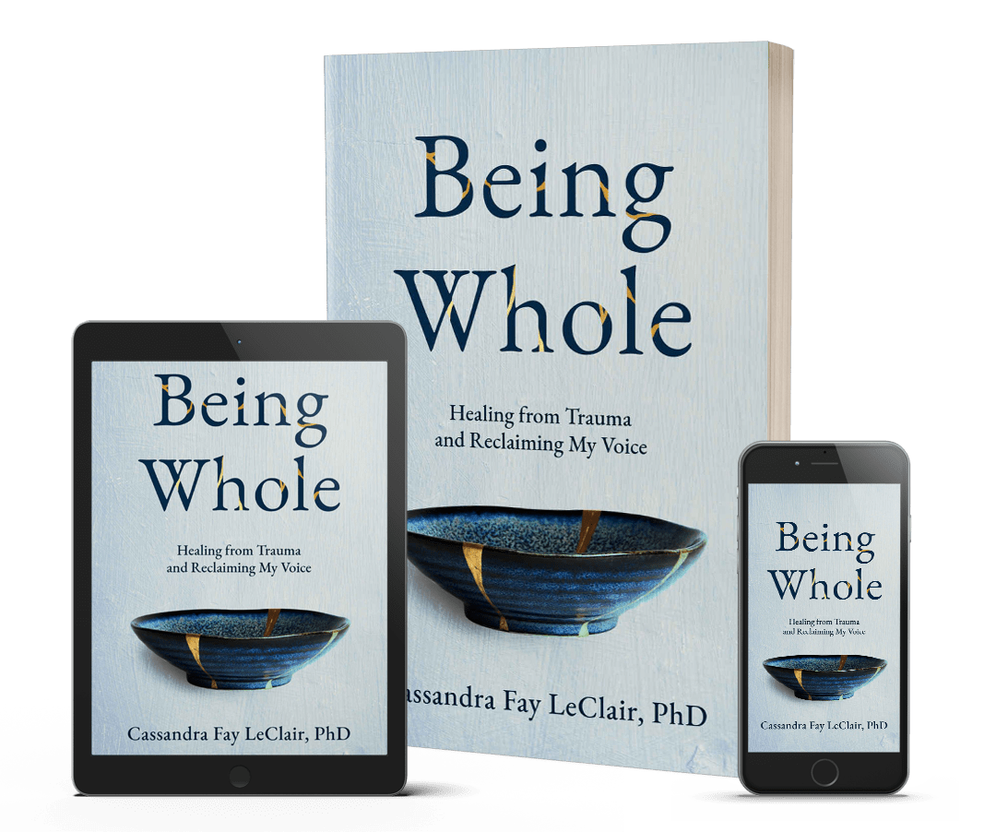
Overview
What is self compassion?
1
Why is self compassion important?
2
How can I build compassion for myself?
3
How can I build compassion for others?
4
5

Slide 3
Self
Compassion
How understanding are you to yourself?
To relate to others kindly, start being more kind to yourself.
Notes:
Self compassion is turning to ourselves with understanding and grace. Our inner critic is strong. What ways do you behave more nicely to others than you do to yourself?

Slide 4
What’s Your Compassion Score?
To have compassion you need to understand when someone is suffering.
To have self-compassion, you have to look within and see the areas where you may have negative self-talk
Notes:
Think about this question deeply. Our knee jerk reaction is to brush it off and think we are “fine”. Go across all areas of your life.
Think about your overall day. What is your messaging like? Keeping track is a good way to asses how you are speaking to yourself about your image, life choices, and general daily activities.

Slide 5
Why is
Self
Compassion
Important?
Lower Stress
You may experience increased self worth. Levels of stress, anxiety, and depression are also reduced when practicing self-compassion.
Greater Sense of Purpose
Motivation and happiness are improved with self-compassion. Self compassion also helps create resiliency and improve mindfulness.
More Fulfilling Relationships
You can show up differently for others when you have a solid base of happiness for yourself. Your capacity for compassion grows beyond your own needs.
Notes:
Self-compassion helps you recover from life events. The self—worth from self-compassion isn’t contingent on outcomes or the feedback of others. Extending kindness to yourself allows you to learn more about yourself, what makes you happy, and enables you to reach your highest potential.

Slide 6
How can I build compassion for myself?
Are you open to looking at the areas where you need compassion?
Start to silence your inner critic. Show compassion to that voice and start a new storyline.
Notes:
Think about the ways that you treat your best friend. Or someone you are really excited to spend times with.

Slide 7
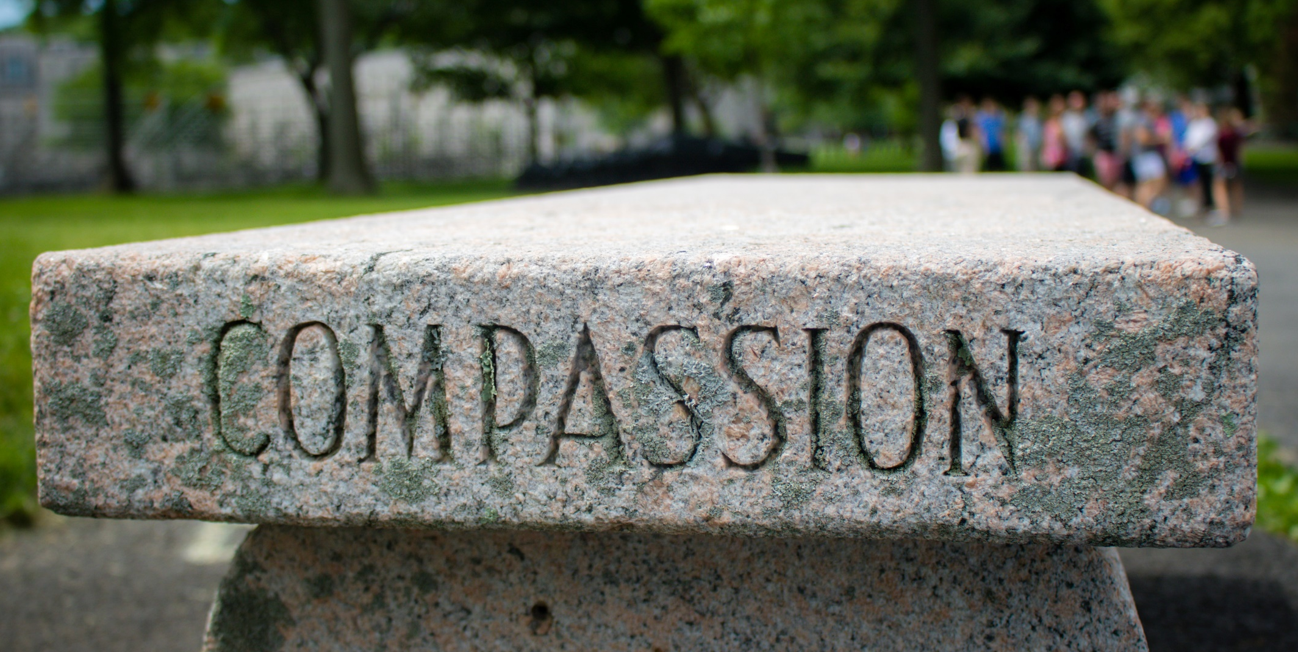
How can I build compassion for others?
When we provide compassion, we move from empathy to deeper understanding.
Listening, letting go of pride, and ceasing judgement. Acceptance, forgiveness, kindness, respect, and support.
Notes:
When you are growing in your own self-compassion, you may find yourself naturally extending grace and understanding to others in a different way. Compassion is like a muscle. The more you use it, the bigger it grows and the greater capacity you will have.

Slide 8
Steps for Success
Make time for
Mindfulness
Find
Forgiveness
Practice Loving-Kindness
Be willing to grow
Notes:
Start small! You can build in new patterns every day. If you “mess up” remember to give yourself grace. Look at all the ways you can be kind to yourself. Emotionally, spiritually, creatively, socially, physically, financially, and mentally.
Forgive yourself and take away the pain of the ways others have hurt you. You do not need to extend forgiveness to others, but you can still make peace for yourself.
Let go of the should

Slide 9
Thank you!
www.instagram.com/drcassandraleclair/
connect@cassandraleclair.com
www.cassandraleclair.com

